Slide 1
DevOps Overview
December 2020
NTT DATA Vietnam

Slide 2
Content
Overview about DevOps
Benefit/ Disadvantages
DevOps roadmap

Slide 3
Overview about DevOps

Slide 4

1. Overview about DevOps

Slide 5
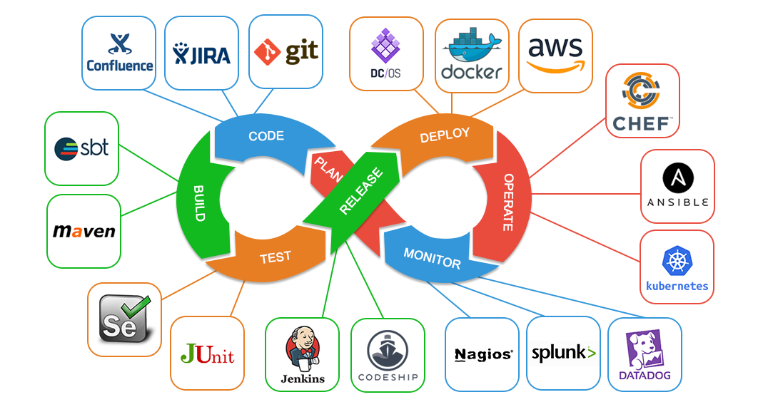
1. Overview about DevOps

Slide 6
Benefit/

Slide 7
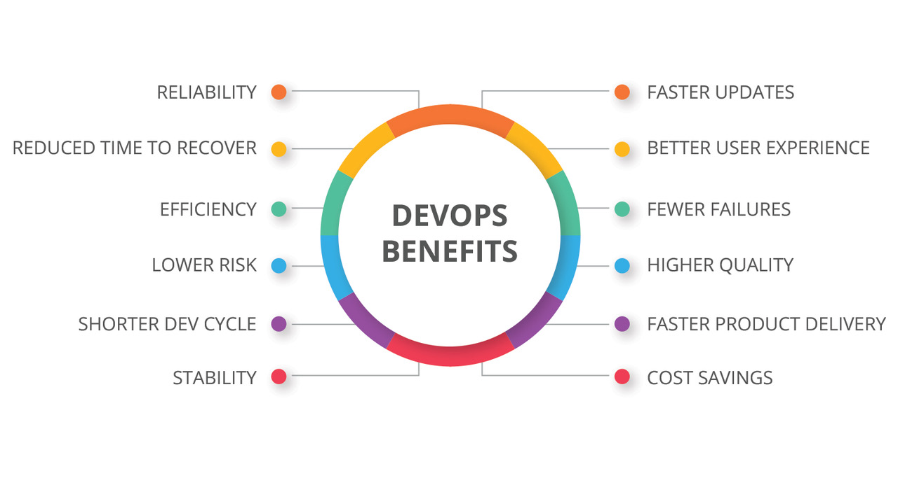
2. Benefit

Slide 8
Benefit

Slide 9

1. Overview about DevOps - DevOps Engineer

