Slide 1
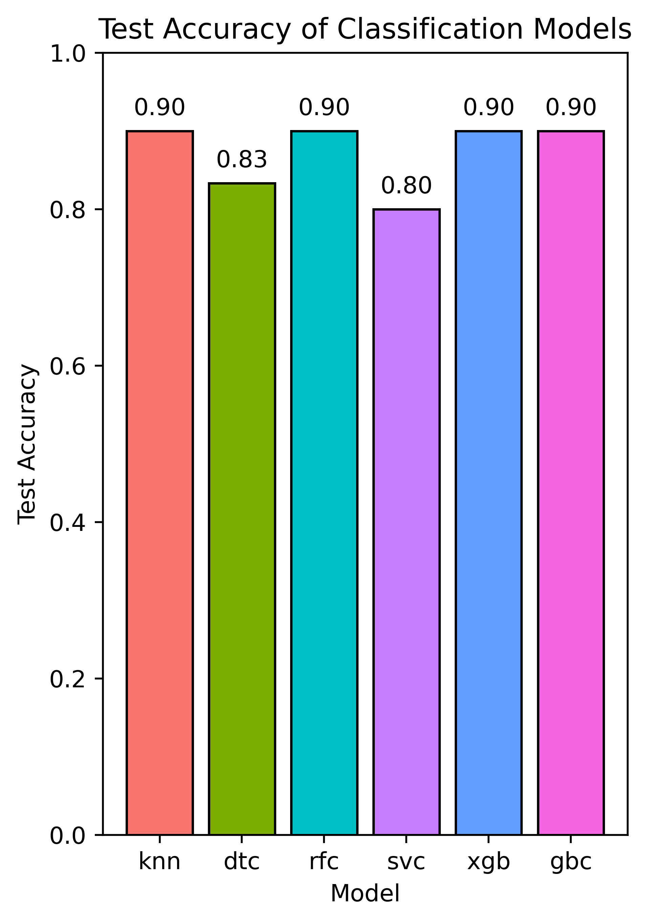
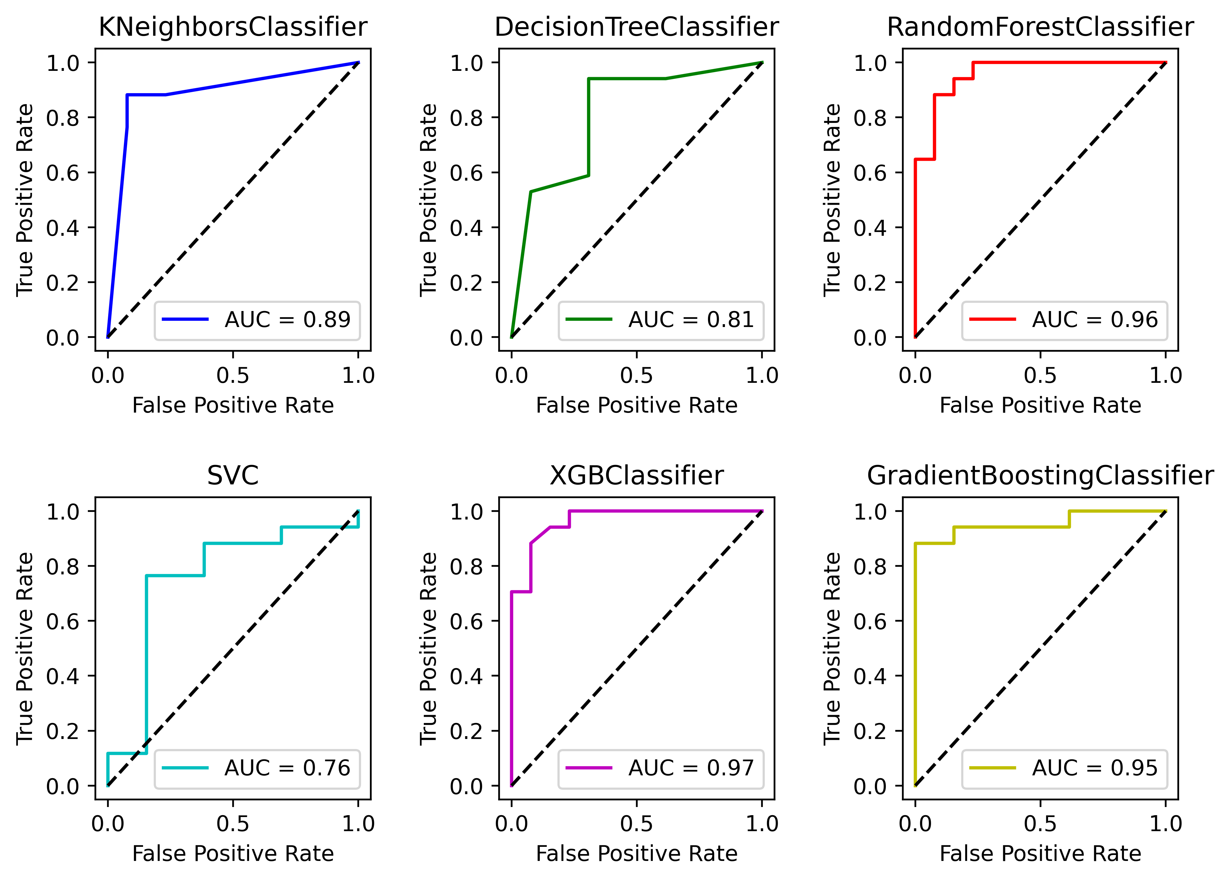
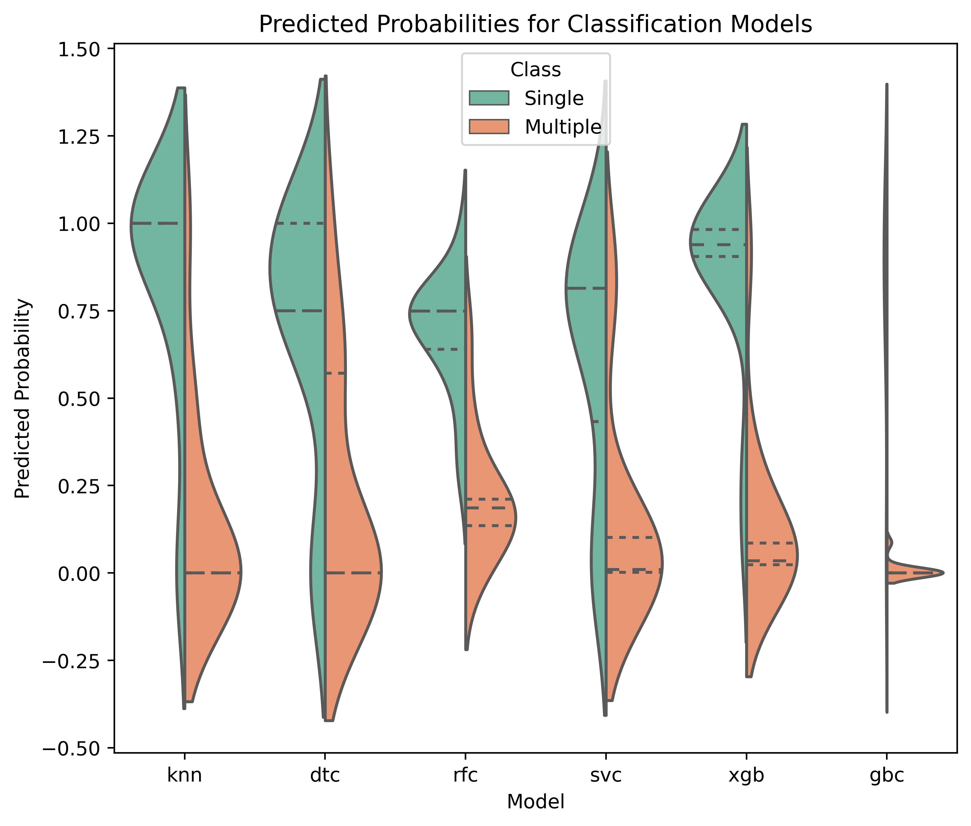
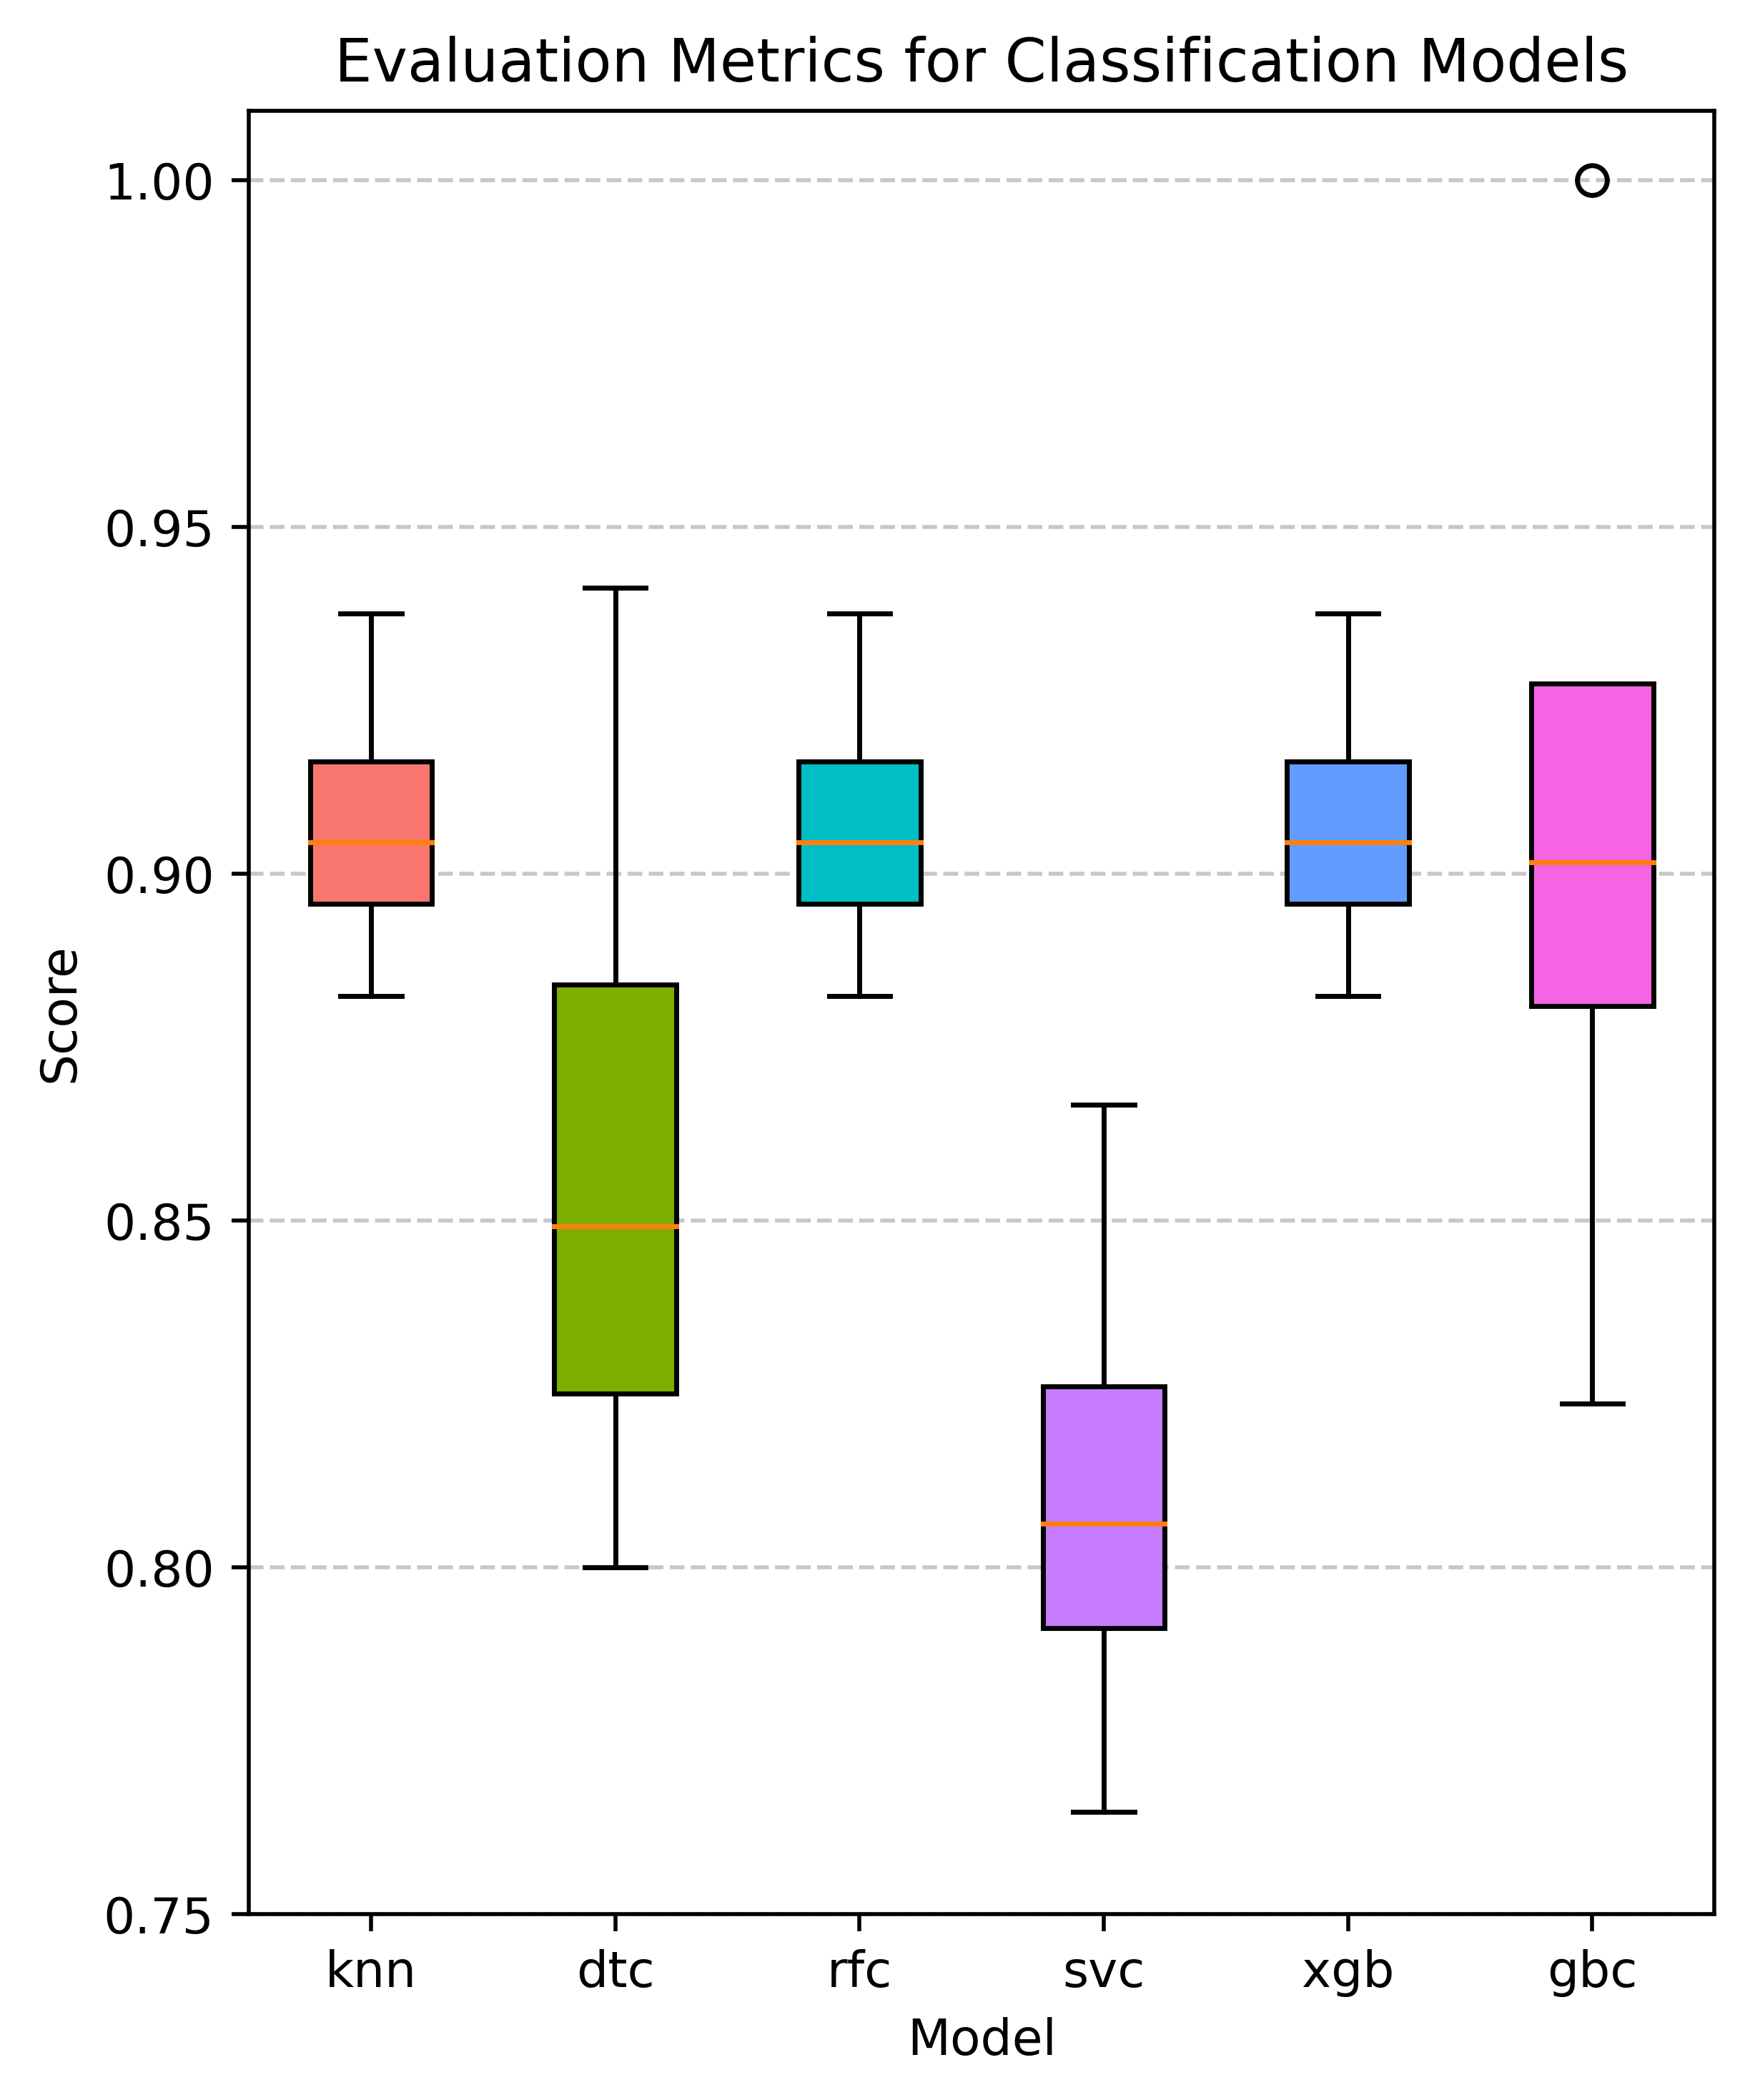

Slide 2
a
b
c
d

Slide 3
Accuracy on test set:
Higher the accuracy on test better the model performance is.
KNN, Random Forest, XGBoost, Gradient Boosting classifiers all performing well with an accuracy score of 0.90.
On the other hand, Decision tree and SVC have accuracy score of 0.77 and 0.90, respectively. But an accuracy score alone (specially on small dataset) can’t tell us the model’s performance. So, we need other evaluation matrices.
Receiver Operating Characteristic (ROC) curves:
The higher the area under the curve value, the better the performance. The curve shows the trade-off between the classifier's tendency to mistakenly classify negative cases as positive (FPR) and its capacity to accurately identify positive instances (TPR).
Better classifier performance in identifying positive cases is indicated by a higher TPR.
Highest AUC is obtained from the XGBoost model (0.97) followed by Random Forest (0.96) and Gradient Boosting classifier (0.95).
The TPR is represented on the Y-axis and the false positive rate (FPR) or 1-specificity is plotted on the X-axis in the ROC curve, which is a graphical representation of the performance of a binary classifier. The performance of the classifier at each point on the ROC curve is indicated by a certain threshold.
The classifier's predictions may alter as the threshold does, resulting in a change in TPR and FPR. This transition can occasionally be fairly abrupt, leading to acute curve changes or corners. This is particularly true if there is a limited sample size.
Prediction probabilities:
The violin plot shows the distribution of predicted probabilities for each model and class. This allows us easier comparison of the predicted probabilities for each class within each model. The estimated probability density of the data at each given y-value is represented by the width of the violin at that value, with broader sections denoting a higher density of data points. The quartiles of the distribution are represented by the inner lines inside the violins.
Considering central tendency, spread, and skewness we need to select the better model.

Slide 4
Box plot of performance metrics:
The box plot compares the performance of six classification models based on four evaluation metrics: Accuracy, Precision, Recall, and F1 Score.
The ratio of accurate projections to all other predictions is known as accuracy. It is a widely used indicator to assess a classification model's overall efficacy.
The ratio of accurate positive predictions to all positive predictions made (i.e., the total of accurate positives and false positives), commonly referred to as precision or positive predictive value, is known as the precision ratio.
Recall, also known as sensitivity or true positive rate, is the ratio of true positive predictions to the total number of actual positive instances (i.e., the sum of true positives and false negatives).
F1 Score is the harmonic mean of precision and recall. It combines both precision and recall into a single metric, providing a balance between them.

