Slide 1
ChainID Vault
Anyone can prove who controls an asset —
without trusting whoever runs the system.
SIH26125 · Bharat Electronics Limited · Blockchain & Cybersecurity
Smart India Hackathon 2026

Slide 2
SPEAKER 1 · START HERE
Everyone here has already used this system
A gate. A guard. A card. It works — until it doesn't.
AT A UNIVERSITY GATE
WHERE IT QUIETLY FAILS
Who are you?
The card is not the person
The guard looks at your card.
Borrowed, cloned, or simply held by someone else.
He waves through the face he knows
Should you be here?
The rule stops being checked. It becomes memory.
He checks you against a list.
The graduate's card still opens the gate
Did anyone record it?
They left last year. Nobody told the gate.
He writes your name in a register.
The register is the guard's own notebook
The record is kept by the person it would hold accountable.
Nobody at that gate is doing anything wrong. The system is simply built on trust rather than proof.
Hold this picture. Every problem in the next ten minutes is this gate, with higher stakes.

Slide 3
SPEAKER 1 · THE PIVOT
Now put that gate inside a defence factory
Same four failures. Thousands of times a day. On controlled equipment.
AT THE GATE
ON A DEFENCE MANUFACTURING FLOOR
The card is not the person
A credential is not a cleared operator
He waves through the face he knows
"He has worked this line for years" — the check stops happening
The graduate's card still opens the gate
The contractor's engagement ended. The calibrated instrument is still logged to them.
The register is the guard's notebook
The inventory system is maintained by the organisation being audited
ONE GATE, ONE GUARD
A FACTORY
A few hundred people a day.
One person can hold it in their head.
Thousands of custody handoffs a day —
since 2021, across seven separate companies.
Nobody can hold that in their head. So it goes into a system — and the system belongs to the people being audited.

Slide 4
SPEAKER 1 · THE CONSEQUENCE
₹1,237 crore of stores nobody could reconcile
₹1,237 crore
WHAT WE ARE NOT SAYING
We are not claiming a blockchain
would have recovered that money.
We cannot prove that, so we will
not say it.
of the Ordnance Factory Board's stores were non-active —
not moving, surplus, or obsolete. Out of ₹6,172 crore held.
WHAT IT DOES SHOW
CAG Audit Report No. 10 of 2024, Government of India
This is what it looks like when an
organisation can no longer reconcile
its own custody records.
That is a verification problem.
Holding time rose from 214 days of consumption to 344.
After corporatisation, CAG went back: 21% still non-active in 2023.
Documented external problem — not a claim about our system.

Slide 5
SPEAKER 2 · WHY NOW
The old approach was given a decade, and the gap did not close
Reorganising the institution did not fix a problem that lives in the records.
2016-17
2020-21
Oct 2021
2023
Stores held 214 days of consumption
Risen to 344 days. ₹1,237 crore non-active.
OFB corporatised into seven defence PSUs
CAG returns. 21% of sampled stores still non-active.
More contractors, more sites, more handoffs between separate entities — and the same
records that could not be reconciled before.
The problem was never the warehouse. It was that no party could prove which record was correct.

Slide 6
SPEAKER 2 · PRECEDENT
We did not invent this. That is the argument.
The same mechanism — tamper-evident records, checkable by someone outside — already runs in production.
WHERE
WHAT IT PROVED
DOCUMENTED RESULT
Walmart · IBM Food Trust
Trace one item's full history across many
handlers, on Hyperledger Fabric
Trace time fell from
7 days to 2.2 seconds
US DoD · Defense Logistics Agency
Authorisation, authentication and traceability
of parts with the Navy and Air Force
Active programme.
No published figures yet.
Government of India · NITI Aayog
"Blockchain: The India Strategy" (2020); land
record pilots in Chandigarh and Andhra Pradesh
Policy precedent —
the approach is accepted here
AND THE ONE THAT FAILED
WHY THAT FAILURE MODE IS NOT OURS
TradeLens (Maersk + IBM) shut down 2023 — competitors would not share data.
One organisation records its own custody chain. No rival has to agree to anything.
THE KPI THAT MOVED THERE, AND ITS EQUIVALENT HERE
Walmart asked: how long to trace one item's full
history? Seven days became 2.2 seconds.
We ask it of custody: who holds this, and is the
record intact? A manual check today — a read here.
Same mechanism, same class of result — but we have not measured ours in the field, and we are not borrowing their number.

Slide 7
SPEAKER 2 · THE INSIGHT
Every critical action comes down to three questions
WHO ARE YOU?
Identity
Is this a real, currently valid person — not just a card?
WHAT ARE YOU ALLOWED TO DO?
Permission
Being known is not the same as being allowed.
CAN ANYONE PROVE WHAT HAPPENED?
Proof
Afterwards, can an outsider check it — and see if it changed?
Miss any one and the action cannot be trusted. We built ChainID Vault around exactly these three.
The gate answered all three badly. So does most enterprise software.

Slide 8
SPEAKER 3 · THE SOLUTION
ChainID Vault: verify the identity, enforce the permission, prove the action
Anyone can prove who controls an asset — without trusting whoever runs the system.
VERIFY THE IDENTITY
ENFORCE THE PERMISSION
PROVE THE ACTION
Not that a record exists — that this person
controls it, and that it is active right now.
The rule is applied every time, automatically.
Nobody has to remember to check.
The record can be checked by someone
outside the organisation entirely.
Notice what we have not mentioned yet: any technology at all.

Slide 9
SPEAKER 3 · HOW IT WORKS
What happens the moment somebody acts
The diagram follows the action, not the components.
Someone acts
Is the identity active?
Is this allowed?
Refuse or allow
Record created
Anyone can check
Issue this equipment
to this person
Not 'did it ever exist'.
Active right now.
Does this identity hold
this permission?
Automatic. Nobody has
to remember to check.
A receipt of what
actually happened.
Including people outside
the organisation.
If either check fails, the action does not happen. Not a warning, not a note in a log for somebody to find later —
the action does not happen.
Only the last two steps need anything unusual. That is where our technology choice matters — and nowhere else.

Slide 10
SPEAKER 3 · THE TECHNOLOGY CHOICE
Blockchain is where we keep the proof, not the files
One job, precisely defined. We are not claiming it is better at everything.
A database is excellent at storing and managing information. But for records that must survive a dispute, the
question is different: can the organisation that changes the record also rewrite its history, undetected?
STAYS WHERE IT ALREADY IS
THE BRIDGE
ON THE CHAIN
· Personnel files
· A digital fingerprint
· Who is a valid identity
· Equipment spec sheets
· of each document
· What each one may do
· Custody paperwork
· Every asset movement
· Calibration certificates
· Every status change
We are not asking anyone to
move their documents anywhere.
Change one character and the
fingerprint no longer matches.
Small, and the only part that
must be tamper-evident.
Runs today on a local chain. The deployment target is a permissioned network such as Hyperledger Besu.

Slide 11
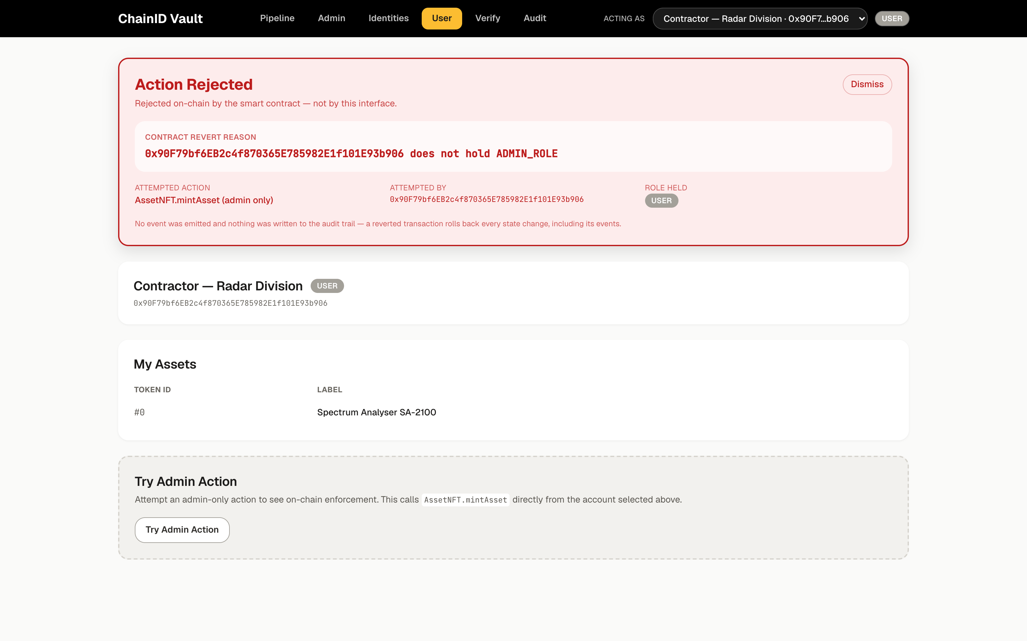
SPEAKER 4 · DEMO
Watch the system refuse something it should refuse
The contractor from slide 3. Engagement ended, identity revoked.
WHAT JUST HAPPENED
An administrator tried to
issue equipment to them.
The system refused.
Not a warning. Not a note
in a log. It did not happen.
The account that just tried holds every privilege in this system. It created that identity. It issued the original
equipment. It still cannot do this. A database administrator can always override the database. Here, nobody can.
Pause here. Let it sit before moving on.

Slide 12
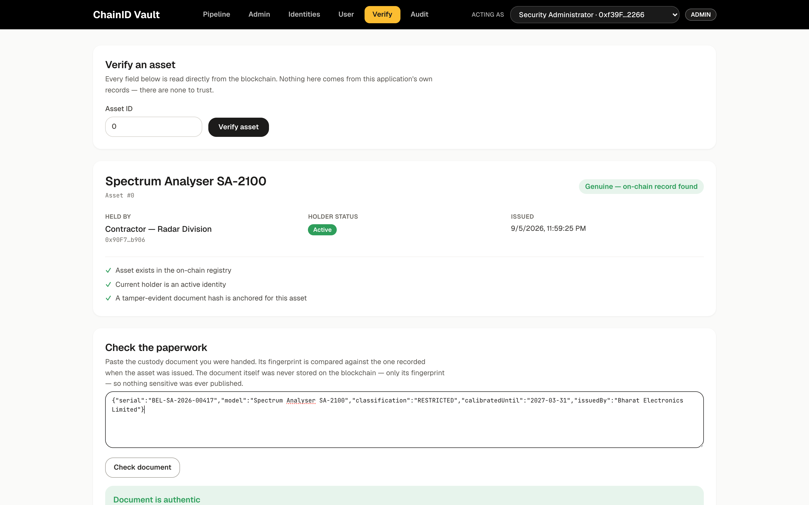
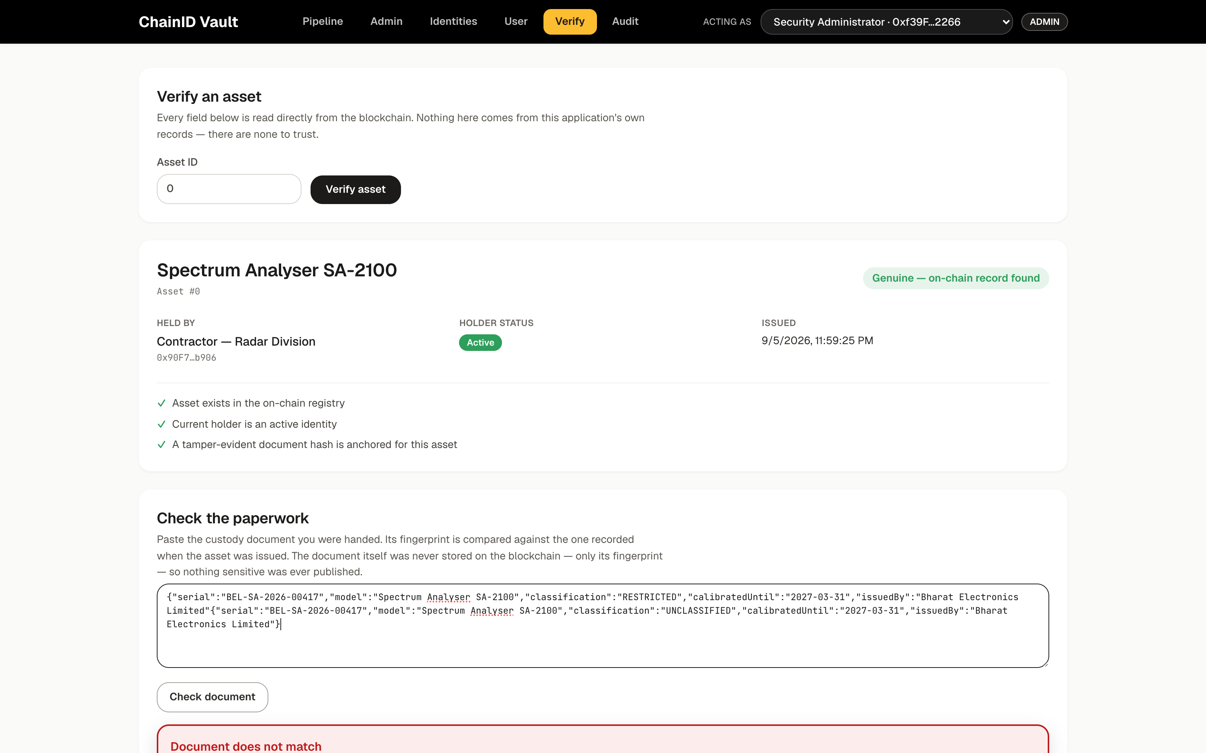
SPEAKER 4 · DEMO
Now watch it allow something it should allow
Same action. Active identity, correct permission.
The original custody document — verified
One word changed: RESTRICTED → UNCLASSIFIED — rejected
Nobody decided the second one was fake. Two fingerprints differ. That is arithmetic, not judgement —
and this screen has no login, so someone who does not trust us can still run the check.
One thing absent from the history: the refused attempts. Nothing was allowed to happen, so nothing was recorded.

Slide 13
SPEAKER 5 · CREDIBILITY
We attacked our own system and it broke
A red banner in our own interface proves nothing. So we switched the interface off.
$ npx hardhat run scripts/prove-it.ts
45
3
4
Contractor tries to issue equipment, UI bypassed
automated tests
passing
flaws we found
in our own code
kinds of invalid action
refused on-chain
REFUSED BY THE CONTRACT
Asset moved to an unregistered address
REFUSED — recipient not an active identity
In the worst one, an asset could leave
the system entirely — and the audit log
showed nothing at all. We fixed it. The
attacks are now tests that must keep failing.
ADMIN issues to a revoked identity
REFUSED — even for the administrator
The web app was never running.
We did not only test that valid actions work. We tested that invalid ones are stopped —
replay, impersonation, expired proofs, revoked identities, tampered documents.

Slide 14
SPEAKER 5 · THE SHIFT
From trusting records to proving them
"The system says this happened."
"The record can be independently checked."
"An administrator decides whether to allow it."
"The rules enforce themselves."
"History lives inside one system."
"Critical actions leave a tamper-evident trail."
"They left, but the record still says they hold it."
"A revoked identity cannot hold or receive."
What changes is not the screens. It is who has to be trusted for the record to mean anything.
No percentages here. We have not measured any, and we will not invent them.

Slide 15
SPEAKER 5 · CLOSE
What we can honestly claim, and what we cannot
BUILT AND VERIFIED
WE ARE NOT CLAIMING
✓
Identity lifecycle — create, suspend, revoke, rotate
—
Measured reduction in inventory loss
✓
Permissions enforced by the system itself
—
Measured reduction in breaches
✓
Asset custody bound to an active identity
—
Deployment inside BEL
✓
Independent verification, no login required
—
Production-scale field results
✓
45 automated tests · 3 flaws found and fixed
—
That we have solved trust — only that we made it checkable
So — who can prove who controls this asset right now?
Don't just record what happened. Make it provable.
Stop here. Do not say "thank you, any questions". Let it land.

