Slide 1
QAGRedo: Technical Benefits and Trade-offs
Scope: Qwen2 (1.5B, 7B), Llama 3.1/3.2 (8B), Voidful | Final: Llama-3.1-8B (Q&A), Qwen2.5-7B (judge), 1 CPU
Benefit Assessment Under Fixed Compute Constraints
Pros | Cons / Trade-offs
Improved factual reliability; lower hallucination exposure versus Voidful. | Dual-model orchestration increases integration and maintenance complexity.
Cross-model separation reduces self-evaluation bias in QAG workflows. | Prompt and grading calibration are required for consistent cross-model behavior.
Reproducible benchmarking with fixed allocation: 1 GPU + 1 GPU + 1 CPU. | End-to-end throughput may be lower than a single-model pipeline at equal budget.
Deployable architecture balancing quality with realistic infrastructure limits. | Residual hallucination risk remains; grounding checks and retry policy are still required.
Conclusion: The two-model design improves factual reliability and evaluation neutrality while staying practical for constrained deployment.

Slide 2
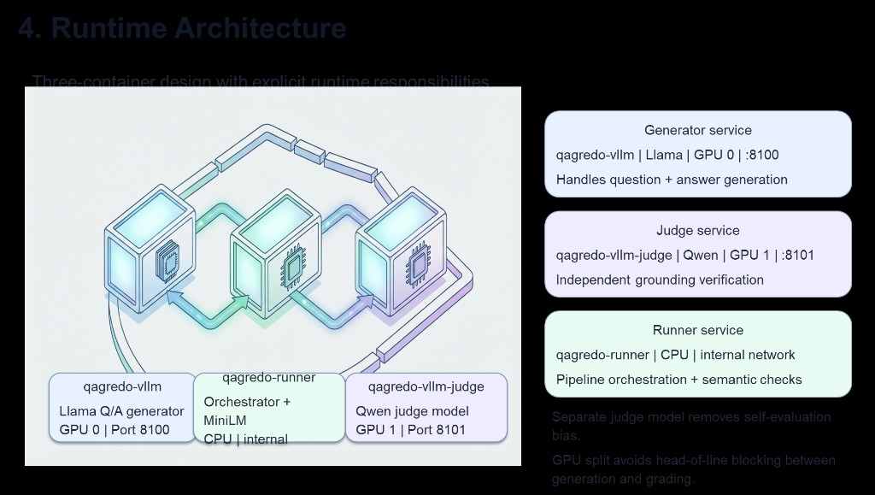
QAGRedo Runtime Architecture (Clarified)
Three-service design with explicit model separation and deterministic orchestration
Service Roles
Generator (GPU 0, :8100)
Llama-3.1-8B for question + answer generation
Judge (GPU 1, :8101)
Qwen2.5-7B for independent grounding verification
Runner (CPU, internal)
Pipeline orchestration, retries, and semantic checks
Execution Flow (per document chunk)
1) Runner sends context to Generator -> candidate questions/answers are produced.
2) Judge evaluates grounding confidence and flags ungrounded outputs.
3) Runner applies retry policy and validation gates until quality criteria are met.
4) Final JSON output includes grounded Q&A and run-level summary metrics.

