Slide 1

QAGRedo Technical Workflow + Framework Upgrade
Balanced view: workflow, algorithm, and tradeoffs

Slide 2

2. Why This Workflow Exists
Problem, design response, target outcome
Need: complex Q&A grounded strictly in source documents.
Risk: raw LLM output can be shallow, repetitive, or hallucinatory.
Response: staged generation + validation + adaptive grading fallback.
Target: explainable, auditable, high-confidence results.
Need
Risk
Response
Target
Key takeaway: Quality comes from explicit gates, not from one model call.

Slide 3
3. End-to-End Workflow
Full pipeline from input to audited output
Lane A: Input + Prep
Converter CLI: --input-type routing
Normalization + optional semantic enrich
Lane B: Q/A Quality Loop
LangChain prompt/template/parsing path
Grounding, retries, and coverage checks
Lane C: Grading + Output
Hybrid scoring path
Grade, issues, run summary + run metrics
Key takeaway: Single visual, three lanes: preparation, quality loop, and final audit output.

Slide 4

4. Runtime Architecture
Three-container responsibility split
Generator (qagredo-vllm)
Llama | GPU 0 | Port ${VLLM_HOST_PORT}
Question + answer generation
Judge (qagredo-vllm-judge)
Qwen | GPU 1 | Port ${VLLM_JUDGE_HOST_PORT}
Independent grounding verification
Runner (qagredo-runner)
CPU | internal
LangGraph orchestration + grading checks
Key takeaway: Generator and judge split improves reliability and throughput.

Slide 5

5. Question Generation Strategy
10 types + few-shot effect
10 types cover analysis -> counterfactual reasoning.
Few-shot uses GOOD/BAD examples to avoid trivial lookup questions.
Dedup + grounding + comprehensiveness filters weak questions.
Better upstream questions reduce downstream answer retries.
Key takeaway: Question quality is the biggest lever for final answer quality.

Slide 6
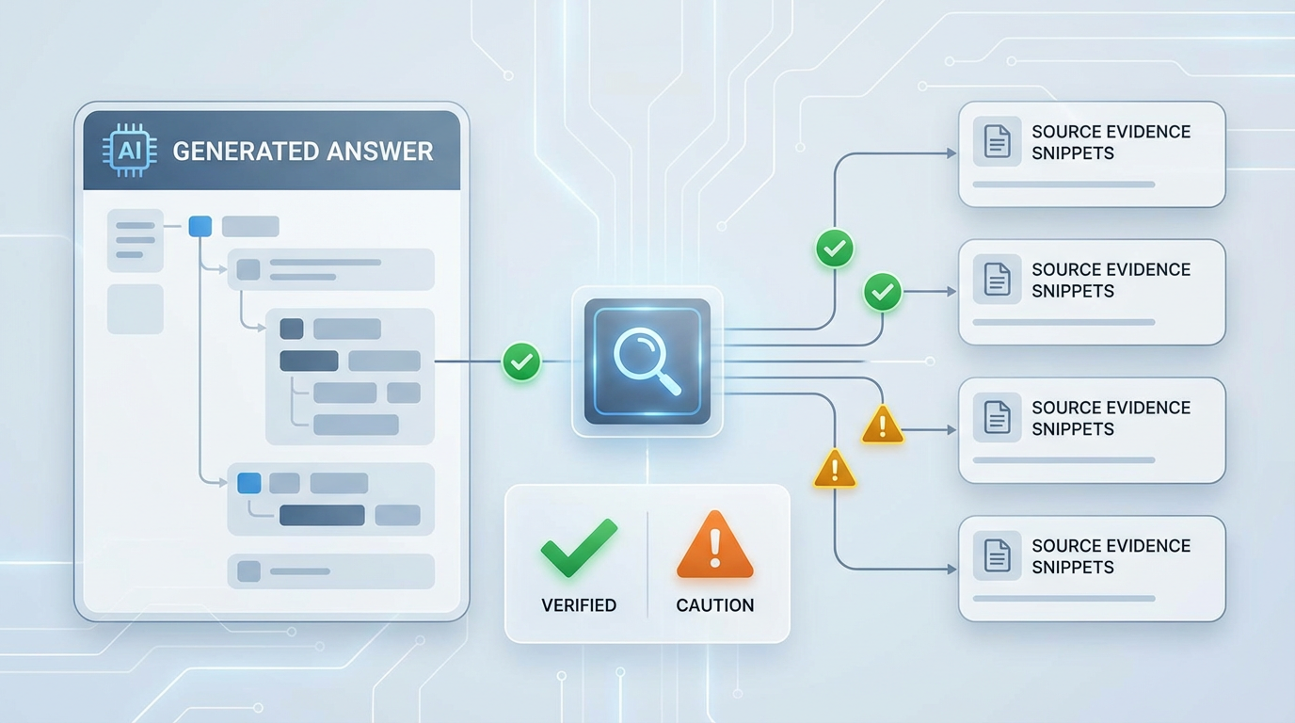
6. Answer Generation + Validation
Structured answer and retry control
Prompt enforces: answer-only-from-document + supporting evidence.
If grounding fails, regenerate up to configured retry limit.
Best attempt is retained with reasons for transparency.
Generated Answer
Supported Evidence
Grounding Check
Ungrounded Claims
Key takeaway: Retries are controlled and evidence-backed, not open-ended.

Slide 7
7. Coverage Validator + Rewrite
Fixes grounded-but-incomplete answers
Detects when answer misses parts of the question.
Runs one targeted rewrite using missing-point feedback.
Rewrite is accepted only if grounding still passes.
Initial Answer
Coverage Check
Low Coverage
Targeted Rewrite (x1)
Key takeaway: Completeness improves without raising hallucination risk.

Slide 8

8. Hybrid Grading Decision Path
Speed-first with robust fallback
Path A: semantic confidence high -> accept quickly.
Path B: low confidence -> invoke independent LLM judge.
Final score combines evidence for confidence and grade.
Hybrid is default for speed/quality balance.
Key takeaway: Only uncertain cases pay the judge-model latency cost.

Slide 9
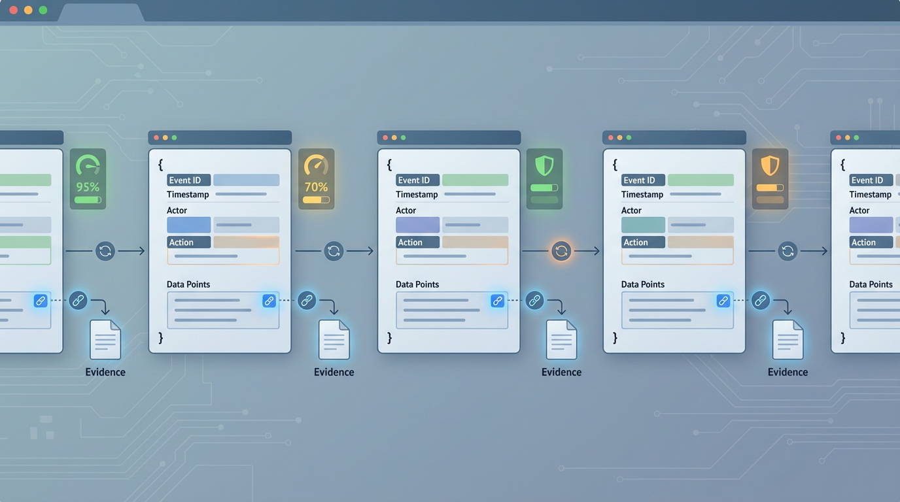
9. Output Schema Made Simple
How to read one result in 30 seconds
Block 1: Context
document.id/title/source
traceability
Block 2: QA details
question + answer + grading
per-pair issues
Block 3: Generation
question/answer metadata
model + timestamps
Block 4: Summary
overall grade/confidence
run metadata + semantic_enrichment
If grade is low, inspect QA issues first, then trace generation metadata.
Key takeaway: Outputs are built for fast audit, not just storage.

Slide 10

10. Tradeoff Summary + Recommendations
Senior decision view
Decision Tradeoffs
Higher depth checks -> better quality, higher latency
Lower temperature -> more factual, less linguistic flexibility
Hybrid grading -> better speed/quality, added routing logic
Coverage rewrite -> better completeness, one extra call
Balance, not optimize one only
Image mapping: Accuracy (quality checks), Latency (retry/fallback depth), Cost (judge-model usage).
Decision: keep current architecture; tune complexity and retry thresholds first.
Deployment: use 6-file split-model (separate llama/qwen archives + bundle updates).
Operations: add observability metrics and fast/standard/strict presets.
Accuracy
Latency
Cost
Key takeaway: Operate with explicit, measurable speed-quality tradeoffs.

