Slide 1

QAGRedo Workflow + LangChain/LangGraph Upgrade
Minimal Workflow, Algorithms, and Engineering Tradeoffs

Slide 2

2. Why This Workflow Exists
Business and technical context
Goal: generate complex Q&A grounded strictly in source documents.
Problem: raw LLM output is fast but can be shallow, repetitive, or hallucinatory.
Design response: multi-stage validation with adaptive fallback checks.
Outcome target: high factual confidence with auditable evidence trail.
Need
Risk
Response
Target

Slide 3
3. Minimal End-to-End Workflow
Full pipeline from input to audited output
Lane A: Input + Preparation
Input routing by file type
Normalization + optional semantic enrich
Lane B: Q/A Quality Loop
LangChain prompt/template/parsing path
Grounding, retries, and coverage checks
Lane C: Grading + Output
Hybrid scoring path
Grade, issues, run summary + run metrics
Key takeaway: Single visual, three lanes: preparation, quality loop, and final audit output.

Slide 4

4. Runtime Architecture
Three-container design with explicit runtime responsibilities
Generator service
qagredo-vllm | Llama | GPU 0 | :${VLLM_HOST_PORT}
Handles question + answer generation
Judge service
qagredo-vllm-judge | Qwen | GPU 1 | :${VLLM_JUDGE_HOST_PORT}
Independent grounding verification
Runner service
qagredo-runner | CPU | internal network
Pipeline orchestration + semantic checks
qagredo-vllm
Llama Q/A generator GPU 0 | Port ${VLLM_HOST_PORT}
qagredo-runner
Orchestrator CPU | internal
qagredo-vllm-judge
Qwen judge model GPU 1 | Port ${VLLM_JUDGE_HOST_PORT}
Separate judge model removes self-evaluation bias.
GPU split avoids head-of-line blocking between generation and grading.

Slide 5
5. Pipeline Orchestration Flow Diagram
Execution sequence with key gates
Input
Load supported input
Normalize to JSONL
Optional semantic metadata
Prepare run metadata
Question Gen
Prompt + few-shot
Dedup (LLM or Jaccard)
Grounding + comp checks
Answer Gen
Structured answer
Grounding retries
Coverage rewrite pass
Grading
Hybrid checker
Semantic first
Judge fallback
Output
analysis.json
run_summary.json
run_metrics
timestamped path
Deterministic stage order keeps behavior explainable and reproducible.
Each stage exposes explicit quality gates before proceeding downstream.
Audit outputs preserve both final verdicts and failure reasons.

Slide 6
6. Question Generation Strategy
10 types, benefits, examples, and why few-shot prevents trivial lookups
Types 1-5 (Core Analytical)
1) Analysis -> uncover drivers and dependencies
2) Aggregation -> improve counting accuracy
3) Comparison -> expose subtle differences
4) Inference -> test implied understanding
5) Causal -> validate cause-effect logic
Types 6-10 (Advanced Reasoning)
6) Temporal -> verify timeline consistency
7) Multi-hop -> connect distant facts
8) Synthesis -> integrate 3+ evidence points
9) Evaluation -> rate claim support strength
10) Counterfactual -> test causal robustness
Few-shot effect: GOOD and BAD examples teach the model what 'complex' looks like, reducing trivial lookup questions.
Practical impact: fewer weak questions pass forward, so downstream answer retries are lower.

Slide 7

7. Question Generation Algorithm
Pictorial flow: generate, filter, validate, and loop
3) Dedup
5) Accept Path
7) Final Set
1) Prompt + LLM
2) Parse
4) Quality Gates
6) Regenerate Loop
Flow interpretation: prompt build -> LLM generation -> parse -> dedup -> quality gates -> final validated set.
Upper path enforces grounding/comprehensiveness acceptance; lower loop represents targeted regeneration cycles.
Tradeoff: extra loop cost improves final question diversity and reduces downstream answer failures.

Slide 8
8. Question Quality Gates
Grounding + comprehensiveness hard gates
Gate A: Grounding
Purpose: reject out-of-doc questions
Default: min_conf=0.7, max_retry=2
Tradeoff: precision vs latency
Gate B: Comprehensiveness
Purpose: reject trivial lookups
Default: min_score=0.6, max_attempts=2
Tradeoff: depth vs extra LLM calls
Method: Semantic-first
Purpose: keep checks fast
Default for question validation path
Risk: misses some nuanced cases
Net effect: questions are both answerable and meaningful before answer generation starts.

Slide 9

9. Structured Answer Prompt Design
Pictorial prompt constraints and output branches
Counting-First Branch
Document + Question
Prompt Constraints
Answer Gen
Answer + Evidence
Insufficient-Info Branch
Fallback Response
Insufficient Info Signal
The visual maps prompt constraints to output behavior: answer + supporting evidence or explicit insufficiency path.
Counting-first branch enforces itemization before totals, reducing aggregation mistakes.
Branch-based prompt design increases factual consistency at temperature 0.3 while preserving auditability.
Key takeaway: Prompt structure enforces both factuality and explainability.

Slide 10
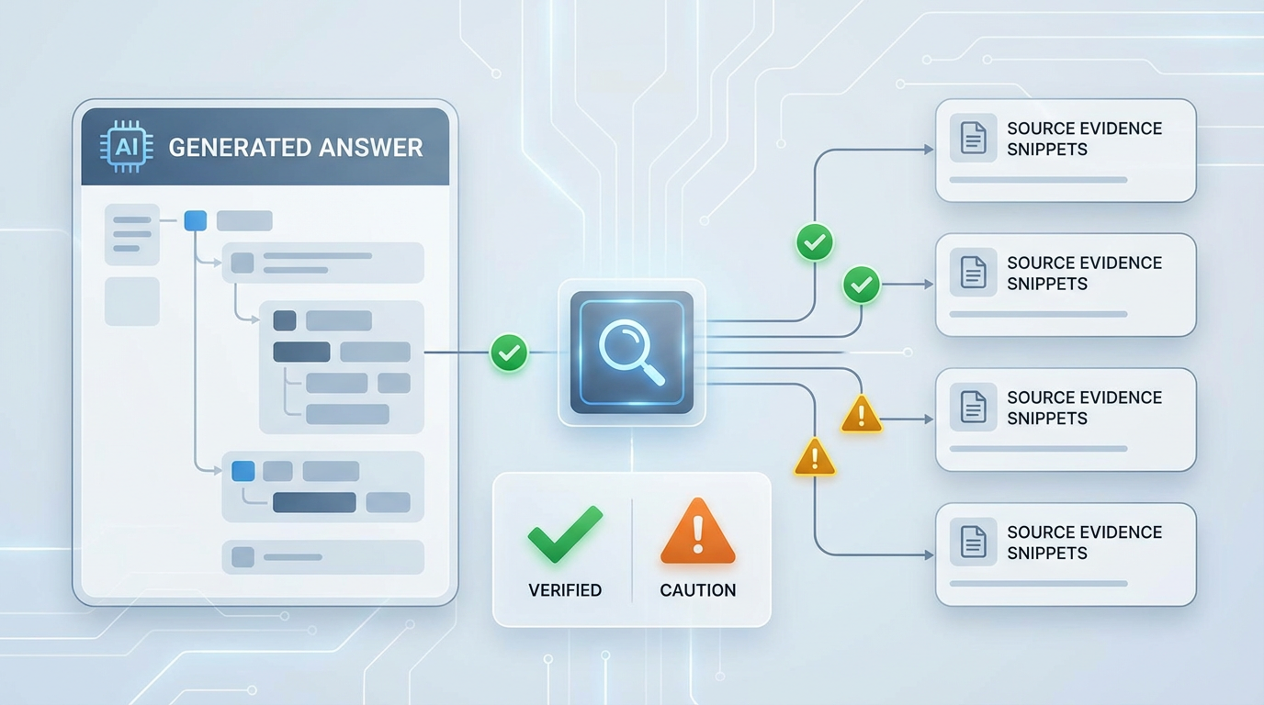
10. Answer Validation and Retry Loop
Grounding-first acceptance policy
Initial answer is checked by hallucination checker.
If not grounded at required confidence -> regenerate up to 3 times.
Best available answer is retained for transparency, not silently dropped.
Generated Answer
Supported Evidence
Grounding Check
Ungrounded Claims
Accept / Retry

Slide 11
11. Coverage Validator + Targeted Rewrite
New quality layer for question-answer alignment
Purpose: detect grounded-but-incomplete answers that miss parts of the question.
If coverage is low, run one targeted rewrite using missing-point feedback.
Safety: rewritten answer is accepted only if grounding/confidence still passes.
Outcome: improves completeness without increasing hallucination risk.
Initial Answer
Covered
Coverage Check
Low Coverage
Targeted Rewrite (x1)
Grounding Gate

Slide 12
12. Hallucination Checking Methods
Method-level strengths and limits
Semantic
Strength: fast, CPU, no GPU
Weakness: limited for counting/inference
Use: first-pass filter
LLM Judge
Strength: handles reasoning/aggregation
Weakness: slower and GPU-expensive
Use: high-ambiguity cases
Hybrid (Default)
Strength: speed-accuracy balance
Weakness: extra routing logic
Use: production default path
Hybrid captures most cases cheaply, escalates only uncertain edges.
Independent judge model gives stronger quality signal than self-judging.

Slide 13

13. Hybrid Grading Decision Path
Adaptive routing logic
A) Fast Semantic Path
A) Fast Semantic Path: high-confidence answers are accepted quickly.
B) Judge Fallback Path: low-confidence cases invoke the independent LLM judge.
C) Merge + Final Verdict: confidence combines evidence from both checks.
Tradeoff: slight routing complexity yields major efficiency gains.
B) Judge Fallback Path
C) Merge + Final Verdict

Slide 14
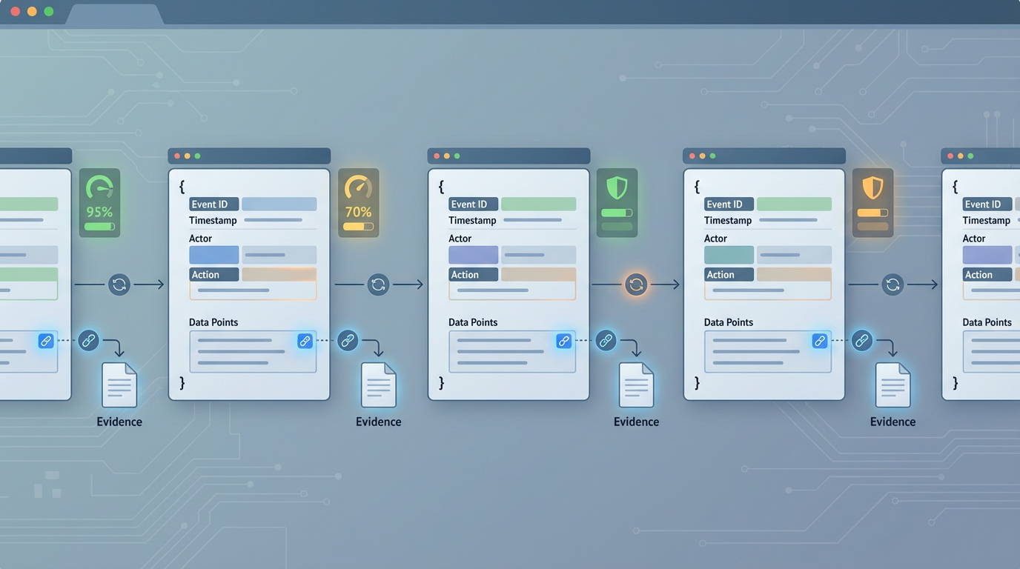
14. Output Schema Made Simple
How to read one result file in under 30 seconds
Block 1: Document context
document.id, title, source
Input identity for traceability
Block 2: QA details
qa_pairs: question + answer + grading
Per-pair confidence and issues
Block 3: Generation metadata
question_generation / answer_generation
Models, provider, timestamps
Block 4: Summary + enrichment
grading_summary + run_metrics
semantic_enrichment (optional)
Interpretation example: if grade is C with low confidence, inspect qa_pairs.issues first, then trace back to question_generation/comprehensiveness metadata.
Key takeaway: Read outputs as four blocks: context, QA details, generation metadata, final summary.

Slide 15

15. Configuration Knobs That Matter
Operational tuning from config/config.<profile>.yaml
Question generation knobs
complexity, num_questions, dedup threshold,
grounding + comprehensiveness thresholds
Image mapping: Quality Knob -> complexity/coverage strictness.
Latency Knob -> retry/fallback frequency and path depth.
Cost Knob -> judge-model usage and compute footprint.
Answer generation knobs
temperature, retry limits,
coverage validation thresholds
Grading knobs
hallucination.method and judge model
semantic | keyword | llm | hybrid
Quality Knob
Latency Knob
Cost Knob

Slide 16
16. Whole Workflow Sequence Diagram
From input document to graded output
Step 1
Load supported input
Normalize + enrich metadata
Step 2
Generate questions
Dedup + validate
Step 3
Generate answers
Retry + coverage
Step 4
Hybrid grading
Confidence + issues
Step 5
Save outputs
Emit summary
Decision Gate A (QG): reject ungrounded or trivial questions before answer stage.
Decision Gate B (AG): retry ungrounded answers; if still failing, generate replacement questions in later rounds (max 3), then apply one coverage rewrite pass.
Decision Gate C (Grading): fallback to LLM judge only for low-confidence semantic results.

Slide 17

17. Core Tradeoff Matrix
Accuracy vs latency vs compute cost
Design Choice | Upside | Downside
High question complexity | Better stress-test of comprehension | More generation instability risk
Low answer temperature | Factual consistency | Less linguistic flexibility
Hybrid grading | Better speed/quality balance | More decision logic
Coverage rewrite pass | Completeness gains | Additional LLM call

Slide 18
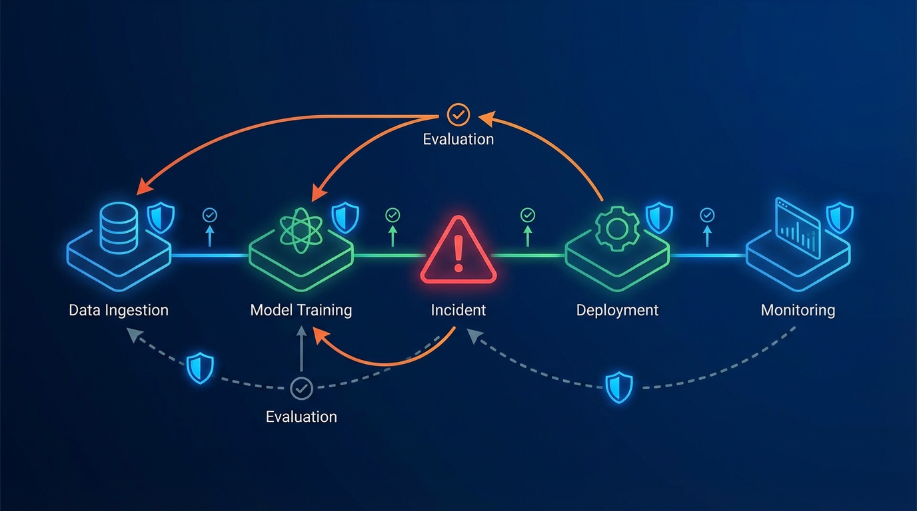
18. Reliability and Failure Handling
How the workflow degrades safely
A) Input Guard: invalid or empty questions are explicitly marked, never silently ignored.
B) Retry Control: insufficient-information path prevents forced hallucinated answers.
C) Fallback Path: semantic-to-judge escalation handles hard reasoning cases.
D) Audit Trail: all issues are stored with reasons for operator review.
D) Audit Trail
A) Input Guard
B) Retry Control
C) Fallback Path
Key takeaway: Map each reliability bullet to its A/B/C/D callout for quick explanation.

Slide 19

19. Deployment Model
Offline/air-gapped 6-file split-model workflow
6-file split-model transfer: vllm rootfs + qagredo image + llama model + qwen model + embed model + bundle.
Model split archives: models_llama.tar.gz (Llama HF tree, typical vLLM-judge) and models_qwen.tar.gz (Qwen HF tree, typical vLLM generator, e.g. Qwen3.5-9B).
setup_offline.sh prepares links, loads containers, and validates runtime.
run.sh executes pipeline with reproducible directory structure and outputs.
Partial runs: bash run.sh -- --resume skips docs with existing *_analysis.json.
Design supports regulated environments with no external network dependency and incremental bundle updates.

Slide 20
20. Senior-Level Recommendations
Action plan for next optimization cycle
1) Add per-answer metadata: coverage_score, rewrite_applied, fallback_path.
2) Build calibration dashboard: confidence distribution vs manual audit outcomes.
3) Introduce workload profiles (fast/standard/strict) via config presets.
4) Expand reliability testing with synthetic hard cases for counting and counterfactuals.
5) Keep current architecture: strongest balance of explainability and quality.
Visual credits: custom-generated professional illustrations for technical presentation use.

