Slide 1
Java Programming Course
OOP Overviews

Slide 2
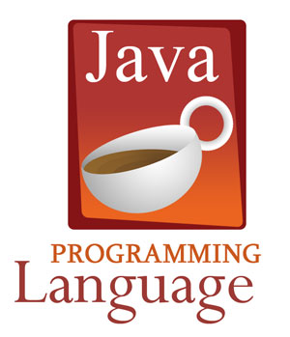
Session objectives
Java proramming language in basic
Objects and classes
Inheritance
Collection
Exception
Generic Programming

Slide 3
Java proramming language in basic
Primitive data types
Variables, constants
Expressions
Control Structures
The flow of control through a method
Decision-making statements
Operators for making complex decisions
Repetition statements

Slide 4
Objects and classes
Class declarations
Method declarations
Instance variables
Encapsulation
Method overloading
Object references and aliases
Passing objects as parameters
The static modifier
Nested classes
Interfaces and polymorphism

Slide 5
Inheritance
Deriving new classes
Class hierarchies
The protected modifier
The super reference
Restricting Inheritance
Abstract class
Polymorphism via inheritance

Slide 6
Collection
Array
Concrete collection
ArrayList/Vector
Set
Map
Enumeration

Slide 7
Exception
The try-catch statement
Exception propagation
Creating and throwing exceptions

Slide 8
Generic Programming
Generic Class
Generic Methods
Bounds for Type Variables
Generic Code and the Virtual Machine
Restrictions and Limitations
Inheritance Rules for Generic Types
Wildcard Types

Slide 9

FAQ

