Slide 1
Java Programming Course
IO

Slide 2

Session objectives
What is an I/O stream?
Types of Streams
Stream class hierarchy
Control flow of an I/O operation using Streams
Byte streams
Character streams
Buffered streams
Standard I/O streams
Data streams
Object streams
File class

Slide 3
I/O stream

Slide 4
I/O Streams
An I/O Stream represents an input source or an output destination.
A stream can represent many different kinds of sources and destinations, including disk files, devices, other programs, and memory arrays.
Streams support many different kinds of data
simple bytes, primitive data types, localized characters, and objects.
Some streams simply pass on data; others manipulate and transform the data in useful ways.

Slide 5
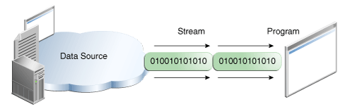
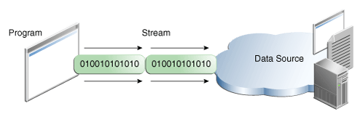
I/O Streams
A stream is a sequence of data.
A program uses an input stream to read data from a source, one item at a time:
A program uses an output stream to write data to a destination, one item at time:

Slide 6
Types of Streams

Slide 7
General Stream Types
Character and Byte Streams
Input and Output Streams
Based on source or destination
Node and Filter Streams
Whether the data on a stream is manipulated or transformed or not.

Slide 8
Character and Byte Streams
Byte streams
For binary data
Root classes for byte streams:
The InputStream Class
The OutputStream Class
Both classes are abstract
Character streams
For Unicode characters
Root classes for character streams:
The Reader class
The Writer class
Both classes are abstract

Slide 9
Input and Output Streams
Input or source streams
Can read from these streams
Root classes of all input streams:
The InputStream Class
The Reader Class
Output or sink (destination) streams
Can write to these streams
Root classes of all output streams:
The OutputStream Class
The Writer Class

Slide 10
Node and Filter Streams
Node streams (Data sink stream)
Contain the basic functionality of reading or writing from a specific location
Types of node streams include files, memory and pipes
Filter streams (Processing stream)
Layered onto node streams between threads or processes
For additional functionality- altering or managing data in the stream
Adding layers to a node stream is called stream chaining

Slide 11
Java IO Stream hierarchy

Slide 12
Control Flow of an I/O operation
Create a stream object and associate it with a data-source (data-destination)
Give the stream object the desired functionality through stream chaining
while (there is more information)
read(write) next data from(to) the stream
close the stream

Slide 13
Byte Stream

Slide 14
Byte Stream
Programs use byte streams to perform input and output of 8-bit bytes
All byte stream classes are descended from InputStream and OutputStream
There are many byte stream classes
FileInputStream and FileOutputStream
They are used in much the same way; they differ mainly in the way they are constructed

Slide 15
When Not to Use Byte Streams?
Byte Stream represents a kind of low-level I/O that you should avoid
If the data contains character data, the best approach is to use character streams
There are also streams for more complicated data types
Byte streams should only be used for the most primitive I/O
All other streams are based on byte stream

Slide 16
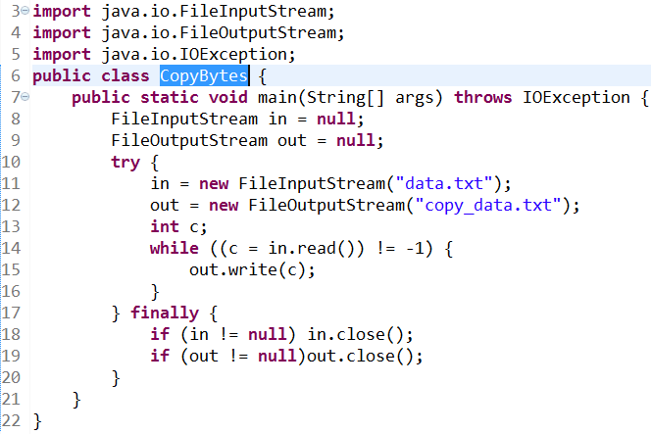
Byte Stream example

Slide 17
Character Stream

Slide 18
Character Stream
The Java platform stores character values using Unicode conventions
Character stream I/O automatically translates this internal format to and from the local character set.
In Western locales, the local character set is usually an 8-bit superset of ASCII.
All character stream classes are descended from Reader and Writer
As with byte streams, there are character stream classes that specialize in file I/O: FileReader and FileWriter.

Slide 19
Character Stream
For most applications, I/O with character streams is no more complicated than I/O with byte streams.
Input and output done with stream classes automatically translates to and from the local character set.
A program that uses character streams in place of byte streams automatically adapts to the local character set and is ready for internationalization — all without extra effort by the programmer.
If internationalization isn't a priority, you can simply use the character stream classes without paying much attention to character set issues.
Later, if internationalization becomes a priority, your program can be adapted without extensive recoding.

Slide 20
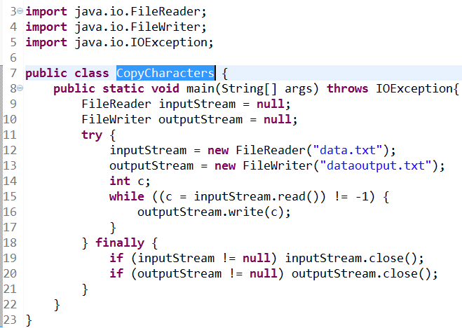
Character Stream example

Slide 21
Character Stream and Byte Stream
Character streams are often "wrappers" for byte streams
The character stream uses the byte stream to perform the physical I/O, while the character stream handles translation between characters and bytes.
FileReader, for example, uses FileInputStream, while FileWriter uses FileOutputStream
There are two general-purpose byte-to-character "bridge" streams: InputStreamReader and OutputStreamWriter. Use them to create character streams when there are no prepackaged character stream classes that meet your needs.

Slide 22
Line-Oriented I/O
Character I/O usually occurs in bigger units than single characters.
One common unit is the line: a string of characters with a line terminator at the end.
A line terminator can be a carriage-return/line-feed sequence ("\r\n"), a single carriage-return ("\r"), or a single line-feed ("\n").

Slide 23
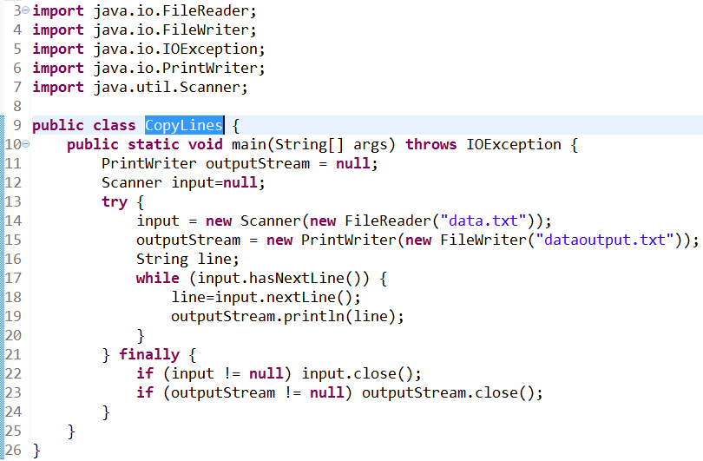
Line-Oriented I/O example

Slide 24
Buffered Stream

Slide 25
The necessary of Buffered Streams
An unbuffered I/O means each read or write request is handled directly by the underlying OS
This can make a program much less efficient, since each such request often triggers disk access, network activity, or some other operation that is relatively expensive.
To reduce this kind of overhead, the Java platform implements buffered I/O streams
Buffered input streams read data from a memory area known as a buffer; the native input API is called only when the buffer is empty
Similarly, buffered output streams write data to a buffer, and the native output API is called only when the buffer is full.

Slide 26
Buffered Stream Classes
There are four buffered stream classes used to wrap unbuffered streams:
BufferedInputStream and BufferedOutputStream create buffered byte streams.
BufferedReader and BufferedWriter create buffered character streams.

Slide 27
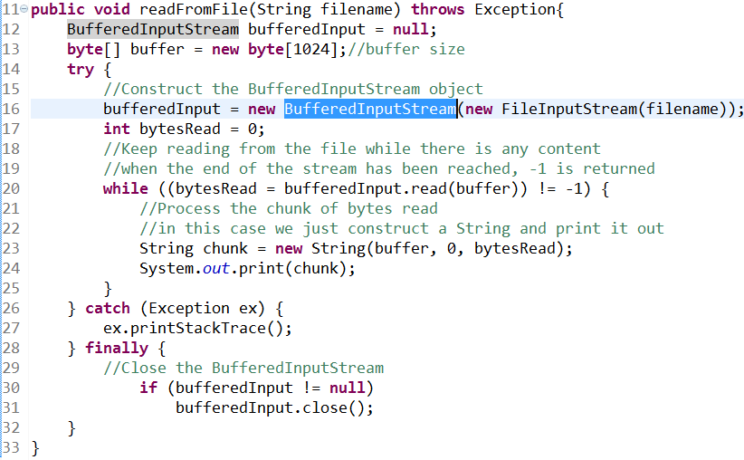
Buffered Stream Classes - Reading demo

Slide 28
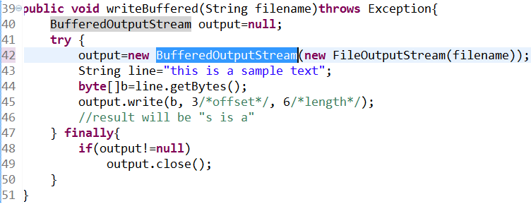
Buffered Stream Classes - Writing demo

Slide 29
Flushing Buffered Streams
It often makes sense to write out a buffer at critical points, without waiting for it to fill. This is known as flushing the buffer.
Some buffered output classes support autoflush, specified by an optional constructor argument.
When autoflush is enabled, certain key events cause the buffer to be flushed
For example, an autoflush PrintWriter object flushes the buffer on every invocation of println or format.
To flush a stream manually, invoke its flush method
The flush method is valid on any output stream, but has no effect unless the stream is buffered.

Slide 30
Standard Streams

Slide 31
Standard Streams on Java Platform
Three standard streams
Standard Input, accessed through System.in
Standard Output, accessed through System.out
Standard Error, accessed through System.err
These objects are defined automatically and do not need to be opened
System.out and System.err are defined as PrintStream objects

Slide 32
Data Streams

Slide 33
Data Streams
Data streams support binary I/O of primitive data type values (boolean, char, byte, short, int, long, float, and double) as well as String values
All data streams implement either the DataInput interface or the DataOutput interface
DataInputStream and DataOutputStream are most widely-used implementations of these interfaces

Slide 34
The DataOutputStream class
A data output stream lets an application write primitive Java data types to an output stream in a portable way. An application can then use a data input stream to read the data back in.
Constructor:
DataOutputStream(OutputStream out)
Creates a new data output stream to write data to the specified underlying output stream.

Slide 35
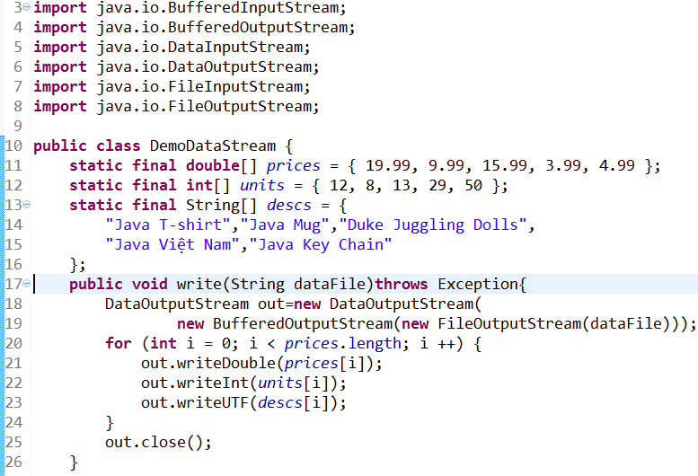
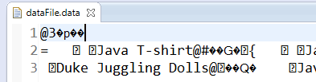
DataOutputStream demo

Slide 36
The DataInputStream class
A data input stream lets an application read primitive Java data types from an underlying input stream in a machine-independent way. An application uses a data output stream to write data that can later be read by a data input stream.
Constructor : DataInputStream(InputStream in) Creates a DataInputStream that uses the specified underlying InputStream.

Slide 37
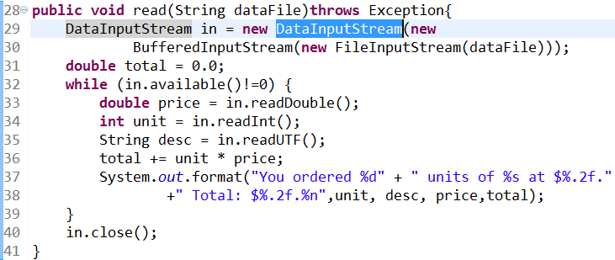
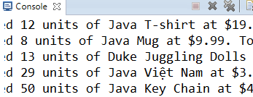

The DataInputStream exemple

Slide 38
Object Streams

Slide 39
Object Serialization
Persistence is the concept that an object can exist separate from the executing program that creates it
Java contains a mechanism called object serialization for creating persistent objects executing program that creates it.
When an object is serialized, it is transformed into a sequence of bytes; this sequence is raw binary representation of the object. Later, this representation can be restored to the original object. Once serialized, the object can be stored in a file for later use.

Slide 40
Object Streams
Object streams support I/O of objects
Like Data streams support I/O of primitive data types
The object has to be Serializable type
The object stream classes are ObjectInputStream and ObjectOutputStream
These classes implement ObjectInput and ObjectOutput, which are subinterfaces of DataInput and DataOutput
An object stream can contain a mixture of primitive and object values

Slide 41
Object Serialization
Any object we want to serialize must implement the Serializable interface.
To serialize an object, we invoke the writeObject method of an ObjectOutputStream.
To deserialize the object, we invoke the readObject method of an ObjectInputStream.
The actual data streams to which the serialized object is written can represent a file, network communication, or some other type of stream.

Slide 42
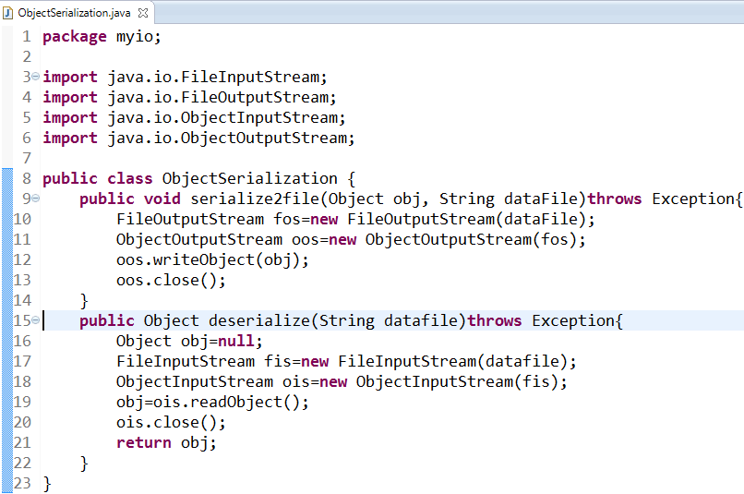
Object serialization demo

Slide 43
Output and Input of Complex Objects
The writeObject and readObject methods are simple to use, but they contain some very sophisticated object management logic
This isn't important for a class like Calendar, which just encapsulates primitive values. But many objects contain references to other objects.
If readObject is to reconstitute an object from a stream, it has to be able to reconstitute all of the objects the original object referred to.
These additional objects might have their own references, and so on.

Slide 44
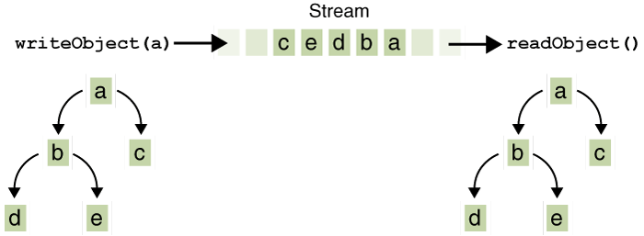
I/O of multiple referred-to objects
Object a contains references to objects b and c, while b contains references to d and e
Invoking writeObject(a) writes not just a, but all the objects necessary to reconstitute a, so the other four objects in this web are written also
When a is read back by readObject, the other four objects are read back as well, and all the original object references are preserved.

Slide 45
NIO - New I/O

Slide 46
NIO.2 - New I/O version 2
Is aimed at simplifying I/O in Java
A new file system and path abstraction
Based on java.nio.file.Path
Bulk access to file attributes
File system specific support (e.g. Symbolic links)
Extra providers (e.g. zip files treated as normal files)
Asynchronous (non-blocking) I/O
For sockets and files
Mainly utilises java.util.concurrent.Future
Socket/Channel construct
Binding, options and multicast

Slide 47
NIO.2 - Path
java.nio2.file.Path interface
Typically represents a file on a file system
normalize() method removes constructs such as . and .. in a Path
relativize(Path) constructs relative Path between this path and the one given
Lots of other expected methods defined in the interface
Dealing with real path, absolute path etc
Can convert java.io.File objects via the toFile() method
java.nio2.file.Paths
Helper class, provides get(URI) method to return you a Path
Uses FileSystems helper class under the hood
Uses the default file system unless you specify otherwise

Slide 48
NIO.2 - Files
java.nio2.file.Files helper class
Day to day class for performing simple file I/O
Many common methods
copy
delete
move
createDirectory/File/Link
write
readAllLines
walkFileTree (recurse over a directory)
newInputStream/OutputStream
Combined with try-with-resources makes code concise

Slide 49
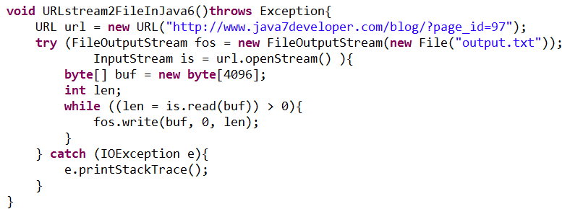
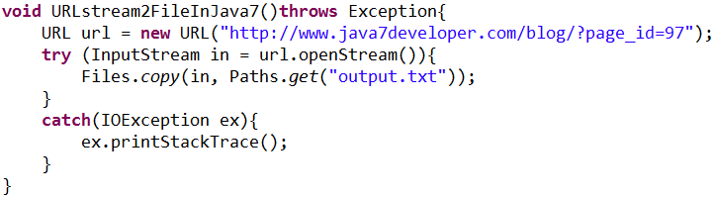
URLStream to file - Java 6 vs. Java 7
Notes:
URL url =
new URL("http://www.java7developer.com/blog/?page_id=97");
try (
FileOutputStream fos =
new FileOutputStream(new File("output.txt"));
InputStream is = url.openStream() )
{
byte[] buf = new byte[4096];
int len;
while ((len = is.read(buf)) > 0)
{
fos.write(buf, 0, len);
}
} catch (IOException e)
{
e.printStackTrace();
}

Slide 50
NIO.2 - Asynchronous I/O
The ability to perform read/write operations in the background
Without having to write your own java.util.concurrent code
Is available for:
file I/O (AsynchronousFileChannel)
networking I/O (AsynchronousSocketChannel)
And AsynchronousServerSocketChannel
Can work in two styles
Future based (order coffee, do something else, collect coffee)
Callbacks (order coffee, do something else, have coffee thrown at you)

Slide 51
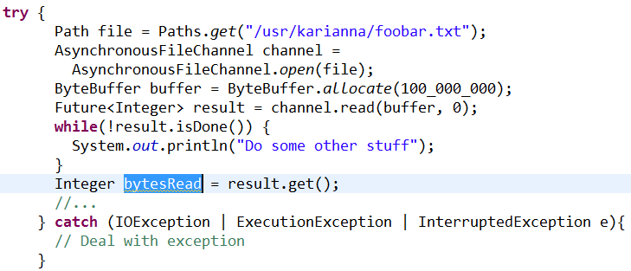
NIO.2 - Future based file I/O example

Slide 52
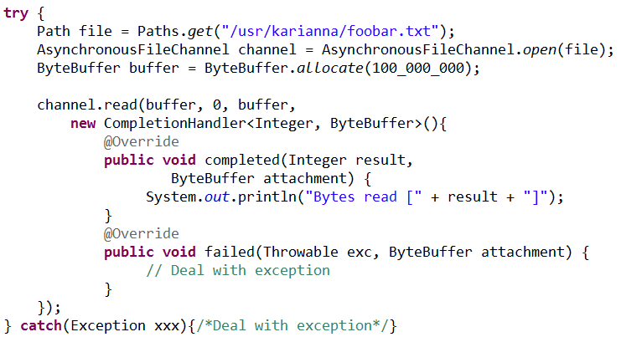
NIO.2 - Callback based file I/O example

Slide 53
Summary
What is an I/O stream?
Types of Streams
Stream class hierarchy
Control flow of an I/O operation using Streams
Byte streams
Character streams
Buffered streams
Standard I/O streams
Data streams
Object streams
File class

Slide 54


