Slide 1
JDBC

Slide 2
JDBC Overview
What is JDBC?
Features
Architecture
Development process
JDBC data access statements
Java JDBC Transactions

Slide 3
What is JDBC?
JDBC
Allows a Java application to connect to a relational database.
The major databases are supported such as Oracle, Microsoft SQL Server, DB2 and many others.
Notes:
The database can be located on the same local machine as in the application. It can also be located in a network in a remote location.

Slide 4
Features
The main feature of JDBC is that it is a standard API. You develop your application code to the JDBC API and you can connected to various databases.
JDBC supported a large number of databases
Oracle, Microsoft SQL server, MySQL, SyBase, DB2, PostgreSQL …
You can build your own custom SQL statement:
select, insert, update and delete.
Complex SQL queries: inner and outer joins.
Call stored procedures.

Slide 5
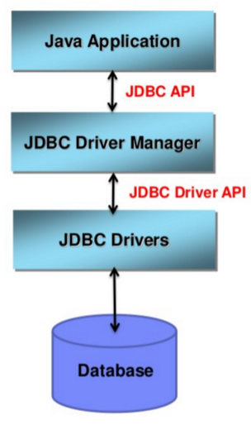
JDBC architecture

Slide 6
JDBC architecture
JDBC driver
Provides a connection to a database.
Converts JDBC calls to for specific database.
JDBC driver implementations
Provided by database vendor.

Slide 7
JDBC Driver manager
Driver manager helps connect an application based on a database connection string.
In JDBC is version 4.0, the JDBC drivers are automatically loaded based on the classpath.
Legacy JDBC 3.0 drivers have to be explicitly loaded with Java code is Class.forName(theDriverName)

Slide 8
JDBC API
The JDBC API is defined in two packages.
java.sql and javax.sql.
Key classes
java.sql.DriverManager
java.sql.Connection
java.sql.statement
java.sql.ResultSet
java.sql.DataSource

Slide 9
Development Process
Get a Connection to database.
Create a Statement object.
Execute SQL query.
Process Results set.
Close connection

Slide 10
Step 1: Get a Connection to database
In order to connect to database
Need to connection string in form of JDBC URL.
Basic syntax
jdbc:<driver protocol>:<driver connection details>
Examples
Database | JBDC URL
MS SQL Server | jdbc:sqlserver://<HOST>:<PORT>;DatabaseName=DB
Oracle | jdbc:oracle:thin:@<HOST>:<PORT>:<DB>
MySQL | jdbc:mysql://<HOST>:<PORT>/<DB>

Slide 11
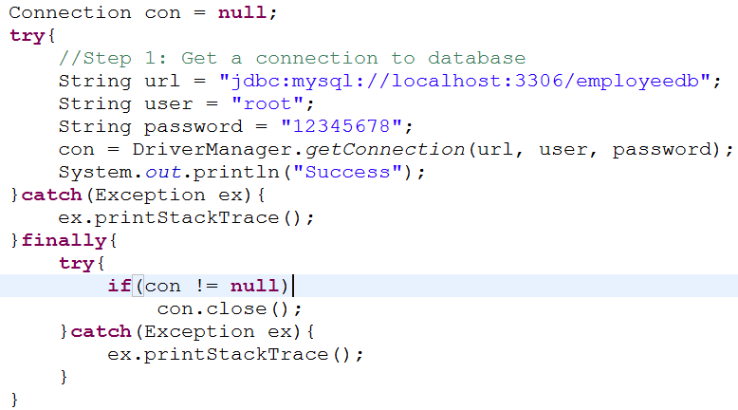
Step 1: Get a Connection to database
Notes:
Create a variable for the connection string.
Declare the JDBC objects.
Establish the connection.
Create and execute an SQL statement that returns some data.
Iterate through the data in the result set and display it.
Handle any errors that may have occurred.
Closing the JDBC objects.

Slide 12
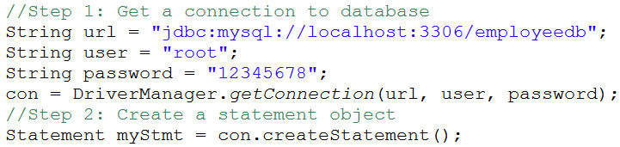
Step 2: Create a Statement object
The Statement object is based on connection.
It will be used later to execute SQL query.

Slide 13

Step 3: Execute SQL query.
Pass in your SQL query

Slide 14
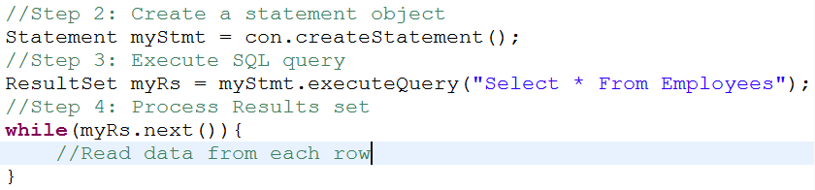
Step 4: Process Results set
Results set is initially placed before first now.
Method: boolean next()
Moves forward one row
Return true if there are more rows to process
Looping through a result set

Slide 15
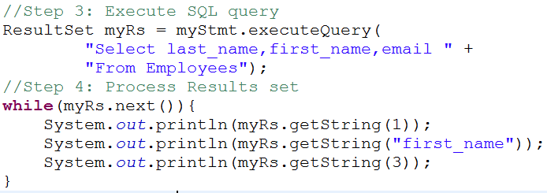
Step 4: Process Results set
Collection of methods for reading data
getXXX(columnName)
getXXX(columnIndex)

Slide 16
Step 5: Close connection
By closing connection object statement and ResultSet will be closed automatically.
The close() method of Connection interface is used to close the connection.
public void close()throws SQLException
Example
con.close();

Slide 17
JDBC data access statements
// Statement creation
Statement statement = connection.createStatement();
// Query string
String query = <SQLQuery>; // CRUD
// for retrieve data
ResultSet result = statement.executeQuery(query);
while (result.next()){
result.getString(<ColName>);
result.getInt(<ColName>);
result.getFloat(<ColName>);
}
// for data modification: insert, update, delete
int nbUpdated = statement.executeUpdate(query);
Notes:
Ask for CRUD with the student information and DB prepared in page 29

Slide 18
JDBC ResultSet update preparation
// for use with ResultSet only
// No “previous” method using, no update
connection.createStatement(
ResultSet.TYPE_FORWARD_ONLY,
ResultSet.CONCUR_READ_ONLY);
// with “previous” method using, update
connection.createStatement(
ResultSet.TYPE_SCROLL_SENSITIVE,
ResultSet.CONCUR_UPDATABLE);
Notes:
TYPE_SCROLL_INSENSITIVE, TYPE_SCROLL_SENSITIVE
CONCUR_UPDATABLE

Slide 19
Prepared Statements
What are Prepared Statements
Create a Prepared Statement
Setting Parameter Values
Executing a Prepared Statement
Reusing a Prepared Statement

Slide 20
Prepared Statements
A Prepared Statement is simply a precompiled SQL statement.
Prepared Statements provide the following benefits.
Makes it easier to set SQL parameters.
Prevent against SQL dependency injection attacks
May improve application performance
SQL statement is precompiled.

Slide 21


Using Prepared Statements
Instead of hard coding your SQL values
Set parameter placeholders
Use a question mark for placeholder: ?
Can also use prepared statement s for
Insert, update and delete

Slide 22
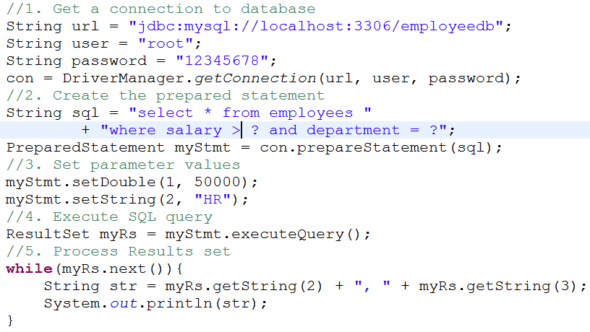
Using Prepared Statements

Slide 23
Calling SQL Stored Procedures
What are Stored Procedures
Using callable Statements
Call Stored Procedures that take parameters.
IN parameters
INOUT parameters
OUT parameters
Return a result set

Slide 24
What are Stored Procedures
A stored procedure is a group of SQL statements that perform a particular task.
The stored procedures are created in a SQL language that supported by the native database.
The stored procedures can also have any combination of input and output parameters.

Slide 25
Using callable Statements
To call stored procedures from Java
The JDBC API provides the CallableStatement
Use a special syntax to call stored procedures
CallableStatement myCall = con.prepareCall(
"{call stored_proc_name()}");

Slide 26
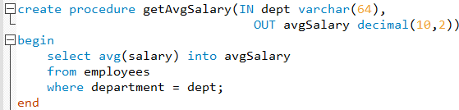
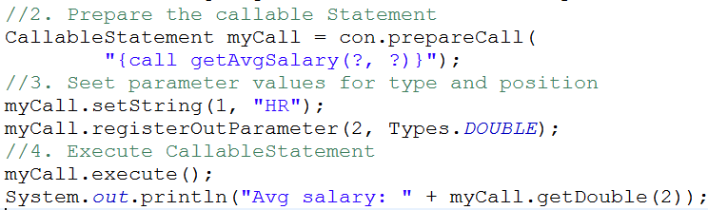
Using callable Statements
Stored procedure
Java coding

Slide 27
Java JDBC Transactions
What are Transactions?
How to develop transactions with JDBC

Slide 28
What are Transactions?
A transaction is basically a unit of work.
One or more SQL statements executed together.
Either all of the statements are executed – Commit
Or none of the statements are executed – Rollback

Slide 29

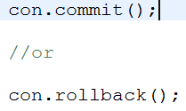
JDBC Transactions
By default, the database connection is to auto-commit
Need to explicitly turn off auto-commit
Developer controls commit or rollback

Slide 30
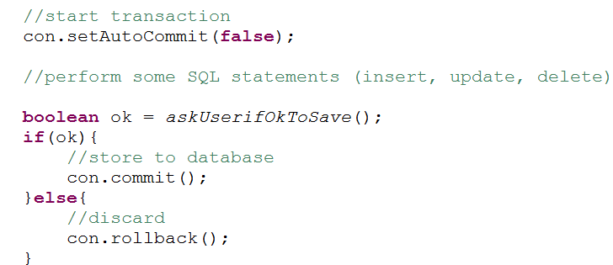
JDBC Transactions
Developer controls commit or rollback

Slide 31
JDBC batch processing
Batch processing allows you to group related SQL statements into a batch and submit them with one call to the database.
The addBatch() is used to add individual statements to the batch.
The executeBatch() is used to start the execution of all the statements grouped together.
The clearBatch() is used to removes all the statements you added to batch.

Slide 32
JDBC Batch Processing
Create a Statement object.
Set auto-commit to false.
Add as many as SQL statements into batch.
Execute all the SQL statements.
Finally, commit all the changes.

Slide 33
JDBC Batch Processing
con.setAutoCommit(false);
// replace executeQuery by addBatch
…
stmt.setString(1, “Titi”); stmt.setInt(2, 25);
stmt.addBatch(); // Insert 1
stmt.setString(1, “Tata”); stmt.setInt(2, 28);
stmt.addBatch(); // Insert 2
// then call batch processing statement
stmt.executeBatch();
// also applied for normal statement (not prepared one)
con.commit();
con.setAutoCommit(true);

Slide 34
JDBC Batch with string query
connect.setAutoCommit(false);
Statement statement = connect.createStatement();
statement.addBatch(<Insert query>);
statement.addBatch(<Insert query>);
statement.addBatch(<Update query>);
statement.addBatch(<Delete query>);
int[] updateCounts = statement.executeBatch();
connect.commit();
statement.close();
connect.setAutoCommit(true);

Slide 35


