Slide 1
Chapter 8
Graphics Programming
(contd.)

Slide 2
Outline
Text Input
Choice Components
Menus
Mnemonics
Toolbars
Tooltips
Tabbed panes
Scroll panes
Dialog Boxes

Slide 3
JTextField
If the cursor is in the text field, the user presses the Enter key, JTextField generates an Action event
Listener?
… implements ActionListener
Method in the listener?
public void actionPerformed(ActionEvent e)
Register listener to the text field?
void addActionListener(ActionListener listener)

Slide 4

Example: JTextFieldDemo.java
import java.awt.*;
import java.awt.event.*;
import javax.swing.*;
public class JTextFieldDemo extends JFrame
implements ActionListener
{
JTextField mmText;
JLabel resultLabel;
public JTextFieldDemo() {
super("Chuyen doi don vi");
setLayout(new GridLayout(2,2));
add (new JLabel (“Nhap vao so millimet:"));
add (mmText = new JTextField (10));
add (new JLabel (“So centimet tuong ung: "));
add (resultLabel = new JLabel ("---"));
mmText.addActionListener (this);
setDefaultCloseOperation(EXIT_ON_CLOSE);
setSize(300,90);
setVisible(true);
}
public void actionPerformed(ActionEvent e)
{
double cm, mm;
mm = Double.parseDouble(mmText.getText());
cm = mm/10;
resultLabel.setText (Double.toString(cm));
}
public static void main(String[] args) {
new JTextFieldDemo();
}
}

Slide 5
JTextArea
Purpose
For texts with more than one line long
Constructors
JTextArea(int rows, int cols)
constructs a new text area with number of rows and columns
JTextArea(String text, int rows, int cols)
constructs a new text area with an initial text

Slide 6
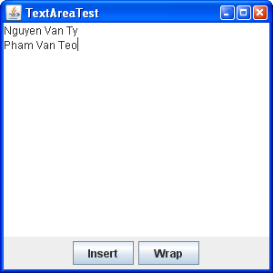
Example: JTextAreaDemo.java
JPanel buttonPanel = new JPanel();
buttonPanel.add(insertButton=new JButton("Insert"));
buttonPanel.add(wrapButton = new JButton("Wrap"));
add(buttonPanel, BorderLayout.SOUTH);
textArea = new JTextArea(8, 40);
add(textArea, BorderLayout.CENTER);

Slide 7
JPasswordField
Purpose: used to enter a password
A JPasswordField is similar to a JTextField except the characters typed in by the user are not echoed back to the user
Instead, an alternate character such as asterisks (*) is displayed
You can set the echo character using the method:
public void setEchoChar(char c)

Slide 8
JPasswordField - Methods
String getText()
char[] getPassword()
returns the text contained in this password field
char getEchoChar()
void setEchoChar(char ch)
gets or sets the character that is displayed as the user types into this field

Slide 9

Example: JPasswordFieldDemo.java
import javax.swing.*;
import java.awt.*;
import java.awt.event.*;
public class JPasswordFieldDemo extends JFrame
implements ActionListener
{
JPasswordField txtPassword;
JButton btnOk, btnCancel;
public JPasswordFieldDemo()
{
super("JPasswordField Demo");
JPanel pnlLeft, pnlRight;
txtPassword = new JPasswordField(12);
txtPassword.addActionListener(this);
pnlLeft = new JPanel();
pnlLeft.add(new JLabel("Password: "));
pnlLeft.add(txtPassword);
pnlRight = new JPanel(new GridLayout(0,1));
pnlRight.add(btnOk = new JButton("OK"));
pnlRight.add(btnCancel=new JButton("Cancel"));
add(pnlLeft, BorderLayout.WEST);
add(pnlRight, BorderLayout.CENTER);
btnOk.addActionListener(this);
btnCancel.addActionListener(this);
setDefaultCloseOperation(EXIT_ON_CLOSE);
setsize(200, 200);
setVisible(true);
}

Slide 10
JPasswordFieldDemo.java
public void actionPerformed(ActionEvent e)
{
Object o = e.getSource();
if (o == btnOk || o == txtPassword) {
char chPassword[] = txtPassword.getPassword();
String strPassword = new String(chPassword);
if(strPassword.trim().equals("pass")) {
JOptionPane.showMessageDialog(this,"Correct Password");
System.exit(0);
}
else {
JOptionPane.showMessageDialog(this,"Incorrect Password","Error Message", JOptionPane.ERROR_MESSAGE);
txtPassword.selectAll();
txtPassword.requestFocus();
}
}
else {
System.exit(0);
}
}
public static void main(String [] args){
new JPasswordFieldDemo();
}
}
Notes:
Dùng getText cho Jpassword bị error

Slide 11
Outline
Text Input
Choice Components
Menus
Mnemonics
Toolbars
Tooltips
Tabbed panes
Scroll panes
Dialog Boxes

Slide 12
JCheckBox
Purpose:
Used for multi-option user input that the user may select or deselect by clicking on them
Constructors:
JCheckBox()
Creates an initially unchecked checkbox with no label
JCheckBox(String text)
Creates a checkbox (initially unchecked) with the specified text; see setSelected for changing it
JCheckBox(String text, boolean selected)
Creates a checkbox with the specified text
The initial state is determined by the boolean value provided
A value of true means it is checked

Slide 13
JCheckBox – Methods
boolean isSelected()
returns the state of the checkbox
void setSelected(boolean state)
sets the checkbox to a new state
String getText()
void setText(String text)
gets or sets the button’s text
addItemListener/removeItemListener
Add or remove an ItemListener to process ItemEvent in itemStateChanged

Slide 14
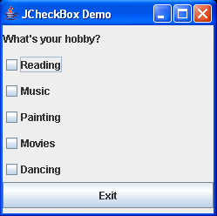
Example: JCheckBoxDemo.java
import java.awt.*;
import javax.swing.*;
public class JCheckBoxDemo extends JFrame {
JCheckBox cboxRead, cboxMusic, cboxPaint, cboxMovie , cboxDance;
JButton btnExit;
public JCheckBoxDemo() {
super("JCheckBox Demo");
JPanel panel = new JPanel(new GridLayout(7,1));
panel.add( new JLabel("What's your hobby?" ));
panel.add(cboxRead = new JCheckBox("Reading"));
panel.add(cboxMusic = new JCheckBox("Music"));
panel.add(cboxPaint = new JCheckBox("Painting"));
panel.add(cboxMovie = new JCheckBox("Movies"));
panel.add(cboxDance = new JCheckBox("Dancing"));
panel.add(btnExit= new JButton("Exit"));
add(panel);
setLocation(400, 300);
setSize(250, 250);
setVisible(true);
}
public static void main(String args[]) {new JCheckBoxDemo();}
}

Slide 15
Handling JCheckBox event
A JCheckBox generates an Item event whenever it changes state (checked/unchecked)
Handle the event
implements ItemListener
Method: public void itemStateChanged (ItemEvent e)
The ItemEvent class has a getItem method which returns the item just selected or deselected
Register: addItemListener
Ignore the event
With checkboxes, it is relatively common to ignore the select/deselect event when it occurs
Instead, you look up the state of the checkbox later using the isSelected method of JCheckBox
Notes:
Trong C, C++, Java, C#, toán tử thao tác bit XOR được biểu diễn bằng kí hiệu "^" (dấu mũ)
Rule: 2 bit giống nhau trả về 0, 2 bit khác nhau trả về 1

Slide 16
JRadioButton
Purpose: Used as option button to specify choices
Only one radio button in a group can be selected at any given time
To define the group of radio buttons, create a ButtonGroup object
ButtonGroup group = new ButtonGroup();
group.add(smallButton);
group.add(mediumButton);
Note: the ButtonGroup controls only the behavior of the buttons; if you want to group the buttons for layout purposes, you also need to add them to a container
When the user checks a radio button, JRadioButton generates an Action event (…)

Slide 17
JRadioButton – Constructors
JRadioButton()
Creates an initially unchecked radio button with no label
JRadioButton(String text)
Creates a radio button (initially unchecked) with the specified text; see setSelected for changing it
JRadioButton(String text, boolean selected)
Creates a radio button with the specified text
The initial state is determined by the boolean value provided
A value of true means it is checked

Slide 18
JRadioButton – Methods
boolean isSelected()
returns the state of the radio button
void setSelected(boolean state)
sets the radio button to a new state
String getText()
void setText(String text)
gets or sets the button’s text

Slide 19

Example: JRadioButtonDemo.java
import java.awt.*;
import java.awt.event.*;
import javax.swing.*;
public class JRadioButtonDemo extends JFrame {
JRadioButton radUnder, radGra, radPost, radDoc;
public JRadioButtonDemo() {
super("JRadioButton Demo");
setLayout(new GridLayout(6,1));
radUnder = new JRadioButton("Undergraduate");
radGra = new JRadioButton("Graduate");
radPost = new JRadioButton("Post Graduate");
radDoc = new JRadioButton("Doctorate");
add(new JLabel("What's your primary qualification?" ));
add(radUnder);
add(radGra);
add(radPost);
add(radDoc);
ButtonGroup group = new ButtonGroup();
group.add (radUnder);
group.add (radGra);
group.add (radPost);
group.add (radDoc);
setLocation(400, 300);
setSize(250, 250);
setVisible(true);
}
public static void main(String args[]) {
new JRadioButtonDemo ();
}
}

Slide 20
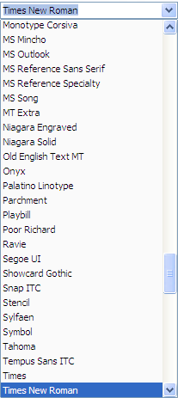
JComboBox
Purpose
To present a set of choices in a small space
Current selection
item displaying
Can be editable
A JComboBox can be either editable or uneditable (default)
Notes:
Options can be established using an array of strings or using the addItem method

Slide 21
JComboBox - Constructors
JComboBox()
Creates a JComboBox with a default data model
JComboBox(Object[] items)
Creates a JComboBox that contains the elements of the specified array
Example:
String[] words= { "quick", "brown", "hungry", "wild", ... };
JComboBox wordChoose = new JComboBox(words);
JComboBox(ComboBoxModel asModel)
Creates a JComboBox that takes its items from an existing ComboBoxModel

Slide 22
JComboBox – Methods
void addItem(Object item)
adds the specified item to the end of the combo box
Object getItemAt(int index)
returns the item at the specified index
int getSelectedIndex()
returns the position of selected item
void setSelectedIndex(int index)
sets the selected index
Object getSelectedItem()
returns the currently selected item
void setSelectedItem(Object item)
sets the selected item

Slide 23
JComboBox – Methods (cont.)
void removeAllItems()
removes all items from the combo box
void removeItem(Object item)
removes an item from the combo box
void removeItemAt(int index)
removes the item at an index
int getItemCount()
returns the number of items in the list
void setEditable(boolean flag)
sets whether this combo box is editable (default by false). Note that editing affects only the current item, it does not change the content of the list

Slide 24
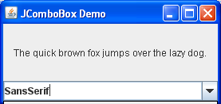
Example
The user can choose a font style from a list of styles (Serif, SansSerif, Monospaced, etc.). The user can also type in another font

Slide 25
Handle event in JComboBox
When the user selects an item from a combo box, the combo box generates an Action event or Item event
implement?
method?
public void actionPerformed(ActionEvent e) {
// sử dụng hàm getSelectedItem()
// hoặc getSelectedIndex()
// để lấy mục đang được chọn trên combo
}
register?
Notes:
public void itemStateChanged(ItemEvent e)
{
// sử dụng hàm getSelectedItem()
// hoặc getSelectedIndex()
// để lấy mục đang được chọn trên combo
}

Slide 26
JComboBoxDemo.java
import java.awt.*;
import java.awt.event.*;
import javax.swing.*;
public class JComboBoxDemo extends JFrame
implements ActionListener {
JComboBox faceCombo;
JLabel label;
public JComboBoxDemo() {
setTitle("JComboBox Demo");
label = new JLabel("The quick brown fox jumps
over the lazy dog.");
label.setFont(new Font("Serif", Font.PLAIN, 12));
add(label, BorderLayout.CENTER);
// make a combo box
faceCombo = new JComboBox();
faceCombo.addItem("Serif");
faceCombo.addItem("SansSerif");
faceCombo.addItem("Monospaced");
faceCombo.addItem("Dialog");
faceCombo.addItem("DialogInput");
faceCombo.addActionListener(this);
add(faceCombo, BorderLayout.SOUTH);
setSize(300, 200);
setVisible(true);
}
public void actionPerformed (ActionEvent e) {
String fontName = (String)faceCombo.getSelectedItem();
label.setFont (new Font(fontName, Font.PLAIN, 12));
}
public static void main(String[] args) {
new JComboBoxDemo();
}
}

Slide 27
Outline
Text Input
Choice Components
Menus
Mnemonics
Toolbars
Tooltips
Tabbed panes
Scroll panes
Dialog Boxes

Slide 28
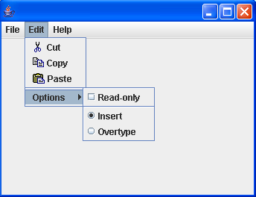
Menus
Menus display several options that are broadly categorized
Menu bar (JMenuBar)
Menu (JMenu)
Menu item (JMenuItem)
Clicking a JMenuItem, it generates an Action event

Slide 29
Components in the menu
JMenu
JMenuBar
JMenuItem
JMenu
JCheckBoxMenuItem
JRadioButtonMenuItem

Slide 30
JMenuBar
JMenuBar is a container for JMenu
Constructor:
JMenuBar()
To set the menu bar for JFrame, using method:
void setJMenuBar(JMenuBar menubar)
To add a JMenu to the menu bar, using add method of JMenuBar
add(JMenu menu)
Notes:
JMenuBar requires two additional classes to supplement its work:
SingleSelectionModel class
Keeps track of the currently selected menu
LookAndFeel class
Responsible for drawing the menu bar and responding to events that occur in it

Slide 31
JMenu - Constructors and Methods
JMenu(String label)
constructs a menu
JMenuItem add(JMenuItem item)
adds a menu item (or a menu)
JMenuItem add(String label)
adds a menu item to this menu
void addSeparator()
adds a separator line to the menu
void remove(int index)
removes a specific item from the menu
void remove(JMenuItem item)
removes a specific item from the menu

Slide 32
JMenuItem – Constructors
JMenuItem()
constructs an empty menu item
JMenuItem(String label)
constructs a menu item with a given label
JMenuItem(Icon icon)
constructs a menu item with the given icon
JMenuItem(String label, Icon icon)
constructs a menu item with the given label and icon
JMenuItem(String label, int mnemonic)
constructs a menu item with the given label and mnemonic

Slide 33
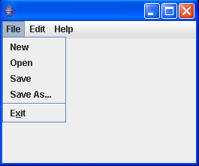
Example: JMenuDemo.java
import java.awt.*;
import javax.swing.*;
public class JMenuDemo extends JFrame {
JMenuBar mnubar;
JMenu mnuFile, mnuEdit, mnuHelp;
JMenuItem mnuFileNew, mnuFileOpen, mnuFileSave, mnuFileSaveAs, mnuFileExit;
JMenuItem mnuEditCut, mnuEditCopy, mnuEditPaste, mnuEditOption;
public JMenuDemo() {
mnubar = new JMenuBar();
setJMenuBar(mnubar);
mnuFile = new JMenu("File"); mnubar.add(mnuFile);
mnuEdit = new JMenu("Edit"); mnubar.add(mnuEdit);
mnuHelp = new JMenu("Help"); mnubar.add(mnuHelp);
// menu File
mnuFileNew = new JMenuItem("New"); mnuFile.add(mnuFileNew);
mnuFileOpen = new JMenuItem("Open"); mnuFile.add(mnuFileOpen);
mnuFileSave = new JMenuItem("Save"); mnuFile.add(mnuFileSave);
mnuFileSaveAs = new JMenuItem("Save As..."); mnuFile.add(mnuFileSaveAs);
mnuFile.addSeparator();
mnuFileExit = new JMenuItem("Exit", 'x'); mnuFile.add(mnuFileExit);

Slide 34
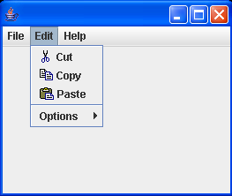
Example (cont.)
//menu Edit
mnuEditCut = new JMenuItem("Cut", new ImageIcon("cut.gif"));
mnuEditCopy = new JMenuItem("Copy", new ImageIcon("copy.gif"));
mnuEditPaste = new JMenuItem("Paste", new ImageIcon("paste.gif"));
mnuEditOption = new JMenu("Options");
mnuEdit.add(mnuEditCut);
mnuEdit.add(mnuEditCopy);
mnuEdit.add(mnuEditPaste);
mnuEdit.addSeparator();
mnuEdit.add(mnuEditOption);
//…
setLocation(200, 200);
setSize(500, 400);
setVisible(true);
}
public static void main(String[] args) {
new JMenuDemo();
}
}

Slide 35
Example (cont.)
JCheckBoxMenuItem readonlyItem = new JCheckBoxMenuItem("Read-only");
optionsMenu.add(readonlyItem);
JRadioButtonMenuItem insertItem = new JRadioButtonMenuItem("Insert", true);
JRadioButtonMenuItem overtypeItem = new JRadioButtonMenuItem("Overtype");
optionsMenu.add(insertItem);
optionsMenu.add(overtypeItem);
ButtonGroup group = new ButtonGroup();
group.add(insertItem);
group.add(overtypeItem);

Slide 36
JPopupMenu
A pop-up menu is a menu that is not attached to a menu bar but that floats somewhere
It is also used as a shortcut menu, which is activated by the right click of the mouse
The constructors used to create JPopupMenu are:
JPopupMenu()
creates a JPopupMenu
JPopupMenu(String label)
creates a JPopupMenu with the specified title
To pop up a menu when the user clicks on a component, simply call the setComponentPopupMenu method

Slide 37
JPopupMenu – Methods
JMenuItem add(JMenuItem menuItem)
appends the specified menu item at the end of the menu
JMenuItem add(String s)
creates a new menu item with the specified text and appends it to the end of the menu
void show(Component c, int x, int y)
displays the popup menu at the position (x,y) in the coordinate space of the component “c”
boolean isPopupTrigger()
determines whether the mouse event is considered as the popup trigger for the current platform

Slide 38
Example: JMenuPopupDemo.java
import java.awt.event.*;
import javax.swing.*;
public class JMenuPopupDemo extends JFrame implements ActionListener {
JPopupMenu popup;
JMenuItem mnuEditCut, mnuEditCopy, mnuEditPaste;
public JMenuPopupDemo() {
popup = new JPopupMenu();
mnuEditCut = new JMenuItem("Cut", new ImageIcon("cut.gif"));
mnuEditCopy = new JMenuItem("Copy", new ImageIcon("copy.gif"));
mnuEditPaste = new JMenuItem("Paste", new ImageIcon("paste.gif"));
popup.add(mnuEditCut);
popup.add(mnuEditCopy);
popup.add(mnuEditPaste);
mnuEditCut.addActionListener(this);
mnuEditCopy.addActionListener(this);
mnuEditPaste.addActionListener(this);
JPanel panel = new JPanel();
panel.setComponentPopupMenu(popup);
panel.addMouseListener( new MouseAdapter() {} );
add(panel);

Slide 39
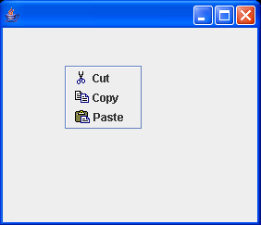
Example (cont.)
setLocation(200, 200);
setSize(500, 400);
setVisible(true);
}
public void actionPerformed(ActionEvent e) {
Object o = e.getSource();
System.out.println(((JMenuItem)o).getText() + " selected.");
}
public static void main(String[] args) {
new JMenuPopupDemo();
}
}

Slide 40
Outline
Text Input
Choice Components
Menus
Mnemonics
Toolbars
Tooltips
Tabbed panes
Scroll panes
Dialog Boxes

Slide 41
Mnemonics
Mnemonics (shortcut keys) provide quick access to menu commands or button commands through the keyboard
Once the mnemonic has been established, the character in the label will appear underlined
You can supply a mnemonic letter by calling the setMnemonic method:
public void setMnemonic(int mnemonic)
Example:
JMenu helpMenu = new JMenu("Help");
helpMenu.setMnemonic('H');
Notes:
Mnemonics can be used with objects of all classes that have subclass javax.swing.AbstractButton

Slide 42
Outline
Text Input
Choice Components
Menus
Mnemonics
Toolbars
Tooltips
Tabbed panes
Scroll panes
Dialog Boxes

Slide 43
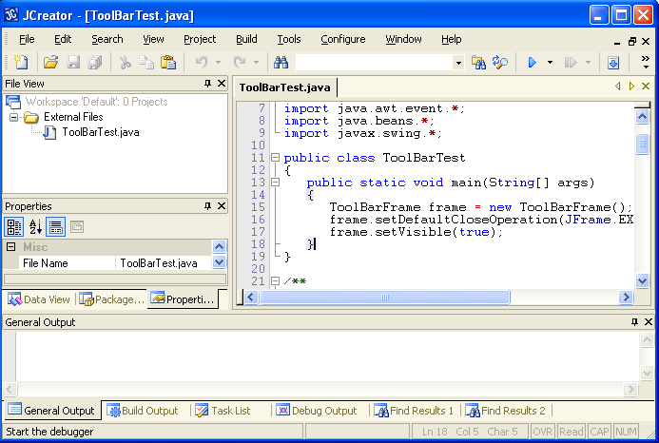
Toolbars
A toolbar is a button bar that gives quick access to the most commonly used commands in a program

Slide 44
Toolbars – Constructors and Methods
JToolBar()
JToolBar(String titleString)
JToolBar(int orientation)
JToolBar(String titleString, int orientation)
construct a toolbar with the given title string and orientation, orientation is one of SwingConstants.HORIZONTAL (the default) and SwingConstants.VERTICAL
void add(Component comp)
add a component to toolbar
void addSeparator()
adds a separator to the end of the toolbar

Slide 45
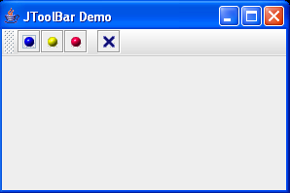
Example: JToolbarDemo.java
import java.awt.*;
import java.awt.event.*;
import javax.swing.*;
public class JToolbarDemo extends JFrame implements ActionListener {
private JPanel panel;
private JButton btnBlue, btnYell, btnRed, btnExit;
JToolBar bar;
public JToolbarDemo() {
super("JToolBar Demo");
btnBlue = new JButton(new ImageIcon("blue-ball.gif")); btnBlue.addActionListener(this);
btnYell = new JButton(new ImageIcon("yellow-ball.gif")); btnYell.addActionListener(this);
btnRed = new JButton(new ImageIcon("red-ball.gif")); btnRed.addActionListener(this);
btnExit = new JButton(new ImageIcon("exit.gif")); btnExit.addActionListener(this);
bar = new JToolBar();
bar.add(btnBlue);
bar.add(btnYell);
bar.add(btnRed);
bar.addSeparator();
bar.add(btnExit);
add(bar, BorderLayout.NORTH);

Slide 46
Example (cont.)
panel = new JPanel();
add(panel);
setSize(300, 200);
setVisible(true);
}
public void actionPerformed(ActionEvent e) {
Object o = e.getSource();
if (o.equals(btnBlue))
panel.setBackground(Color.BLUE);
if (o.equals(btnYell))
panel.setBackground(Color.YELLOW);
if (o.equals(btnRed))
panel.setBackground(Color.RED);
if (o.equals(btnExit))
System.exit(0);
}
public static void main(String[] args) { new JToolbarDemo(); }
}

Slide 47
Outline
Text Input
Choice Components
Menus
Mnemonics
Toolbars
Tooltips
Tabbed panes
Scroll panes
Dialog Boxes

Slide 48
Tooltips
A tooltip represents a text tip that is displayed when the mouse cursor rests for a moment over a button and when the user moves the mouse away, the tooltip is removed
The tooltip text is displayed inside a colored rectangle
Add tooltip by calling the setToolTipText method
void setToolTipText(String text)
Example:
exitButton.setToolTipText("Bấm vào đây để thoát chương trình");

Slide 49
Outline
Text Input
Choice Components
Menus
Mnemonics
Toolbars
Tooltips
Tabbed panes
Scroll panes
Dialog Boxes

Slide 50
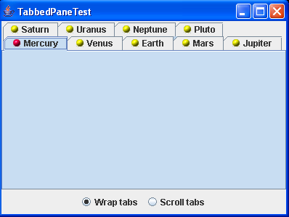
Tabbed panes

Slide 51
Tabbed panes
Purpose
Break up a complex dialog box into subsets of related options
A tabbed pane is defined by the JTabbedPane class
To create a tabbed pane, you first construct a JTabbedPane object, then you add tabs to it
Example:
JTabbedPane tabbedPane = new JTabbedPane();
tabbedPane.addTab(“ScreenSaver”, new ImageIcon(“Ss.gif”), panel1);
Notes:
Component add (String title, Component comp)
Adds the specified component to a tab with the specified title.

Slide 52
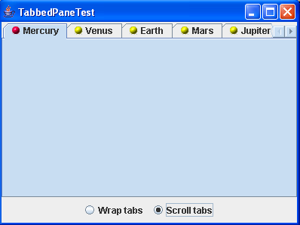
JTabbedPane
You set the tab layout to wrapped or scrolling mode by calling setTabLayoutPolicy method:
tabbedPane.setTabLayoutPolicy(JTabbedPane.WRAP_TAB_LAYOUT); or
tabbedPane.setTabLayoutPolicy(JTabbedPane.SCROLL_TAB_LAYOUT);
Notes:
When you add a new tab to the tab collection, it is not automatically displayed. You must select it with the setSelectedIndex method

Slide 53
Methods
void addTab(String title, Component c)
void addTab(String title, Icon icon, Component c)
void addTab(String title, Icon icon, Component c, String tooltip)
add a tab to the end of the tabbed pane
void insertTab(String title, Icon icon, Component c, String tooltip, int index)
inserts a tab to the tabbed pane at the given index
void removeTabAt(int index)
removes the tab at the given index
void setSelectedIndex(int index)
selects the tab at the given index
int getSelectedIndex()
returns the index of the selected tab

Slide 54
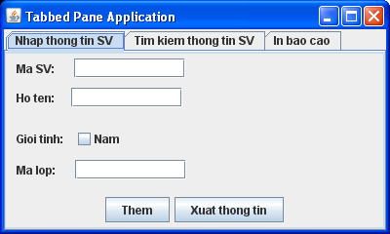
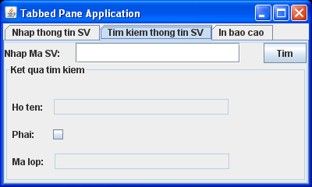
Example: JTabbedPaneExample.java

Slide 55
Outline
Text Input
Choice Components
Menus
Mnemonics
Toolbars
Tooltips
Tabbed panes
Scroll panes
Dialog Boxes

Slide 56
JScrollPane
Why do we use JScrollPane?
Components do not automatically provide a scrollbar
Such as: JTextArea, JList, JTable,…
A JScrollPane object is used to provide the automatic scrolling capability for components
JScrollPane automatically appears if there is much data than the component can display, and they vanish again if text is deleted
Notes:
.

Slide 57
JScrollPane - Contructors
JScrollPane(Component comp)
Creates a JScrollPane that displays the contents of the specified component, where both horizontal and vertical scrollbars appear whenever the component's contents are larger than the view
JScrollPane(Component comp, int vsbPolicy, int hsbPolicy)
Creates a JScrollPane that displays the view component in a viewport whose view position can be controlled with a pair of scrollbars
JScrollPane.VERTICAL_SCROLLBAR_ALWAYS
JScrollPane.HORIZONTAL_SCROLLBAR_ALWAYS
JScrollPane.VERTICAL_SCROLLBAR_AS_NEEDED
JScrollPane.HORIZONTAL_SCROLLBAR_AS_NEEDED

Slide 58
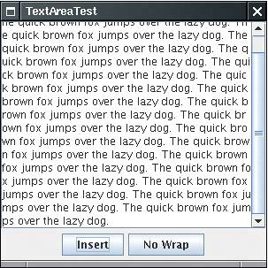
Example: TextAreaTest.java
textArea = new JTextArea(8, 40);
scrollPane = new JScrollPane(textArea);
add(scrollPane, BorderLayout.CENTER);

Slide 59
Outline
Text Input
Choice Components
Menus
Mnemonics
Toolbars
Tooltips
Tabbed panes
Scroll pane
Dialog Boxes

Slide 60
Dialog Boxes
A dialog box is a window that appears on top of any currently active window
It may be used to:
Show message / confirm an action / enter data
Display information
Choose a file
Pick a color
Dialog box in Swing
JOptionPane
JDialog
JFileChooser
JColorChooser

Slide 61
JOptionPane
Purpose: presenting information, confirming an action, or accepting an input value
Four static methods to show these simple dialogs:
showMessageDialog(…)
Show a message and wait for the user to click OK
showConfirmDialog(…)
Show a message and get a confirmation (like OK/Cancel)
showOptionDialog(…)
Show a message and get a user option from a set of options
showInputDialog(…)
Show a message and get one line of user input
The message string can contain newline ('\n') characters

Slide 62
JOptionPane - Parameters
Component parent
The parent component (this or null)
Object message
The message to show on the dialog (can be a string, icon, component, or an array of them)
String title
the string in the title bar of the dialog
int messageType: a property of JOptionPane class
Can be one of ERROR_MESSAGE, INFORMATION_MESSAGE, WARNING_MESSAGE, QUESTION_MESSAGE, PLAIN_MESSAGE
int optionType: a property of JOptionPane class
Can be one of DEFAULT_OPTION, YES_NO_OPTION, YES_NO_CANCEL_OPTION, OK_CANCEL_OPTION
Icon icon
an icon to show instead of one of the standard icons

Slide 63
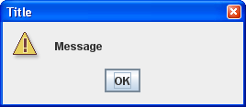
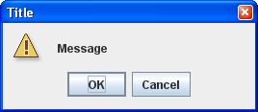
JOptionPane – Message and Confirm
JOptionPane.showMessageDialog(this, "Message", "Title",
JOptionPane.WARNING_MESSAGE);
int selection = JOptionPane.showConfirmDialog(this, "Message", "Title",
JOptionPane.OK_CANCEL_OPTION,
JOptionPane.WARNING_MESSAGE);
if (selection == JOptionPane.OK_OPTION) . . .

Slide 64
Example: JOptionPaneDemo.java
import javax.swing.*;
public class JOptionPaneDemo {
public static void main (String[] args) {
String numStr, result;
int num, again;
do {
numStr = JOptionPane.showInputDialog ("Enter an integer: ");
num = Integer.parseInt(numStr);
result = "That number is " + ((num%2 == 0) ? "even" : "odd");
JOptionPane.showMessageDialog (null, result);
again = JOptionPane.showConfirmDialog (null, "Do Another?");
} while (again == JOptionPane.YES_OPTION);
}
}

Slide 65
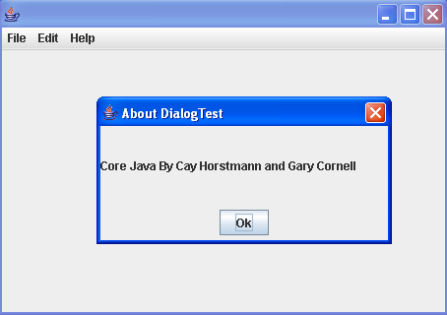
JDialog
To implement a dialog box, you derive a class from JDialog
A modal dialog box won't let users interact with the remaining windows of the application until it is closed
You use a modal dialog box when you need information from the user before you can proceed with execution

Slide 66
Example: JDialogDemo.java
public class AboutDialog extends JDialog implements ActionListener {
JPanel panel;
JButton ok;
JLabel infor;
public AboutDialog(JFrame owner) {
super(owner, "About DialogTest", true);
infor = new JLabel("Core Java By Cay Horstmann and Gary Cornell");
add(infor, BorderLayout.CENTER);
ok = new JButton("Ok");
ok.addActionListener(this);
panel = new JPanel();
panel.add(ok);
add(panel, BorderLayout.SOUTH);
setSize(300, 150);
setLocation(300,300);
}
public void actionPerformed(ActionEvent e) { setVisible(false); }
}
AboutDialog dialog;
public void actionPerformed(ActionEvent e)
{
if (dialog == null)
dialog = new AboutDialog(this);
dialog.setVisible(true);
}

Slide 67
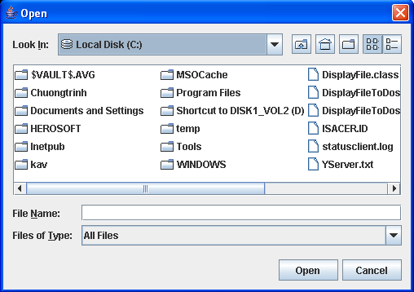
JFileChooser
Purpose
display a dialog for opening a file or saving a file

Slide 68
JFileChooser
To create a JFileChooser object:
JFileChooser chooser = new JFileChooser();
To show the dialog box, calling the showOpenDialog or showSaveDialog method
return JFileChooser.APPROVE_OPTION: if approval (Yes, Ok) is chosen
return JFileChooser.CANCEL_OPTION: if Cancel is chosen
return JFileChooser.ERROR_OPTION: if an error occured
To get the selected file or files:
File f = chooser.getSelectedFile();
File[] f = chooser.getSelectedFiles();
To get path of the selected file:
String filename = chooser.getSelectedFile().getPath();

Slide 69
JFileChooser
To set the current directory:
setCurrentDirectory(new File("."));
To allow to select multiple files in the dialog
setMultiSelectionEnabled(true);
To allow to select only directories, only files or files and directories:
setFileSelectionMode(JFileChooser.FILES_ONLY) (default)
setFileSelectionMode(JFileChooser.DIRECTORIES_ONLY)
setFileSelectionMode(JFileChooser.FILES_AND_DIRECTORIES)
To restrict the display of files in the dialog to those of a particular type, you need to set a file filter
See JFileChooserDemo.java, DisplayFileToTextArea.java

Slide 70
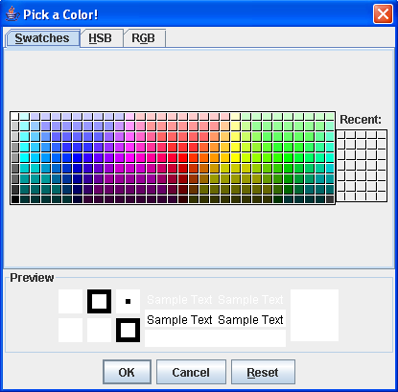
JColorChooser
Purpose
To allow the user to select a color
A dialog box that lets the user click on a color of choice from a palette or specify the color using RGB values

Slide 71
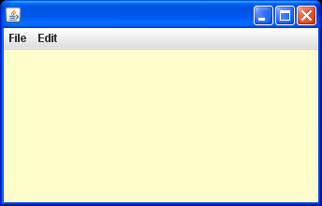
Example: JColorChooserDemo.java
import java.awt.*;
import java.awt.event.*;
import javax.swing.*;
public class JColorChooserDemo extends JFrame
implements ActionListener {
JMenuBar mnubar;
JMenu mnuFile, mnuEdit;
JMenuItem mnuFileExit;
JMenuItem mnuEditColor;
JPanel panel;
public JColorChooserDemo() {
mnubar = new JMenuBar();
mnuFile = new JMenu("File"); mnubar.add(mnuFile);
mnuEdit = new JMenu("Edit"); mnubar.add(mnuEdit);
// menu File
mnuFileExit = new JMenuItem("Exit");
mnuFile.add(mnuFileExit);
// menu Edit
mnuEditColor = new JMenuItem("Color");
mnuEditColor.addActionListener(this);
mnuEdit.add(mnuEditColor);
setJMenuBar(mnubar);
panel = new JPanel();
add (panel);
setLocation(200,100);
setSize(500, 500);
setVisible(true);
}
public void actionPerformed(ActionEvent e) {
Color mau= panel.getBackground();
mau = JColorChooser.showDialog (this,
"Pick a Color!", mau);
panel.setBackground (mau);
}
public static void main(String[] args) {
new JColorChooserDemo();
}
}

Slide 72
JPopupMenu – Example
import javax.swing.*;
import java.awt.*;
import java.awt.event.*;
import javax.swing.event.*;
class PopupMenutest extends JPanel
{
static JFrame frame1;
JLabel l1;
JPopupMenu popupMenu;
public PopupMenutest()
{
l1 = new JLabel("Click the right mouse button");
popupMenu = new JPopupMenu();
JMenuItem menu1 = new JMenuItem("Orange");
JMenuItem menu2 = new JMenuItem("Pineapple");
JMenuItem menu3 = new JMenuItem("Mango");
menu1.addActionListener(new ActionListener()
{
public void actionPerformed(ActionEvent e)
{
l1.setText("Orange");
}
});

Slide 73
JPopupMenu – Example Contd…
menu2.addActionListener(new ActionListener()
{
public void actionPerformed(ActionEvent e)
{
l1.setText("Pineapple");
}
});
menu3.addActionListener(new ActionListener()
{
public void actionPerformed(ActionEvent e)
{
l1.setText("Mango");
}});
popupMenu.add(menu1);
popupMenu.add(menu2);
popupMenu.add(menu3);
addMouseListener(new MouseAdapter()
{
public void mouseReleased(MouseEvent e)
{
if (e.isPopupTrigger())
{
popupMenu.show(e.getComponent(), e.getX(), e.getY());
}
}});
add(l1);
}

Slide 74
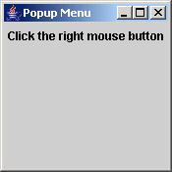
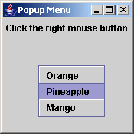
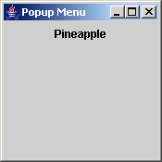
JPopupMenu – Example Contd…
public static void main(String args[])
{
frame1 = new JFrame("Popup Menu");
PopupMenutest p1 = new PopupMenutest( );
frame1.getContentPane().add("Center",p1);
frame1.getContentPane().setBackground(Color.gray);
frame1.setSize(175,175);
frame1.addWindowListener(new WindowAdapter()
{
public void windowClosing(WindowEvent e)
{
System.exit(0);
}
});
frame1.setVisible(true);
}
}
Output

Slide 75
PopupMenu-Example
import javax.swing.*;
import java.awt.*;
import java.awt.event.*;
import javax.swing.event.*;
class CheckMenutest extends JFrame
{
JButton b1, b2;
JPopupMenu popupMenu;
public CheckMenutest()
{
super("CheckBox Menu Items");
JPanel p = (JPanel)getContentPane( );
p.setLayout(new BoxLayout( p,BoxLayout.Y_AXIS));
b1 = new JButton("Click here");
b2 = new JButton("Exit");
p.add(b1);
p.add(b2);
popupMenu = new JPopupMenu();
JMenuItem menu1 = new JMenuItem("JMenuItem");
popupMenu.add(menu1);
JCheckBoxMenuItem jcb1 = new JCheckBoxMenuItem("JCheckBoxMenuItem1");
JCheckBoxMenuItem jcb2 = new JCheckBoxMenuItem("JCheckBoxMenuItem2");
JCheckBoxMenuItem jcb3 = new JCheckBoxMenuItem("JCheckBoxMenuItem3");
popupMenu.add(jcb1);
popupMenu.add(jcb2);
popupMenu.add(jcb3);
popupMenu.addSeparator( );
JRadioButtonMenuItem jrb1 = new JRadioButtonMenuItem("JRadioButtonMenuItem1");
JRadioButtonMenuItem jrb2 = new JRadioButtonMenuItem("JRadioButtonMenuItem2");
jrb1.setSelected(true);
ButtonGroup bg = new ButtonGroup( );
bg.add(jrb1);
bg.add(jrb2);
popupMenu.add(jrb1);
popupMenu.add(jrb2);
b1.addMouseListener(new myListener( ));
}
class myListener extends MouseAdapter
{
public void mouseReleased(MouseEvent e)
{
popupMenu.show((JComponent)e.getSource(), e.getX(), e.getY());
}
}

Slide 76
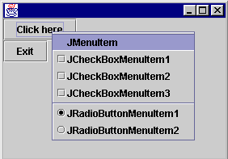
PopupMenu – Example Contd…
public static void main(String args[])
{
CheckMenutest p1 = new CheckMenutest();
p1.setForeground(Color.black);
p1.setBackground(Color.lightGray);
p1.setSize(300,200);
p1.addWindowListener(new WindowAdapter()
{
public void windowClosing(WindowEvent e)
{
System.exit(0);
}
});
p1.setVisible(true);
}
}
Output

