Slide 1
Chapter 8
Advanced Swing & MVC
Originals of Slides and Source Code for Examples:
http://courses.coreservlets.com/Course-Materials/java5.html

Slide 2
MVC Architecture
Custom data models
Changing the way the GUI control obtains the data. Instead of copying data from an existing object into a GUI control, simply tell the GUI control how to get at the existing data
Custom cell renderers
Changing the way the GUI control displays data values. Instead of changing the data values, simply tell the GUI control how to build a Swing component that represents each data value
Main applicable components
JList
JTable
JTree
2
Notes:
Ví dụ: Custom data model
RectangleCollection collection = new RectangleCollection();
Random gen = new Random();
for (int i = 0; i < 6; i++) {
collection.addRectangle(gen.nextInt(20), gen.nextInt(20));
}
lstModel = new RectangleListModel(collection);
lstRect = new JList(lstModel);
lstRect.setVisibleRowCount(6);
JScrollPane listPane = new JScrollPane(lstRect);
add(listPane, BorderLayout.CENTER);
collection.addRectangle(gen.nextInt(20), gen.nextInt(20));

Slide 3
Outline
JList
JTable
JTree
JSplitPane
JSlider
Key Events
Mouse Events

Slide 4
JList Outline
JList overview
Building a JList with fixed set of choices
Adding and removing entries from a JList at runtime
Making a custom data model
Telling JList how to extract data from existing objects
Making a custom cell renderer
Telling JList what GUI component to use for each of the data cells
4

Slide 5
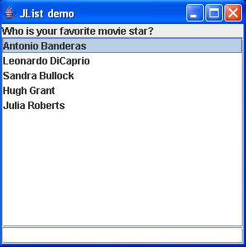
JList
Purpose
To present a set of choices to a user
Behavior
Items in JList can be selected individually or in a group
A JList does not provide support for double-click action
5
Notes:
Combo boxes were covered in Volume 1 because they are relatively simple. The JList component has many more features, and its design is similar to that of the tree and table components. For that reason, it is our starting point for the discussion of complex Swing components.

Slide 6
JList – Constructors
JList()
Constructs a JList with an empty model
JList(Object[] listData)
Displays the elements of the specified array
Example:
String[] words= { "quick", "brown", "hungry", "wild", ... };
JList wordList = new JList(words);
JList (ListModel dataModel)
displays the elements in the specified, non-null list model
6

Slide 7
JList – Methods
int getSelectedIndex()
void setSelectedIndex(int index)
gets or sets the selected index
int[] getSelectedIndices()
void setSelectedIndices(int[] index)
gets or sets the array of selected indices
Object getSelectedValue()
returns the first selected value or null if the selection is empty
Object[] getSelectedValues()
returns the selected values or an empty array if the selection is empty
boolean isSelectedIndex(int index)
returns true if the specified index is selected
7

Slide 8
JList – Methods (cont.)
boolean isSelectionEmpty()
returns true if no item is currently selected
int getVisibleRowCount()
void setVisibleRowCount(int height)
get or set the number of rows in the list that can be displayed without a scroll bar
int getSelectionMode()
void setSelectionMode(int mode)
sets the selection mode for the list using ListSelectionModel constants (ListSelectionModel.SINGLE_SELECTION, ListSelectionModel.SINGLE_INTERVAL_SELECTION-contiguous items, ListSelectionModel.MULTIPLE_INTERVAL_SELECTION), by default, a user can select multiple items
8
Notes:
A JList object can be set so that multiple items can be selected at the same time
The list selection mode can be one of three options:
single selection – only one item can be selected at a time
single interval selection – multiple, contiguous items can be selected at a time
multiple interval selection – any combination of items can be selected
The list selection mode is defined by a ListSelectionModel object

Slide 9
Handle event of JList
When the current selection changes, JList object generates a ListSelection event
implement ListSelectionListener (in package: javax.swing.event)
Method: public void valueChanged (ListSelectionEvent e)
Register
public void valueChanged (ListSelectionEvent e) {
Object value = list.getSelectedValue();
//do something with value
}
public void valueChanged (ListSelectionEvent e) {
Object[] items = list.getSelectedValues();
for (Object value : items)
//do something with value
}
9

Slide 10
JList with fixed set of choices
Build JList:
The simplest way to use a JList is to supply an array of strings to the JList constructor. Cannot add or remove elements once the JList is created
String options = { "Option 1", ... , "Option N"};
JList optionList = new JList(options);
Set visible rows
Call setVisibleRowCount and drop JList into JScrollPane
optionList.setVisibleRowCount(4);
JScrollPane scrolList = new JScrollPane(optionList);
someContainer.add(scrolList);
10

Slide 11
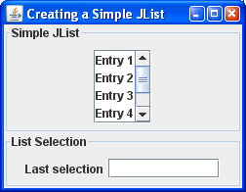
Example: JListSimpleDemo.java
String[] entries = { "Entry 1", "Entry 2", "Entry 3",
"Entry 4", "Entry 5", "Entry 6" };
JList lstEntry;
lstEntry = new JList(entries);
lstEntry.setVisibleRowCount(4);
JScrollPane listPane = new JScrollPane(lstEntry);
JPanel pCen = new JPanel();
pCen.setBorder(BorderFactory.createTitledBorder("Simple JList"));
pCen.add(listPane);
add(pCen, BorderLayout.CENTER);
11

Slide 12
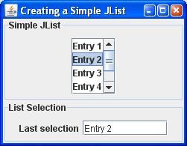
Example: JListSimpleDemo.java (cont.)
public void valueChanged(ListSelectionEvent e)
{
if (!e.getValueIsAdjusting()) {
Object value = lstEntry.getSelectedValue();
if (value != null) {
txtSelected.setText(value.toString());
}
}
}
12

Slide 13
Editing JList
In the JList class, no methods to add or remove items, so you cannot directly edit the collection of list values
To add or remove elements, you must access the ListModel
ListModel is an interface. How do you obtain it?
Constructing your own list by creating a class that implements the ListModel interface
Using a DefaultListModel class (in package javax.swing)
13
Notes:
The list component uses the model-view-controller design pattern to separate the visual appearance
The ListModel interface has no methods to insert or remove elements because, after all, the whole point of having a list model is that it need not store the elements.

Slide 14
JList with Changeable Choices
Build JList:
Create a DefaultListModel, add data, pass to constructor:
DefaultListModel sampleModel = new DefaultListModel();
JList optionList = new JList(sampleModel);
Set visible rows
Same: Use setVisibleRowCount and a JScrollPane
Add/remove elements
Use the model, not the JList directly
14

Slide 15
Methods in DefaultListModel
void addElement(Object obj)
adds object to the end of the model
boolean removeElement(Object obj)
removes the first occurrence of the object from the model. Return true if the object was contained in the model, false otherwise
int getSize()
returns the number of elements of the model
Object getElementAt(int position)
returns an element of the model at the given position
void setElementAt(Object item, int index)
sets item at index
15

Slide 16
Traverse DefaultListModel
To traverse all elements of the model, using:
Enumeration e = listmodel.elements();
while (e.hasMoreElements())
{
Object o = e.nextElement();
// process o
}
Package: java.util
16

Slide 17
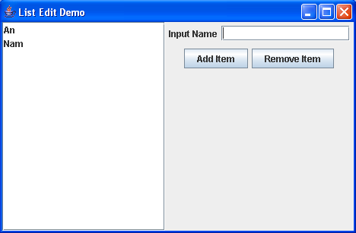
Example: JListEditDemo.java
import java.awt.*;
import java.awt.event.*;
import javax.swing.*;
import javax.swing.event.*;
public class ListEditDemo extends JFrame implements ActionListener {
JButton btnAdd, btnRemove;
JTextField txtName;
DefaultListModel listmodelName;
JList listName;
public ListEditDemo() {
super("List Edit Demo");
// list
listmodelName = new DefaultListModel();
listName = new JList(listmodelName);
add(new JScrollPane(listName), BorderLayout.CENTER);
17

Slide 18
Example: JListEditDemo.java (cont.)
JPanel pRight;
JPanel pTop, pBottom;
pTop = new JPanel();
pTop.add(new JLabel("Input Name"));
pTop.add(txtName = new JTextField(15));
pBottom = new JPanel();
pBottom.add(btnAdd = new JButton("Add Item"));
pBottom.add(btnRemove = new JButton("Remove Item"));
pRight = new JPanel(new BorderLayout());
pRight.add(pTop, BorderLayout.NORTH );
pRight.add(pBottom, BorderLayout.CENTER);
add(pRight, BorderLayout.EAST);
txtName.addActionListener(this);
btnAdd.addActionListener(this);
btnRemove.addActionListener(this);
setSize(500, 320);
setVisible(true);
}
18

Slide 19
Example: JListEditDemo.java (cont.)
public void actionPerformed(ActionEvent e) {
Object o = e.getSource();
if ( o==btnAdd ) {
String name = txtName.getText().trim();
if ( name == "" )
JOptionPane.showMessageDialog(this, "Please input name!");
else {
listmodelName.addElement(name);
txtName.setText( "" );
}
}
else if (o.equals (btnRemove))
listmodelName.removeElement(listName.getSelectedValue());
else if (o.equals (btnEdit))
listmodelName.setElementAt( txtName.getText(),
listName.getSelectedIndex() );
}
public static void main(String[] args){ new ListEditDemo(); }}
19

Slide 20
JList with Custom Data Model
Build JList
Have existing data implement ListModel interface
getElementAt
Given an index, returns data element
getSize
Tells JList how many entries are in list
addListDataListener
Lets user add listeners that should be notified when an item is selected or deselected
removeListDataListener
Pass model to JList constructor
Set visible rows & handle events: as before
Add/remove items: use the model
20
Notes:
Có thể dùng cách đơn giản hơn là: add(Object)

Slide 21
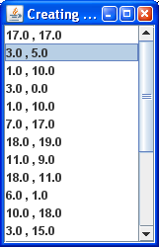
Example: JList with custom data
Rectangle.java
RectangleCollection.java
RectangleListModel.java
JListRectangleGUI.java
21

Slide 22
Example: JList with custom data (cont.)
// Rectangle.java
public class Rectangle {
public String toString(){ return width + " , " + height; } …
}
// RectangleListModel.java
public class RectangleListModel implements ListModel {
private RectangleCollection collection;
public RectangleListModel(RectangleCollection collection) {
this.collection = collection;
}
public Object getElementAt(int index) {
return collection.getElement(index);
}
public int getSize() {
return collection.getSize();
}
public void addListDataListener(ListDataListener l) { }
public void removeListDataListener(ListDataListener l) { }
}
22

Slide 23
Example: JList with custom data (cont.)
// JListRectangleGUI.java
RectangleCollection collection = new RectangleCollection();
Random gen = new Random();
for (int i = 0; i < 20; i++) {
collection.addRectangle(gen.nextInt(20), gen.nextInt(20));
}
JList lstRect;
RectangleListModel lstModel;
lstModel = new RectangleListModel(collection);
lstRect = new JList(lstModel);
lstRect.setVisibleRowCount(6);
JScrollPane listPane = new JScrollPane(lstRect);
add(listPane, BorderLayout.CENTER);
23

Slide 24
JList with Custom Cell Renderer
Idea
Instead of predetermining how the JList will draw the list elements, Swing lets you specify what graphical component to use for the various entries.
Attach a ListCellRenderer that has a getListCellRendererComponent method that determines the GUI component used for each cell
getListCellRendererComponent arguments
JList: the list itself
Object: the value of the current cell
int: the index of the current cell
boolean: is the current cell selected?
boolean: does the current cell have focus?
24

Slide 25
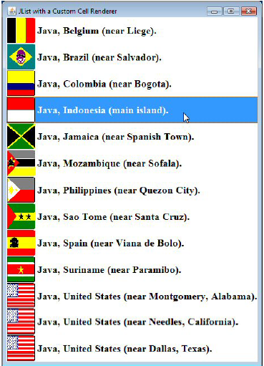
Example: JList with Custom Cell Renderer
25
Notes:
public class JavaLocationRenderer extends
DefaultListCellRenderer {
private Map<Object,ImageIcon> iconTable =
new HashMap<Object,ImageIcon>();
public Component getListCellRendererComponent
(JList list, Object value, int index,
boolean isSelected, boolean hasFocus) {
JLabel label = (JLabel)super.getListCellRendererComponent
(list,value,index,isSelected,hasFocus);
if (value instanceof JavaLocation) {
JavaLocation location = (JavaLocation)value;
ImageIcon icon = iconTable.get(value);
if (icon == null) {
icon = new ImageIcon(location.getFlagFile());
iconTable.put(value, icon);
}
label.setIcon(icon);
...
return(label);
20 }}

Slide 26
Outline
JList
JTable
JTree
JSplitPane
JSlider
Key Events
Mouse Events

Slide 27
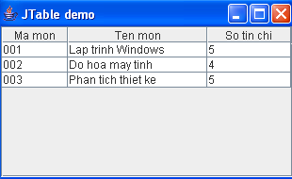
JTable
A table displays a two-dimensional grid of objects
27
Notes:
Volumes of data are better maintained in a tabular format than as a list

Slide 28
Constructors - Methods of JTable
JTable(Object[][] entries, Object[] columnNames)
constructs a table with a default table model
JTable(TableModel model)
displays the elements in the specified, non-null table model
int getSelectedRow()
returns the index of the first selected row, -1 if no row is selected
Object getValueAt(int row, int column)
void setValueAt(Object value, int row, int column)
gets or sets the value at the given row and column
int getRowCount()
returns the number of row in the table
28

Slide 29
JTable with Fixed Set of Choices
Build JTable:
Supply the column names:
String[] columnNames = { "Ma mon", "Ten mon", "So tin chi"};
Create data in two-dimensional array of Object:
Object[][] cells = {{"001", "Lap trinh Windows", new Integer(5)}, {"002", "Do hoa may tinh", new Integer(4)}, {"003", "Phan tich thiet ke", new Integer(5)}, …};
Construct a table from the cell and column name arrays:
JTable table = new JTable(cells, columnNames);
Finally, add scroll bars in the usual way, by wrapping the table in a JScrollPane:
JScrollPane pane = new JScrollPane(table);
29

Slide 30
Example: JTableDemo.java
import javax.swing.*;
import java.awt.*;
import java.awt.event.*;
class JTableDemo extends JFrame {
public JTableDemo() {
super(“JTable demo”);
String[] colnames = {“Ma mon",“Ten mon",“So tin chi"};
Object[ ][ ] cells = {
{"001", "Lap trinh Windows", new Integer(5)},
{"002", "Do hoa may tinh", new Integer(4)},
{"003", "Phan tich thiet ke", new Integer(5)}
};
JTable table = new JTable(cells, colnames);
add(new JScrollPane(table));
setSize(200,200);
setVisible(true);
}
public static void main(String args[]) {
new JTableDemo();
}
}
30

Slide 31
Editing table
In the JTable class, no methods to add or remove rows, so you cannot directly edit the collection of table values
JTable does not store data, it only provides a view of it, so you obtain its data through a TableModel
TableModel is an interface. How do you obtain a TableModel?
constructing your own table by creating a class that implements the TableModel interface
You can use a DefaultTableModel (javax.swing.table)
DefaultTableModel tblmodel = new DefaultTableModel();
JTable tbl = new JTable(tblmodel);
31

Slide 32
JTable with Changeable Choices
Build JTable:
Create a columns name array, create a DefaultTableModel, pass to constructor
String[] cols= {"Ma mon", "Ten mon", "So tin chi"};
DefaultTableModel model=new DefaultTableModel(cols,0);
JTable table = new JTable(model);
JScrollPane pane = new JScrollPane(table);
Add/remove elements
Use the model, not the JTable directly
32

Slide 33
Methods in DefaultTableModel
void addRow(Object[] rowData)
add a row of data to the end of the table model
void insertRow(int row, Object[] rowData)
adds a row of data at index row
void removeRow(int row)
removes the given row from the model
33
Notes:
Delete all rows in table:
while (model.getRowCount()>0){ model.remove(0); }
Or:
DefaultTableModel dm = (DefaultTableModel)table.getModel(); dm.getDataVector().removeAllElements();

Slide 34
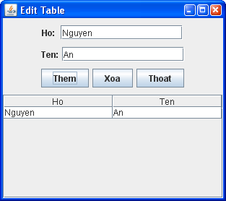
Example: JTableEditDemo.java
public void actionPerformed(ActionEvent e) {
Object o = e.getSource();
if (o.equals(btnAdd)) {
if( txtHo.getText().equals("") || txtTen.getText().equals(""))
JOptionPane.showMessageDialog(this, "Phai nhap du lieu truoc.");
else {
Object[] obj = new Object[2];
obj[0] = txtHo.getText();
obj[1] = txtTen.getText();
model.addRow(obj);
} }
else if (o.equals(btnRemove)) {
if (table.getSelectedRow() == -1)
JOptionPane.showMessageDialog(this, "Phai chon dong can xoa.");
else{
if (JOptionPane.showConfirmDialog(this,"Ban co muon xoa dong nay khong?","Canh bao",JOptionPane.YES_NO_OPTION)==JOptionPane.YES_OPTION model.removeRow(table.getSelectedRow());
}
}
34

Slide 35
Example: JTableEditDemo.java
else if (o.equals(btnEdit)) {
if (table.getSelectedRow() == -1)
JOptionPane.showMessageDialog(this,
"Phai chon dong can sua.");
else {
// lay dong dang chon tren table
int row = table.getSelectedRow();
model.setValueAt( txtHo.getText(), row, 0 );
model.setValueAt( txtTen.getText(), row, 1 );
}
}
35

Slide 36
Event of JTable
We use MouseEvent to process event of choosing rows on JTable
implement MouseListener (in java.awt.event)
method ?
register ?
public void mouseClicked (MouseEvent e) {}
public void mousePressed (MouseEvent e) {}
public void mouseReleased (MouseEvent e) {}
public void mouseEntered (MouseEvent e) {}
public void mouseExited (MouseEvent e) {}
36

Slide 37
Example: JTableEditDemo.java
public void mouseClicked(MouseEvent e)
{
// lay dong dang chon tren table
int row = table.getSelectedRow();
txtHo.setText(table.getValueAt(row, 0).toString());
txtTen.setText(table.getValueAt(row, 1).toString());
}
public void mousePressed(MouseEvent e) {}
public void mouseReleased(MouseEvent e) {}
public void mouseEntered(MouseEvent e) {}
public void mouseExited(MouseEvent e) {}

Slide 38
JTable with Custom Data Model
Build custom JTable
Create a class has Vector field, this class extends AbstractTableModel
public int getColumnCount()
public int getRowCount()
public void setValueAt(Object value, int row, int col)
public Object getValueAt(int row, int col)
public String getColumnName(int col)
public Class getColumnClass(int c)
Pass model to JTable constructor
Add/remove items: use the model
Handle events: as before
38
Notes:
Có thể dùng cách đơn giản hơn là: add(Object)

Slide 39
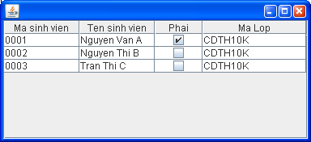
Example: JTable with custom data
Student.java
StudentTableModel.java
JTableWithStudentTableModelGUI.java
39

Slide 40
Outline
JList
JTable
JTree
JSplitPane
JSlider
Key Events
Mouse Events

Slide 41
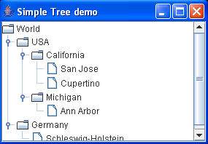
JTree
JTree is used to display hierarchical data
A JTree is composed of TreeNode
Root node
Parent node
Child node
Leaf node
41
Notes:
By default, the tree displays the root node.
A node having child nodes is called a branch node else it is called as a.
A specific node in a tree can be identified either by a TreePath, an object that encapsulates a node and all of its ancestors

Slide 42
Contructors of JTree
JTree (TreeNode root)
construct a tree with a default tree model that displays the root
JTree (TreeModel model)
constructs a tree from a tree model
TreeNode is an interface. How do you obtain it?
Using the DefaultMutableTreeNode class (in package javax.swing.tree)
Constructing your own treenode by creating a class that implements the TreeNode interface
42
Notes:
Có khoảng 7 hàm khởi tạo JTree
You populate the default tree model with objects of any class that implements the interface. We can use the concrete node class, namely, DefaultMutableTreeNode. This class implements the MutableTreeNode interface, a subinterface of TreeNode

Slide 43


Methods of JTree
void setEditable(boolean b)
If b is true, then a node on JTree can be edited
void setRootVisible(boolean b)
If b is true, then the root node is displayed
void makeVisible(TreePath path)
Expands all nodes along the path
void scrollPathToVisible(TreePath path)
Expands all nodes along the path and, if the tree is contained in a scroll pane, scrolls to ensure that the last node on the path is visible
Object getLastSelectedPathComponent()
Gets the node object that represents the currently selected node, or the first node if multiple nodes are selected. Returns null if no node is selected
43
Notes:
setRootVisible: áp dụng cho trường hợp cây chưa có nút gốc

Slide 44
Event of JTree
When the user selects tree nodes, a tree produces a TreeSelectionEvent
implement TreeSelectionListener (javax.swing.event)
method
public void valueChanged(TreeSelectionEvent event)
→ That method is called whenever the user selects or deselects tree nodes
register
44
Notes:
DefaultMutableTreeNode selectedNode = (DefaultMutableTreeNode) tree.getLastSelectedPathComponent();
if (selectedNode == null) return;

Slide 45
JTree with Fixed Set of Nodes
Build JTree
Create a root node and child nodes:
DefaultMutableTreeNode root=new DefaultMutableTreeNode("World");
DefaultMutableTreeNode country;
country = new DefaultMutableTreeNode("USA");
root.add(country);
country = new DefaultMutableTreeNode("Germany");
root.add(country);
Pass root node in JTree’s constructor:
JTree tree = new JTree(root);
Add JTree to scrollpane:
JScrollPane scrollTree = new JScrollPane(tree);
45

Slide 46
JTreeSimpleDemo.java
import java.awt.*;
import javax.swing.*;
import javax.swing.tree.*;
public class TreeSimpleDemo extends JFrame {
JTree tree;
public TreeSimpleDemo() {
setTitle("Simple Tree demo");
// set up tree model data
DefaultMutableTreeNode root = new DefaultMutableTreeNode("World");
DefaultMutableTreeNode country = new DefaultMutableTreeNode("USA");
root.add(country);
DefaultMutableTreeNode state = new DefaultMutableTreeNode("California");
country.add(state);
DefaultMutableTreeNode city = new DefaultMutableTreeNode("San Jose");
state.add(city);
city = new DefaultMutableTreeNode("Cupertino");
state.add(city);
state = new DefaultMutableTreeNode("Michigan");
country.add(state);
46

Slide 47
JTreeSimpleDemo.java (cont.)
city = new DefaultMutableTreeNode("Ann Arbor");
state.add(city);
country = new DefaultMutableTreeNode("Germany");
root.add(country);
state = new DefaultMutableTreeNode("Schleswig-Holstein");
country.add(state);
// construct tree and put it in a scroll pane
tree = new JTree(root);
JScrollPane scrollTree = new JScrollPane(tree);
add(scrollTree);
setSize(300, 200);
setVisible(true);
}
public static void main(String[] args) {
new TreeSimpleDemo();
}
}
47

Slide 48
Methods of DefaultMutableTreeNode
int getChildCount(Object parent)
returns the number of children of parent
TreeNode getParent()
returns the parent node of the node
int getIndex(TreeNode item)
return the index of the node
Object getUserObject()
returns this node's user object
Enumeration breadthFirstEnumeration()
Enumeration depthFirstEnumeration()
return enumeration objects for visiting all nodes of the tree model in a particular order
48
Notes:
setShowsRootHandles: có icon bên trái nút gốc không
setRootVisible: áp dụng cho trường hợp cây chưa có nút gốc
Breadth: bề ngang

Slide 49
Visit all nodes
Sometimes you need to find a node in a tree by starting at the root (or any node) and visiting all children until you have found a match
The typical usage pattern (if beginning from root node)
DefaultMutableTreeNode root =
(DefaultMutableTreeNode) tree.getModel().getRoot();
Enumeration e = root.breadthFirstEnumeration();
while (e.hasMoreElements()) {
DefaultMutableTreeNode node =
(DefaultMutableTreeNode) e.nextElement();
// process node
}
49
Notes:
Enumeration : liệt kê

Slide 50
Editing in JTree
JTree doesn’t actually store the data; it provides an organized view that allows the user to traverse the data
So you edit its data from a TreeModel
TreeModel is interface. How do you obtain a it?
Using the DefaultTreeModel (in package javax.swing.tree)
Constructing your own model by creating a class that implements the TreeModel interface
50

Slide 51
Editing in JTree with DefaultTreeModel
Build JTree
Create root node and child nodes
DefaultMutableTreeNode root=new DefaultMutableTreeNode(“…");
You can establish the parent/child relationships between the nodes by using the add method
Construct a DefaultTreeModel with the root node
DefaultTreeModel treeModel = new DefaultTreeModel (root);
Construct a JTree with the tree model
JTree tree = new JTree (treeModel);
Add JTree to scrollpane: same before
51

Slide 52
Methods of DefaultTreeModel
void insertNodeInto (MutableTreeNode newChild, MutableTreeNode parent, int index)
Inserts newChild as a new child node of parent at the given index and notifies the tree model listeners
void removeNodeFromParent (MutableTreeNode node)
Removes node from this model
Object getRoot()
Returns the root node of tree
TreeNode[] getPathToRoot (DefaultMutableTreeNode node)
Returns a TreeNode array of all nodes from a node to the root node
52

Slide 53
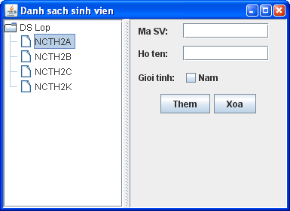
Example: JTreeNhapSV.java
53

Slide 54
Outline
JList
JTable
JTree
JSplitPane
JSlider
Key Events
Mouse Events

Slide 55
JSplitPane
JSplitPane is a container that displays two components separated by a moveable divider bar
The two components can be displayed side by side, or one on top of the other
Moveable Divider Bar
Top Component
Left
Component
Right
Component
Bottom Component
HORIZONTAL_SPLIT
VERTICAL_SPLIT
55

Slide 56
JSplitPane (cont.)
Usage
The orientation of the split pane is set using the HORIZONTAL_SPLIT or VERTICAL_SPLIT constants
Split panes can be nested
Instead of adding the components of interest directly to a split pane, you often put each component into a scroll pane. You then put the scroll panes into the split pane
56

Slide 57
Constructors of JSplitPane
JSplitPane()
constructs a split pane by the orientation: JSplitPane.HORIZONTAL_SPLIT
JSplitPane(int direction)
constructs a split pane by specifying the orientation: JSplitPane.HORIZONTAL_SPLIT or JSplitPane.VERTICAL_SPLIT
JSplitPane(int direction, Component comLeft, Component comRight)
57

Slide 58
Methods of JSplitPane
void setLeftComponent(Component c)
void setTopComponent(Component c)
These operations have the same effect, to set c as the first component in the split pane
void setRightComponent(Component c)
void setBottomComponent(Component c)
These operations have the same effect, to set c as the second component in the split pane
58

Slide 59
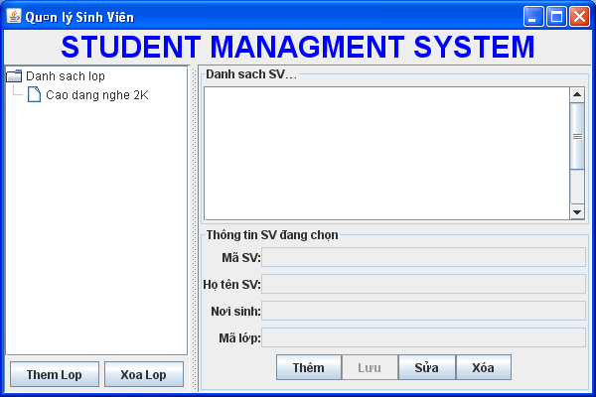
Example: Compound
59

Slide 60
Outline
JList
JTable
JTree
JSplitPane
JSlider
Key Events
Mouse Events

Slide 61
JSlider
Purpose
allows the user to select a numeric value by sliding a knob within a bounded interval
Usage
A JSlider can be oriented vertically or horizontally
A JSlider can have optional tick marks and labels
By default, tick marks and labels are invisible and spacing for major and minor tick marks is zero
To see tick marks, use method: setPaintTicks(true)
To display standard numeric labels at major tick mark locations, use method setPaintLabels(true)
Notes:
To see tick marks, you must set the spacing for either major or minor tick marks (or both) to a non-zero value and call the setPaintTicks(true) method
To display standard numeric labels at major tick mark locations, set the major tick spacing, then call the setPaintLabels(true) method

Slide 62
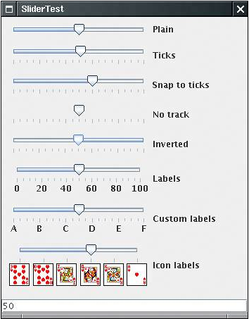
JSlider
62

Slide 63
Constructors of JSlider
JSlider()
Creates a horizontal slider with the range 0 to 100 and an initial value of 50
JSlider(int min, int max) JSlider(int min, int max, int init_value)
Creates a horizontal slider with the specified minimum and maximum values. The third int argument, when present, specifies the slider's initial value
JSlider(int orientation) JSlider(int orientation, int min, int max, int init_value)
Creates a slider with the specified orientation, which must be either JSlider.HORIZONTAL or JSlider.VERTICAL. The last three int arguments, when present, specify the slider's minimum, maximum, and initial values, respectively
63
Notes:
Creates a new slider with the specified orientation, minimum value, maximum value, and initial
value. The default orientation is horizontal, the default minimum value is 0, the default maximum
value is 100, and the default initial value is the range midpoint JSlider(int min, int max, int initialValue)

Slide 64
Methods of JSlider
void setMajorTickSpacing(int value)
void setMinorTickSpacing(int value)
sets the major or minor tick spacing for this slider
void setPaintTicks(boolean b)
sets whether tick marks are painted on the slider
void setValue(int value)
int getValue()
sets or gets the slider’s current value
void setOrientation(int orientation)
int getOrientation()
sets or gets the orientation for the slider
64

Slide 65
Methods of JSlider (cont.)
setMinimum(int minimumValue)
setMaximum(int maximumValue)
sets the minimum or maximum value for this slider
int getMinimum()
int getMaximum()
returns the minimum or maximum value of this slider
void setPaintLabels(boolean b)
boolean getPaintLabels()
sets or gets whether labels are painted on the slider
boolean getValueIsAdjusting()
returns true if the slider knob is being dragged
65

Slide 66
Event of JSlider
When the slider is moved, a slider produces a ChangeEvent
implement ?
method ?
register ?
public void stateChanged (ChangeEvent event)
{
JSlider slider = (JSlider) event.getSource();
int value = slider.getValue();
// do something with value. . .
}
66

Slide 67
Example: JSliderDemo.java
import java.awt.*;
import javax.swing.*;
import javax.swing.event.*;
public class SliderDemo extends JFrame
implements ChangeListener
{
JSlider jSlider;
public SliderDemo()
{
super("Tick Slider");
setDefaultCloseOperation(DISPOSE_ON_CLOSE);
jSlider = new JSlider();
// large tick marks every 25 units and small tick //marks every 5 units
jSlider.setMinorTickSpacing(5);
jSlider.setMajorTickSpacing(25);
jSlider.setPaintTicks(true);
jSlider.addChangeListener(this);
add(jSlider, BorderLayout.NORTH);
setSize(300, 200);
setVisible(true);
}
public void stateChanged(ChangeEvent e)
{
Object source = e.getSource();
if (source.equals(jSlider))
if (!jSlider.getValueIsAdjusting())
System.out.println("Slider changed: " + jSlider.getValue());
}
public static void main(String args[]) {
new SliderDemo();
}
}
67

Slide 68
Outline
JList
JTable
JTree
JSplitPane
JSlider
Key Events
Mouse Events

Slide 69
Key Events
Key events are generated when keys on the keyboard are pressed and released
Any component can generate these events
To handle, write a class that implements KeyListener interface, with methods
keyPressed(KeyEvent event) -- any key pressed down
keyReleased(KeyEvent event) -- any key released
keyTyped(KeyEvent event) -- key for printable char released
See KeyDemo.java
69
Notes:
key not printable: e.g., an arrow key, Home, End, Page Up, Page Down, a function key, Num Lock, Print Screen, Scroll Lock, Caps Lock and Pause

Slide 70
Outline
JList
JTable
JTree
JSplitPane
JSlider
Key Events
Mouse Events

Slide 71
Mouse Events
A mouse event is generated when the mouse button is clicked or when the mouse moves into or out of a component’s drawing area
Java divides these events into two categories: mouse events and mouse motion events
71
Notes:
When you click the mouse button over a Java GUI component, three events are
generated: one when the mouse button is pushed down (mouse pressed) and two
when it is let up (mouse released and mouse clicked). A mouse click is defined as
pressing and releasing the mouse button in the same location. If you press the
mouse button down, move the mouse, and then release the mouse button, a
mouse clicked event is not generated.
A component will generate a mouse entered event when the mouse pointer
passes into its graphical space. Likewise, it generates a mouse exited event when
the mouse pointer leaves.
Mouse motion events, as the name implies, occur while
the mouse is in motion. The mouse moved event indicates
simply that the mouse is in motion. The mouse dragged
event is generated when the user has pressed the mouse
button down and moved the mouse without releasing the
button. Mouse motion events are generated

Slide 72
Methods in MouseListener interface
Defined Methods | Description
mouseClicked(MouseEvent e) | Called when a mouse button is clicked on a component - that is, when the button is pressed and released
mousePressed(MouseEvent e) | Called when a mouse button is pressed on a component
mouseReleased(MouseEvent e) | Called when a mouse button is released on a component
mouseEntered(MouseEvent e) | Called when the mouse enters the area occupied by a component
mouseExited(MouseEvent e) | Called when the mouse exits the area occupied by a component
72
Notes:
A MouseEvent object contains information about the mouse event that occurred, including the x- and y-coordinates of the location where the event occurred

Slide 73
Methods in MouseMotionListener interface
Defined Methods | Description
mouseMoved(MouseEvent e) | Called when a mouse button is moved on a component
mouseDragged(MouseEvent e) | Called when the user has pressed the mouse button down and moved the mouse without releasing the button
See MouseTracker.java
73

Slide 74
Mouse Events
The MouseMotionListener or MouseListener interface: respond to events when the mouse cursor is moved into or out of the area occupied by a component, or one of the mouse buttons is pressed, released, or clicked
A class that implements MouseMotionListener or MouseListener must provide definitions some methods, each of which receives a MouseEvent as its argument
74

Slide 75
Example
public DefaultMutableTreeNode findUserObject (Object obj)
{
Enumeration e = root.breadthFirstEnumeration();
while (e.hasMoreElements())
{
DefaultMutableTreeNode node=(DefaultMutableTreeNode)e.nextElement();
if (node.getUserObject().equals(obj))
return node;
}
return null;
}
75

Slide 76
Editable ComboBox
import java.awt.*;
import java.awt.event.*;
import javax.swing.*;
import javax.swing.event.*;
import javax.swing.border.*;
import java.text.*;
import java.util.*;
class DateDisplay extends JPanel implements ActionListener
{
JLabel result;
String curpat;
DateDisplay ()
{
// Set the layout of the panel as BoxLayout
setLayout(new BoxLayout(this, BoxLayout.PAGE_AXIS));
// Declare a string array and store the various patterns in it.
// Set the current pattern to the first element in the array
String []patterns ={"dd MMMMM yyyy", "dd.MM.yy","MM/dd/yy", "yyyy.MM.dd G 'at' hh:mm:ss z","yyyy.MMMMM.dd GGG hh.mm aaa"};
curpat = patterns[0];
// Create a combo box and initialize it with the String array that contains the pattern list
JLabel patlab = new JLabel ("Enter the pattern or select from list : ");
76

Slide 77
Editable ComboBox Contd…
JComboBox patlist = new JComboBox(patterns);
patlist.setEditable(true);
// Make the combo box editable
patlist.addActionListener(this);
JLabel reslabel = new JLabel("Current Date / Time is :", JLabel.LEADING);
result = new JLabel(" ");
result.setForeground(Color.red);
// Add the label and the combo box to a panel
JPanel patPanel = new JPanel();
patPanel.setLayout(new
BoxLayout(patPanel,BoxLayout.PAGE_AXIS));
patPanel.add(patlab);
patlist.setAlignmentX(Component.LEFT_ALIGNMENT);
patPanel.add(patlist);
// Add the label where the result will be displayed in the appropriate format
JPanel resPanel = new JPanel(new GridLayout(0,1));
resPanel.add(reslabel);
resPanel.add(result);
//Setting the alignment to the left
patPanel.setAlignmentX(Component.LEFT_ALIGNMENT);
resPanel.setAlignmentX(Component.LEFT_ALIGNMENT);
add(patPanel);
add(Box.createRigidArea(new Dimension(0,10)));
add(resPanel);
reformat();
}
77

Slide 78
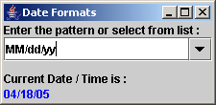
Editable ComboBox Contd…
// Check the currently selected item
public void actionPerformed(ActionEvent e)
{
JComboBox cb = (JComboBox)e.getSource();
String sel = (String)cb.getSelectedItem();
curpat = sel;
reformat();
}
// Get the current date and display it.
// Set the date object to the appropriate format before displaying it.
public void reformat()
{
Date today = new Date();
SimpleDateFormat dateformat = new SimpleDateFormat(curpat);
try
{
String dateString = dateformat.format(today);
result.setForeground(Color.blue);
result.setText(dateString);
}
catch(IllegalArgumentException e)
{
result.setForeground(Color.red);
result.setText("Error " + e.getMessage());
}
}
public static void main ( String [] args)
{
JFrame frame = new JFrame("Date Formats");
frame.setDefaultCloseOperation(JFrame.EXIT_ON_CLOSE);
JComponent objDate = new DateDisplay();
frame.setContentPane(objDate);
frame.pack();
frame.setVisible(true);
}
}
Output
78

