Slide 1
Units 1-3. English for mathematicians revision: basics of spoken mathematics. Pronunciation of Greek alphabet, famous mathematicians’ names. Basic terms, symbols, notions and expressions in logic, set theory, algebra, geometry, trigonometry, calculus, probability theory, statistics, actuarial science, finance. Verbal description of diagrams and graphs. The Reading List: 1. Lawrence A. Chang. Handbook for Spoken Mathematics. Lawrence Livermore Laboratory, 1983. 2. Mathematical terms. CollinsEnglishWordList 3. Англо-русский и русско-английский словари математических терминов. Изд.2. М.: Мир. 1994. 4. The names of famous mathematicians.pdf 5. Greek alphabet.pdf
Performed by Alexandra Tokaeva, 509 group
16.02.2022

Slide 2
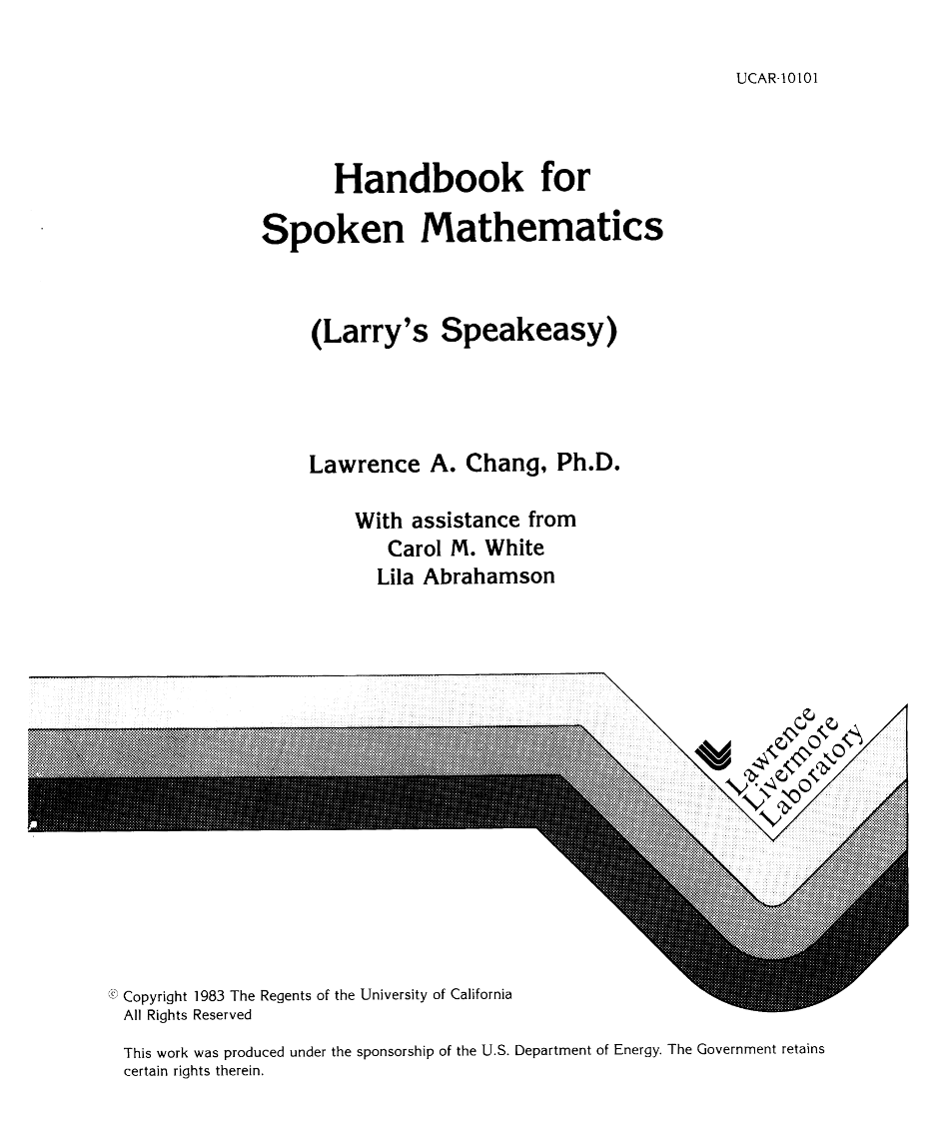
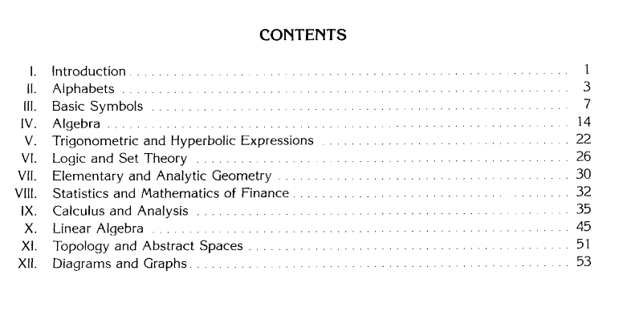
The Reading List

Slide 3

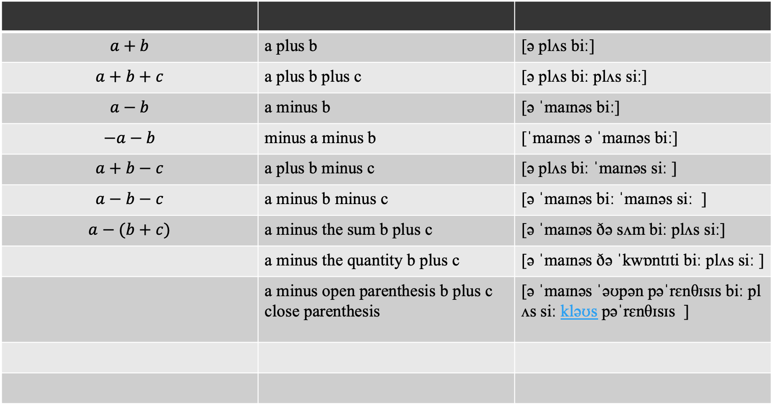
4. Algebra
$$a+b$$ | a plus b | [ə plʌs biː]
$$a+b+c$$ | a plus b plus c | [ə plʌs biː plʌs siː]
$$a−b$$ | a minus b | [ə ˈmaɪnəs biː]
$$−a−b$$ | minus a minus b | [ˈmaɪnəs ə ˈmaɪnəs biː]
$$a+b−c$$ | a plus b minus c | [ə plʌs biː ˈmaɪnəs siː ]
$$a−b−c$$ | a minus b minus c | [ə ˈmaɪnəs biː ˈmaɪnəs siː ]
$$a−(b+c)$$ | a minus the sum b plus c | [ə ˈmaɪnəs ðə sʌm biː plʌs siː]
 | a minus the quantity b plus c | [ə ˈmaɪnəs ðə ˈkwɒntɪti biː plʌs siː ]
 | a minus open parenthesis b plus c close parenthesis | [ə ˈmaɪnəs ˈəʊpən pəˈrɛnθɪsɪs biː plʌs siː kləʊs pəˈrɛnθɪsɪs ]

Slide 4
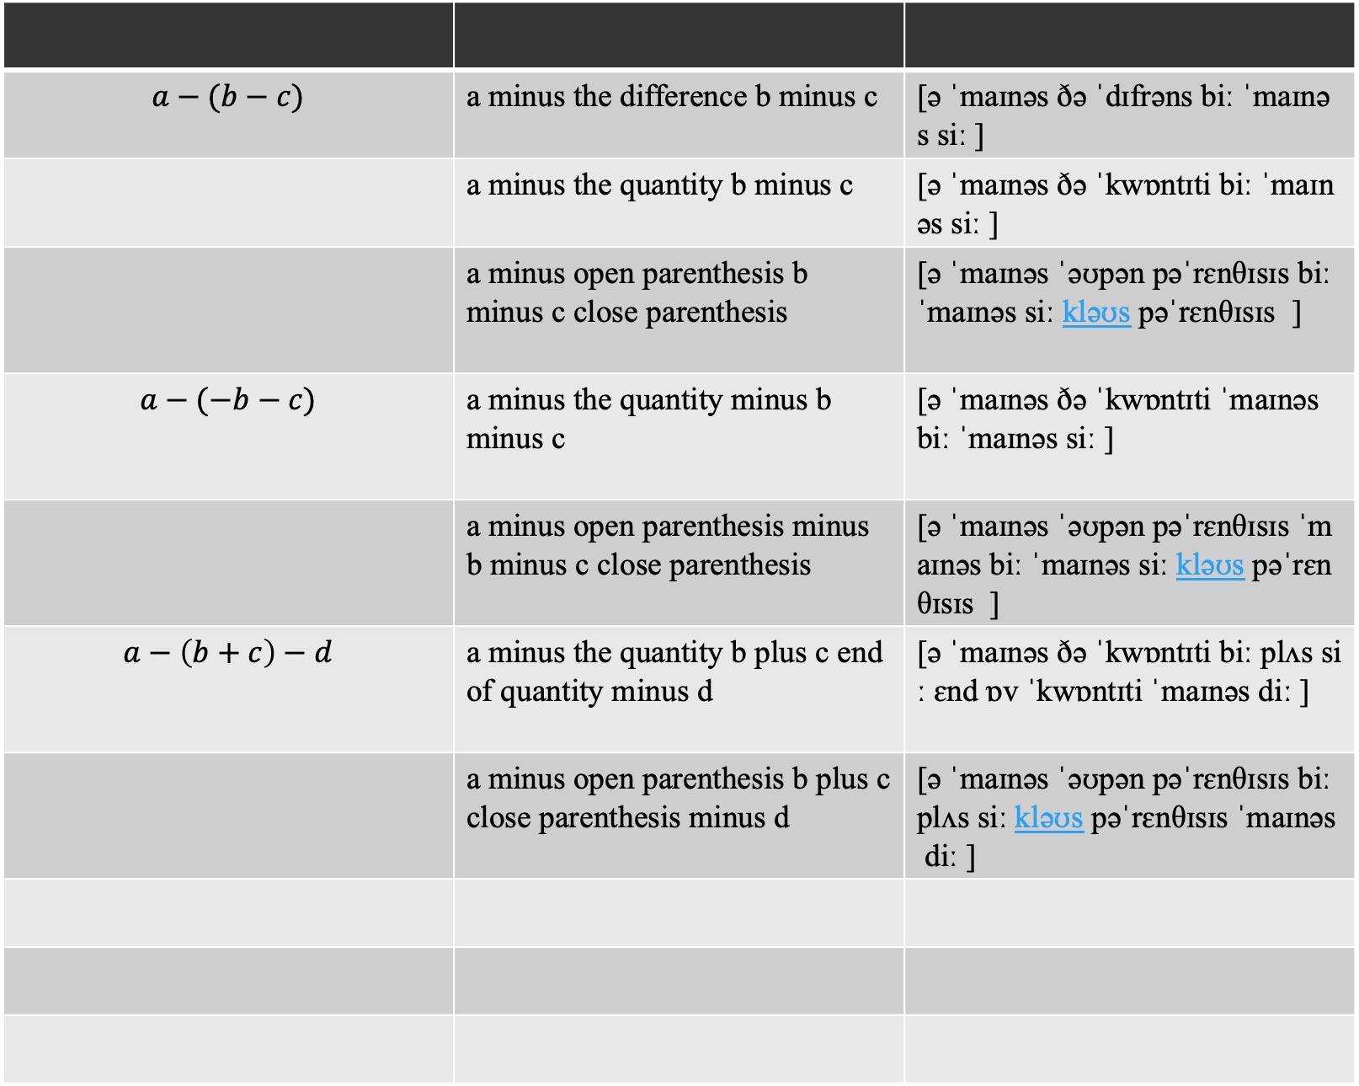
$$a−(b−c)$$ | a minus the difference b minus c | [ə ˈmaɪnəs ðə ˈdɪfrəns biː ˈmaɪnəs siː ]
 | a minus the quantity b minus c | [ə ˈmaɪnəs ðə ˈkwɒntɪti biː ˈmaɪnəs siː ]
 | a minus open parenthesis b minus c close parenthesis | [ə ˈmaɪnəs ˈəʊpən pəˈrɛnθɪsɪs biː ˈmaɪnəs siː kləʊs pəˈrɛnθɪsɪs ]
$$a−(−b−c)$$ | a minus the quantity minus b minus c | [ə ˈmaɪnəs ðə ˈkwɒntɪti ˈmaɪnəs biː ˈmaɪnəs siː ]
 | a minus open parenthesis minus b minus c close parenthesis | [ə ˈmaɪnəs ˈəʊpən pəˈrɛnθɪsɪs ˈmaɪnəs biː ˈmaɪnəs siː kləʊs pəˈrɛnθɪsɪs ]
$$a−\left(b+c\right)−d$$ | a minus the quantity b plus c end of quantity minus d | [ə ˈmaɪnəs ðə ˈkwɒntɪti biː plʌs siː ɛnd ɒv ˈkwɒntɪti ˈmaɪnəs diː ]
 | a minus open parenthesis b plus c close parenthesis minus d | [ə ˈmaɪnəs ˈəʊpən pəˈrɛnθɪsɪs biː plʌs siː kləʊs pəˈrɛnθɪsɪs ˈmaɪnəs diː ]

