Slide 1


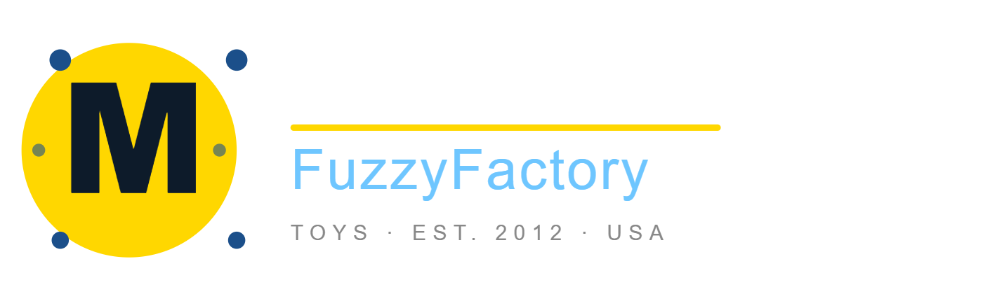
MavenFuzzyFactory
Analysis
Business analytics hackathon
E-Commerce Growth Challenge
Presented by : Zeina Ahmed, Toka Gabr, Omar El Yemani, Saleh Hossam
Zesto Team | March 2026

Slide 2
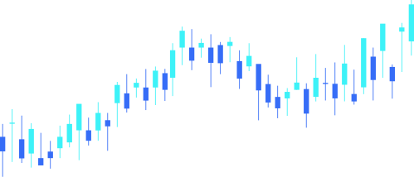
Executive Summary
3 Key Findings for Investors
GROWTH
RESILIENCE
EFFICIENCY
Orders From Free Channels 1 in 3 orders now costs nothing to acquire Built from 0% at launch 33.5%
Order Growth 2012–2014: from 59 orders (Q1 2012) to 5,681 (Q4 2014)
Sessions grew from 1,879 to 72,048 over the same period
Revenue Per Session Lift $1.57 per visitor at launch → $5.03 per visitor in Q4 2014 (+220%)
OBSERVATION | Sessions grew significantly (1,879 → 72,048), and orders scaled from 59 to 5,681. Revenue per session improved ~220% from $1.57 to $5.03.
INSIGHT | The business did not just get bigger — it became dramatically more efficient. Each visitor generates 3.4x more revenue than at launch, while 33.5% of orders now require zero paid acquisition spend.
ACTION | Use these three numbers as the opening anchor for every investor conversation: scale (100x), efficiency (+237%), and resilience (33.5% free channel share).
IMPACT | KPI: maintain quarterly session-to-order conversion rate above 8%. Track monthly. Benchmark: Q4 2014 = 7.89%.
MavenFuzzyFactory
Analysis
page 02

Slide 3
DATA QUALITY REPORT
Is Our Data Fit for Purpose?
Issue Category | Count | % of Dataset | Action Taken
Duplicate sessions | 1 | 0.000% | Excluded — identical user_id + timestamp
Bad price orders | 8 | 0.001% | Excluded — price_usd = 0 or negative
Impossible pageviews | 10 | 0.001% | Excluded — pageview timestamp before session timestamp
Orphan product items | 15 | 0.001% | Excluded — product_id = 99, not in products table
TOTAL HARD EXCLUSIONS | 34 | 0.002% | Dataset is clean — every metric is fully defensible
Case/spacing issues fixed | 89+ | n/a | LOWER(TRIM()) applied to all text fields — not excluded
3-Step Data Governance Recommendation:
Referential integrity check on all foreign keys before export
Auto-reject price ≤ 0 at database write layer
Timestamp constraint — pageview cannot pre-date its own session
OBSERVATION | 34 records excluded out of 472,871 total — just 0.002% of the dataset. Issues found: duplicates, zero-price orders, impossible timestamps, and orphan product IDs.
INSIGHT | The data is structurally sound. Every metric in this deck is fully defensible. Dirty data leads to wrong decisions — wrong decisions in front of investors can be fatal.
ACTION | Implement the 3-step validation process immediately at the engineering level to prevent these issues from reaching the analyst team in future exports.
IMPACT | Zero data exclusions in future analysis cycles. KPI: data error rate per export — target 0%.
MavenFuzzyFactory
Analysis
C01-page 03

Slide 4
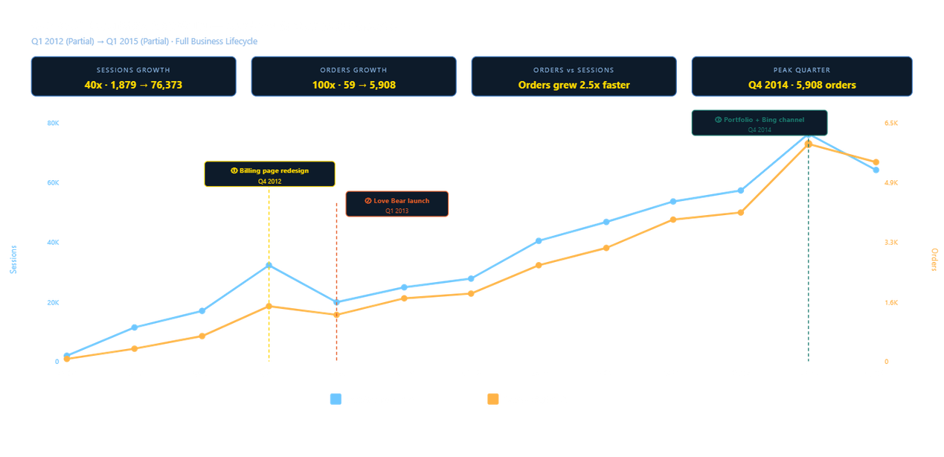
OVERALL BUSINESS GROWTH
How Big Have We Become? Sessions & Orders by Quarter — Full Business Lifecycle
3 Inflection Points:
🔴 Q4 2012 — Conversion improvements (landing + billing tests) + holiday demand drove sharp spike
🟡 Q1 2013 — Love Bear launch + increasing bsearch contribution established higher baseline
🟢 2013–2014 — Product expansion + scaled bsearch channel → sustained, compounding growth
OBSERVATION | Sessions grew 38x (1,879 → 72,048) and orders grew 96x (59 → 5,681) between Q1 2012 and Q4 2014.
INSIGHT | Orders outpaced sessions — meaning the business converted traffic more efficiently as it scaled, not less. Volume and efficiency improved simultaneously.
ACTION | Continue investing in the three proven growth levers: website conversion testing, product portfolio expansion, and channel diversification.
IMPACT | KPI: quarterly order growth rate must remain above session growth rate — confirming compounding efficiency. Benchmark: orders grew 2.5x faster than sessions over the full lifecycle.
MavenFuzzyFactory
Analysis
C02-page 04

Slide 5
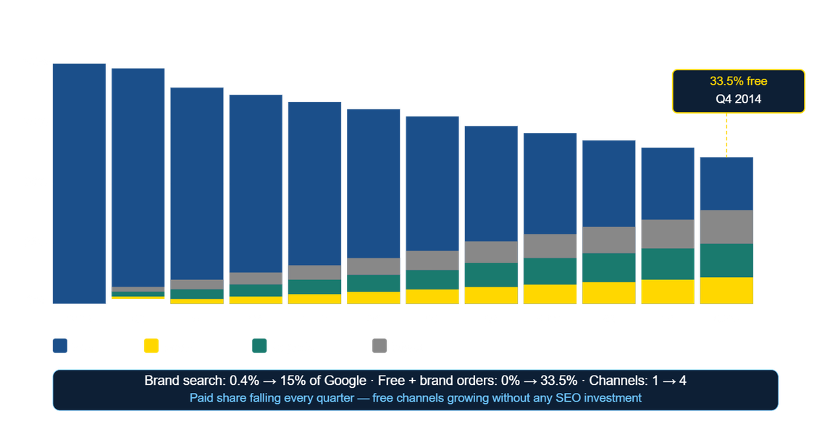
CHANNEL MIX & TRAFFIC TRENDS
Are We Over-Reliant on One Channel? Traffic Source Breakdown — 2012 to 2015
Key Numbers:
Brand search: 0.4% → 15% of Google traffic
Free + brand orders: 0% → 33.5% of total orders
Channels at launch: 1 → Channels today: 4
OBSERVATION | At launch the business had one single paid channel. By Q4 2014 it had four meaningful traffic sources, with brand and free channels growing the fastest.
INSIGHT | Brand search growth from 0.4% to 15% means customers are actively searching the company name — that is not paid discovery, that is earned brand awareness. It grew with zero SEO investment.
ACTION | Formalise the organic growth with a lightweight content and referral program. The audience is already arriving — invest modestly to earn more of it.
IMPACT | KPI: free + brand share of total orders — currently 33.5%. Target: 40% within 12 months. Every order shifted from paid to free is direct margin improvement.
MavenFuzzyFactory
Analysis
C02 + C04 - page 05

Slide 6
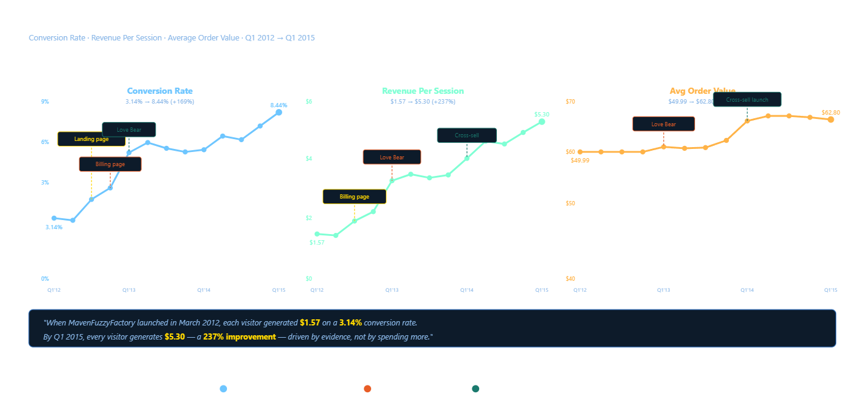
EFFICIENCY METRICS
Are We Getting Smarter With Every Sale? Conversion Rate · Revenue Per Session · Average Order Value
What drove each jump:
🔴 Jun–Jul 2012 — Landing page A/B test → +0.88pp conversion lift
🟡 Sep–Nov 2012 — Billing page redesign → +17.18pp at billing step
🟢 2013–2014 — 4-product portfolio + cross-sell → AOV from $49.99 to $62.80
Investor Narrative:
"In March 2012, every visitor was worth $1.57. Today every visitor is worth $5.03 — about a 220% improvement — driven by evidence, not by spending more."
OBSERVATION | Conversion rate increased from 3.14% to 7.89%. Revenue per session grew ~220% from $1.57 to $5.03.
INSIGHT | Every single improvement traces to a specific, tested, evidence-backed decision. This business did not get lucky — it got smarter, methodically, over three years.
ACTION | Continue systematic A/B testing on remaining funnel steps. The product detail page is the next highest-leverage target — converting at only 43.4%.
IMPACT | KPI: revenue per session — currently $5.03. Each +1pp sitewide conversion improvement at Q4 2014 volumes generates ~$400–$500/month additional revenue. Target: $6.00 per session by Q4 2025.
MavenFuzzyFactory
Analysis
C03 -page 06

Slide 7
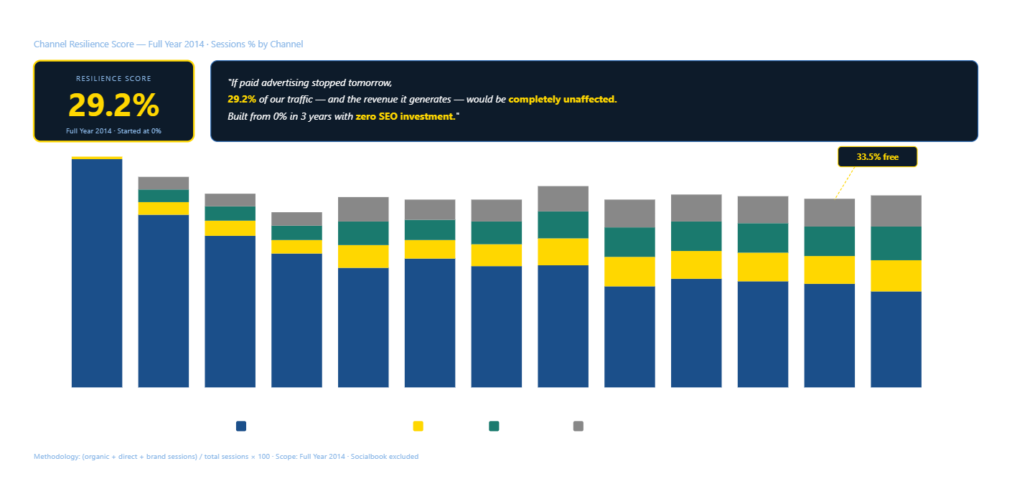
CHANNEL RESILIENCE
Have We Built a Resilient Revenue Base? Channel Resilience Score — 2014
29.2%
Channel Resilience Score — Full Year 2014 Started at 0%. Built without a single dollar of SEO investment.
Investor Soundbite:
"If paid advertising stopped tomorrow, 29.2% of our traffic — and the revenue it generates — would be completely unaffected."
OBSERVATION | 1 in 3 orders today costs nothing to acquire. The Channel Resilience Score reached 29.2% in 2014, up from 0% at launch, with zero investment in SEO or referral programs.
INSIGHT | Returning customers never come back through a paid non-brand ad — not approximately zero, exactly zero. The company is not paying to bring these people back. They return on their own through organic, direct, and brand channels.
ACTION | Invest modestly in content and referral to accelerate what is already growing organically. Suppress existing customers from non-brand paid targeting — redirect that budget to new user acquisition only.
IMPACT | KPI: Channel Resilience Score — currently 29.2%. Target: 40% within 12 months. Every percentage point gained is permanent margin improvement.
MavenFuzzyFactory
Analysis
C04- page 07

Slide 8
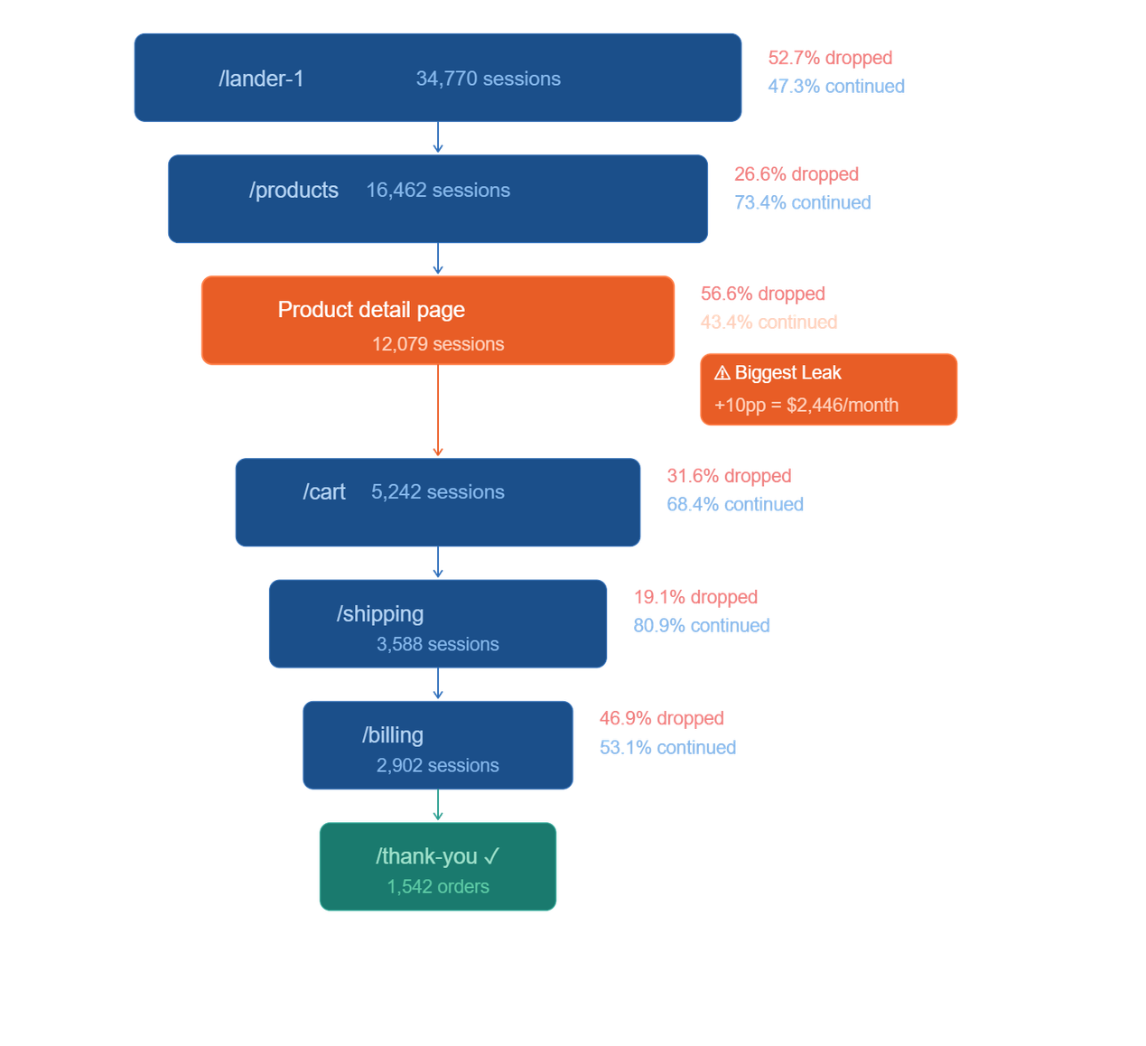
THE CUSTOMER PURCHASE FUNNEL
Where Are We Losing Our Customers? Full Conversion Funnel — gsearch Nonbrand Traffic
OBSERVATION | The product detail page converts at only 43.4% — the single worst step in the entire funnel. Every other major step exceeds 68%. 56.6% of interested visitors leave without adding to cart.
INSIGHT | These are warm, already-interested visitors — they clicked through to a product page. The failure is not at acquisition, it is at presentation. This is the highest-leverage fix in the entire business right now.
ACTION | Launch a structured A/B test on the product detail page within 30 days. Test: lifestyle photography, customer review count, CTA button wording, and gift-use prompts.
IMPACT | KPI: product detail → cart conversion rate — currently 43.4%. Target: 53%+ within 90 days. A 10pp improvement generates $2,446 per month.
Product Detail
→ Cart Conversion Every other step converts at 68% or higher. This step is 25 points below the rest.
43.4%
Revenue Opportunity:
+10pp fix at this step = $2,446/month
38 extra orders × $63.79 AOV
MavenFuzzyFactory
Analysis
C05- page 08

Slide 9
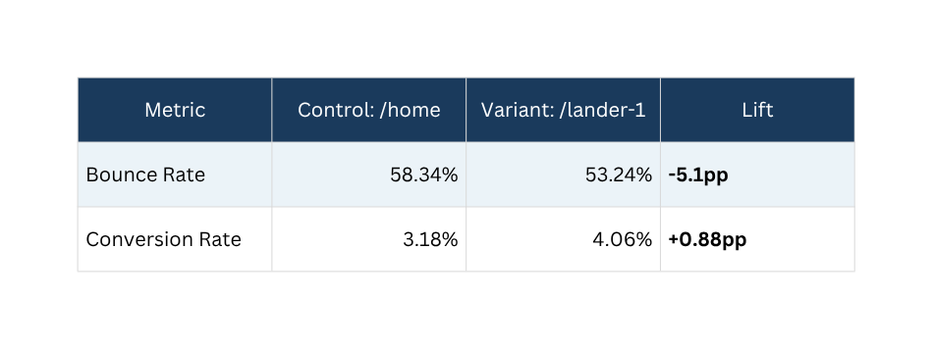
LANDING PAGE A/B TEST
What Was the Return on Our Website Investments? Landing Page A/B Test — June 19 to July 28, 2012
How We Calculated It: +0.88pp lift × sessions since test ended × AOV at the time
What Happened After the Test:
/lander-1 declared winner after July 28, 2012
Traffic correctly routed to /lander-1 — confirmed in weekly volume data
Every paid nonbrand visitor since has landed on the winning page
Proposed Next Test:
Page: Product detail page
Variables: Lifestyle photography · Customer review count · CTA wording
Hypothesis: Reduce detail→cart abandonment from 56.6% to below 50%
Window: 90 days
~$497/month incremental revenue (~$15,900 cumulative since July 2012 — 32 months)
OBSERVATION | The new landing page cut bounce rate by 5.1pp and raised conversion by 0.88pp — generating ~$497/month in ongoing incremental revenue since deployment in July 2012
INSIGHT | A single tested page change created a permanent improvement that has compounded with every new visitor since. This is not a one-time win — it is a structural upgrade to the business.
ACTION | Apply the same A/B testing discipline to the product detail page immediately — it is the next highest-leverage opportunity with the same proven methodology.
IMPACT | KPI: landing page bounce rate — currently 53.24%. Each additional 1pp reduction compounds forward with every paid session. Target: below 50% within next test cycle.
MavenFuzzyFactory
Analysis
C06 - page 09

Slide 10
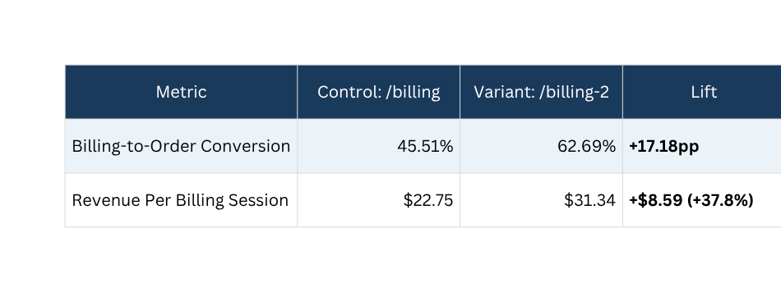
BILLING PAGE A/B TEST
Billing Page A/B Test What Was the Return on Our Website Investments? September 10 – November 10, 2012 | All traffic
What Happened After :
/billing-2 declared winner November 2012
Still the live page today
Every billing session since has been on the winning page
Proposed Next Test:
Page: Shipping page
Hypothesis: Progress indicator (step 3 of 5) raises 80.9% conversion above 88%
Window: 60 days
~$27,800/month Ongoing Incremental Revenue Grows as session volume grows
OBSERVATION | Billing page redesign raised conversion at that single step from 45.51% to 62.69% — a 17.18pp lift — adding ~$27,800 every month.
INSIGHT | The largest single performance lift in any test in the dataset. Unlike a one-time gain, this improvement compounds — as session volumes grow, so does the monthly value.
ACTION | Protect this page — do not change without testing. Apply the same discipline to the shipping page next.
IMPACT | KPI: revenue per billing session — currently $31.34. Target: one high-value page test per quarter. Each successful test adds permanent monthly revenue.
MavenFuzzyFactory
Analysis
C06 - page 10

Slide 11
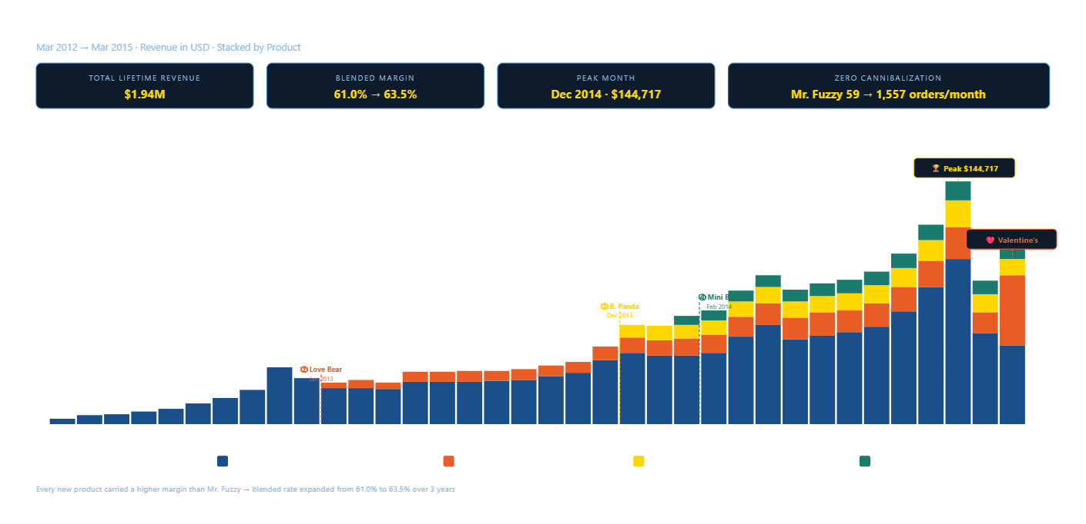
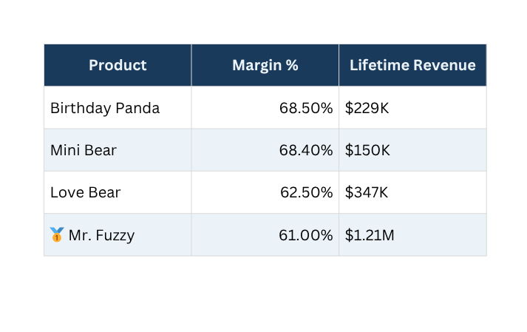
Product Performance
Which Products Are Pulling Their Weight?
Priority Product:
Mini Bear Highest margin (68.4%)
Lowest refund rate (max 2.41%)
Cross-sell engine at 20–22% attachment
OBSERVATION | Blended margin expanded from 61.0% → 63.5% over 3 years. Birthday Panda = highest margin at 68.5%, Mini Bear at 68.4%. Mr. Fuzzy dominates revenue at $1.21M lifetime. Peak month: Dec 2014 — 2,312 orders / $144,717 revenue.
INSIGHT | Every new product added margin points to the blended rate without cannibalizing Mr. Fuzzy. The portfolio is structurally healthy — volume lives in Mr. Fuzzy, margin lives in the newer products.
ACTION | Prioritise Mini Bear visibility at cart step. Shift marketing mix toward Birthday Panda and Mini Bear where margin is highest. Apply the proven launch playbook to the next product entry.
IMPACT | KPI: blended margin % — currently 63.5%. Target: 65% within 12 months. Each 1pp lift on ~$100K monthly revenue = +$1,000/month permanent margin improvement.
MavenFuzzyFactory
Analysis
C07 - page 11

Slide 12
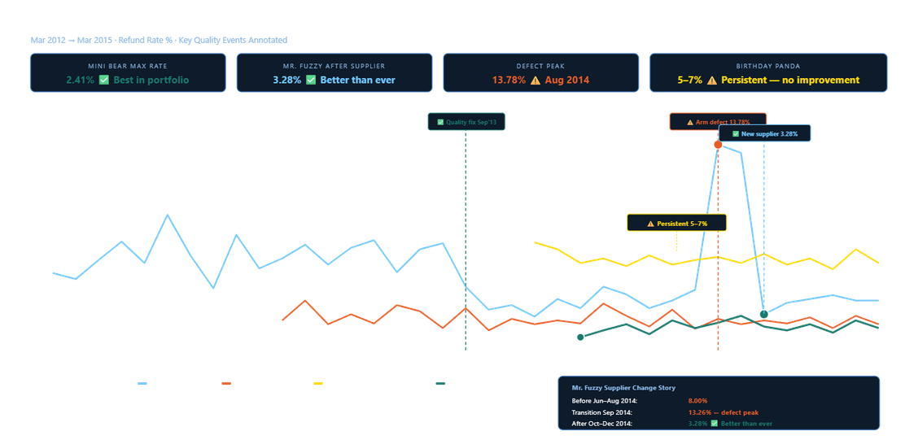
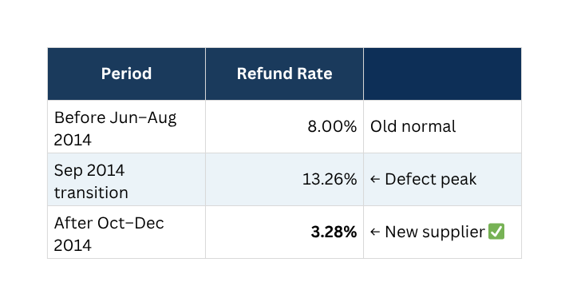
Seasonality & Refunds
OBSERVATION | Love Bear spikes every February — Feb 2015: 644 orders vs 290 in Dec 2014 (+122%). Mr. Fuzzy refund rate dropped from 8% → 3.28% after new supplier Oct 2014. Birthday Panda stuck at 5–7% every month since launch — no improvement in 15 months. Mini Bear never exceeded 2.41%.
INSIGHT | Seasonality is predictable — Valentine's and December peaks repeat every year and can be planned. The supplier change was a permanent quality upgrade for Mr. Fuzzy. Birthday Panda's refund rate is a structural problem — it's eroding the highest-margin product in the portfolio.
ACTION | 1. Plan inventory + paid spend for Valentine's (Love Bear) and December (all products). 2. Investigate Birthday Panda root cause — customer refund survey + supplier audit. 3. Apply Mr. Fuzzy's new supplier framework to Birthday Panda supply chain.
IMPACT | KPI 1: Birthday Panda refund rate — target below 3% within 6 months → ~$184/month saved per 1pp reduction. KPI 2: Valentine's benchmark 644 orders Feb 2015 → target +15% = 740+ orders Feb 2026.
Nov dip
Conv rate drops ~1pp every November — seasonal, not a problem
2,312 orders
Dec 2014 — holiday peak, $144,717 revenue
644 orders
Love Bear — Feb 2015 Valentine's spike (+122% vs Dec 2014)
MavenFuzzyFactory
Analysis
C07 - page 12

Slide 13
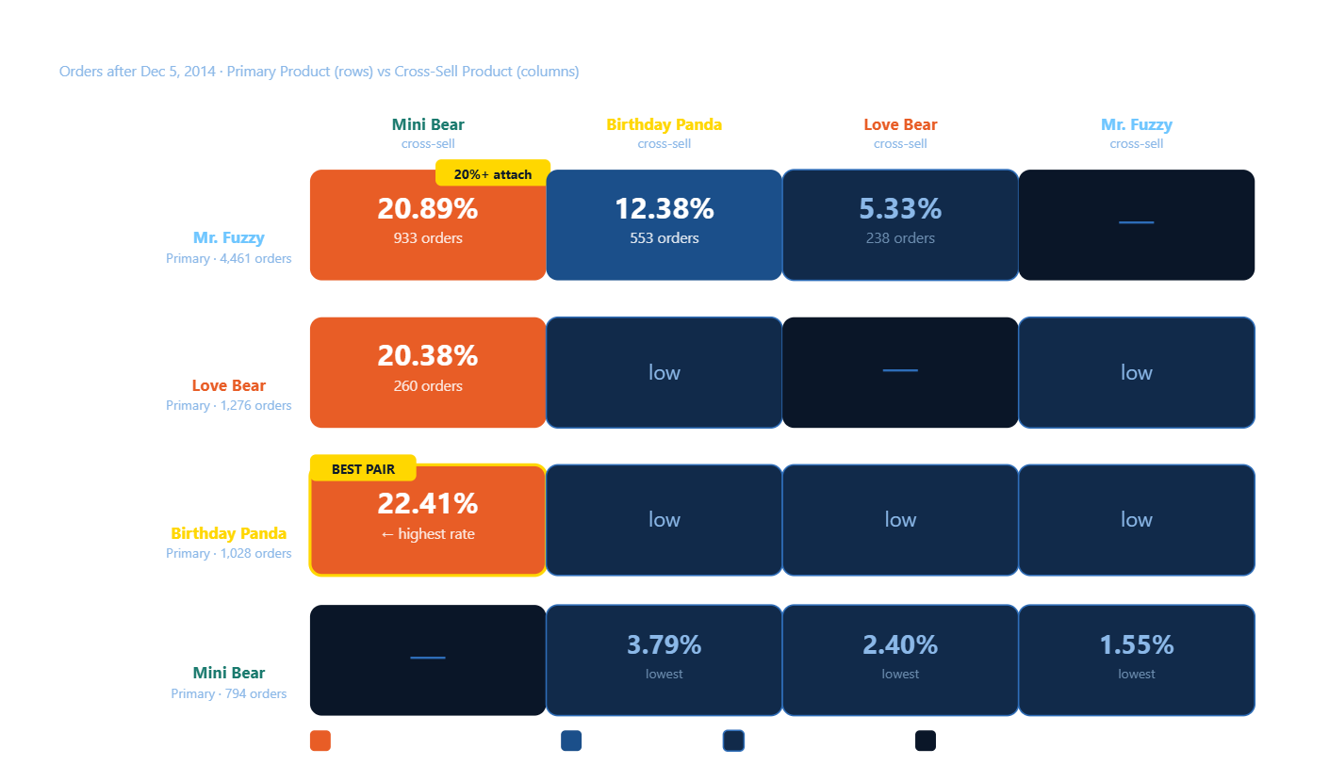
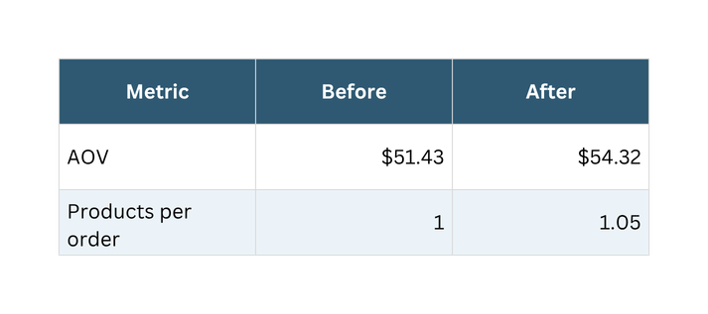
CROSS-SELL ANALYSIS
Are We Leaving Money in the Cart? Cross-Sell Analysis — September 2013 to December 2014
OBSERVATION | Mini Bear attaches at 20–22% across every primary product.
INSIGHT | Mini Bear is the cross-sell engine — 1 in 5 customers adds it regardless of primary product.
ACTION | Feature Mini Bear at the cart page for every primary product.
IMPACT | KPI: Mini Bear attachment rate. Target: 21% → 26% within 60 days. +5pp = ~$1,600/month.
$74,621 Mr. Fuzzy + Mini Bear — 3.5 months ~$21,800/month
MavenFuzzyFactory
Analysis
C08- page 13

Slide 14
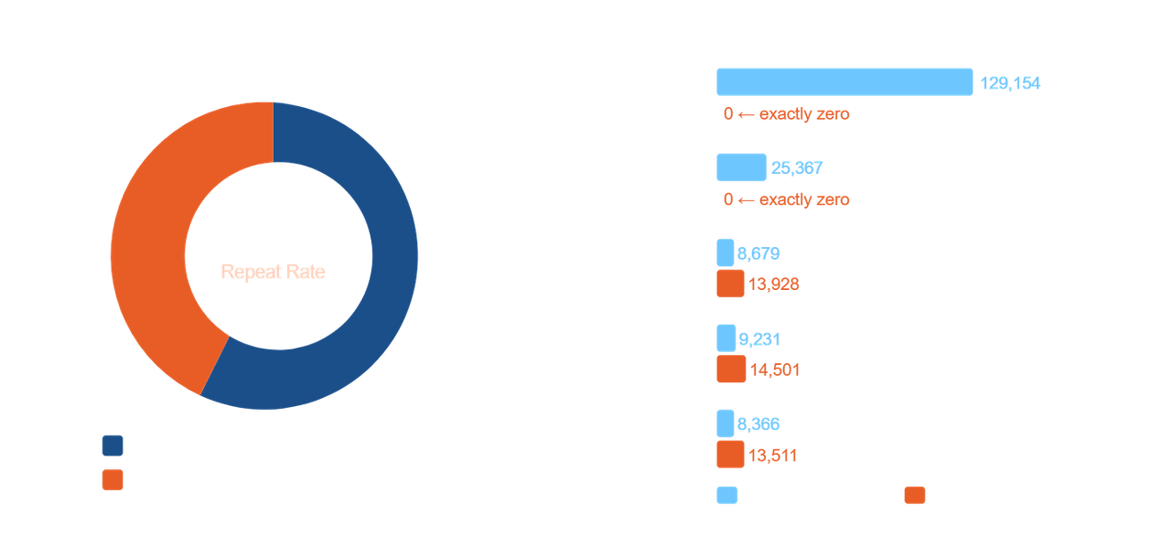
REPEAT CUSTOMER BEHAVIOUR
How Valuable Are Our Repeat Customers? Repeat Visitor Behaviour — 2014 Year-to-Date
Min
Avg
Max
1 day
32.5 days
69 days
OBSERVATION | 13.4% of users returned at least once in 2014. Zero returned through a paid non-brand ad — not approximately zero, exactly zero.
INSIGHT | 66.8% of repeat sessions came through free channels. The company is not paying to bring these customers back — they return on their own.
ACTION | Suppress existing customers from non-brand paid targeting. Redirect that budget to new user acquisition only.
IMPACT | KPI: share of paid spend reaching verified new users only. Target: reduce wasted repeat impressions by 10% within 60 days.
MavenFuzzyFactory
Analysis
C9- page 14

Slide 15
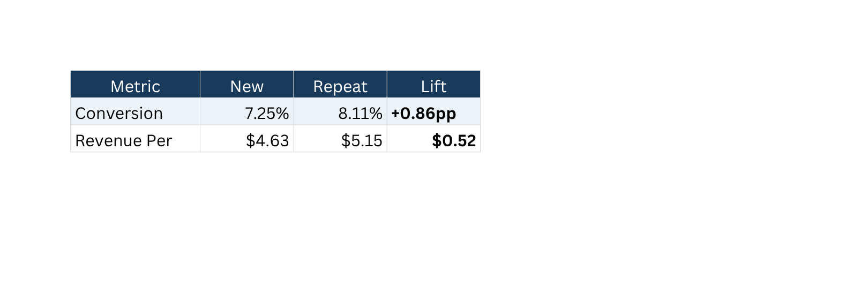
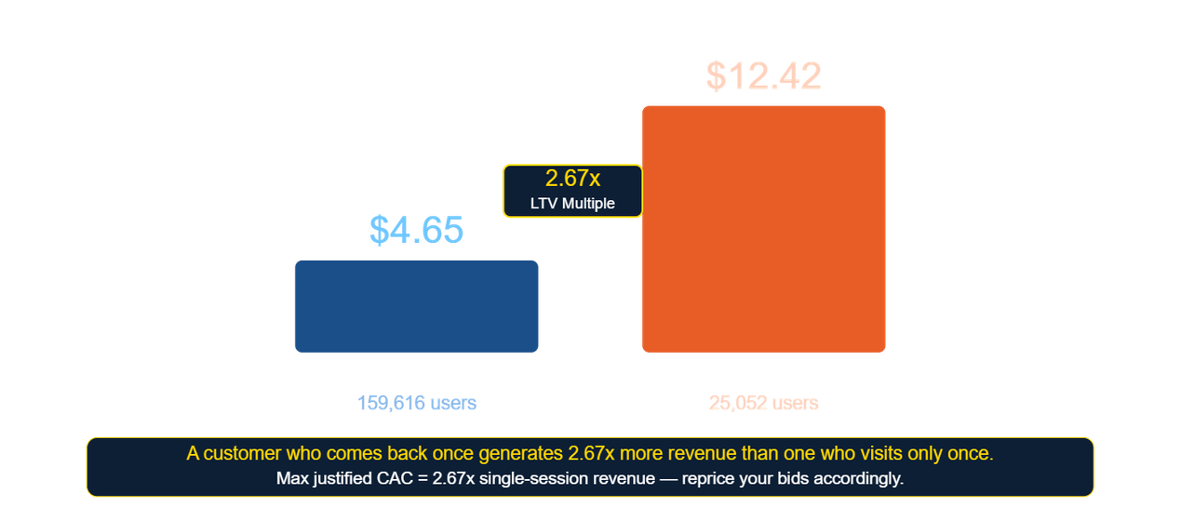
LIFETIME VALUE
What Is a Returning Customer Actually Worth? Customer Lifetime Value — 2014
OBSERVATION | $12.42 vs $4.65 — 2.67x LTV multiple
INSIGHT | Underbidding for customers who will return and spend more
ACTION | Suppress existing customers from nonbrand paid targeting
IMPACT | Adjust max CAC to 2.67x multiplier within next campaign cycle
MavenFuzzyFactory
Analysis
C19- page 15

Slide 16
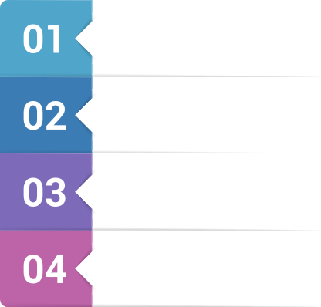




Strategic Recommendation 1 Fix the Biggest Funnel Leak
What Is a Returning Customer Actually Worth? Customer Lifetime Value — 2014
Product detail → cart converts at 43.4%. Every other funnel step converts at 68%+. 56.6% ofinterested visitors leave without adding to cart.
OBSERVATION
These are warm, already-interested visitors — they clicked through to a product page. The failure is at the presentation layer, not the acquisition layer.
INSIGHT
Launch a structured A/B test on the product detail page within 30 days:
Hero image: lifestyle photography vs product-only
Social proof: customer review count + star rating
CTA: button size, colour, wording
Gift-use prompts and size guidance
ACTION
+10pp lift = $2,446/month incremental revenue
Same methodology that returned $27,800/month from billing page
Target: 43.4% → 53%+ within 90 days
KPI: product detail → cart conversion rate — reviewed weekly
IMPACT
Trade-off: Fixing this step requires dev + design time. Risk: if test fails to lift, no revenue gain. Mitigation: run test for minimum 2 weeks before declaring winner.
MavenFuzzyFactory
Analysis
C10- page 16

Slide 17




Strategic Recommendation 2 Formalise the Free Channel Flywheel
OBSERVATION
INSIGHT
The flywheel is already spinning on its own momentum. A small deliberate investment accelerates what is already working for free. Repeat visitors convert 11.9% better and generate $0.52 more per session.
Channel Resilience Score: 29.2%. Free + brand orders grew from 0% → 33.5% of total. Built with zero SEO or referral investment.
ACTION
IMPACT
3 low-cost initiatives:
Content program — seasonal gift guides targeting organic search
Review generation — email prompt post-delivery
Re-engagement email sequence — timed to 32.5-day average return window
Target: Resilience Score 29.2% → 40% within 12 months KPI: free + brand share of total orders — reviewed monthly Every order shifted from paid to free = direct margin improvement
Trade-off: Content and email programs take 60–90 days to show results. Start with review generation — lowest cost, fastest impact.
MavenFuzzyFactory
Analysis
C10- page 17

Slide 18
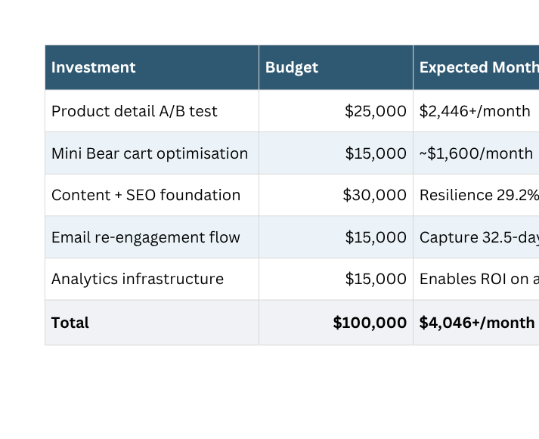
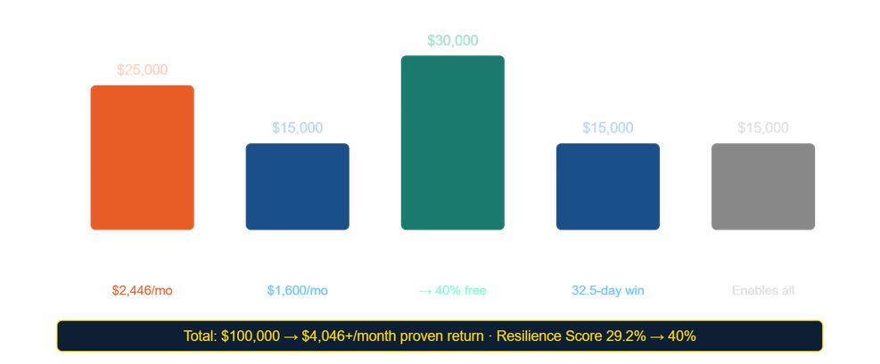
Strategic Recommendation 3 $100,000 Budget Allocation
Every Dollar Traces to a Confirmed Number
Key Risk:
70% of traffic still paid. Channel concentration = biggest vulnerability in the business. This budget directly reduces it.
$4,046+/month Proven monthly return from top 2 investments alone
OBSERVATION | 3 proven levers identified — conversion testing, cross-sell, and free channel growth — all with confirmed numbers.
INSIGHT | Every dollar follows a confirmed number. Nothing is speculative.
ACTION | Allocate $100K as per table above. Start with product detail test — highest return per dollar.
IMPACT | $4,046+/month proven return · Resilience Score 29.2% → 40% · KPI: conversion rate · attachment rate · resilience score · repeat rate.
MavenFuzzyFactory
Analysis
C10- page 18

Slide 19
Appendix — Methodology, Data Quality & Files
A. Dataset Overview:
472,871 sessions · 1,188,124 pageviews · 32,313 orders
40,025 order items · 1,731 refunds · 4 products
Data range: March 19, 2012 – March 19, 2015
E. Files Submitted:
B. Data Quality Decisions:
·challenge_01_data_quality.sql ·challenge_02_the_growth_story.sql
·challenge_03_04_efficiency_resilience_FINAL.sql ·challenge_05_conversion_funnel.sql
·challenge_06_website_AB_test_roi.sql ·challenge_07_ Product_Performance.sql
·challenge_08_cross_sell_analysis.sql ·challenge_09_repeat_customer_behaviour.sql
·MavenFuzzyFactory.pptx ·View.sql
LOWER(TRIM()) applied to all text fields
Socialbook excluded — undocumented channel
price_usd > 0 enforced in all order joins
product_id ≠ 99 enforced in all order_items queries
COALESCE(TRIM(http_referer)) for organic vs direct
34 records excluded (0.002%)
C. Methodology Notes:
During the data preparation phase, several data quality issues were identified and resolved. These included duplicate sessions, orders with zero or negative prices, invalid timestamps where pageviews occurred before sessions, and orphan product IDs not present in the products table. A total of 34 records (0.002% of the dataset) were removed. Additionally, text fields were standardized using LOWER(TRIM()). These steps ensured the dataset is clean, consistent, and reliable for analysis.
All charts are generated from SQL queries and views, ensuring consistency and reproducibility
Channel Resilience Score = (free + brand orders ÷ total orders) × 100
Funnel analysis: gsearch nonbrand from /lander-1, August 5, 2012 onwards
Cross-sell matrix: orders after December 5, 2014 only
LTV estimate: 2014 year-to-date, Socialbook excluded
Repeat visitor analysis: is_repeat_session flag
D. What One Dataset Would Change Everything:
Customer Acquisition Cost (CPC/CPM by channel) — would enable true CAC payback period, LTV-to-CAC ratio, and sharper budget allocation. The single most valuable missing input.
MavenFuzzyFactory
Analysis
All Challenges - page 19

Slide 20

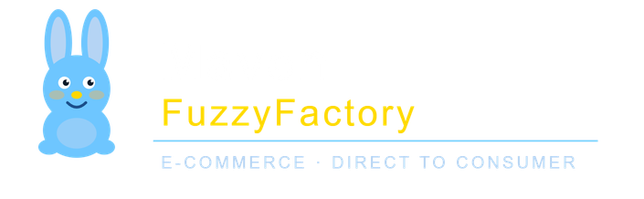
Every number in this deck is sourced from clean, audited data and every recommendation traces back to a confirmed result.
We are ready for your questions.
Zesto Team | MavenFuzzyFactory Analysis | March 2026

