Slide 1
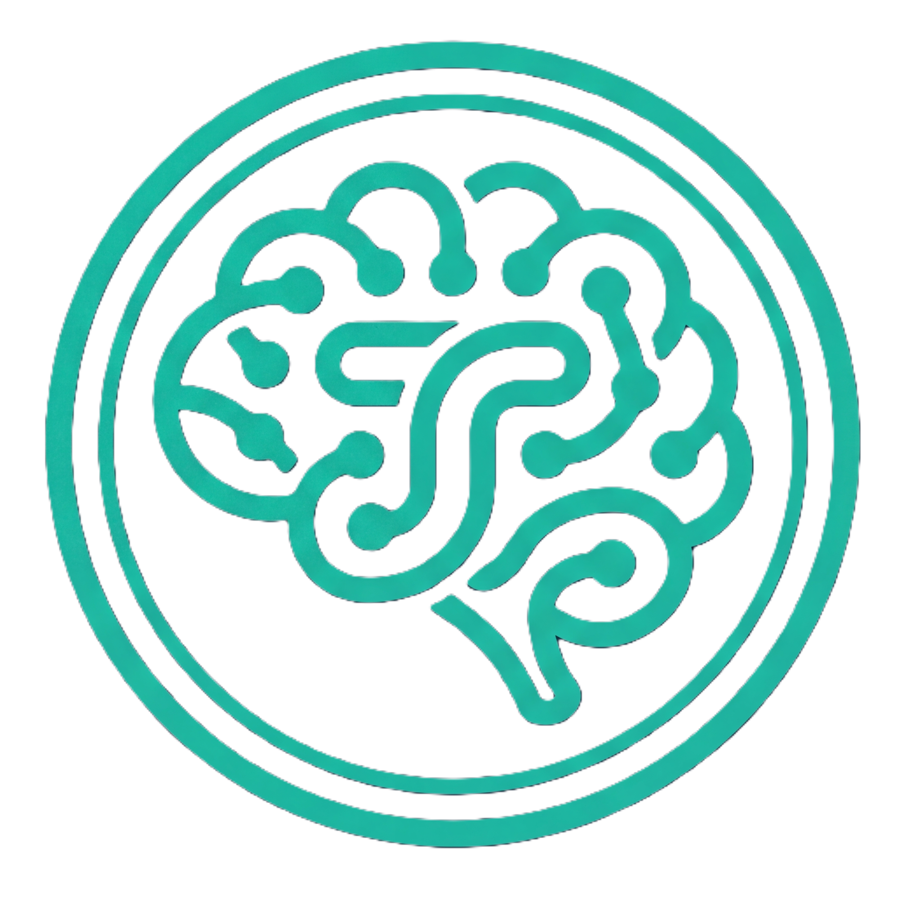
TOKANS
AI needs Tokens.
Humans need
Tokans.
A privacy-native ecosystem where verified human expertise meets AI-built software.
tokans.org
Notes:
Open with the tagline. AI consumes tokens; humans deserve Tokans — a privacy-native ecosystem. Set the frame: who owns data in an AI world.

Slide 2

— 01 / THE SHIFT
Building apps is no longer a barrier.
7
working apps built in one month · solo
GenAI has collapsed the cost of app creation to near zero. A solo founder built 7 working apps in one month alongside a full-time CTO role. Finance · Health · Memories · Docs · Work · Hobbies · Education If building is trivial — who still pays for software, and why? For interconnected data and access to resources otherwise not easily available. However, …
Notes:
The shift: GenAI made building trivial. Proof — 7 apps in a month, solo, alongside a CTO job. Land the question: if building is free, where's the value? Begin answering it.

Slide 3
— 02 / THE PROBLEM
A floor — but breaches still happen.
The economics of data security are broken.
AI-assisted attack
cheap
fast
Compliance is not enough GDPR and DPDP set a regulatory floor — but your data still sits on someone else's server. Delegation of risk, not ownership.
CENTRAL VAULT Millions of records
AI killed the cost of attacks Cyberattacks are now trivially cheap and fast. The limiting factor is simple economics.
Prize > Cost of attack
Centralisation is the vulnerability Any vault holding millions of records is always worth attacking. The prize exceeds the cost of the key. Every time.
inevitable
Prize value > Cost of attack. The economics are broken.
Notes:
The problem isn't compliance — it's economics. AI makes attacks cheap; any central vault is a standing prize. End on prize > cost.

Slide 4
— 03 / THE SOLUTION
Privacy as intrinsic architecture.
Eliminate the central vault for personal data When data lives only on the user's own device, there is no central target worth attacking.
No central target. Each device is its own vault.
Each device is its own vault Distributed personal storage means the prize value of any single breach drops below the cost of the attack.
Only non-confidential data gets transferred To avoid tracking, additional data gets queried and the downloaded data gets filtered at the client.
Architecture is the guarantee Not because a company promises to behave — but because the structure makes data theft unviable.
Prize < Cost of attack ✓
Privacy not as a policy. Privacy as a structural guarantee.
Notes:
The solution flips the economics: no central vault means no prize. Each device is its own encrypted vault; only non-confidential data ever leaves, filtered client-side. The guarantee is structural.

Slide 5
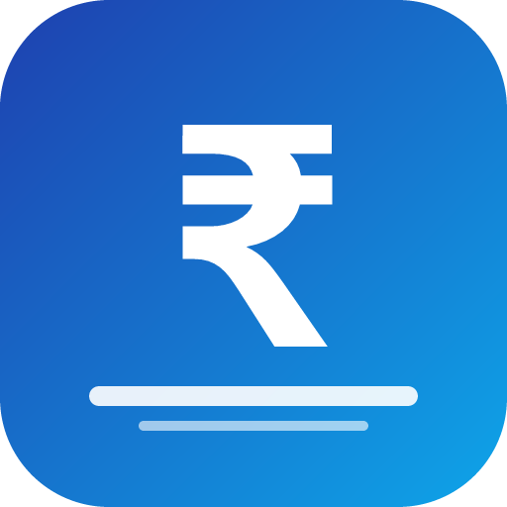

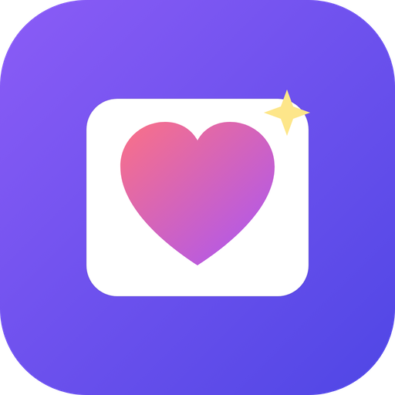
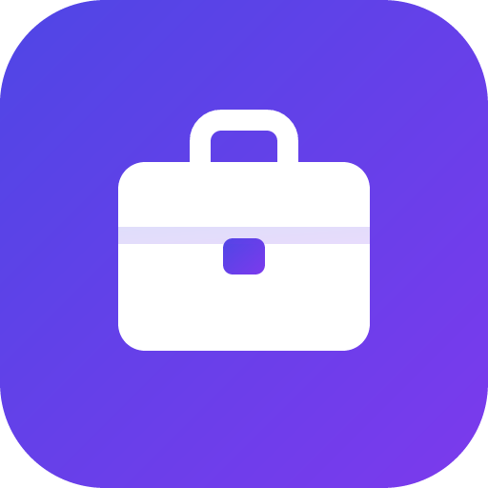
— 04 / THE ECOSYSTEM
Seeded by us · grown by partners
Curated secure apps. Seeded by us. Grown by verified partners.
myFinance
myHealth
myMemories
● We seeded the ecosystem Finance, health, memories, documents, hobbies — the personal life stack.
LIVE
SOON
SOON
● Partners grow it Verified vibe coders and domain experts submit apps. We curate and approve every listing.
▢
+
● Built on sharedCoreLib Encrypted local storage, LAN sync, device-native architecture out of the box.
myWork
myDocs
+ Your App
SOON
SOON
SUBMIT
● Users own their data Every app runs locally. No telemetry. No cloud dependency. Free to start.
Built on sharedCoreLib
A great app built in isolation stays an island. Tokans connects it to the mainland.
Notes:
We seeded the marketplace with real apps across the life stack. Partners extend it; sharedCoreLib makes their apps private-by-default and fast-tracks approval.

Slide 6
— 05 / PLATFORM & BUSINESS
The Ecosystem Flywheel
Netflix for apps — but the content is your own life.
Users
FREE
SUBSCRIBER
Local Apps
AI + Human Layer
Tokans trust layer
Apps
Builders
Full suite of privacy-first apps
Data stays on your device
No subscription required
Become a partner — inside every app
myLifeAssistant — personal AI + human services
myWorkAssistant — distributed workflow
Optional encrypted sync & backup
Access to verified partner network
Partners
Every transaction builds trust.
Partners enter at zero cost · pay only as they consume services
Notes:
Free local apps build the install base; the AI + human layer is the subscription. Partners enter free, pay as they earn. The flywheel — users, builders, partners, apps — compounds trust.

Slide 7

— 06 / WHY US
The niche is growing.
The product suite is live.
myFinance Live · tokans.github.io/myFinance
Tokans.org Platform onboarding live
Anshuman Das
IIT Delhi · ISB Hyderabad
20 years in financial technology
CTO / CIO — MNC banks & retail brokerages
300+ person technology teams
HFT · trading platforms · risk systems at scale
7 working apps built in one month
Kahaniverse Social storytelling · Tokans-powered
myLife suite 7 seeded apps · open source · Tauri
sharedCoreLib Encrypted local DB · LAN sync · device-native
AI needs Tokens. Humans need Tokans.
Notes:
Close on proof, not promise: live products across finance, platform, storytelling, plus the open core. End on the tagline — the natural next step, not a pivot.

