Slide 1
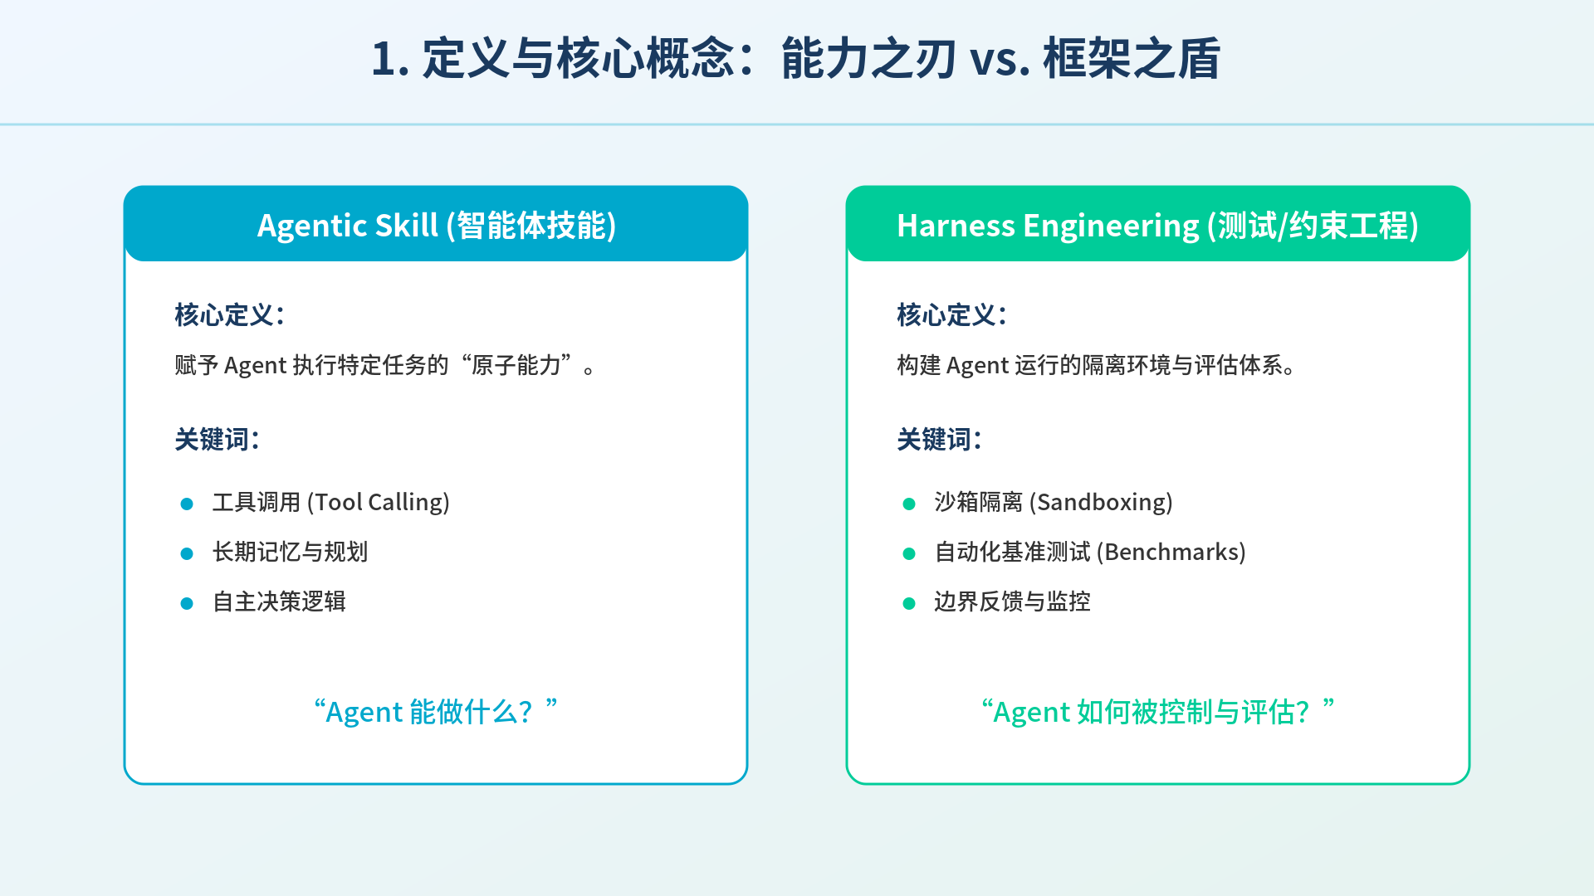
Notes:
=== Slide 1 SVG Source ===
(You can copy the code below and save as .svg to edit)
<svg xmlns="http://www.w3.org/2000/svg" viewBox="0 0 1280 720">
<!-- 背景 -->
<defs>
<linearGradient id="grad1" x1="0%" y1="0%" x2="100%" y2="100%">
<stop offset="0%" style="stop-color:#f0f7ff;stop-opacity:1" />
<stop offset="100%" style="stop-color:#e6f3f0;stop-opacity:1" />
</linearGradient>
</defs>
<rect width="1280" height="720" fill="url(#grad1)" />
<!-- 装饰线条 -->
<path d="M0 100 L1280 100" stroke="#00a8cc" stroke-width="2" opacity="0.3"/>
<!-- 标题 -->
<text x="640" y="60" text-anchor="middle" font-family="'Noto Sans CJK SC', sans-serif" font-size="36" font-weight="bold" fill="#1a3a5f">1. 定义与核心概念：能力之刃 vs. 框架之盾</text>
<!-- 左侧：Agentic Skill -->
<rect x="100" y="150" width="500" height="480" rx="15" fill="#ffffff" stroke="#00a8cc" stroke-width="2" />
<rect x="100" y="150" width="500" height="60" rx="15" fill="#00a8cc" />
<text x="350" y="190" text-anchor="middle" font-family="'Noto Sans CJK SC', sans-serif" font-size="24" fill="#ffffff" font-weight="bold">Agentic Skill (智能体技能)</text>
<text x="140" y="260" font-family="'Noto Sans CJK SC', sans-serif" font-size="20" fill="#1a3a5f" font-weight="bold">核心定义：</text>
<text x="140" y="300" font-family="'Noto Sans CJK SC', sans-serif" font-size="18" fill="#333">赋予 Agent 执行特定任务的“原子能力”。</text>
<text x="140" y="360" font-family="'Noto Sans CJK SC', sans-serif" font-size="20" fill="#1a3a5f" font-weight="bold">关键词：</text>
<circle cx="150" cy="405" r="5" fill="#00a8cc" />
<text x="170" y="410" font-family="'Noto Sans CJK SC', sans-serif" font-size="18" fill="#333">工具调用 (Tool Calling)</text>
<circle cx="150" cy="445" r="5" fill="#00a8cc" />
<text x="170" y="450" font-family="'Noto Sans CJK SC', sans-serif" font-size="18" fill="#333">长期记忆与规划</text>
<circle cx="150" cy="485" r="5" fill="#00a8cc" />
<text x="170" y="490" font-family="'Noto Sans CJK SC', sans-serif" font-size="18" fill="#333">自主决策逻辑</text>
<text x="350" y="580" text-anchor="middle" font-family="'Noto Sans CJK SC', sans-serif" font-size="22" fill="#00a8cc" font-style="italic">“Agent 能做什么？”</text>
<!-- 右侧：Harness Engineering -->
<rect x="680" y="150" width="500" height="480" rx="15" fill="#ffffff" stroke="#00cc99" stroke-width="2" />
<rect x="680" y="150" width="500" height="60" rx="15" fill="#00cc99" />
<text x="930" y="190" text-anchor="middle" font-family="'Noto Sans CJK SC', sans-serif" font-size="24" fill="#ffffff" font-weight="bold">Harness Engineering (测试/约束工程)</text>
<text x="720" y="260" font-family="'Noto Sans CJK SC', sans-serif" font-size="20" fill="#1a3a5f" font-weight="bold">核心定义：</text>
<text x="720" y="300" font-family="'Noto Sans CJK SC', sans-serif" font-size="18" fill="#333">构建 Agent 运行的隔离环境与评估体系。</text>
<text x="720" y="360" font-family="'Noto Sans CJK SC', sans-serif" font-size="20" fill="#1a3a5f" font-weight="bold">关键词：</text>
<circle cx="730" cy="405" r="5" fill="#00cc99" />
<text x="750" y="410" font-family="'Noto Sans CJK SC', sans-serif" font-size="18" fill="#333">沙箱隔离 (Sandboxing)</text>
<circle cx="730" cy="445" r="5" fill="#00cc99" />
<text x="750" y="450" font-family="'Noto Sans CJK SC', sans-serif" font-size="18" fill="#333">自动化基准测试 (Benchmarks)</text>
<circle cx="730" cy="485" r="5" fill="#00cc99" />
<text x="750" y="490" font-family="'Noto Sans CJK SC', sans-serif" font-size="18" fill="#333">边界反馈与监控</text>
<text x="930" y="580" text-anchor="middle" font-family="'Noto Sans CJK SC', sans-serif" font-size="22" fill="#00cc99" font-style="italic">“Agent 如何被控制与评估？”</text>
</svg>

Slide 2
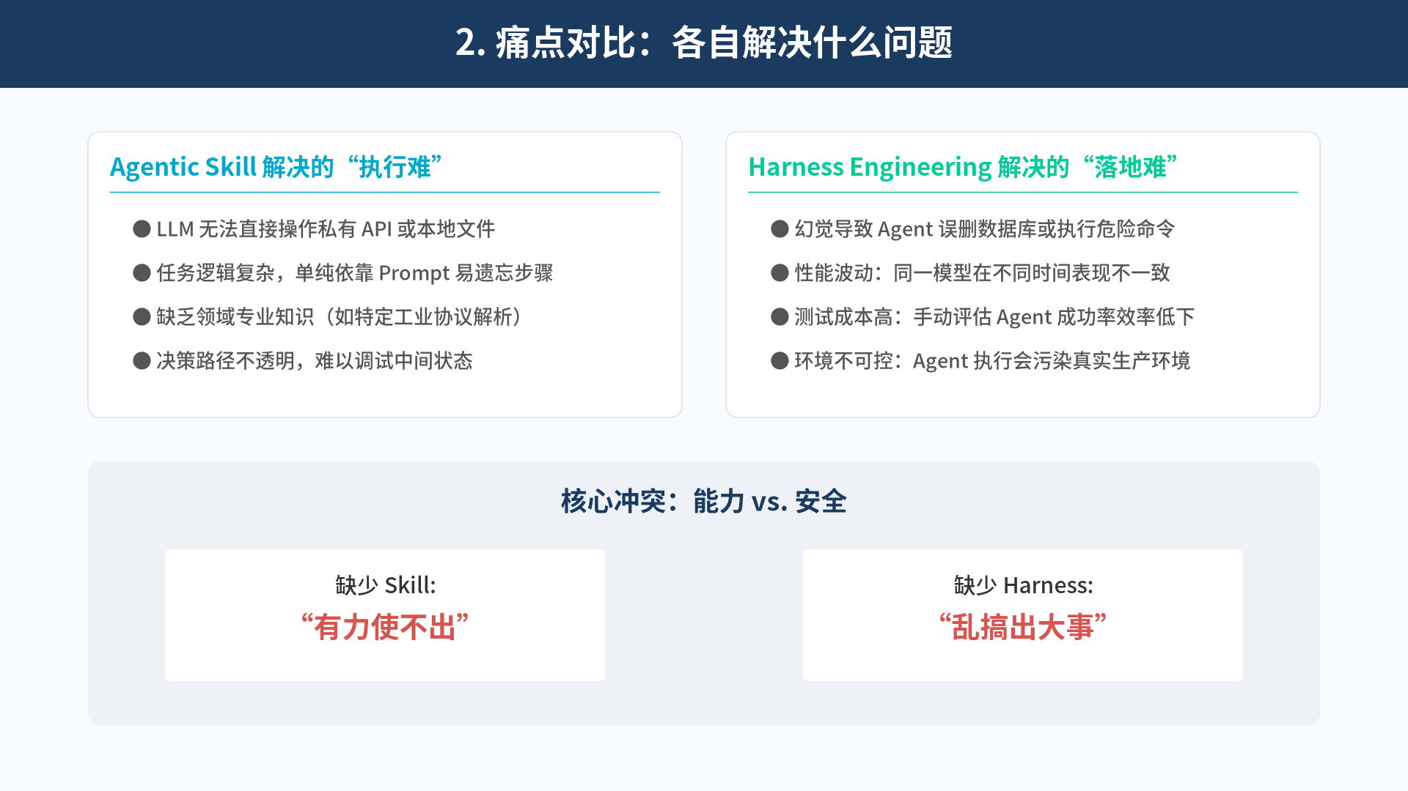
Notes:
=== Slide 2 SVG Source ===
(You can copy the code below and save as .svg to edit)
<svg xmlns="http://www.w3.org/2000/svg" viewBox="0 0 1280 720">
<rect width="1280" height="720" fill="#f8fbff" />
<rect x="0" y="0" width="1280" height="80" fill="#1a3a5f" />
<text x="640" y="50" text-anchor="middle" font-family="'Noto Sans CJK SC', sans-serif" font-size="32" font-weight="bold" fill="#ffffff">2. 痛点对比：各自解决什么问题</text>
<!-- 三栏对比布局 -->
<!-- Agentic Skill 痛点 -->
<rect x="80" y="120" width="540" height="260" rx="10" fill="#ffffff" stroke="#e0e0e0" />
<text x="100" y="160" font-family="'Noto Sans CJK SC', sans-serif" font-size="22" font-weight="bold" fill="#00a8cc">Agentic Skill 解决的“执行难”</text>
<line x1="100" y1="175" x2="600" y2="175" stroke="#00a8cc" stroke-width="1" />
<text x="120" y="215" font-family="'Noto Sans CJK SC', sans-serif" font-size="18" fill="#555">● LLM 无法直接操作私有 API 或本地文件</text>
<text x="120" y="255" font-family="'Noto Sans CJK SC', sans-serif" font-size="18" fill="#555">● 任务逻辑复杂，单纯依靠 Prompt 易遗忘步骤</text>
<text x="120" y="295" font-family="'Noto Sans CJK SC', sans-serif" font-size="18" fill="#555">● 缺乏领域专业知识（如特定工业协议解析）</text>
<text x="120" y="335" font-family="'Noto Sans CJK SC', sans-serif" font-size="18" fill="#555">● 决策路径不透明，难以调试中间状态</text>
<!-- Harness Engineering 痛点 -->
<rect x="660" y="120" width="540" height="260" rx="10" fill="#ffffff" stroke="#e0e0e0" />
<text x="680" y="160" font-family="'Noto Sans CJK SC', sans-serif" font-size="22" font-weight="bold" fill="#00cc99">Harness Engineering 解决的“落地难”</text>
<line x1="680" y1="175" x2="1180" y2="175" stroke="#00cc99" stroke-width="1" />
<text x="700" y="215" font-family="'Noto Sans CJK SC', sans-serif" font-size="18" fill="#555">● 幻觉导致 Agent 误删数据库或执行危险命令</text>
<text x="700" y="255" font-family="'Noto Sans CJK SC', sans-serif" font-size="18" fill="#555">● 性能波动：同一模型在不同时间表现不一致</text>
<text x="700" y="295" font-family="'Noto Sans CJK SC', sans-serif" font-size="18" fill="#555">● 测试成本高：手动评估 Agent 成功率效率低下</text>
<text x="700" y="335" font-family="'Noto Sans CJK SC', sans-serif" font-size="18" fill="#555">● 环境不可控：Agent 执行会污染真实生产环境</text>
<!-- 总结图示 -->
<rect x="80" y="420" width="1120" height="240" rx="10" fill="#eef2f6" />
<text x="640" y="465" text-anchor="middle" font-family="'Noto Sans CJK SC', sans-serif" font-size="24" font-weight="bold" fill="#1a3a5f">核心冲突：能力 vs. 安全</text>
<rect x="150" y="500" width="400" height="120" rx="5" fill="#ffffff" />
<text x="350" y="540" text-anchor="middle" font-family="'Noto Sans CJK SC', sans-serif" font-size="20" fill="#333">缺少 Skill:</text>
<text x="350" y="580" text-anchor="middle" font-family="'Noto Sans CJK SC', sans-serif" font-size="26" font-weight="bold" fill="#d9534f">“有力使不出”</text>
<rect x="730" y="500" width="400" height="120" rx="5" fill="#ffffff" />
<text x="930" y="540" text-anchor="middle" font-family="'Noto Sans CJK SC', sans-serif" font-size="20" fill="#333">缺少 Harness:</text>
<text x="930" y="580" text-anchor="middle" font-family="'Noto Sans CJK SC', sans-serif" font-size="26" font-weight="bold" fill="#d9534f">“乱搞出大事”</text>
</svg>

Slide 3
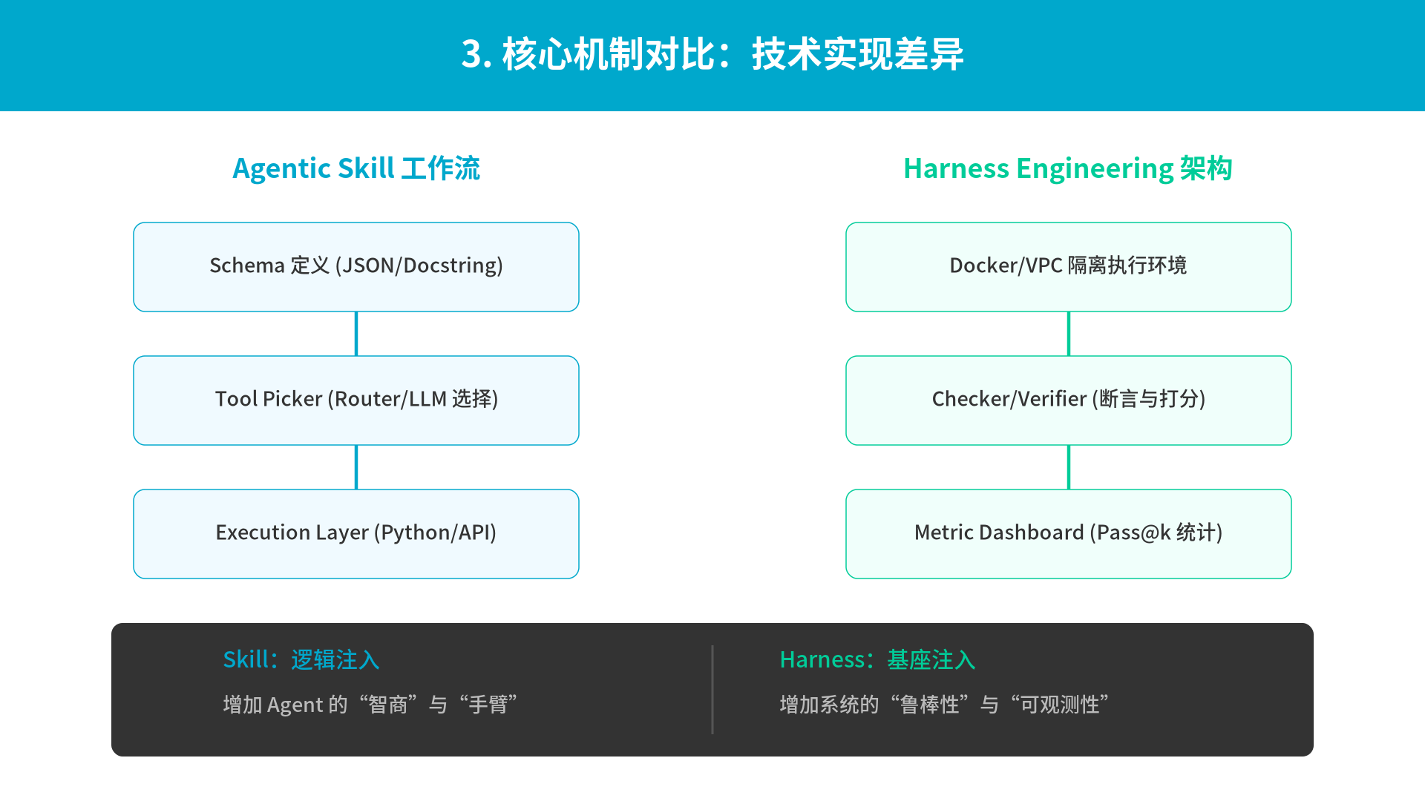
Notes:
=== Slide 3 SVG Source ===
(You can copy the code below and save as .svg to edit)
<svg xmlns="http://www.w3.org/2000/svg" viewBox="0 0 1280 720">
<rect width="1280" height="720" fill="#ffffff" />
<rect x="0" y="0" width="1280" height="100" fill="#00a8cc" />
<text x="640" y="60" text-anchor="middle" font-family="'Noto Sans CJK SC', sans-serif" font-size="32" font-weight="bold" fill="#ffffff">3. 核心机制对比：技术实现差异</text>
<!-- 流程图 -->
<!-- 左侧 Skill 机制 -->
<text x="320" y="160" text-anchor="middle" font-family="'Noto Sans CJK SC', sans-serif" font-size="24" font-weight="bold" fill="#00a8cc">Agentic Skill 工作流</text>
<rect x="120" y="200" width="400" height="80" rx="10" fill="#f0faff" stroke="#00a8cc" />
<text x="320" y="245" text-anchor="middle" font-family="'Noto Sans CJK SC', sans-serif" font-size="18" fill="#333">Schema 定义 (JSON/Docstring)</text>
<path d="M320 280 L320 320" fill="none" stroke="#00a8cc" stroke-width="3" />
<rect x="120" y="320" width="400" height="80" rx="10" fill="#f0faff" stroke="#00a8cc" />
<text x="320" y="365" text-anchor="middle" font-family="'Noto Sans CJK SC', sans-serif" font-size="18" fill="#333">Tool Picker (Router/LLM 选择)</text>
<path d="M320 400 L320 440" fill="none" stroke="#00a8cc" stroke-width="3" />
<rect x="120" y="440" width="400" height="80" rx="10" fill="#f0faff" stroke="#00a8cc" />
<text x="320" y="485" text-anchor="middle" font-family="'Noto Sans CJK SC', sans-serif" font-size="18" fill="#333">Execution Layer (Python/API)</text>
<!-- 右侧 Harness 机制 -->
<text x="960" y="160" text-anchor="middle" font-family="'Noto Sans CJK SC', sans-serif" font-size="24" font-weight="bold" fill="#00cc99">Harness Engineering 架构</text>
<rect x="760" y="200" width="400" height="80" rx="10" fill="#f0fffb" stroke="#00cc99" />
<text x="960" y="245" text-anchor="middle" font-family="'Noto Sans CJK SC', sans-serif" font-size="18" fill="#333">Docker/VPC 隔离执行环境</text>
<path d="M960 280 L960 320" fill="none" stroke="#00cc99" stroke-width="3" />
<rect x="760" y="320" width="400" height="80" rx="10" fill="#f0fffb" stroke="#00cc99" />
<text x="960" y="365" text-anchor="middle" font-family="'Noto Sans CJK SC', sans-serif" font-size="18" fill="#333">Checker/Verifier (断言与打分)</text>
<path d="M960 400 L960 440" fill="none" stroke="#00cc99" stroke-width="3" />
<rect x="760" y="440" width="400" height="80" rx="10" fill="#f0fffb" stroke="#00cc99" />
<text x="960" y="485" text-anchor="middle" font-family="'Noto Sans CJK SC', sans-serif" font-size="18" fill="#333">Metric Dashboard (Pass@k 统计)</text>
<!-- 底部对比表 -->
<rect x="100" y="560" width="1080" height="120" rx="10" fill="#333" />
<text x="200" y="600" font-family="'Noto Sans CJK SC', sans-serif" font-size="20" fill="#00a8cc">Skill：逻辑注入</text>
<text x="200" y="640" font-family="'Noto Sans CJK SC', sans-serif" font-size="18" fill="#bbb">增加 Agent 的“智商”与“手臂”</text>
<line x1="640" y1="580" x2="640" y2="660" stroke="#555" stroke-width="2" />
<text x="700" y="600" font-family="'Noto Sans CJK SC', sans-serif" font-size="20" fill="#00cc99">Harness：基座注入</text>
<text x="700" y="640" font-family="'Noto Sans CJK SC', sans-serif" font-size="18" fill="#bbb">增加系统的“鲁棒性”与“可观测性”</text>
</svg>

Slide 4
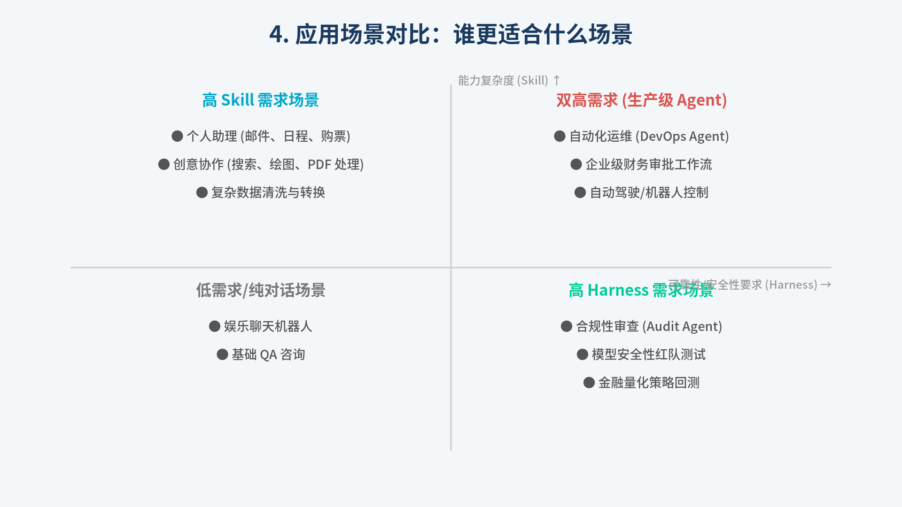
Notes:
=== Slide 4 SVG Source ===
(You can copy the code below and save as .svg to edit)
<svg xmlns="http://www.w3.org/2000/svg" viewBox="0 0 1280 720">
<rect width="1280" height="720" fill="#f4f7f9" />
<text x="640" y="60" text-anchor="middle" font-family="'Noto Sans CJK SC', sans-serif" font-size="32" font-weight="bold" fill="#1a3a5f">4. 应用场景对比：谁更适合什么场景</text>
<!-- 2x2 矩阵 -->
<line x1="100" y1="380" x2="1180" y2="380" stroke="#ccc" stroke-width="2" />
<line x1="640" y1="120" x2="640" y2="640" stroke="#ccc" stroke-width="2" />
<!-- 象限 1 -->
<text x="370" y="150" text-anchor="middle" font-family="'Noto Sans CJK SC', sans-serif" font-size="22" font-weight="bold" fill="#00a8cc">高 Skill 需求场景</text>
<text x="370" y="200" text-anchor="middle" font-family="'Noto Sans CJK SC', sans-serif" font-size="18" fill="#555">● 个人助理 (邮件、日程、购票)</text>
<text x="370" y="240" text-anchor="middle" font-family="'Noto Sans CJK SC', sans-serif" font-size="18" fill="#555">● 创意协作 (搜索、绘图、PDF 处理)</text>
<text x="370" y="280" text-anchor="middle" font-family="'Noto Sans CJK SC', sans-serif" font-size="18" fill="#555">● 复杂数据清洗与转换</text>
<!-- 象限 2 -->
<text x="910" y="150" text-anchor="middle" font-family="'Noto Sans CJK SC', sans-serif" font-size="22" font-weight="bold" fill="#d9534f">双高需求 (生产级 Agent)</text>
<text x="910" y="200" text-anchor="middle" font-family="'Noto Sans CJK SC', sans-serif" font-size="18" fill="#555">● 自动化运维 (DevOps Agent)</text>
<text x="910" y="240" text-anchor="middle" font-family="'Noto Sans CJK SC', sans-serif" font-size="18" fill="#555">● 企业级财务审批工作流</text>
<text x="910" y="280" text-anchor="middle" font-family="'Noto Sans CJK SC', sans-serif" font-size="18" fill="#555">● 自动驾驶/机器人控制</text>
<!-- 象限 3 -->
<text x="370" y="420" text-anchor="middle" font-family="'Noto Sans CJK SC', sans-serif" font-size="22" font-weight="bold" fill="#777">低需求/纯对话场景</text>
<text x="370" y="470" text-anchor="middle" font-family="'Noto Sans CJK SC', sans-serif" font-size="18" fill="#555">● 娱乐聊天机器人</text>
<text x="370" y="510" text-anchor="middle" font-family="'Noto Sans CJK SC', sans-serif" font-size="18" fill="#555">● 基础 QA 咨询</text>
<!-- 象限 4 -->
<text x="910" y="420" text-anchor="middle" font-family="'Noto Sans CJK SC', sans-serif" font-size="22" font-weight="bold" fill="#00cc99">高 Harness 需求场景</text>
<text x="910" y="470" text-anchor="middle" font-family="'Noto Sans CJK SC', sans-serif" font-size="18" fill="#555">● 合规性审查 (Audit Agent)</text>
<text x="910" y="510" text-anchor="middle" font-family="'Noto Sans CJK SC', sans-serif" font-size="18" fill="#555">● 模型安全性红队测试</text>
<text x="910" y="550" text-anchor="middle" font-family="'Noto Sans CJK SC', sans-serif" font-size="18" fill="#555">● 金融量化策略回测</text>
<!-- 轴标签 -->
<text x="1180" y="410" text-anchor="end" font-family="'Noto Sans CJK SC', sans-serif" font-size="16" fill="#999">可靠性/安全性要求 (Harness) →</text>
<text x="650" y="120" font-family="'Noto Sans CJK SC', sans-serif" font-size="16" fill="#999">能力复杂度 (Skill) ↑</text>
</svg>

Slide 5
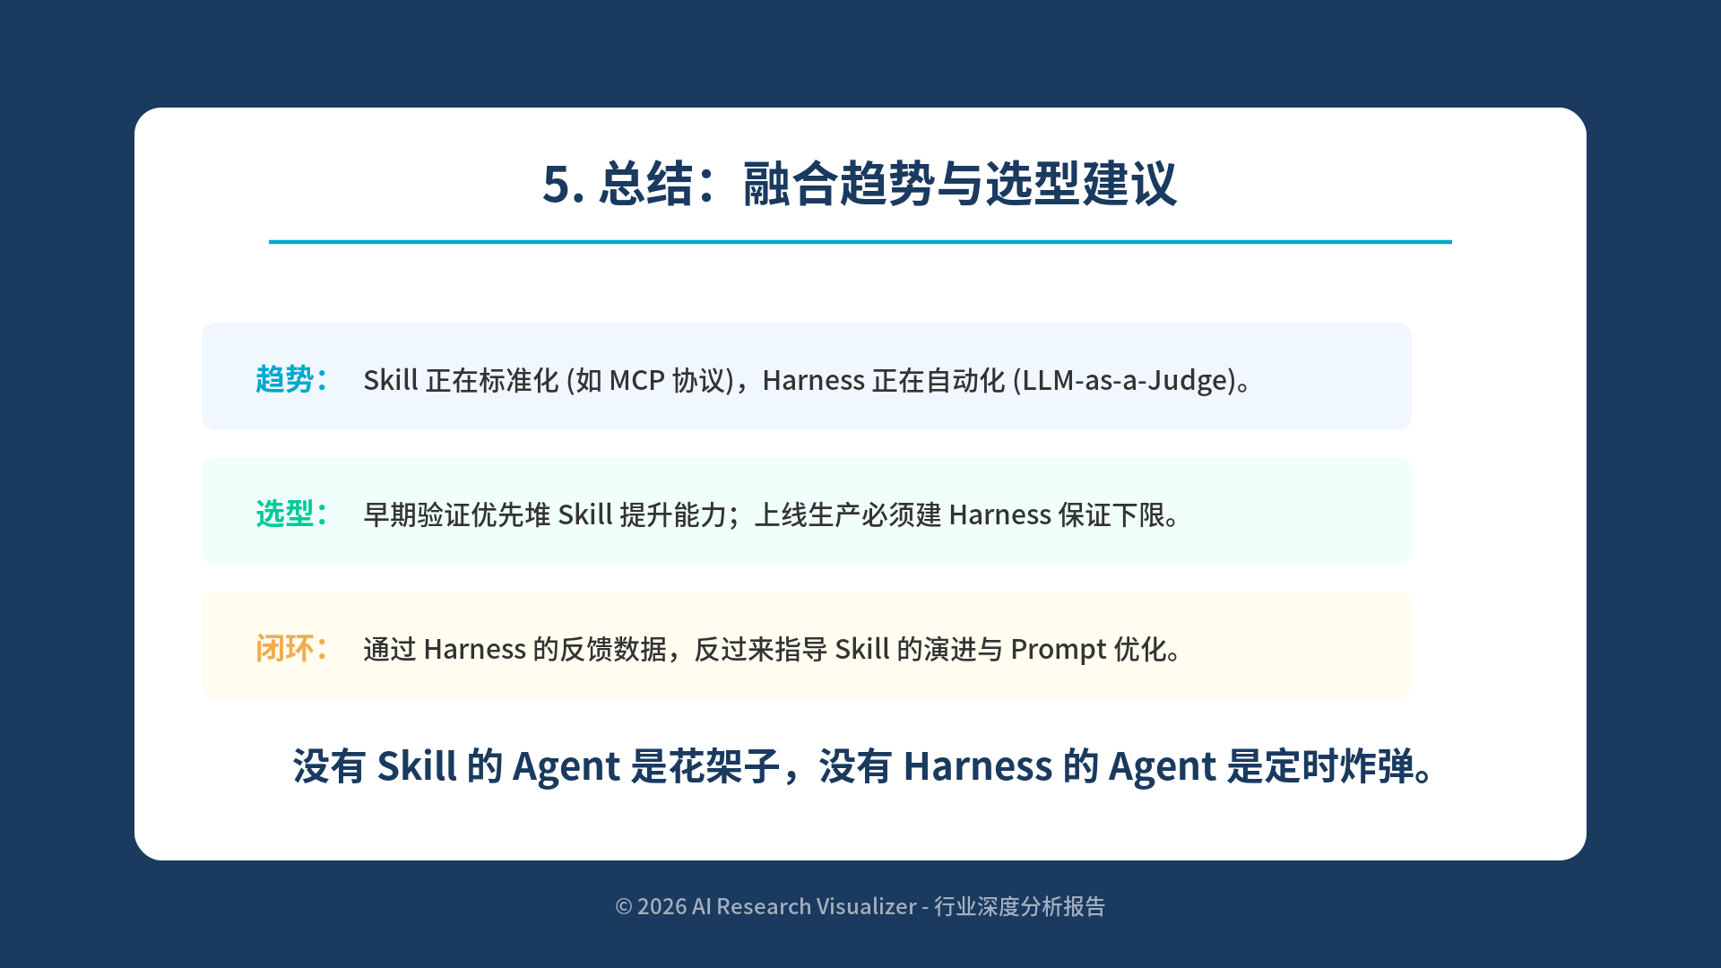
Notes:
=== Slide 5 SVG Source ===
(You can copy the code below and save as .svg to edit)
<svg xmlns="http://www.w3.org/2000/svg" viewBox="0 0 1280 720">
<rect width="1280" height="720" fill="#1a3a5f" />
<!-- 结论框 -->
<rect x="100" y="80" width="1080" height="560" rx="20" fill="#ffffff" />
<text x="640" y="150" text-anchor="middle" font-family="'Noto Sans CJK SC', sans-serif" font-size="36" font-weight="bold" fill="#1a3a5f">5. 总结：融合趋势与选型建议</text>
<line x1="200" y1="180" x2="1080" y2="180" stroke="#00a8cc" stroke-width="3" />
<!-- 核心结论点 -->
<g transform="translate(150, 240)">
<rect width="900" height="80" rx="10" fill="#f0f7ff" />
<text x="40" y="50" font-family="'Noto Sans CJK SC', sans-serif" font-size="22" font-weight="bold" fill="#00a8cc">趋势：</text>
<text x="120" y="50" font-family="'Noto Sans CJK SC', sans-serif" font-size="20" fill="#333">Skill 正在标准化 (如 MCP 协议)，Harness 正在自动化 (LLM-as-a-Judge)。</text>
</g>
<g transform="translate(150, 340)">
<rect width="900" height="80" rx="10" fill="#f0fffb" />
<text x="40" y="50" font-family="'Noto Sans CJK SC', sans-serif" font-size="22" font-weight="bold" fill="#00cc99">选型：</text>
<text x="120" y="50" font-family="'Noto Sans CJK SC', sans-serif" font-size="20" fill="#333">早期验证优先堆 Skill 提升能力；上线生产必须建 Harness 保证下限。</text>
</g>
<g transform="translate(150, 440)">
<rect width="900" height="80" rx="10" fill="#fffcf0" />
<text x="40" y="50" font-family="'Noto Sans CJK SC', sans-serif" font-size="22" font-weight="bold" fill="#f0ad4e">闭环：</text>
<text x="120" y="50" font-family="'Noto Sans CJK SC', sans-serif" font-size="20" fill="#333">通过 Harness 的反馈数据，反过来指导 Skill 的演进与 Prompt 优化。</text>
</g>
<text x="640" y="580" text-anchor="middle" font-family="'Noto Sans CJK SC', sans-serif" font-size="28" font-weight="bold" fill="#1a3a5f">没有 Skill 的 Agent 是花架子，没有 Harness 的 Agent 是定时炸弹。</text>
<text x="640" y="680" text-anchor="middle" font-family="'Noto Sans CJK SC', sans-serif" font-size="16" fill="#ffffff" opacity="0.6">© 2026 AI Research Visualizer - 行业深度分析报告</text>
</svg>

