Slide 1

EOSFACTORY
SMART-CONTRACT DEVELOPMENT & TESTING IDE
Presented by

Slide 2
What is eosFactory?
A Python-based EOS smart-contract development & testing framework
WHY is eosFactory NEEDED?
Automation is essential for efficient unit testing
WHAT ARE THE MAIN FEATURES?
Object-oriented, Simple syntax, Real testnet, Truly cross-platform

Slide 3
An integrated development environment (IDE) is a software application that provides comprehensive facilities to computer programmers for software development.
An IDE normally consists of a source code editor, build automation tools, and a debugger.

Slide 4
EOSIO INFRASTRUCURE
nodeos
cleos
EOSF C++
EOSF Python
Node
Clients
Tools
eosjs
scatter
keosd

Slide 5
eosFactory COMPONENTS
Demos, Templates, Unit Tests
Python CLI
C++

Slide 6
Main features in v1.0
Standard unit-testing framework
Support for user-defined workspaces
Support for debugging
Preliminary code verification
Visual Studio Code integration

Slide 7
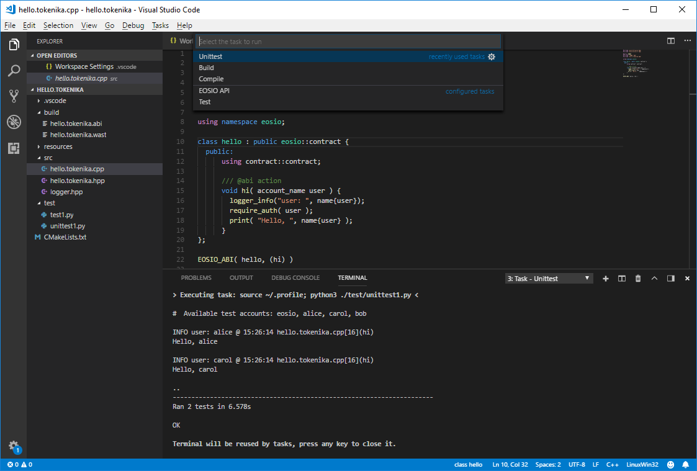
eosFactory UNIT TESTS

Slide 8
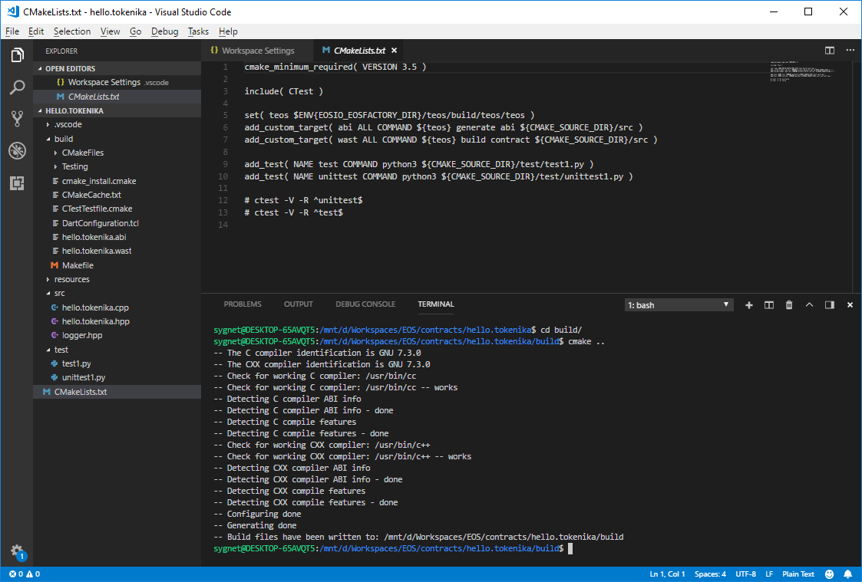
eosFactory CMAKE SUPPORT

Slide 9
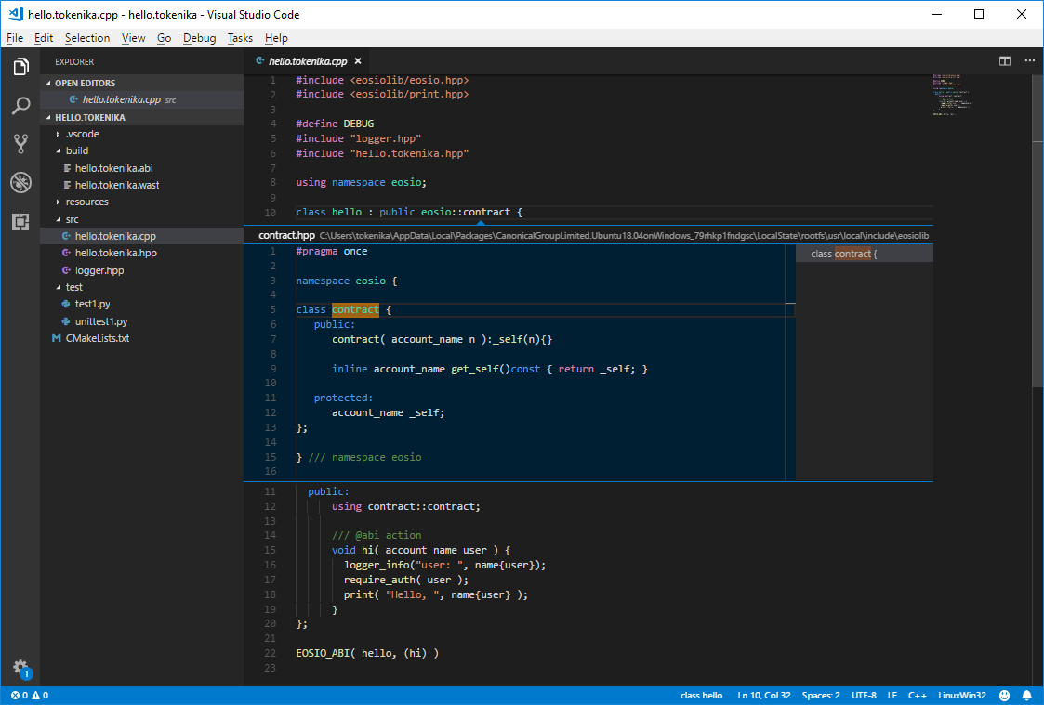
eosFactory IntelliSense

Slide 10
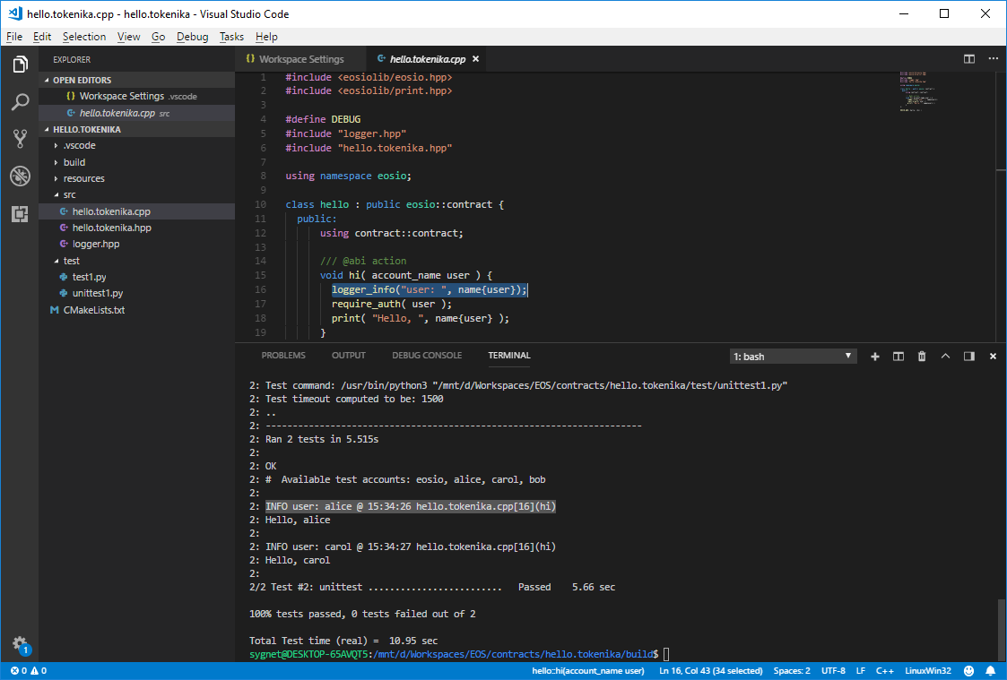
eosFactory DEBUGGING

Slide 11
Thank you
Any questions?
EOSFACTORY
eosfactory.io
github.com/tokenika/eosfactory
Presented by
tokenika.io contact@tokenika.io

