Slide 1
Project:
Rock, Paper, Scissors

Slide 2
Learning Objectives
Statement(s):
if
elif
else
Boolean
  What is a boolean?
    ==
    and
Challenges:
ASCII art - Use conditional logic to display ASCII art for Rock, Paper, and Scissors game
Create a new game - Duplicate the Rock, Paper, Scissors game and remix it to create a new game

Slide 3
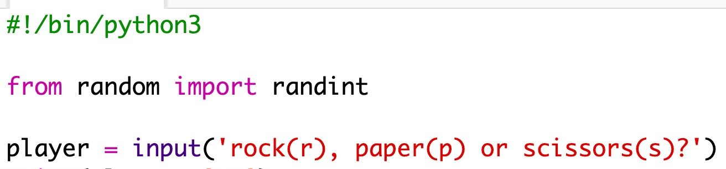
Getting Started
https://trinket.io/embed/python/de918c4f5d
First, let the player choose Rock, Paper or Scissors by typing the letter ‘r’, ‘p’, or ‘s’.

Slide 4
Now print out what the player chose:
Test your code by clicking Run. Click in the trinket output window to enter your choice.

Slide 5
Now it’s the computers turn. You can use randint function to generate a random number to decide between rock, paper, and scissors.

Slide 6
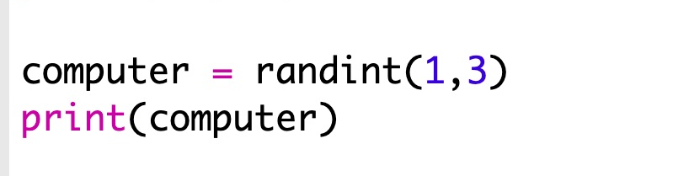
Use randint to
generate a number
Make the computer choose a number between 1 and 3
Name this variable computer
Print computer

Slide 7
Computer’s Turn
What does this random number mean?
Let’s assign meanings to the number!
1 = rock (r)
2 = paper (p)
3 = scissors (s)

Slide 8

Use if to check if the chosen number is 1
Use == to see if 2 things are the same

Slide 9
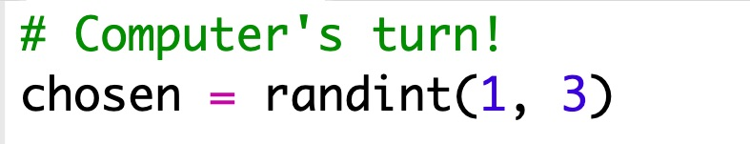
Use indentation to show which code is inside the if statement
This can be done using two spaces(tap the spacebar twice) or by using the tab key
Set computer to ‘r’ inside the if using indentation

Slide 10
You can add an alternative check using elif (short for else if):
***Remember indentation is important***
This condition will only be checked if the first condition fails (if the computer didn’t choose 1).

Slide 11
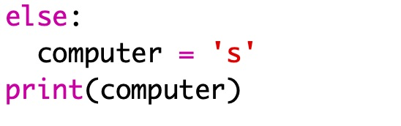
And finally, if the computer didn’t choose 1 or 2 then it must have chosen 3.
This time we can just use else which means otherwise.
Let’s print computer and Run to make sure our random number is correct.

Slide 12
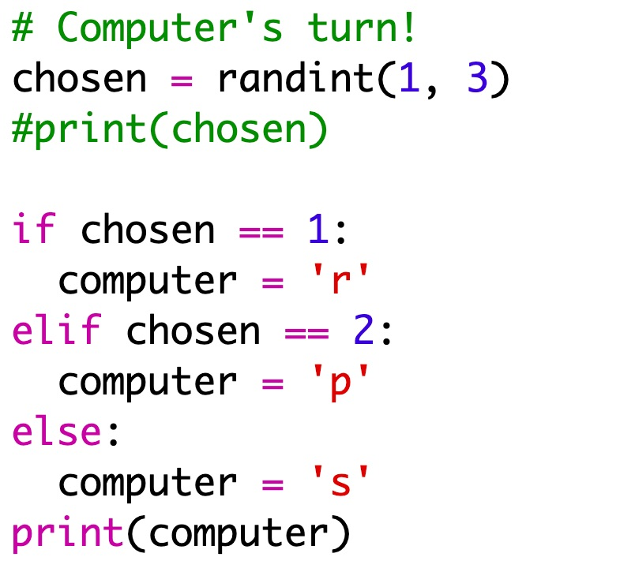
Now, instead of printing out the random number that the computer chose you can print the letter.
You can either delete the line print(chosen)
Or you can make the computer ignore it by adding a # at the start of the line

Slide 13

Hmmm, the computer’s choice gets printed on a new line. How do we fix this?
You can fix this by adding end=’ ‘ after vs
Are there any other ways we can fix this?

Slide 14
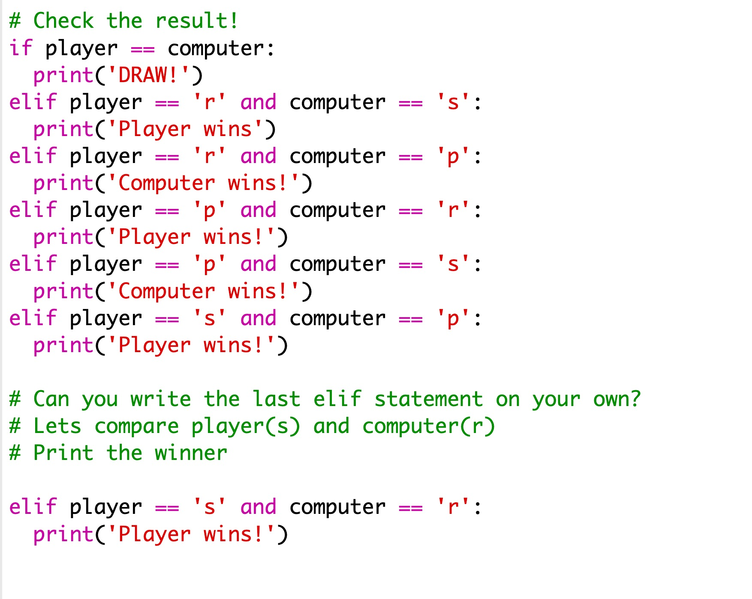
Check the result
Let’s add some code to see who won.
You need to compare the player and computer variables to see who won.
If they’re the same then its a draw

Slide 15
Now let’s look at the cases where the player
chose ‘r’ (rock) but the computer didn’t.
If the computer chose ‘s’ (scissors) then the player wins (rock beats scissors).
If the computer chose ‘p’ (paper) then the computer wins (paper beats rock).
We can check the player choice and the computer choice using and

Slide 16
Next let’s look at the cases where the player chose ‘p’ (paper) but the computer didn’t.

Slide 17
And finally, can you add the code to check for the winner when the player chose ‘s’ (scissors) and the computer chose ‘r’ (rock) or ‘p’ (paper)?

Slide 18
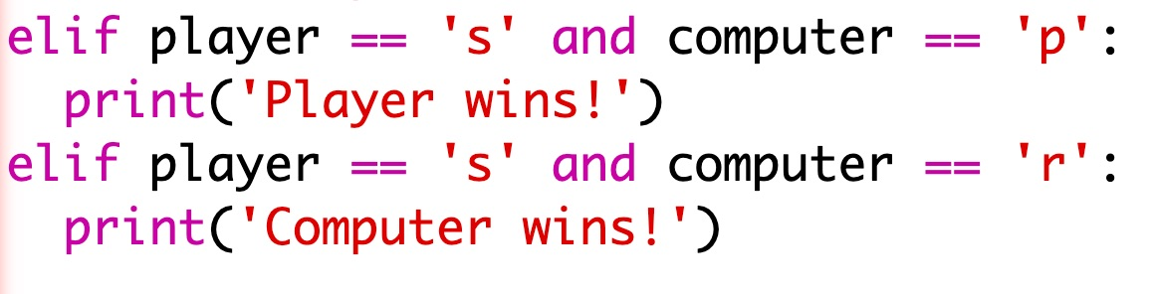
Let’s review your code for player == ‘s’
Raise your hand if you need help with your code.

Slide 19
Now play the game
to test your code. \o/
Click Run to start a new game.

Slide 20
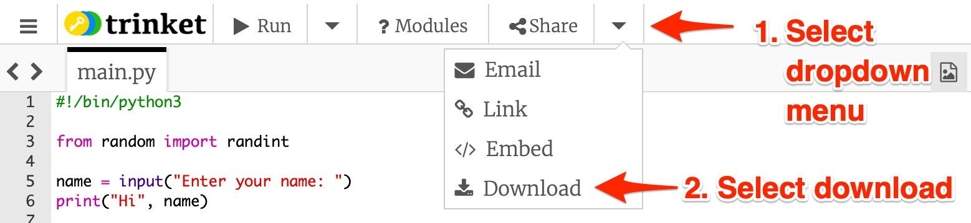
How to download your code:

Slide 21
Goodbye !
（✿ ͡◕ ᴗ◕)つ━━✫·*。

