Slide 1
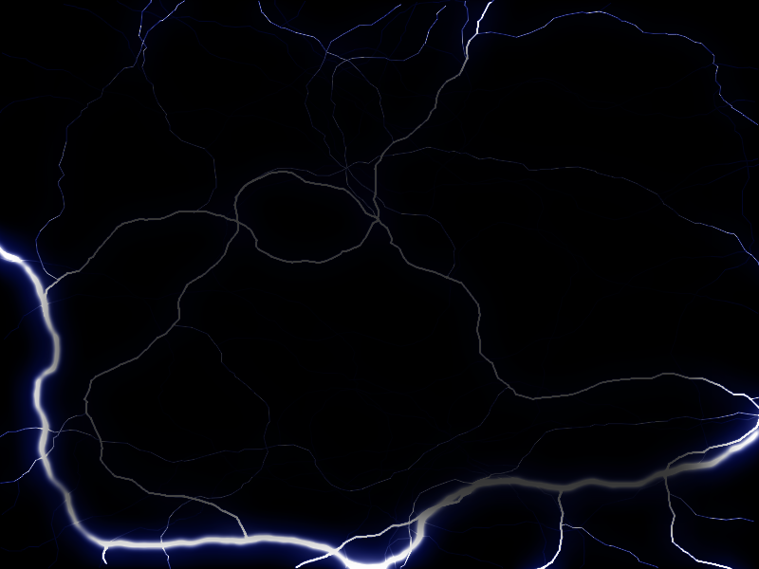
Mixed character encodings test.
RTF file created using WordPad (important, because character encodings are saved differently).
Polskie litery: ąćęłńśźżĄĆĘŁŃŚŹŻ
Arabski tekst: عينة نص
Rosyjski tekst (cyrylica): Образец текста

