Slide 1

SUSTAINABLE FASHION
By: Carol Ashraf Mamdouh

Slide 2
TABLE OF CONTENTS
01
04
02
05
03
06
Definition of sustainable fashion
Questions about the dataset
Importance of sustainable fashion
Charts
Dataset Content
Conclusion

Slide 3
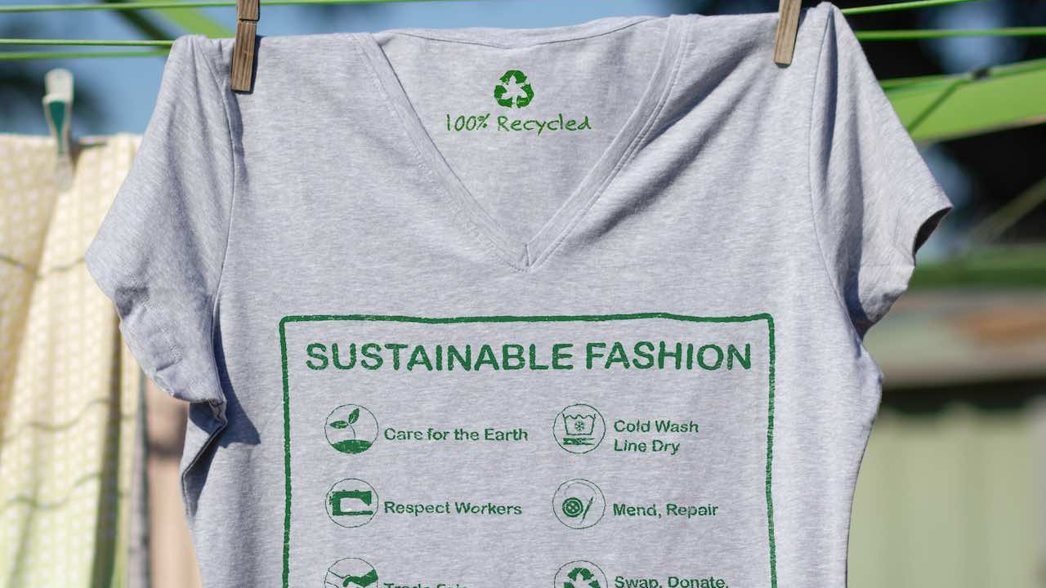
01
Definition of sustainable fashion

Slide 4
Sustainable Fashion
Sustainable fashion refers to clothing and accessories that are produced and consumed in a way that minimize environmental impact and promote ethical practices. It emphasizes eco-friendly materials, reduced waste, and fair labor conditions throughout the supply chain

Slide 5


02 Importance of sustaiable fashion
01 Reduction of environmental waste
02 Minimized waste consumption
03 Improves consumer trust through certification

Slide 6
03 Dataset Content
Brand ID
Brand Name
Country
Unique identifier for each brand
Country where the brand is based
Year
Sustainability Rating
Material Type
Year of data collection
Sustainability rating of the brand (A to D scale)
The primary materials used by brands in its products
Eco Friendly
Manufacturing
Carbon Footprint
Water Usage
Amount of water used in liters
Carbon footprint in metric tons
Whether the manufacturing
process is eco-friendly (Yes/No)

Slide 7
03 Dataset Content
Recycling Program
Product Lines
Average Price
Whether the brand has recycling programs or not (Yes/ No)
Number of product lines offered
How price levels correlate with sustainability practices
Market Trends
Certifications
Correlation of sustainability efforts with economic performance
The brand’s compliance with recognized sustainability standards

Slide 8
04 Questions to be answered
What is the total net waste by each country?
What are the price ranges for the brands?
What is the number of brands in each price range across different countries?
What is the Water usage per product line ?
What is the average sustainability rating per country?
What are the common materials used by brands according to sustainability ratings?
Which certifications are most common among brands with (growing, stable, declining) market trends?
How have the sustainability metrics evolved over time across the industry?

Slide 9
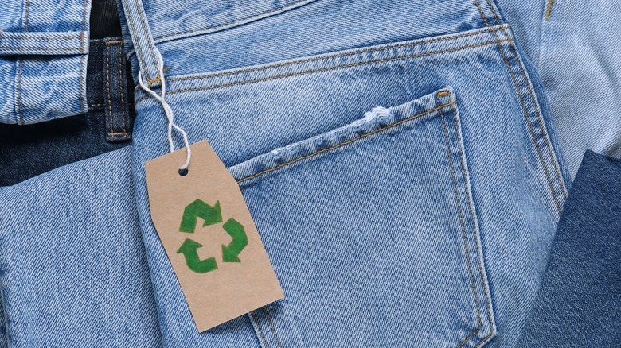
05 Charts

Slide 10
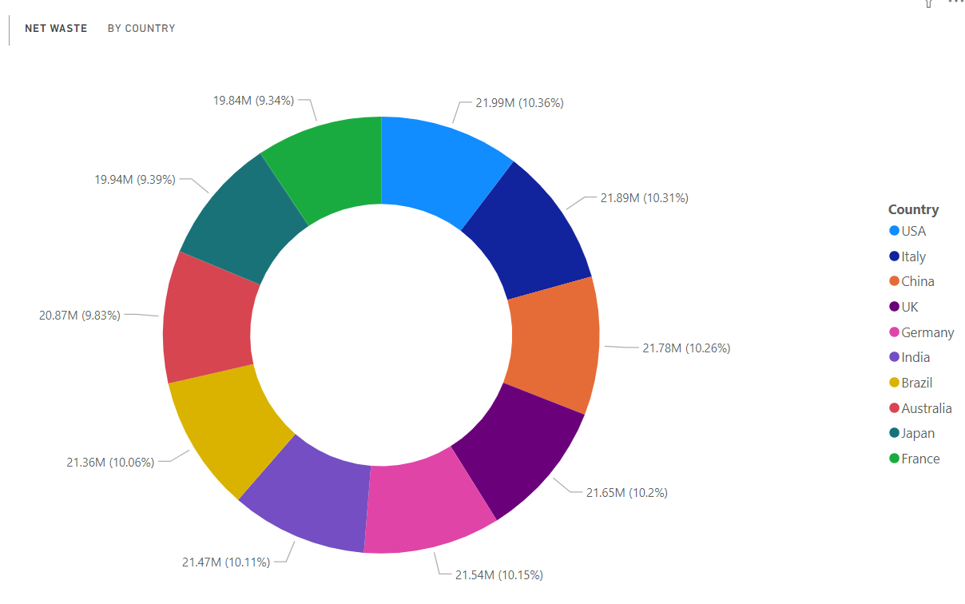
1) What is the total net waste by each country ?
The net waste distribution is relatively balanced among these 10 countries, with the USA being the top contributor at 10.36%, and France being the lowest at 9.34%. The majority of countries contribute between 9% and 10% of the total waste.

Slide 11
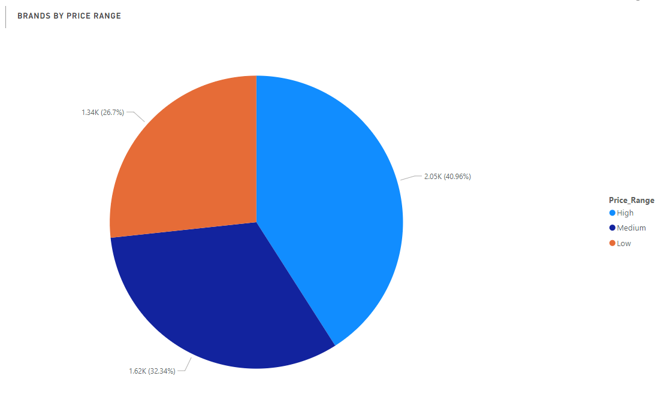
2) What are the price ranges for the brands ?
The majority of brands fall into the High price range, outnumbering the Medium and Low price ranges combined. This suggests that a significant portion of the market is willing to invest in higher-priced brands, possibly due to perceived quality, prestige, or unique features. However, the presence of a considerable number of brands in the Medium and Low price ranges indicates that there is still a demand for more affordable options, catering to budget-conscious consumers

Slide 12
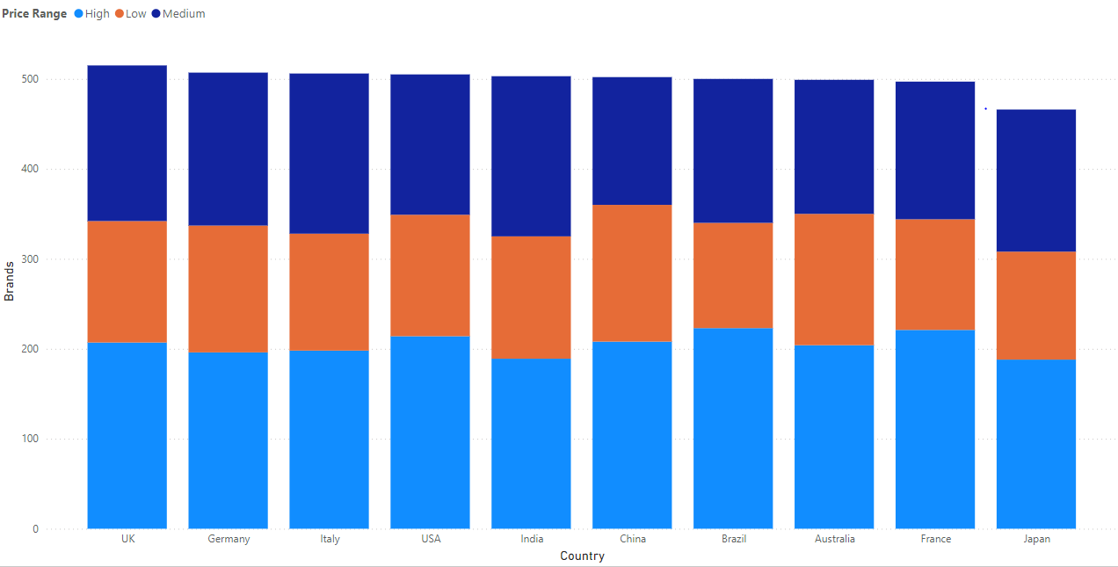
3) What is the number of brands in each price range across different countries ?
Each country has an equal number of brands in each price range. This suggests that the distribution of brands across price ranges is relatively consistent across the ten countries analyzed.

Slide 13
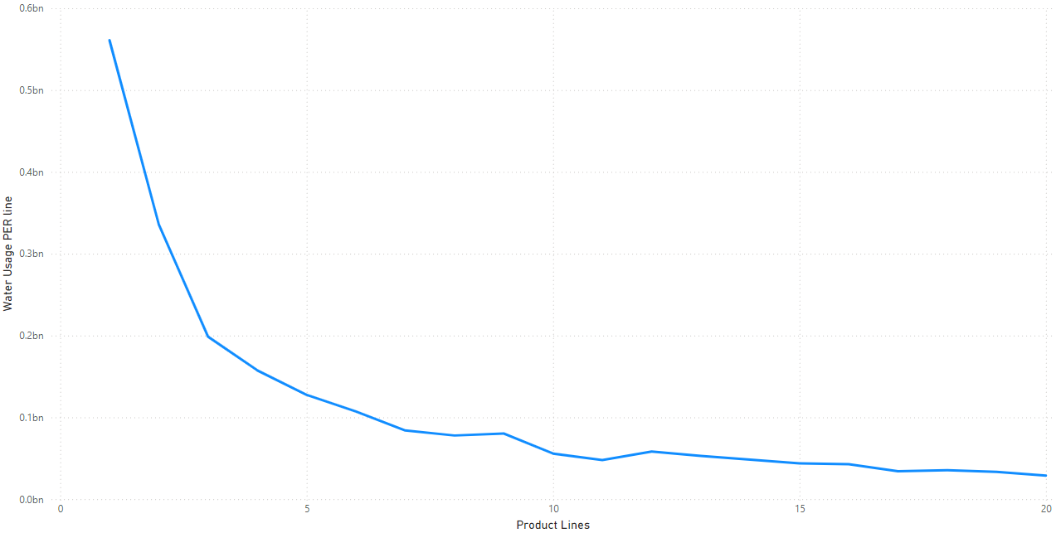
4) What is the Water usage per product line?
The line graph shows that water usage per product line decreases as the product line number increases. The first few product lines use significantly more water than the later ones. The water usage levels off around product line 15, with only a slight decrease for the remaining product lines.

Slide 14
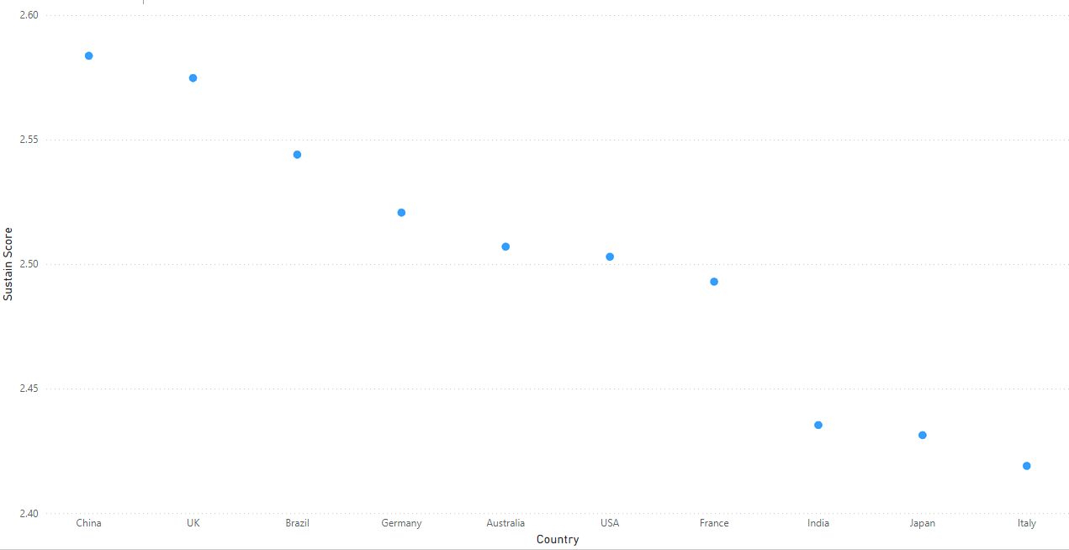
5) What is the average sustainability rating per country ?
The average sustainability rating varies slightly among the countries. China and the UK have the highest average ratings, followed by Brazil and Germany. The lowest average rating is for Italy. Overall, the sustainability ratings are relatively close, suggesting that there is not a significant difference in sustainability practices among these countries.

Slide 15
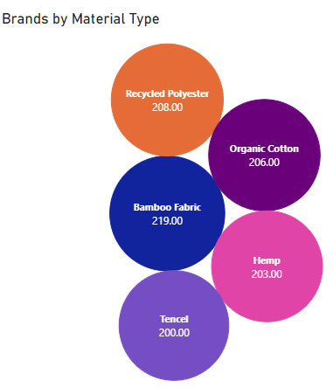
6.1) What are the common materials used by brands according to sustainability ratings ?
Brands with the highest (A) sustainability ratings are 1,036 out of 5000 brands
Bamboo Fabric is the most used fabric among the brands with the highest sustainability rating

Slide 16
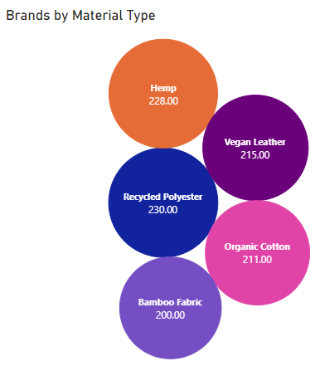
6.2) What are the common materials used by brands according to sustainability ratings ?
Brands with medium (B) sustainability ratings are 1,084 out of 5000 brands
Recycled Polyester is the most used fabric among the brand with medium sustainability ratings

Slide 17
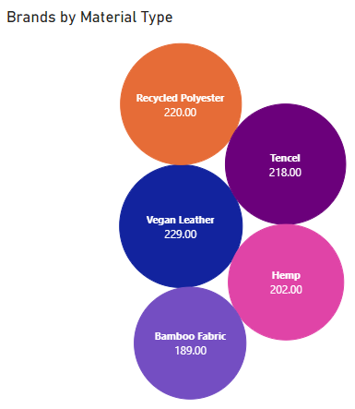
6.3) What are the common materials used by brands according to sustainability ratings ?
Brands with fair (C) sustainability ratings are 1,058 out of 5000 brands
Vegan Leather is the most used fabric among the brands with fair sustainability ratings

Slide 18

6.4) What are the common materials used by brands according to sustainability ratings ?
Brands with low (D) sustainability ratings are 1,055 out of 5000 brands
Organic Cotton is the most used fabric among the brands with low sustainability ratings.

Slide 19
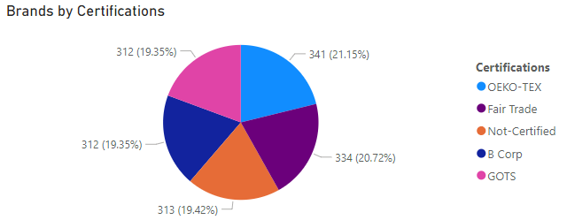
7.1) Which certifications are most common among brands with (growing, stable, declining) market trends ?
Brands with growing market trend are 1,300 out of 5,000 brands
OEKO-TEX is the most common certificate among brands with high market trend

Slide 20
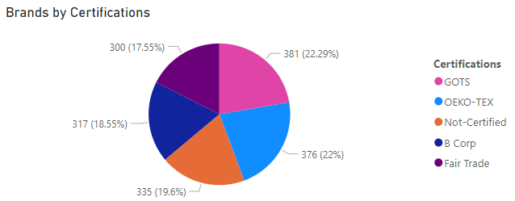
7.2) Which certifications are most common among brands with (growing, stable, declining) market trends ?
Brands with stable market trend are 1,709out of 5,000 brands
GOTS is the most common certificate among brands with stable market trend

Slide 21
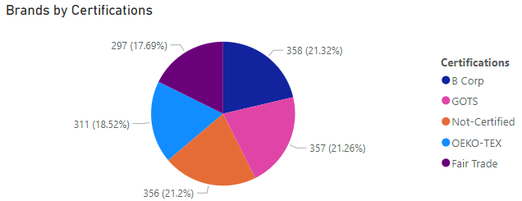
7.2) Which certifications are most common among brands with (growing, stable, declining) market trends ?
Brands with declining market trend are 1,679 out of 5,000 brands
B CORP is the most common certificate among brands with declining market trend

Slide 22
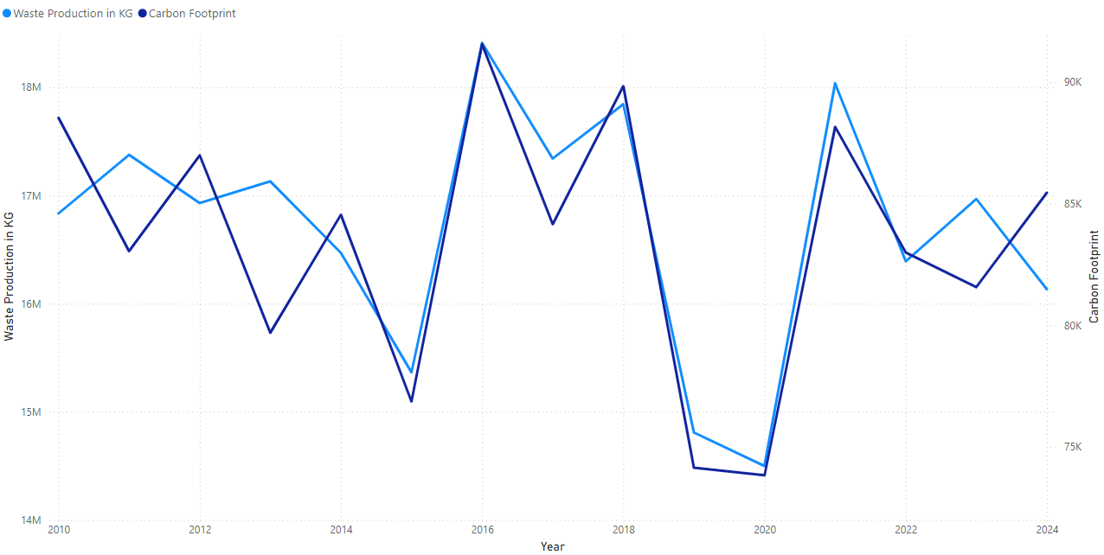
8) How have the sustainability metrics evolved over time across the industry ?
The industry has made progress in reducing its environmental impact, with a decline in waste production and carbon footprint since 2016. However, further efforts are needed to continue this trend. Key strategies include investing in sustainable technologies, enhancing waste management, promoting circular economy practices, and transitioning from fossil fuels to renewable energy sources.

Slide 23
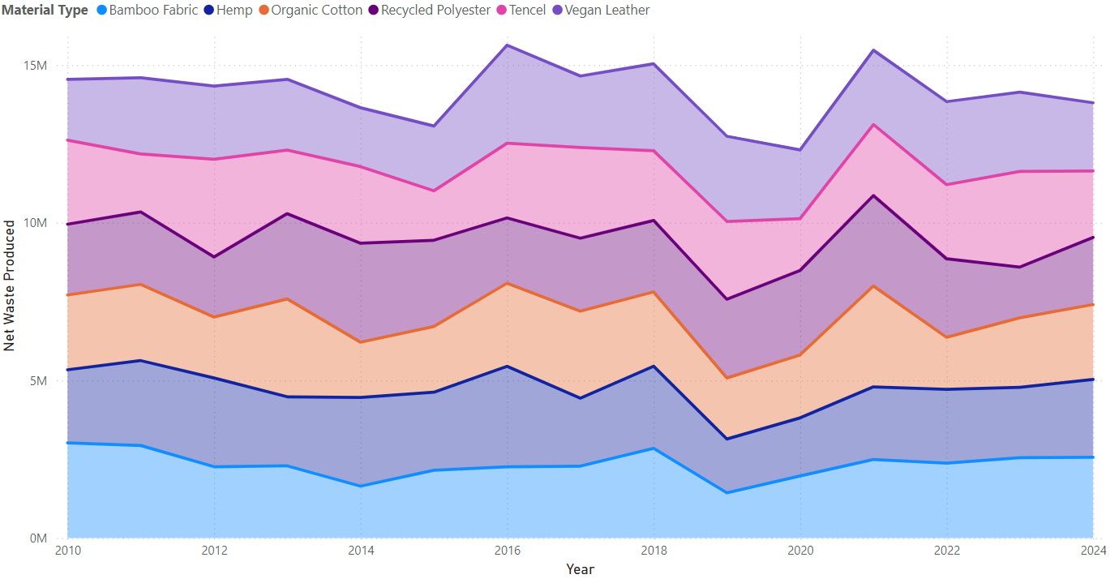
9) What is the waste production by material type over the years ?
All of the material types have experienced similar trends in waste production, with a peak in 2016 and subsequent stabilization. This suggests that the industry has made progress in reducing waste production across different materials. However, further efforts are needed to continue this trend and explore more sustainable practices to minimize waste generation.

Slide 24
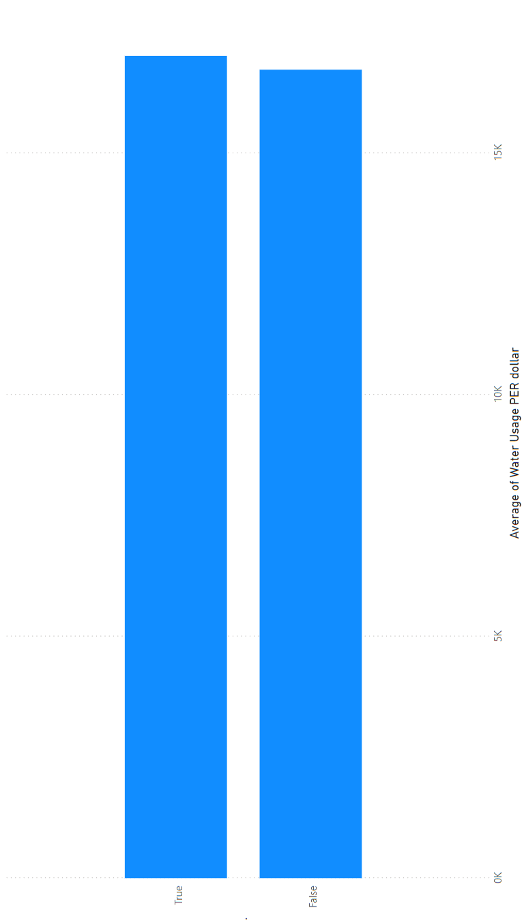
10) What is the difference in the average price for brands with Recycle programs ?
While sustainable brands often prioritize environmental responsibility, this can sometimes come at a premium. As shown in the chart, brands with recycling programs tend to have slightly higher average prices than those without. However, the price difference is relatively modest, suggesting that consumers can make sustainable choices without significantly impacting their budget.

Slide 25
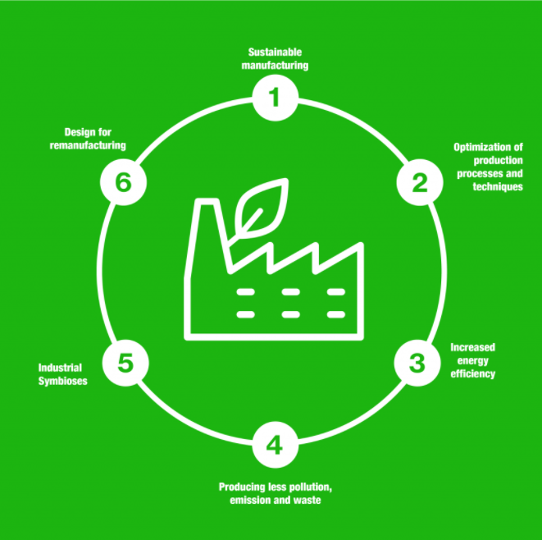
04 Conclusion
Sustainable fashion is vital for addressing environmental changes. As we move forward, embracing sustainability will be essential for responsible fashion industry.

Slide 26

THANK You

