Slide 1

Natural Language Processing Project
Authors: Toni Ihab, Hassan Mahmoud, Hussein Ibrahim, Ahmed Samah, Ahmed Samy, Ahmed Mohamed Shaaban
Supervisor: Dr. Amr Nagy BNU, 2025

Slide 2

Project Name
Title
Sentiment Classification of IMDB Movie Reviews
Techniques
TF-IDF vectorization and Machine Learning

Slide 3

Abstract
Text preprocessing: cleaning, tokenization, lemmatization
TF-IDF converts text to numerical features
Models: Logistic Regression, Naive Bayes, SVM
SVM achieves highest accuracy (~89.5%)

Slide 4
Introduction
Problem Statement
Objectives
Sentiment polarity classification
End-to-end pipeline implementation
IMDB dataset: 50,000 labeled reviews
Use classical ML over deep learning
Binary classification: positive vs. negative
Evaluate models with precision, recall, F1

Slide 5

Dataset Overview
50,000 reviews, balanced classes
Median review length ~150 words
Vocabulary reduced to ~20,000 tokens after cleaning
Labels: positive or negative, no missing data

Slide 6





Methodology
Data Exploration
Class balance, word frequency, review length
Preprocessing
Lowercase, clean, tokenize, remove stopwords, lemmatize
Feature Engineering
TF-IDF vectorization with unigrams
Model Training
Logistic Regression, Naive Bayes, SVM

Slide 7

Experiment Results
Model
Accuracy
F1-Score
Logistic Regression
88.0%
0.88
Naive Bayes
85.0%
0.85
SVM
89.5%
0.89-0.90

Slide 8
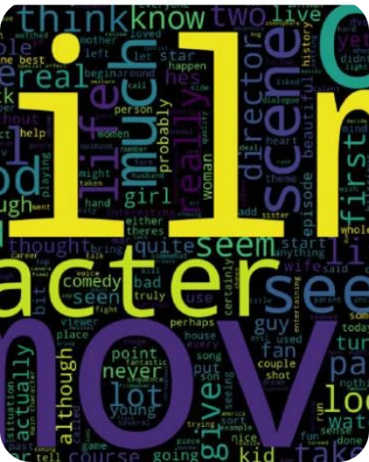
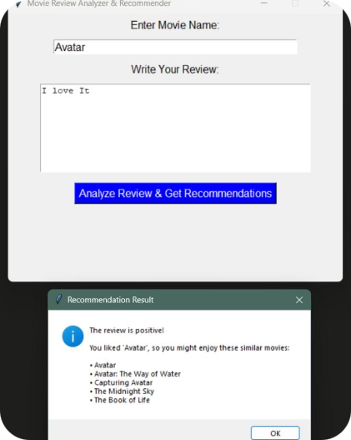
Visuals & GUI
Word Cloud
GUI Showcase
Most frequent words in reviews
Movie Review Analyzer & Recommender interface

Slide 9

Discussion
Model learned intuitive sentiment features
Errors from mixed sentiment, sarcasm, negation
SVM slightly better margin robustness than Logistic Regression
Naive Bayes fastest but less accurate

Slide 10

Conclusion
Effective NLP pipeline with classical ML models
SVM achieved highest accuracy (~89%)
Proper preprocessing and TF-IDF critical
Confusion matrices revealed error types

Slide 11

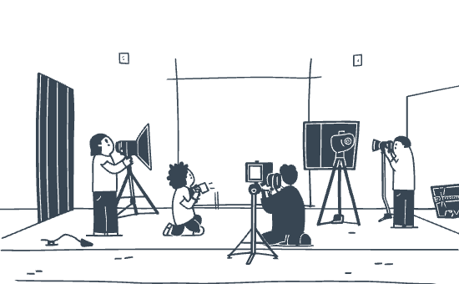

Thank You
Appreciation for collaboration
Our dedicated team
Thank you for your attention

