Slide 1
A framework for teaching web-based application development
Toktam Ramezani
toktamr@ifi.uio.no
Nov 12th, 2019

Slide 2
Outline
Different teaching frameworks
Effective parameters: background and reality
Main goals and challenges
Patterns of web applications
Initiatives and prerequisites
Teaching Format and Infrastructures
Teaching Projects
Teaching Infrastructures
Expected Results
References
Notes:
Educational Information (Dissertation, Papers)
Ph.D
MSc
Job Experiences
Some Technical Skills
Formal Methods
IoTSec

Slide 3
Different Teaching frameworks
Department and School
Student level and experiences
Computer Science (CS)
Computer Engineering (CE)
Information Technology (IT)
Department of Business, Marketing and Law, USN School of Business
Notes:
to easily create small/medium websites, beautiful website blocks, templates and themes help you to start easily.
Mobirise
perfect for non-techies who are not familiar with the intricacies of web development and prefer to work as visually as possible. Also great for pro-coders for fast prototyping and small customers' projects.
Minimalistic, extremely easy-to-use interface; Mobile-friendliness, latest website blocks and techniques "out-the-box"; Free for commercial and non-profit use

Slide 4
Experiences and Reality
In Computer Science there is such a gap due to three major aspects:
(1) The content of the courses
Theoretical modules and practical assignments,
(2) The infrastructure
The physical infrastructure limits the number of students to the size of the laboratories
(3) The environment
the environment of academia is quite relaxed
(4) Extraordinary changes in the industry, business, methodology, etc.
Notes:
Gap

Slide 5
Students Context
Lack of skill for 1st–2nd year students to develop a complete web application upon a tight schedule.
Prerequisite:
Basic algorithms,
Non-linear data structures,
Object-Oriented (OO) programming
Database

Slide 6
Main Goals and Questions
Being realistic and reduce the gap in a practical way
By motivating the students to
Participation in the decisions
how we chose the development methodology?
Be organized and get the big picture
Providing a good degree of independency for students
Teaching in a way they learn how to learn on-demand

Slide 7
Patterns of Web Applications
Patterns relative to the user interaction:
E-Commerce (e.g. Amazon),
Search engine (e.g. Google),
Wikis (e.g. Wikipedia),
Social media (e.g. Facebook)
Enterprise-like applications, based on create/read/update/delete (CRUD) functionalities
The goal in our case: MVC-based web development (Model–View–Controller) using CRUD applications

Slide 8
Boost Students with the Initiatives
Introduce Object-Oriented Design
Inheritance, encapsulation, polymorphism, etc.
Teach the Model–View–Controller (MVC) software by handouts;
Teaching Web Application Development: a Case Study in a Computer Science Course
Teaching database
Data model, Information retrieval, queries, views
Teaching Basic algorithms on demand
Notes:
Due to the project requirements, we had to boost their formation with the following initiatives:

Slide 9
Teaching Format and the Project
Depending on:
Human resources:
undergraduate students, professors, engineers, lab assistants, etc.
Time constraints: from six to eight months.
The students schedule is dedicated to:
the projects, lectures, exams, assignments
professors have an even tighter schedule
Choosing web applications based on real requirements
longer working time, scholarship, lab equipment
Case study
Notes:
Choosing web applications based on real requirements
as a motivator for the students
Offering practical apprenticeships
As much as possible

Slide 10
Project 1 – Automation of Student-Course Management
The data model containing information about elements:
Students, professors, scholarships, courses, classes, grades, etc.
The application can be divided into three sets of components:
(1) CRUD applications such as:
create/read/update/delete elements,
(2) Listings such as:
provide different kinds of listings over the existing data: transcript of graduate students, enrolled students in a course, etc.
(3) General consistency checking such as:
students that fail the exams lose their scholarship, number of credits must be determined

Slide 11
Project Requirements and Steps
The initial steps:
Define the team and project roles
Choose and to set up a common development framework
Define the application data model and user interface
Start implementing
The main steps:
CRUD applications and listings
User access control
Database access

Slide 12
Project Roles: The Challenge
The lecturers as
Project leaders, and tutors
The students as
Developers/architects.
Forming groups of students and lecturers to work together with different skills:
Programming skills
Research skills
Analytical skills
Curiosity skills
Working with the applications and tools
Testing new things

Slide 13
Extreme Tutoring
The tutoring time followed agile programming principles: short and periodical
(1) Assign simple tasks: study the MVC API and to reproduce a simple application found on the Internet
(2) Reschedule the tasks
(3) Reschedule the groups
The objective: to show the students how to search for a solution
Become confident to reproduce the solution step-by-step afterward.
Notes:
tutors should not DO the tasks, only HELP students to search for solutions for themselves.
The extreme tutorial is an adaptation of extreme programming/agile methods (Reifer, 2002) and the constraint-driven human resource scheduling method in software development (Xiao et al., 2008) with an amount of time for tutoring
Giving assignment: study the MVC API and to reproduce a simple application found on the Internet.

Slide 14
Choosing the Infrastructure - Available Tools (AT)
Perfect for:
Non-techies, not familiar with the intricacies of web development
To work as visually as possible,
Pro-coders for fast prototyping and small customers' projects
Benefits:
To easily create small/medium websites,
Beautiful with templates and themes
Extremely easy-to-use interface;
Mobile-friendliness,
Latest website blocks and techniques,
Free for commercial and non-profit use
Notes:
Mobirise
The students may end up using these techniques
https://www.appypie.com/top-web-development-frameworks

Slide 15
Choosing the Infrastructure (1)
Choose an AT and MVC development framework
The tasks for the students and tutors:
(1) To do research on the existing frameworks,
Most Popular Web Development Frameworks for 2019-20
(2) To experiment with them and
(3) To choose the most appropriate one
Java: Struts, Struts2, Spring, Spring Roo;
Ruby: Ruby on Rails, Nitro, Ramaze;
.Net: ASP .Net, MonoRail, Spring Framework.Net;
PHP: Agavi, Drupal, Joomla;
Python: Django, Pylons, TurboGears.
Notes:
open source, so .Net branch was not a choice.
PHP neither, because of some security issues.
The framework must support an open source database, such as PostgreSQL or MySQL derivations, which led to Java, Python and Ruby-based frameworks
We reviewed the remaining systems platforms. We needed to choose between a richenough platform for rapidly developing the applications and that was suitable for teaching as well. However, it was not feasible to test all of them in detail. Based on the size of the community, the documentation found and on the apparent maturity

Slide 16
Choosing the Infrastructure (2)
To determine the preference not the better frameworks
Platform for rapid development
Suitable for teaching
The size of the community, and the documentation
Technological parameters
Open source, so .Net branch was not a choice.
Support open source database, such as MySQL derivations
Practical aspects of teaching
HR Skills: the experiences of the involved people
Familiarity with the languages
Creating sample applications in the candidate frameworks
Code generation facilities
Notes:
open source, so .Net branch was not a choice.
PHP neither, because of some security issues.
The framework must support an open source database, such as PostgreSQL or MySQL derivations, which led to Java, Python and Ruby-based framewo
Choose the preference not the better platform
rks

Slide 17
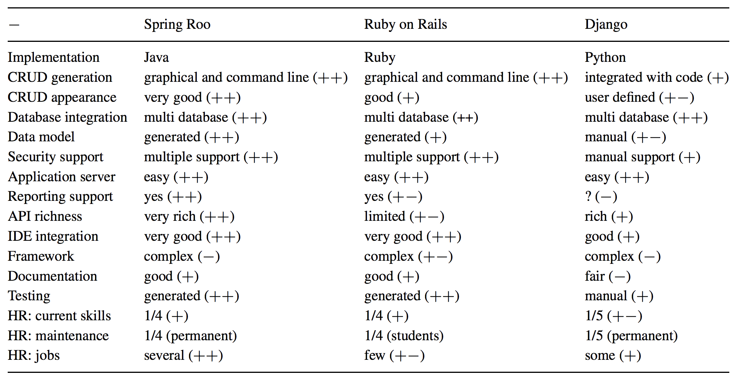
Choosing the Infrastructure (2)
most known in Java
increased popularity
Python-based, very rich API
Good to experience challanges
Simpler in small case
Good looking
Simpler
non-English
available components
Notes:
Possible to use command line, or integrated within Eclipse.

Slide 18
Required concepts and technologies
JSP,
OOP,
Java,
HTML,
ORM mapping,
SQL, relational databases, DBMS
MVC framework,
Configuration files,
Application server,
Version control, etc.
Could be overwhelming for students and for tutoring
Notes:
. Otherwise, it is difficult to technically help the students.
that did not have any real development experience. This means that the initial tutoring time was crucial
Object-relational mapping

Slide 19
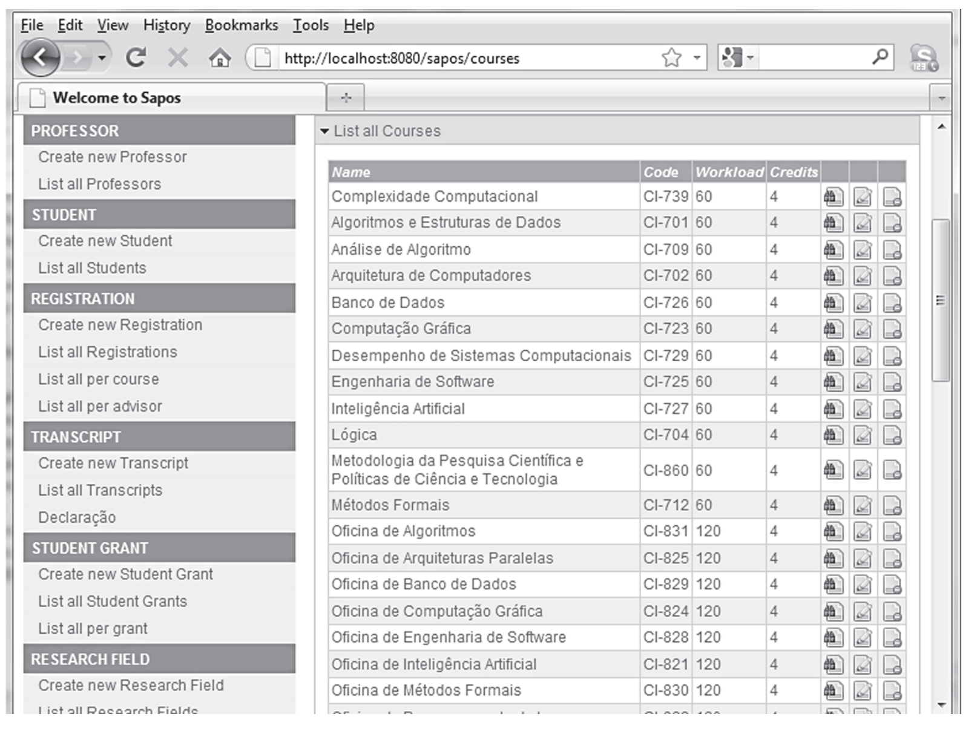
Expected Result

Slide 20
Web application Security
Security Concepts
Security and Security Requirements (CIA)
Vulnerabilities and Weaknesses
Attacks
Exploits
Open Web Application Security Project (OWASP)
online community with the aim of web application security methodologies, documentation, tools, and technologies
Common Weakness Enumeration (CWE)
a list of software weaknesses and vulnerabilities
Notes:
The applications had database access, user access control and test interfaces
online community that produces freely-available articles, methodologies, documentation, tools, and technologies in the field of web application security

Slide 21
Project 2 – Web application Security
Top web application vulnerabilities
Investigation on that as task assignments
How vulnerabilities can be exploited to make successful unauthorized access
Running examples
How to detect the vulnerability
Applying some existing tools
How to fix it and prevent the attack
Secure programming
Applying the lesson learned to the first project
Secure Application for Student-Course Management (extra points)
Notes:
The applications had database access, user access control and test interfaces
online community that produces freely-available articles, methodologies, documentation, tools, and technologies in the field of web application security

Slide 22
The Final Expected Result
Technology is just a facilitator
The most important concepts
OO, MVC, agile programming, ORM, etc.
To give a real vision of application development
development is complex, with dozens of API’s, databases, providers, functionalities
Overcome real challenges
in reality when students start a job
Notes:
String sql = "SELECT id, first_name, last_name, phone, birth_date, sex, age FROM persons WHERE id = 10";
Result res = db.execSql(sql); String name = res[0]["first_name"];
In contrast, the following makes use of an ORM-job API, allowing the writing of code which naturally makes use of the features of the language.
Person p = repository.GetPerson(10);
String name = p.getFirstName();
The case above makes use of an object representing the storage repository and methods of that object. Other frameworks might provide code as static methods, as in the below, and yet other methods may not implement an object-oriented system at all. Often the choice of paradigm is made to fit the ORM best into the surrounding language's design principles.
Person p = Person.Get(10);
Usually, the framework will expose some filtering and querying functionality, allowing subsets of the storage base to be accessed and modified. The code below queries for people in the database whose ID value is '10'.
Person p = Person.Get(Person.Properties.Id == 10);

Slide 23
Course References
Reference Books in the field
Tutorials
Online videos
Web pages, etc.

Slide 24
References
ASP.NET, Free. Cross-platform. Open source, A framework for building web apps and services with .NET and C#, https://dotnet.microsoft.com/apps/aspnet
Spring Roo. Springsource community, https://projects.spring.io/spring-roo/
Django project, 2011, https://www.djangoproject.com/
Del Fabro, Marcos Didonet, Eduardo Cunha de Alimeda, and Fabiano Sluzarski. "Teaching Web Application Development: A Case Study in a Computer Science Course." Informatics in Education 11.1, 2012, 29-44.
Reifer, Donald J. "How to get the most out of extreme programming/agile methods." Conference on Extreme Programming and Agile Methods. Springer, Berlin, Heidelberg, 2002.
Notes:
Krasner, G., Pope, S. (1988). A cookbook for using the model-view controller user interface paradigm in smalltalk-80. J. Object Oriented Program., 1, 26–49.

Slide 25
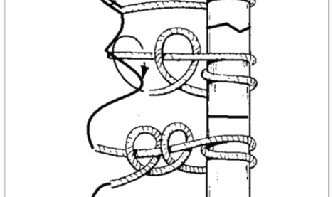
Thanks

Slide 26
Module #1 - Web Applications in Context
Web Applications - An Overview39s
Video 1: Modern Web Applications5m
Video 2: Historical Perspectives10m
Video 3: Web App Characteristics5m
Video 4: Course Overview3m
Video 5: Interview with Edwin Agbenyega3m
Video 1: Networking Concepts4m
Video 2: The Internet6m
Video 3: Internet Hot Topics2m
Video 4: Interview -Brian Pietrewicz5m
What is a Web Application? - An Overview33s
Video 1: Web Apps - A Model2m
Video 2: Web App Definition5m
Video 3: Evolution of Web Apps8m
Video 4: Design Patterns4m
Video 5: n-Tier Architecture6m
Setting up your Development Environment - An Overview34s
Video 1: Setting up your Development Environment7m
Video 2: Ruby and Rails4m
Video 3: Editors, GIT, SQLiteBrowser4m
Video 4: Web Developer Tools2m
Video 5: Interview - Melanie Moses5m
Notes:
22 videos (Total 102 min), 3 readings, 1 quiz
https://www.coursera.org/learn/web-app
https://www.coursera.org/lecture/web-app/video-5-interview-with-edwin-agbenyega-1cSlT

Slide 27
Module #2 - Web Applications Frameworks
What are Web App Frameworks? - An Overview41s
Video 1: What is Programming?6m
Video 2: Application Frameworks2m
Video 3: Web Application Frameworks8m
Video 4: The Model-View-Controller Design Pattern5m
The Ruby on Rails Framework - An Overview16s
Video 1: Your First Rails Program10m
Video 2: Scaffolding11m
Video 3: Ruby Programming I: Objects, Classes and Inheritance12m
Video 4: Ruby Programming II: Strings, Regular Expressions and Symbols12m
Video 5: Ruby Programming III: Expressions and Control Structures10m
Modern Software Practices - An Overview30s
Video 1 -Software Processes8m
Video 2 - Agile Development4m
Video 3 - The Blog App8m
Version Control - An Overview19s
Video 1 - Why Version Control3m
Video 2 - Version Control Basics2m
Video 3 - Git Introduction7m
Video 4 - Git in Practice4m
Notes:
20 videos (Total 122 min), 1 reading, 1 quiz
SEE ALL

Slide 28
Module #3 - Managing Data
Relational Databases in Web Apps - An Overview20s
Video #1 - Data Management in Web Apps3m
Video #2 - Relational Databases: Basic Concepts3m
Video #3 - Database Schema I4m
Video #4 - Database Schema II2m
Database Integration in Web Apps - An Overview27s
Video #1 - Application Environments6m
Video #2 - Database Configuration4m
Video #3 - Database Management3m
Video #4 - Blog App Databases6m
Active Record Design Pattern - An Overview38s
Video #1 - Active Record Design - An Overview4m
Video #2 - Active Record in Rails8m
Video #3 - Database Migrations6m
Video #4 - Blog - Iteration 24m
Database Associations and Validations - An Overview23s
Video #1 - Associations4m
Video #2 -Blog App - Iteration 35m
Video #3 - Validations6m
Video #4 - Blog App - Iteration 43m
Notes:
20 videos (Total 83 min), 1 reading, 1 quiz
SEE ALL

Slide 29
Module #4 - Middleware
Middleware an Introduction - An Overview33s
Video 1: What is Middleware?2m
Video 2: Middleware in Web Apps11m
Video 3: Middleware Frameworks9m
The HTTP Protocal - An Overview24s
Video 1: HTTP Overview5m
Video 2: HTTP Request7m
Video 3: HTTP Response4m
Video 4: HTTP Sessions and Cookies5m
MVC Over Rails Middleware- An Overview34s
Video 1: Request Processing7m
Video 2: RESTful Web Services3m
Video 3: Response Processing5m
Video 4: MVC in Rails6m
Notes:
14 videos (Total 71 min), 1 reading, 1 quiz
SEE LESS

Slide 30
Module #5 - The User Interface
Presentation Tier Overview - An Overview53s
Video 1: The Presentation Tier3m
Video 2: Layout and Design8m
Video 3: HTML: History and Philosophy5m
Video 4: HTML CSS and JavaScript3m
HTML CSS and JavaScript Overview - An Overview35s
Video 1: HTML Overivew12m
Video 2: CSS Overview5m
Video 3: JavaScript Overview5m
Dynamic Content and Ajax Overview - An Overview28s
Video 1: Ajax Background2m
Video 2: Ajax Cycle3m
Video 3: Dynamic Content Creation5m
Video 4: Blog App - Iteration 58m

