Slide 1

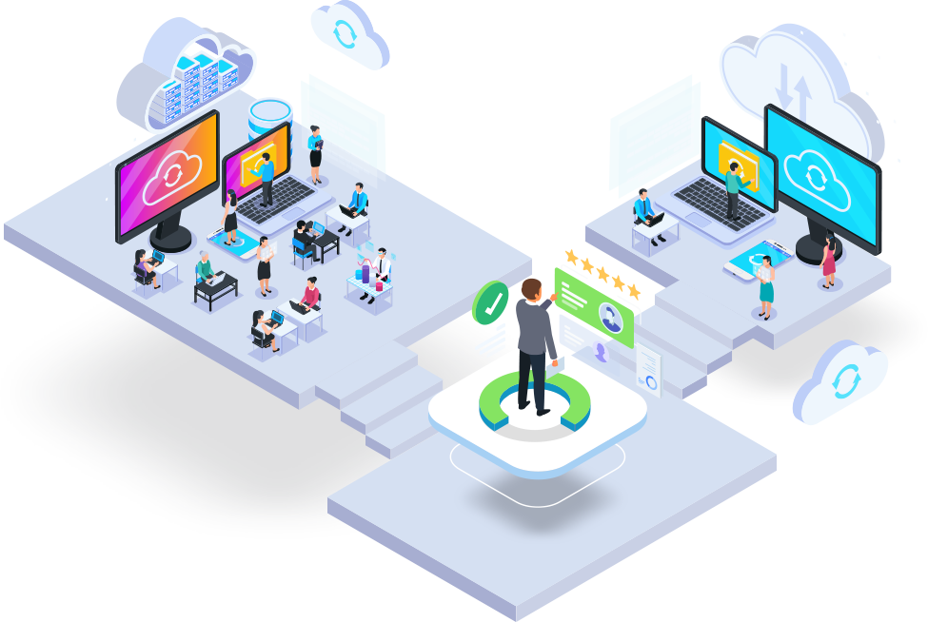

AGILE

Slide 2


SDLC(SOFTWARE DEVELOPMENT LIFE CYCLE)
Software Development Life Cycle (SDLC) is a process used by the software industry to design, develop and test high quality softwares.
The SDLC aims to produce a high-quality software that meets or exceeds customer expectations, reaches completion within times and cost estimates.
It is also called as Software Development Process.
SDLC is a framework defining tasks performed at each step in the software development process.
SO/IEC 12207 is an international standard for software life-cycle processes. It aims to be the standard that defines all the tasks required for developing and maintaining software.

Slide 3
What is SDLC
SDLC is a process followed for a software project, within a software organization.
It consists of a detailed plan describing how to develop, maintain, replace and alter or enhance specific software.

Slide 4
Why is SDLC important?
It provides a standardized framework that defines activities and deliverables.
It aids in project planning, estimating and scheduling
It makes project tracking and control easier
It increases visibility on all aspects of the life cycle to all stakeholders involved in the development process
It increases the speed of development
It improves clients relations
It decreases project risks
It decreases project management expenses and the overall cost of production

Slide 5
Security in SDLC
The initial concept and creation of the SDLC only addressed security activities as a separate and singular task, performance as part of the testing phase.
The shortcomings of this after-the-fact approach were the inevitable high number of vulnerabilities or bugs discovered too late in the process or in certain cases not discovered at all.

Slide 6
Advantages of pursuing a secure SDLC
More secure software as security is a continuous concern
Awareness of security considerations by stakeholders
Early detection of flaws in the system
Cost reduction as a result of early detection and resolution of issues
Overall reduction of intrinsic business risks for the organization

Slide 7
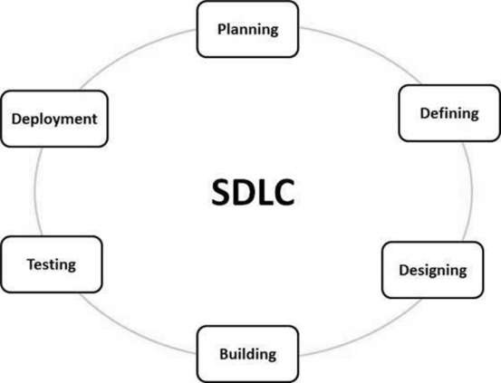

Slide 8
Planning and Requirement Analysis
Requirement analysis is the most important and fundamental stage in SDLC.
It is performed by the senior members of the team with inputs from the customer, the sales department, market surveys and domain experts in the industry.
This information is then used to plan the basic project approach and to conduct product feasibility study in the economical, operational and technical areas.
Planning for the quality assurance requirements and identification of the risks associated with the project is also done in the planning stage.

Slide 9
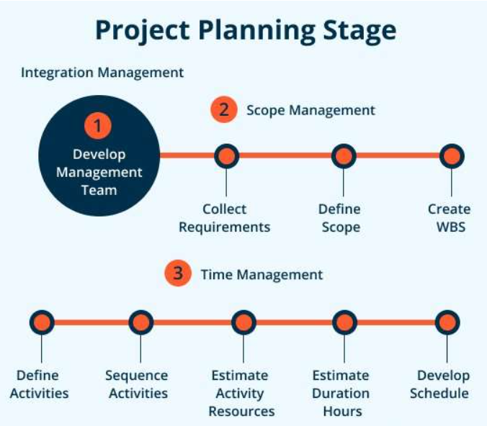

Slide 10
Defining Requirements
Once the requirement analysis is done the next step is to clearly define and document the product requirements and get them approved from the customer or the market analysts.
This is done through an SRS (Software Requirement Specification) document which consists of all the product requirements to be designed and developed during the project life cycle.

Slide 11
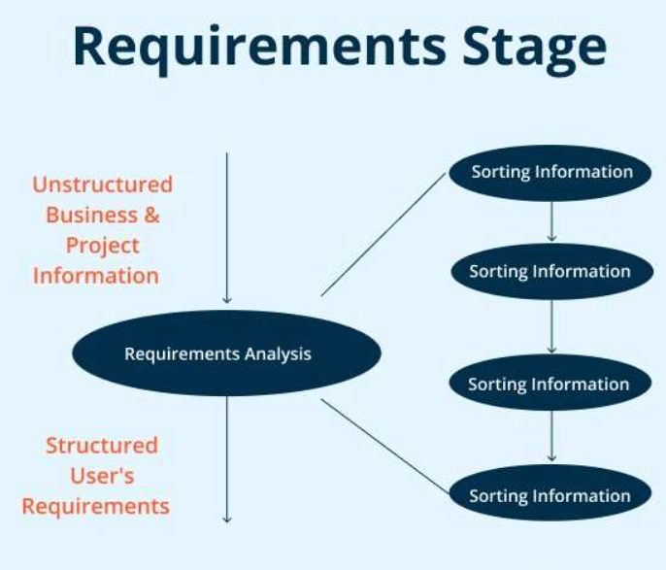

Slide 12
Designing the Product Architecture
SRS is the reference for product architects to come out with the best architecture for the product to be developed.
Based on the requirements specified in SRS, usually more than one design approach for the product architecture is proposed and documented in a DDS - Design Document Specification.
This DDS is reviewed by all the important stakeholders and based on various parameters as risk assessment, product robustness, design modularity, budget and time constraints, the best design approach is selected for the product.

Slide 13
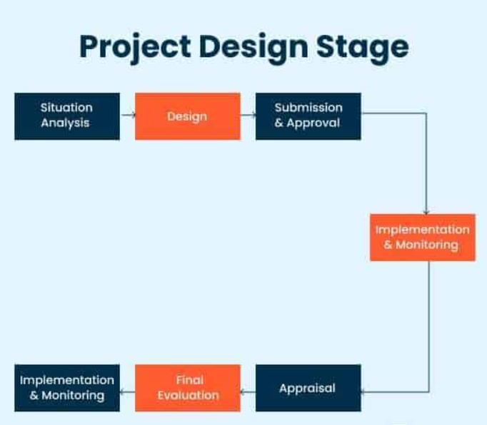

Slide 14
Building or Developing the Product
The programming code is generated as per DDS during this stage.
If the design is performed in a detailed and organized manner, code generation can be accomplished without much hassle.
Developers must follow the coding guidelines defined by their organization and programming tools like compilers, interpreters, debuggers, etc. are used to generate the code.
Different high level programming languages such as C, C++, Pascal, Java and PHP are used for coding.
The programming language is chosen with respect to the type of software being developed.

Slide 15
Testing the Product
The testing activities are mostly involved in all the stages of SDLC.
Product defects are reported, tracked, fixed and retested, until the product reaches the quality standards defined in the SRS.

Slide 16
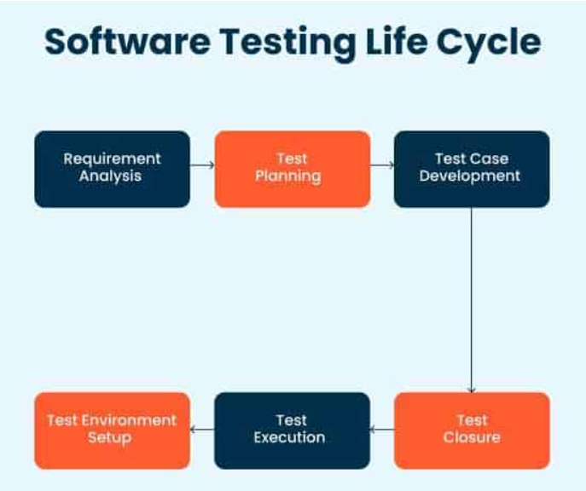

Slide 17
Deployment in the Market and Maintenance
Once the product is tested and ready to be deployed it is released formally in the appropriate market.
Sometimes product deployment happens in stages as per the business strategy of that organization.
The product may first be released in a limited segment and tested in the real business environment (UAT- User acceptance testing).
After the product is released in the market, its maintenance is done for the existing customer base.

Slide 18
Example : Develop an e-commerce platform
1. Planning and Analysis :
Business analyst and program manager will gather requirements from business stake holders about how e-commerce should work and what features it should contain.
A detailed SRS documents will be created
Business analyst will get review SRS document with business stake holders and will get sign off on it.

Slide 19
2. Design :
SRS documents will be sent to developers.
Developers will go through the documents and will understand requirements.
Designers will be design web pages.
Developers will prepare high level system architecture.

Slide 20
3. Development:
Coding
Develop web pages
API’s required to implement the functionality

Slide 21
4. Testing:
Testing will perform end-to-end functionality testing.
Make sure the e-commerce platform is working fine without any bugs

Slide 22
5. Deployment and Maintenance :
Code will be deployed and will be available to the customer
Customer can use the e-commerce after this deployment

Slide 23
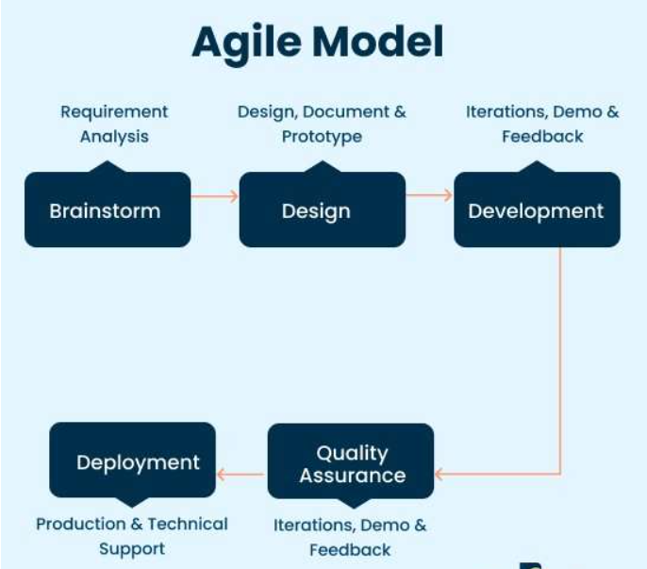
Agile Model
There are some common Software Life Cycle Examples or SDLC models available. They are as given below.

Slide 24
A major characteristics of the Agile Model is that it demarcates the product into different cycles and produces a working product quickly.
After every releases are tested, that back information is used in the following version for more improvement.
There is a drawback in this model and that revolves around the dependency on customer interaction.

Slide 25
When to use Agile Model?
To implement new changes
To implement a feature that would require some extra hours
Very few initial requirements
Product owner involvement is high

Slide 26
SDLC Models
There are various software development life cycle models defined and designed which are followed during the software development process.
These models are also referred as Software Development Process Models".
Each process model follows a Series of steps unique to its type to ensure success in the process of software development.
Waterfall Model
Iterative Model
Spiral Model
V-Model
Big Bang Model

Slide 27
Waterfall Model
The Waterfall Model was the first Process Model to be introduced. It is also referred to as a linear-sequential life cycle model.
It is very simple to understand and use. In a waterfall model, each phase must be completed before the next phase can begin and there is no overlapping in the phases.

Slide 28
The Waterfall model is the earliest SDLC approach that was used for software development.
The waterfall Model illustrates the software development process in a linear sequential flow.
This means that any phase in the development process begins only if the previous phase is complete.
The phases do not overlap.

Slide 29
Waterfall Model - Design
Waterfall approach was first SDLC Model to be used widely in Software Engineering to ensure success of the project.
In "The Waterfall" approach, the whole process of software development is divided into separate phases.
In this Waterfall model, typically, the outcome of one phase acts as the input for the next phase sequentially.

Slide 30
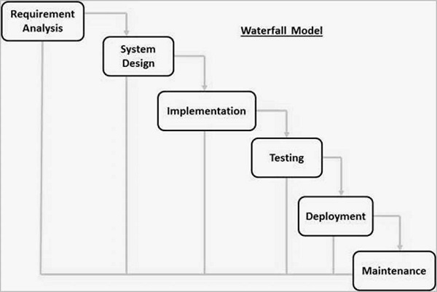

Slide 31
Requirement Gathering and analysis
All possible requirements of the system to be developed are captured in this phase and documented in a requirement specification document.
System Design
The requirement specifications from first phase are studied in this phase and the system design is prepared. This system design helps in specifying hardware and system requirements and helps in defining the overall system architecture.

Slide 32
Implementation
With inputs from the system design, the system is first developed in small programs called units, which are integrated in the next phase. Each unit is developed and tested for its functionality, which is referred to as Unit Testing.
Integration and Testing
All the units developed in the implementation phase are integrated into a system after testing of each unit. Post integration the entire system is tested for any faults and failures.

Slide 33
Deployment of system
Once the functional and non-functional testing is done; the product is deployed in the customer environment or released into the market.
Maintenance
There are some issues which come up in the client environment. To fix those issues, patches are released. Also to enhance the product some better versions are released. Maintenance is done to deliver these changes in the customer environment.

Slide 34
Waterfall Model - Application
Requirements are very well documented, clear and fixed.
Product definition is stable.
Technology is understood and is not dynamic.
There are no ambiguous requirements.
Ample resources with required expertise are available to support the product.
The project is short.

Slide 35
Advantages
Simple and easy to understand and use
Easy to manage due to the rigidity of the model. Each phase has specific deliverables and a review process.
Phases are processed and completed one at a time.
Works well for smaller projects where requirements are very well understood.
Clearly defined stages.
Well understood milestones.
Easy to arrange tasks.
Process and results are well documented.

Slide 36
Disadvantages
No working software is produced until late during the life cycle.
High amounts of risk and uncertainty.
Not a good model for complex and object-oriented projects.
Poor model for long and ongoing projects.
Not suitable for the projects where requirements are at a moderate to high risk of changing. So, risk and uncertainty is high with this process model.
It is difficult to measure progress within stages.
Cannot accommodate changing requirements.
Adjusting scope during the life cycle can end a project.
Integration is done as a "big-bang. at the very end, which doesn't allow identifying any technological or business bottleneck or challenges early.

Slide 37
Agile Methodology
An agile methodology is an iterative approach to software development.
Each iteration of agile methodology takes a short time interval of 1 to 4 weeks.
The agile development process is aligned to deliver the changing business requirement.
It distributes the software with faster and fewer changes.
The single-phase software development takes 6 to 18 months.
In single-phase development, all the requirement gathering and risks management factors are predicted initially.

Slide 38
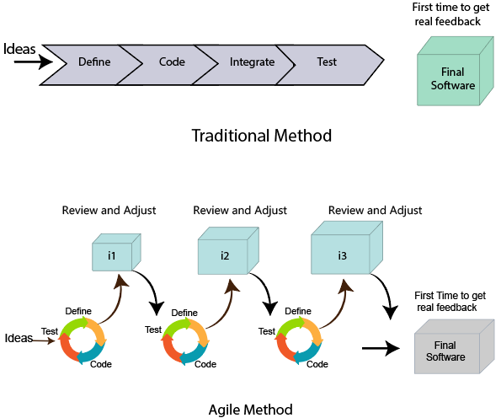
Agile Methodology

Slide 39
Agile Development Model Phases
Requirements gathering
Design the requirements
Construction/ iteration
Testing/ Quality assurance
Deployment
Feedback

Slide 40
Requirements gathering:
In this phase, you must define the requirements. You should explain business opportunities and plan the time and effort needed to build the project. Based on this information, you can evaluate technical and economic feasibility.
Design the requirements:
When you have identified the project, work with stakeholders to define requirements. You can use the user flow diagram or the high-level UML diagram to show the work of new features and show how it will apply to your existing system

Slide 41
Construction/ iteration:
When the team defines the requirements, the work begins. Designers and developers start working on their project, which aims to deploy a working product. The product will undergo various stages of improvement, so it includes simple, minimal functionality.
Testing:
In this phase, the Quality Assurance team examines the product's performance and looks for the bug.
Deployment:
In this phase, the team issues a product for the user's work environment.

Slide 42
Feedback:
After releasing the product, the last step is feedback. In this, the team receives feedback about the product and works through the feedback.

Slide 43
Agile Testing Methods:
Scrum
Crystal
Dynamic Software Development Method(DSDM)
Feature Driven Development(FDD)
Lean Software Development
Extreme Programming(XP)

Slide 44
Agile Manifesto:
In February 2001, at the Snowbird resort in Utah, a team of 17 software developers met to discuss lightweight development methods. The result of their meeting was the following Agile Manifesto for software development
Individuals and interactions over Processes and tools.
Working software over comprehensive documentation.
Customers are collaboration over contact negotiation.
Responding to change over following a plan.

Slide 45
Principles of Agile
Customer Satisfaction:
Manifesto provides high priority to satisfy the costumer's requirements. This is done through early and continuous delivery of valuable software.
Welcome Change:
Making changes during software development is common and inevitable. Every changing requirement should be welcome, even in the late development phase. Agile process works to increase the customers' competitive advantage

Slide 46
Deliver the Working Software:
Deliver the working software frequently, ranging from a few weeks to a few months with considering the shortest time period.
Collaboration:
Business people (Scrum Master and Project Owner) and developers must work together during the entire life of a project development phase.
Motivation:
Projects should be build around motivated team members. Provide such environment that supports individual team members and trust them. It makes them feel responsible for getting the job done thoroughly.

Slide 47
Face-to-face Conversation:
Face-to-face conversation between Scrum Master and development team and between the Scrum Master and customers for the most efficient and effective method of conveying information to and within a development team.
Measure the Progress as per the Working Software:
The working software is the key and primary measure of the progress.
Maintain Constant Pace:
The aim of agile development is sustainable development. All the businesses and users should be able to maintain a constant pace with the project.

Slide 48
Monitoring:
Pay regular attention to technical excellence and good design to maximize agility.
Simplicity:
Keep things simple and use simple terms to measure the work that is not completed.
Self-organized Teams:
The Agile team should be self-organized. They should not be depending heavily on other teams because the best architectures, requirements, and designs emerge from self-organized teams

Slide 49
Review the Work Regularly:
The work should be reviewed at regular intervals, so that the team can reflect on how to become more productive and adjust its behavior accordingly.

Slide 50
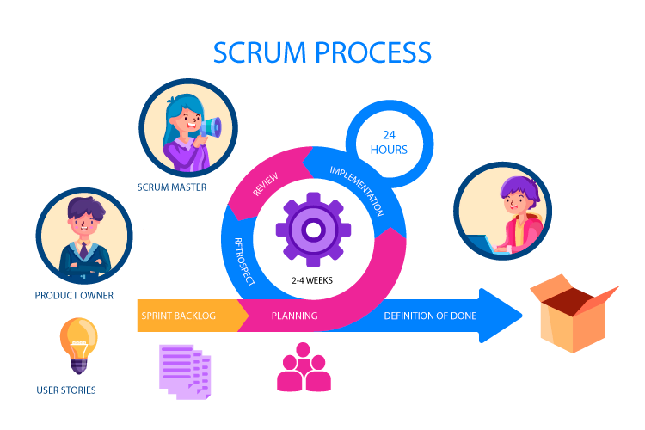
Scrum
Scrum is a framework that helps teams work together.
Scrum encourages teams to learn through experiences, self organize while working on a problem and reflect on their wins and losses to continuously improve.
Scrum is structured to adapt team to naturally adapt to changing conditions and user requirements, with re-prioritization built into the process and short release cycles so your team can constantly learn and improve.

Slide 51
Crystal
The crystal method is an agile methodology that is considered a lightweight that focuses on individuals and their interactions.
It is mainly for short term projects by a team of developers working out of a single workspace.
Two Core benefits of Crystal Method:
Find your own way and methods to optimize workflow
Make use of unique methods to make the project unique and dynamic

Slide 52
Properties of Crystal Framework
Frequent Delivery
Reflective Improvement
Osmotic communication
Personal Safety
Focus
Easy access to expert users
Technical tooling

Slide 53
How does Crystal Function
Crystal Clear – short term projects – 1 to 6 members – single workspace
Crystal Yellow – small team size – 7 to 20 members – automated testing – resolve bugs – reduce documentations
Crystal Orange – 21 to 40 members – team splits as per the function – project last to 1 to 2 years
Crystal Orange Web – 21 to 40 members – project used by public – series requires programming
Crystal Red – 40 to 80 members – team formed and divided according to requirements
Crystal Maroon – large size project – 80 to 200 members – methods are different as per the requirement of the software
Crystal Diamond – Large Projects

Slide 54
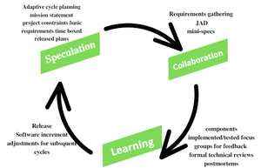
Adaptive Software Development
Adaptive Software Development is a method to build complex software and system.
ASD life cycle incorporates three phases
Speculation
Collaboration
Learning

Slide 55
Speculation:
During this phase the project is initiated and planning is conducted. The project plan uses project initiation information like project requirements, user needs, customer mission statement, etc, to define set of release cycles that the project wants.
Collaboration:
It collaborates communication and teamwork but emphasizes individualism as individual creativity play a major role in creative thinking.
Criticize without animosity
Assist without resentment
Work as hard as possible
Possession of skill set
Communicate problems to find effective solution

Slide 56
Learning:
Learning helps the workers to increase their level of understanding over the project.
Learning process is of 3 ways
Focus groups
Technical reviews
Project postmortem

Slide 57
Dynamic Software Development
The DSD technique is an associate degree agile code development approach that provides a framework for building and maintaining systems.
The DSDM philosophy is borrowed from a modified version of the sociologist principle – 80% of An application is often delivered in twenty percent of the time it would desire deliver the entire application.
DSDM Life Cycle:
1. Feasibility Study
2. Business Study
3. Functional Model Iteration
4. Design and Build Iteration
5. Implementation

Slide 58
Feasibility Study:
It establishes the essential business necessities and constraints related to the applying to be designed then assesses whether or not the application could be viable candidate for the DSDM method.
Business Study:
It establishes the use and knowledge necessities that may permit the applying to supply business value; additionally, it is the essential application design and identifies the maintainability necessities for the applying.
Functional Model Iteration:
It produces a collection of progressive prototypes that demonstrates practically for the client.
Design and Build Iteration:
It revisits prototypes designed throughout useful model iteration to make sure that everyone has been designed during a manner that may alter it to supply operational business price for finish users.

Slide 59
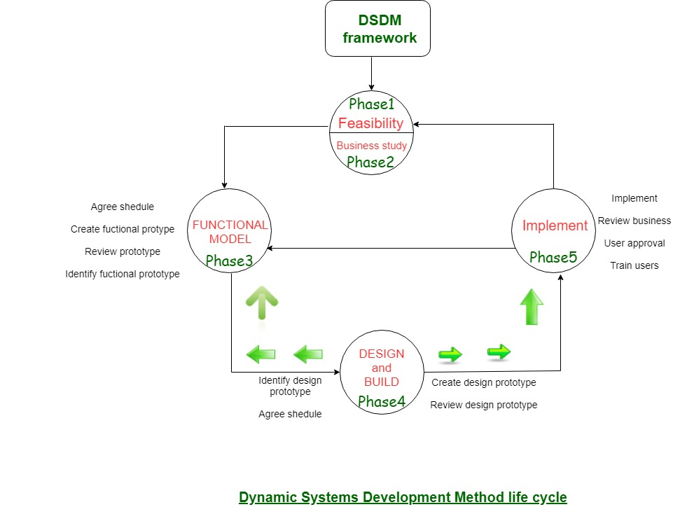
Implementation:
It places the newest code increment into the operational surroundings.

Slide 60
Feature Driven Development
An Agile method of developing software, Feature-Driven Development (FDD) is customer – centric, iterative and incremental with the goal of delivering tangible software results often and efficiently.
FDD in Agile encourages status reporting at all levels, which helps track progress and results.
How does FDD Work?
Develop Overall Model
Build Feature List
Plan by Feature
Design by Feature
Build by Feature

Slide 61
Lean Software Development (LSD)
LSD is used to streamline and optimize the software development process.
It is also referred to as Minimum Viable Product (MVP)
As its intend is to speed up development by focusing on new delivarbles.
Key Principles of Lean Software Development:
Eliminating the waste
Fast Delivery
Amplify Learning
Builds Quality
Respect Teamwork
Delay the commitment
Optimizing the whole system

Slide 62
Advantages of LSD
Removes unnecessary process stages when designing software so that it acts as a time saver as simplifies the development process.
With a focus on MVP, Lean Software Development prioritizes essential functions so this removes the risk of spending time on valueless builds.
It increases the involvement power of your team as more and more members participate due to which the overall workflow becomes optimized and losses get reduced.

