Slide 1
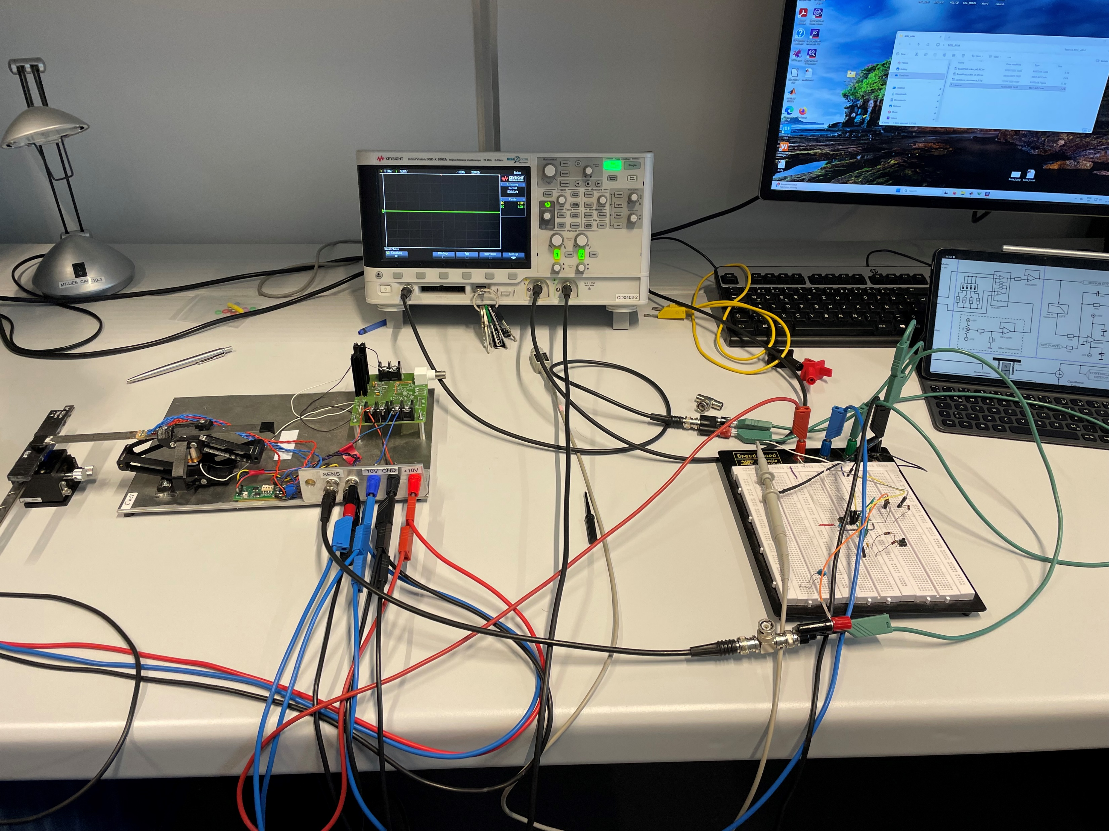
Lowpass Filter (not shown)
Sample
AFM Cantilever
Strain Gauges
Integral Controller
Setpoint Signal
Lorentz Actuator Electronics
Power Supply (±10V)
Lorentz Actuator
Controller Reset
Deflection Readout Electronics,
Offset Compensation Potentiometer
Deflection Readout Signal

Slide 2
Mechanical Domain
Electric Domain
Offset Compensation
Deflection Readout Electronics
Strain Gauges
+
Sensor Output
Lowpass Filter
AFM Mechanics
+
Set point
Lorentz Actuator
Integral Controller
+
+
Sample Topography
Actuation Signal

Slide 3
Strain Gauges
Power Supply (±10V)
Lorentz Actuator
Deflection Readout Electronics,
Offset Compensation Potentiometer
Deflection Readout Signal

Slide 4
Offset Compensation
+10 V
Deflection Readout Electronics
Strain Gauges
+
Sensor Output

Slide 5
AFM Cantilever
Strain Gauges
Lorentz Actuator Electronics
Power Supply (±10V)
Lorentz Actuator
Deflection Readout Electronics,
Offset Compensation Potentiometer
Deflection Readout Signal

Slide 6
Offset Compensation
+10 V
Deflection Readout Electronics
Strain Gauges
+
Sensor Output
AFM Mechanics
Lorentz Actuator
Actuation Signal
-0.5 V - +0.5 V

Slide 7
Offset Compensation
+10 V
Deflection Readout Electronics
Strain Gauges
+
Sensor Output
AFM Mechanics
Lorentz Actuator
Actuation Signal
10 Hz - 100 Hz sine

Slide 8
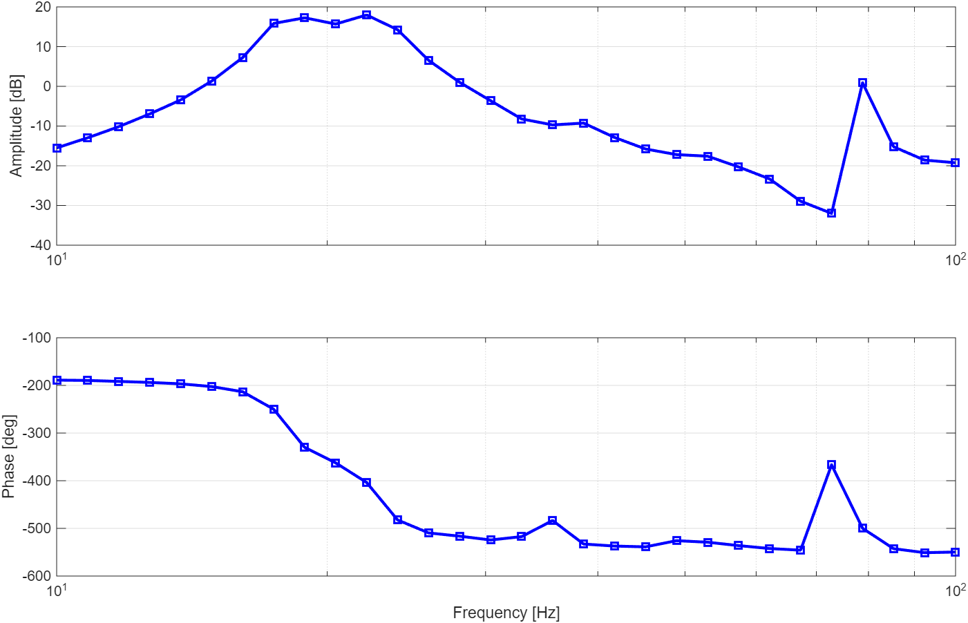




$$0.8 \text{dB} \\ 78.8 \text{Hz}$$
$$17.3 \text{dB} \\ 18.9 \text{Hz}$$
$$18.0 \text{dB} \\ 22.1 \text{Hz}$$
$$−9.3 \text{dB} \\ 38.6 \text{Hz}$$

Slide 9
Sample
AFM Cantilever
Strain Gauges
Lorentz Actuator Electronics
Power Supply (±10V)
Lorentz Actuator
Deflection Readout Electronics,
Offset Compensation Potentiometer
Deflection Readout Signal

Slide 10
Offset Compensation
+10 V
Deflection Readout Electronics
Strain Gauges
+
Sensor Output
AFM Mechanics
Lorentz Actuator
+
Sample Topography
Actuation Signal
0.5 Hz
triangle

Slide 11
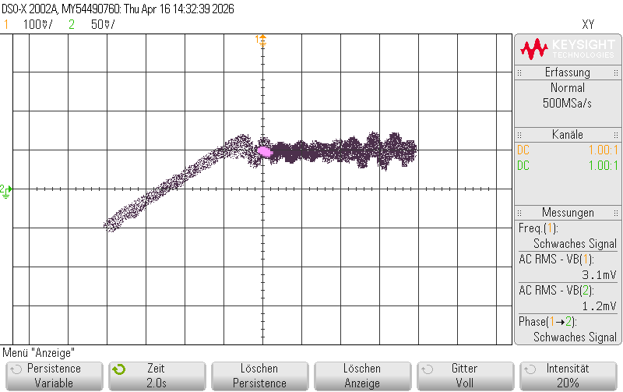
Actuator input signal (height)
contact/release point
approaching the sample
Strain gauge readout (deflection)
cantilever deflection
oscillation on release due to surface stickyness
oscillation due to sudden direction change

Slide 12
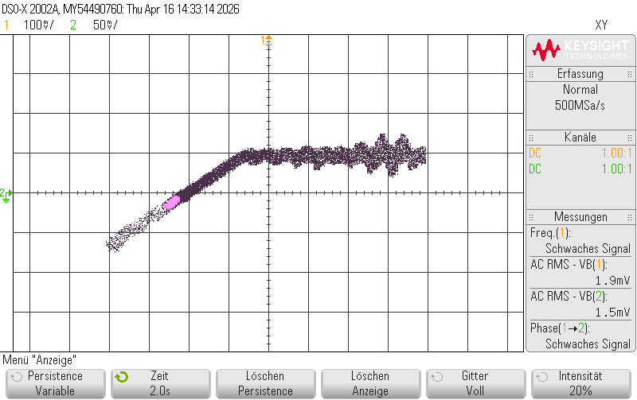
Actuator input signal (height)
contact/release point
approaching the sample
Strain gauge readout (deflection)
cantilever deflection
no oscillation on release
oscillation due to sudden direction change

Slide 13
Sample
AFM Cantilever
Strain Gauges
Integral Controller
Setpoint Signal
Lorentz Actuator Electronics
Power Supply (±10V)
Lorentz Actuator
Controller Reset
Deflection Readout Electronics,
Offset Compensation Potentiometer
Deflection Readout Signal

Slide 14
Offset Compensation
+10 V
Deflection Readout Electronics
Strain Gauges
+
Sensor Output
AFM Mechanics
+
Set point
Lorentz Actuator
Integral Controller
+
Sample Topography

Slide 15
Offset Compensation
+10 V
Deflection Readout Electronics
Strain Gauges
+
Sensor Output
AFM Mechanics
+
Set point
Lorentz Actuator
Integral Controller
+
+
Sample Topography
Actuation Signal
constant
1 – 100 Hz

Slide 16
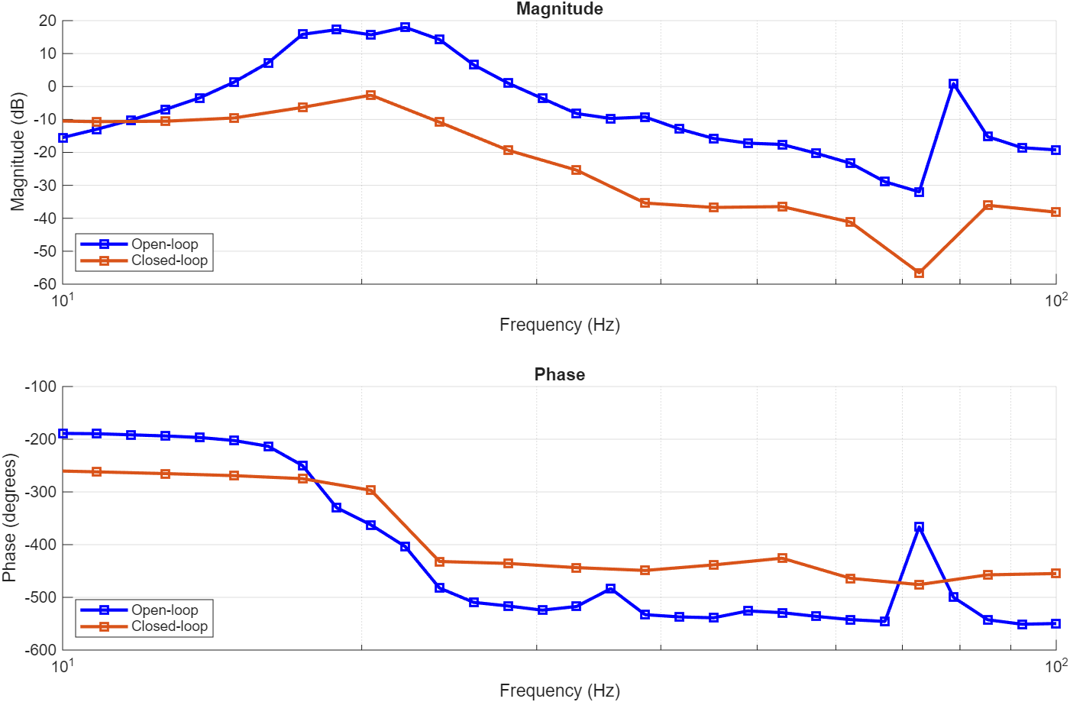




$$72.8 \text{Hz}$$
$$20.4 \text{Hz}$$
$$−20 \text{dB}$$
$$+90°$$

Slide 17
Sample
AFM Cantilever
Strain Gauges
Lorentz Actuator Electronics
Power Supply (±10V)
Lorentz Actuator
Deflection Readout Electronics,
Offset Compensation Potentiometer
Deflection Readout Signal

Slide 18
Offset Compensation
Deflection Readout Electronics
Strain Gauges
+
Sensor Output
AFM Mechanics
Adder
Lorentz Actuator
+
+
Sample Topography
Actuation Signal
20.4 Hz

Slide 19
Lowpass Filter (not shown)
Sample
AFM Cantilever
Strain Gauges
Setpoint Signal
Lorentz Actuator Electronics
Power Supply (±10V)
Lorentz Actuator
Controller Reset
Deflection Readout Electronics,
Offset Compensation Potentiometer
Deflection Readout Signal

Slide 20
Offset Compensation
20.4 Hz
185°
Deflection Readout Electronics
Strain Gauges
+
Sensor Output
Lowpass Filter
14 Hz
0 dB
AFM Mechanics
+
Set point
Adder
Lorentz Actuator
readout
+
+
Sample Topography
Actuation Signal
20.4 Hz

Slide 21
Lowpass Filter (not shown)
Sample
AFM Cantilever
Strain Gauges
Integral Controller
Setpoint Signal
Lorentz Actuator Electronics
Power Supply (±10V)
Lorentz Actuator
Controller Reset
Deflection Readout Electronics,
Offset Compensation Potentiometer
Deflection Readout Signal

Slide 22
Offset Compensation
20.4 Hz
185°
Deflection Readout Electronics
Strain Gauges
+
Sensor Output
Lowpass Filter
14 Hz
0 dB
AFM Mechanics
+
Set point
Adder
Lorentz Actuator
Integral Controller
+
+
Sample Topography
Actuation Signal
20.4 Hz

