Slide 1
DEFENSIVE UNLEARNING WITH ADVERSARIAL TRAINING FOR ROBUST CONCEPT ERASURE IN DIFFUSION MODELS

Slide 2
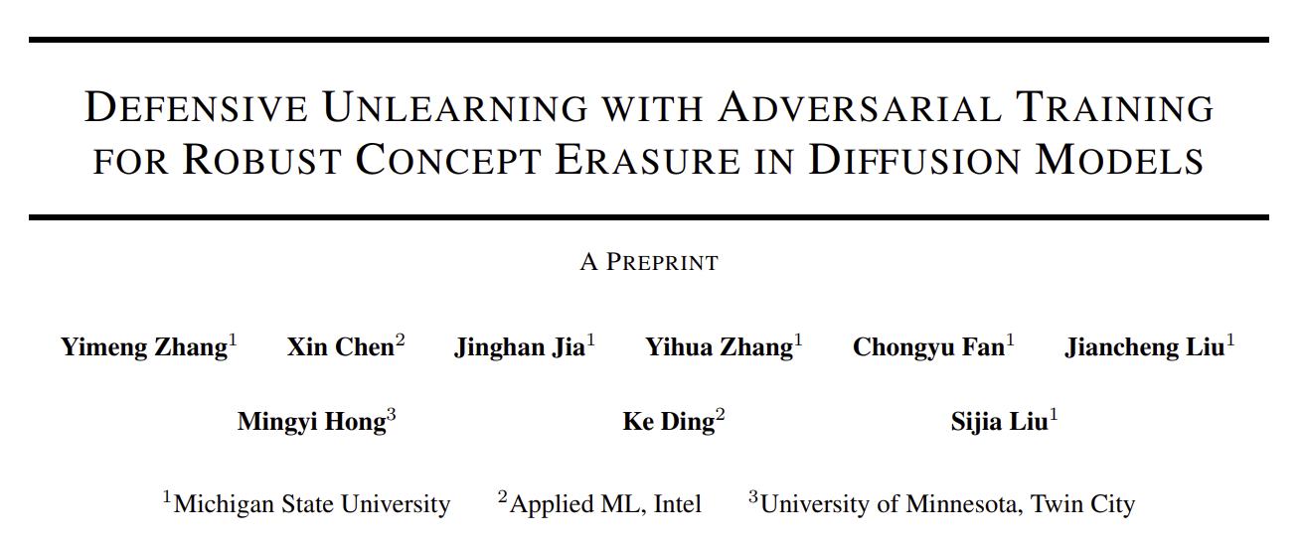
2024.05 / CVPR 2024

Slide 3
Overview
AdvUnlearn
0. Introduction
1. Summary
2. Method
3. Experiment
4. 고찰

Slide 4
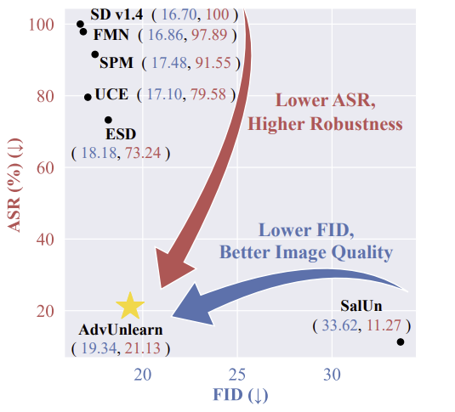
0. Introduction
0. Introduction
1. Summary
2. Method
3. Experiment
4. 고찰
AdvUnlearn
SOTA달성 주장

Slide 5

1. Summary
0. Introduction
1. Summary
2. Method
3. Experiment
4. 고찰
AdvUnlean
SPM total loss에 Adversarial Training 추가한 AdvUnlean
loss를 Diffusion Model의 UNet보다 text encoder에 적용하는게 좋음을 입증, 이 경우 다양한 checkpoint별로 plug and play 가능
AdvUnlean
SPM
Erase로스의 타겟 c와 비슷한 C*들을 AdvATK으로 구해서 전부 erase
Retain 컨셉들은 anchoring

Slide 6



2. Method
0. Introduction
1. Summary
2. Method
3. Experiment
4. 고찰
AdvUnlearn
1. AdvUnlearn
1. Generation of Adversarial Prompts
원본 모델과
원본 타겟 c
Erased 모델과
Adv prompt c’
2. Generation of Retain Prompts
ImageNet,
COCO, …
[OBJECT CLASS]
a photo of apple
a photo of pineapple… .csv
Retain prompts.csv
Judge relevant to target or not

Slide 7
2. Method
0. Introduction
1. Summary
2. Method
3. Experiment
4. 고찰
AdvUnlearn
1. AdvUnlearn
3. AdvUnlearn
Adv prompts c* erase loss
Retain prompts c~ anchoring loss

Slide 8
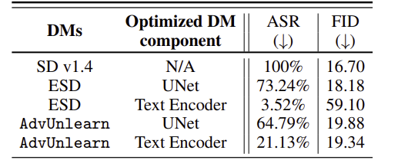
2. Method
0. Introduction
1. Summary
2. Method
3. Experiment
4. 고찰
AdvUnlearn
1. AdvUnlearn
4. Text encoder or UNet

Slide 9
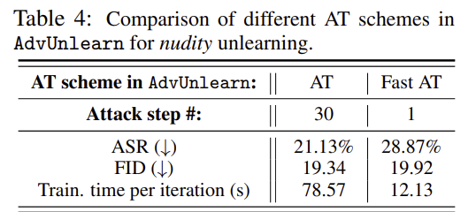


2. Method
0. Introduction
1. Summary
2. Method
3. Experiment
4. 고찰
AdvUnlearn
2. Fast Adversarial Training
1. c’을 fast gradient sign method (FGSM)로 구하면 성능은 살짝 감소하는 대신 학습이 빨라진다 (c’ = c + δ)

Slide 10
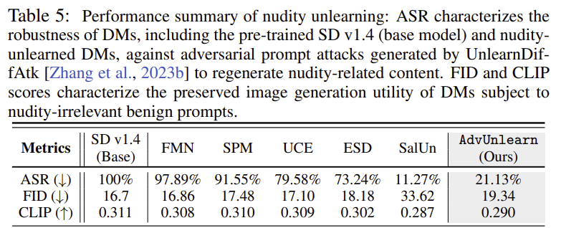
3. Experiment
0. Introduction
1. Summary
2. Method
3. Experiment
4. 고찰
AdvUnlearn

Slide 11
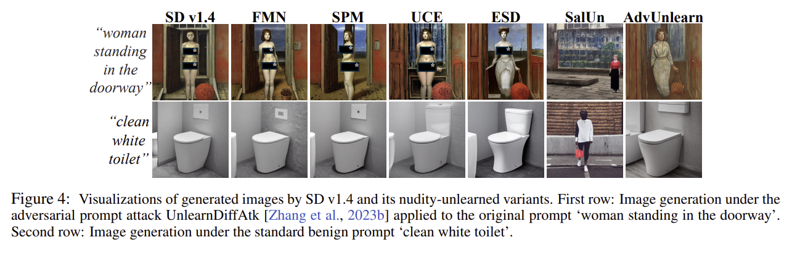
3. Experiment
0. Introduction
1. Summary
2. Method
3. Experiment
4. 고찰
AdvUnlearn

Slide 12
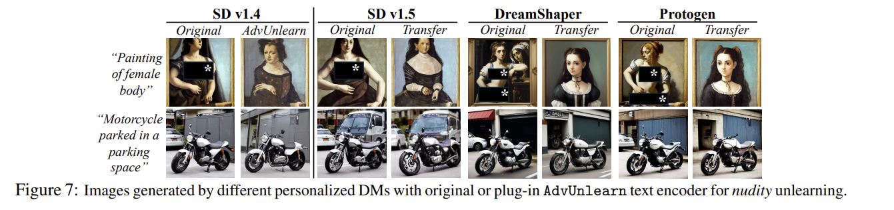
3. Experiment
0. Introduction
1. Summary
2. Method
3. Experiment
4. 고찰
AdvUnlearn

Slide 13
4. 고찰
0. Introduction
1. Summary
2. Method
3. Experiment
4. 고찰
AdvUnlearn
Adversarial Prompts를 이용해 타겟 c를 좀 더 넓은 범위에서 unlearning해서 robustness를 향상시켰지만 멋있는 방법은 아닌 거 같다
Retain prompt는 필수

