Slide 1
Momentum Contrast for Unsupervised Visual Representation Learning

Slide 2
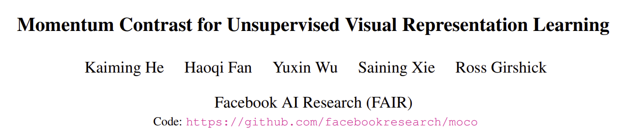
2019.11/CVPR

Slide 3
Overview
MoCo
0. Background
1. Summary
2. Method
3. Experiment

Slide 4
0. Background
0. Background
1. Summary
2. Method
3. Experiment
MoCo
NLP보다 비지도 학습 성능이 떨어지는 CV분야, 이를 Contrastive learning으로 해결하려는 시도가 행해지고 있다.
그러나 최근의 방식들에는 한계가 있고, 발전시킬 여지가 있다.

Slide 5
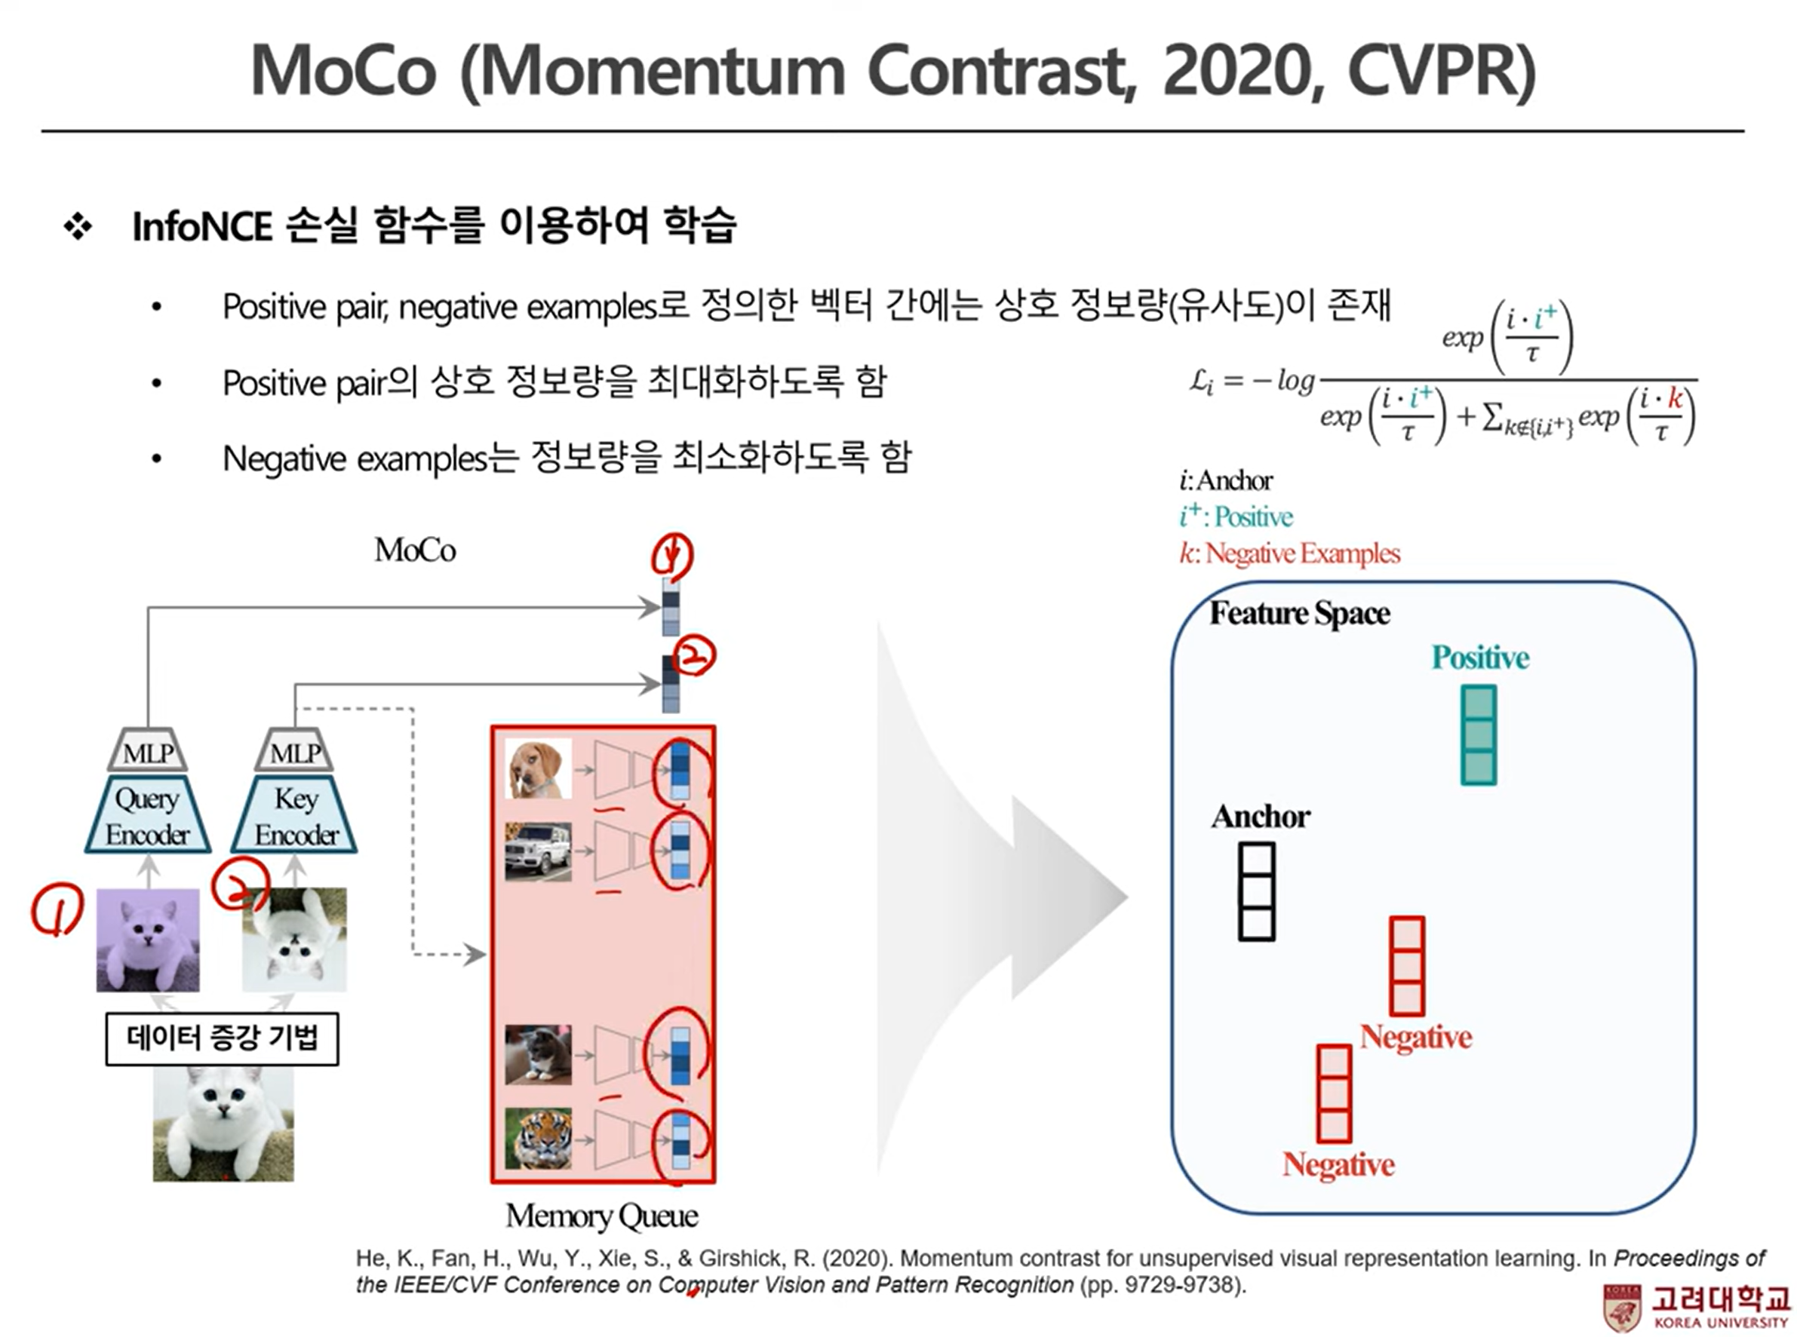
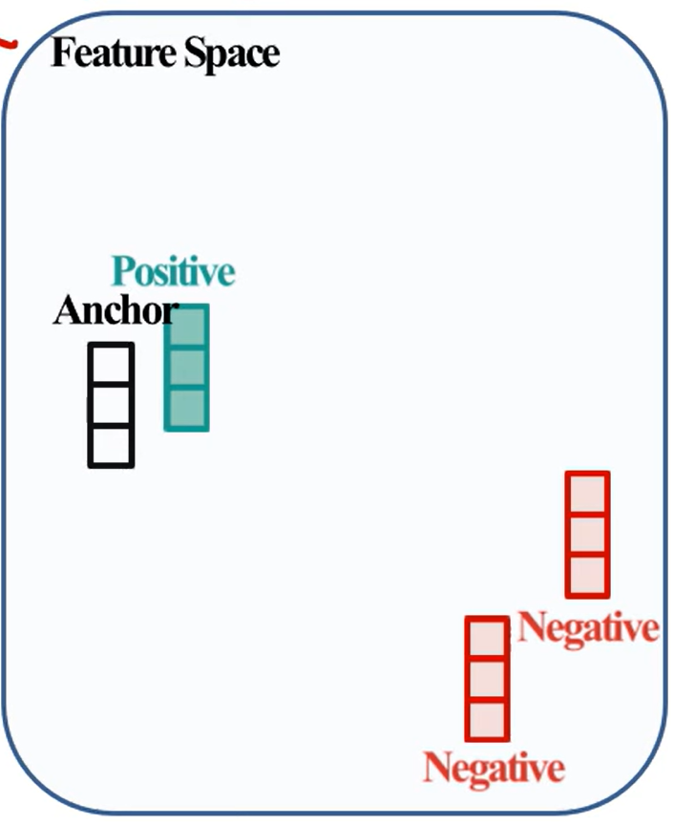
1. Summary
0. Background
1. Summary
2. Method
3. Experiment
MoCo

Slide 6

2. Method
0. Background
1. Summary
2. Method
3. Experiment
MoCo
1. InfoNCE
Contrastive loss function
여기서 ki는 random sampling되던 NPID와 다르게 Dataset Queue를 이용해 구해짐
q = anchor, k+ = positive pair

Slide 7
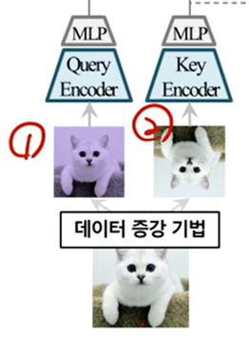

2. Method
0. Background
1. Summary
2. Method
3. Experiment
MoCo
2. Momentum update
Query encoder는 infoNCE 손실함수로 학습, Key encoder는 Query encoder를 활용해 업데이트한다. 최종적으로 downstream task에선 Query encoder 사용
M = 0.999일 때 제일 성능이 좋음

Slide 8
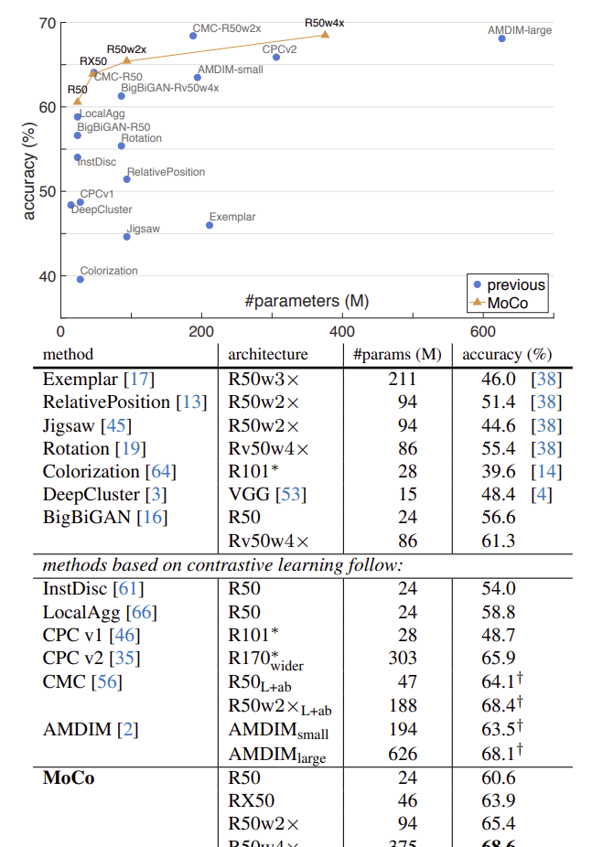
3. Experiment
0. Introduction
1. Summary
2. Method
3. Experiment
MoCo

Slide 9
3. Experiment
0. Introduction
1. Summary
2. Method
3. Experiment
MoCo
1. Linear Classification Protocol
ImageNet-1M에서 unsupervised pre-training 후 features를 freeze, train supervised linear classifier (a fully-connected layer followed by softmax)
Ablation: contrastive loss mechanisms
end to end와 memory bank(npid)보다 성능이 좋았다
Ablation: momentum
M = 0.999에서 성능이 좋았다

Slide 10
3. Experiment
0. Introduction
1. Summary
2. Method
3. Experiment
MoCo
2. Transferring Features
Pre-trained ImageNet supervised training과 MoCo를 새로운 데이터셋에 fine tuning하여 다운스트림 비교(이 때 fine tuning에서 BN적용)
데이터셋 : PASCAL VOC Object Detection, COCO Object Detection and Segmentation, COCO keypoint detection, COCO dense pose estimation, LVIS v0.5 instance segmentation, Cityscapes instance segmentation, Semantic segmentation: On Cityscapes
결과 : MoCo can outperform its ImageNet supervised pre-training

