Slide 1
UNSC, SSD, ERM-KTP

Slide 2
최신 연구 위주
Image Classification 위주
오픈 소스 위주

Slide 3
1. UNSC
2024

Slide 4
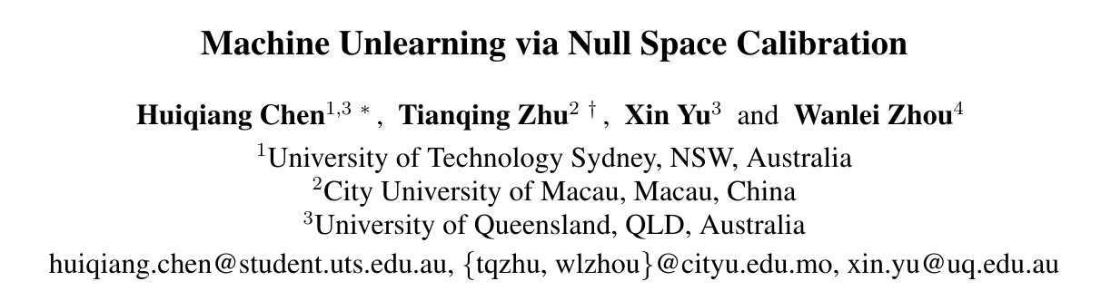
2024 4월 21일 게재 논문
오픈 소스 : https://github.com/HQC-ML/UNSC
SalUn 이후 연구, SOTA

Slide 5
Summary
Null space unlearning
Pseudo-labeling
위 두 방식을 활용하여 Over unlearning 방지
최신 연구 동향 : Dr에 대한 정확성 유지

Slide 6
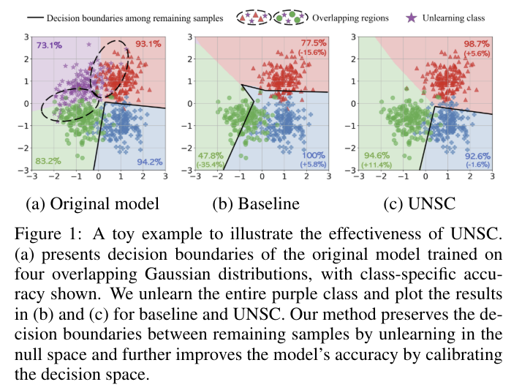
Summary

Slide 7


Method – definition
Null space definition
SVD(특이값 분해)
R = 클래스 k, l번째 레이어, 피쳐

Slide 8
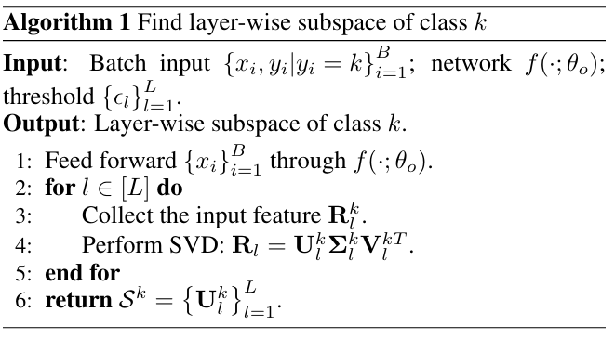

Method – null space
Subspace

Slide 9



Method – null space
Subspace for other classes

Slide 10


Method – null space
projection matrix
weight

Slide 11

Method – pseudo-labeling
제일 유사한 class로 labeling

Slide 12
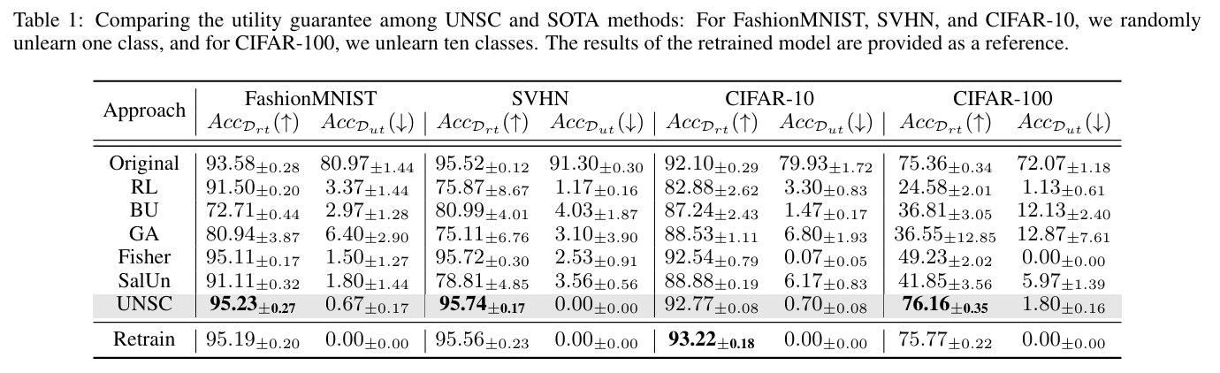
Experiment

Slide 13
2. SSD
2023, AAAI

Slide 14
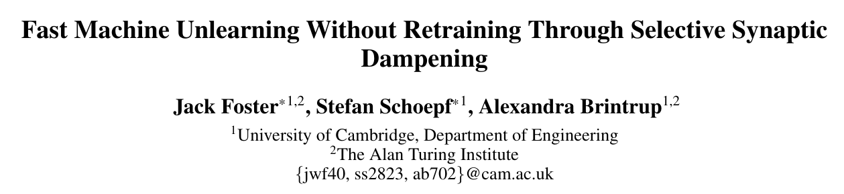
오픈 소스 GitHub - if-loops/selective-synaptic-dampening: Fast Machine Unlearning Without Retraining Through Selective Synaptic Dampening
Selective Synaptic Dampening (SSD)

Slide 15
Summary
Hessian and the Fisher information matrix
Selective Synaptic Dampening
위 두 방식을 활용하여 unlearning

Slide 16
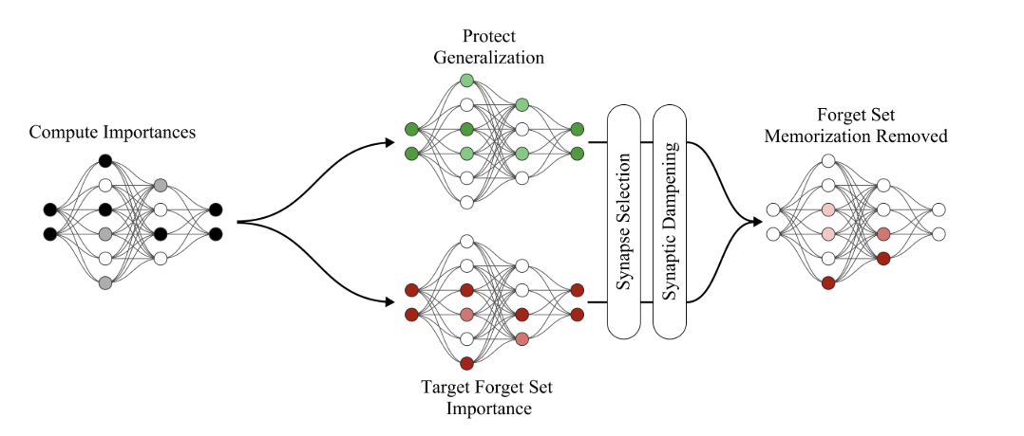
Summary

Slide 17
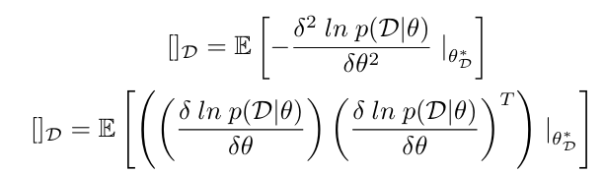
Method – Hessian and the Fisher information matrix
p(D∣θ): 데이터 𝐷와 파라미터 𝜃의 확률 분포
𝜃𝐷∗: 데이터 𝐷로 최적화된 파라미터

Slide 18


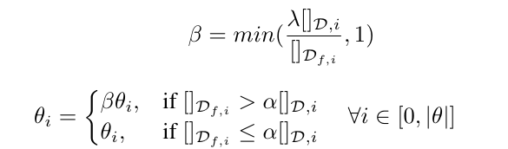
Method – Selective Synaptic Dampening
naive
selective
dampening

Slide 19
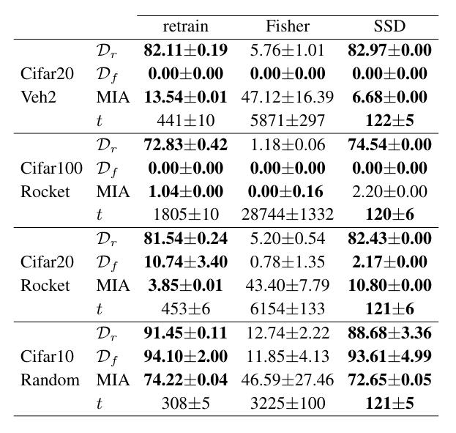
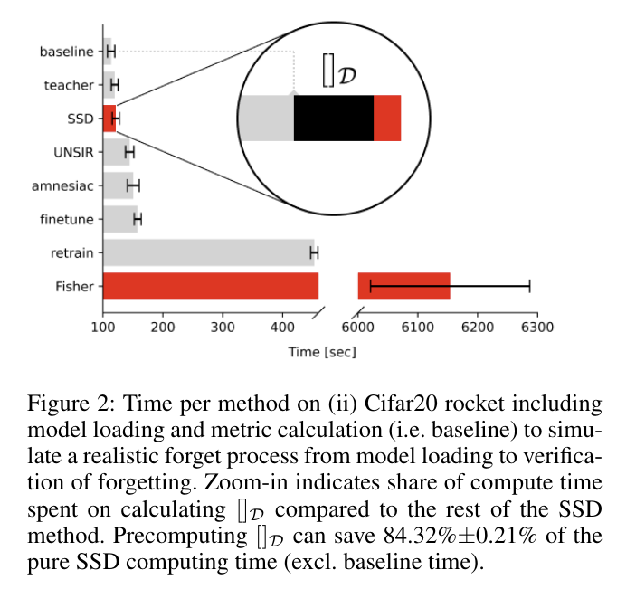
Experiment

Slide 20
3. ERM-KTP
2023, CVPR

Slide 21
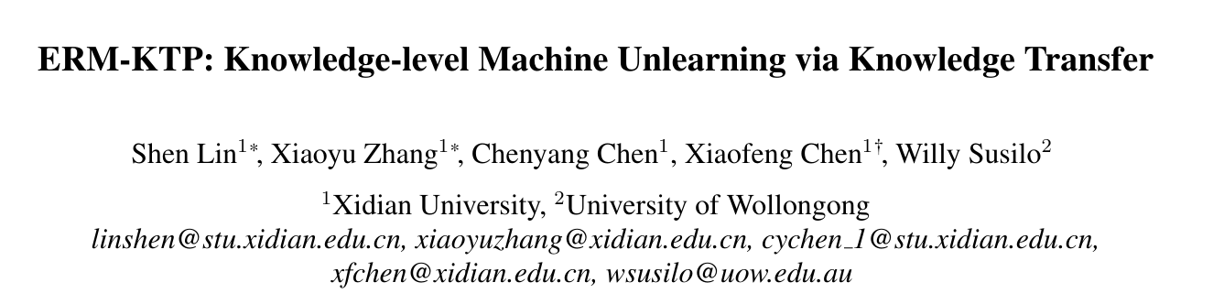
오픈 소스 : https://github.com/RUIYUN-ML/ERM-KTP
entanglement-reduced mask (ERM)
knowledge transfer and prohibition (KTP)

Slide 22
Summary
ERM structure that reduces the knowledge entanglement among classes
KTP method to transfer the knowledge of the remaining set from the original model to the unlearned model and, meanwhile, prohibit the knowledge of the unlearning set.
위 두 방식을 활용하여 unlearning

Slide 23
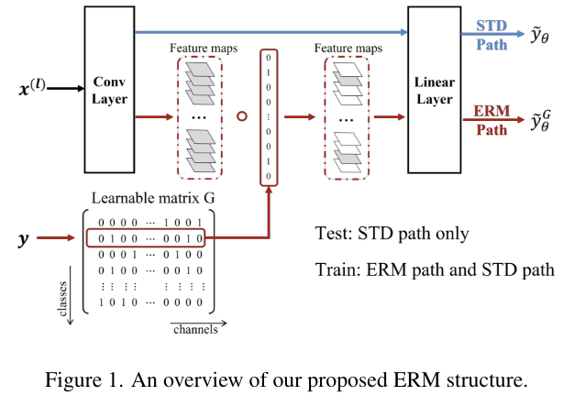
Summary

Slide 24


Method – ERM
Learnable matrix G, c = class, k = channel
L0 = naive

Slide 25

Method – ERM
regulation term to encourage the sparsity of the matrix
L1 = Alpha보다 작으면 0

Slide 26
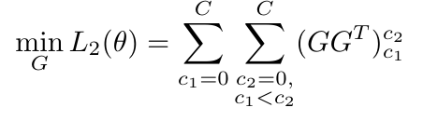
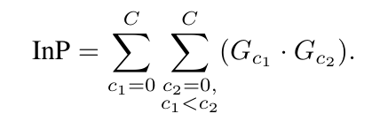
Method – ERM
regulation term to encourage the sparsity of the matrix
L2 =
inner product regulation : to encourage each row of G to be orthogonal to the other

Slide 27
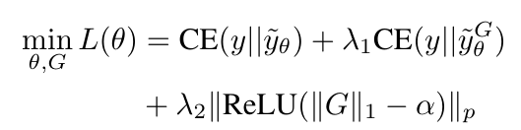
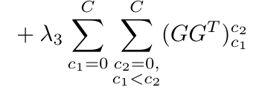
Method – ERM
regulation term to encourage the sparsity of the matrix

Slide 28
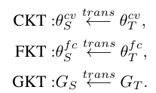
Method – KTP
convolution layers (θ cv S and θ cv T ) knowledge transfer (CKT);
fully connected layers (θ f c S and θ f c T ) knowledge transfer (FKT);
matrix G (GS and GT ) knowledge transfer (GKT).

Slide 29


Method – KTP
Naïve in CKT
1인 경우 0 -> prohibit knowledge
f = original, g = unlearned

Slide 30
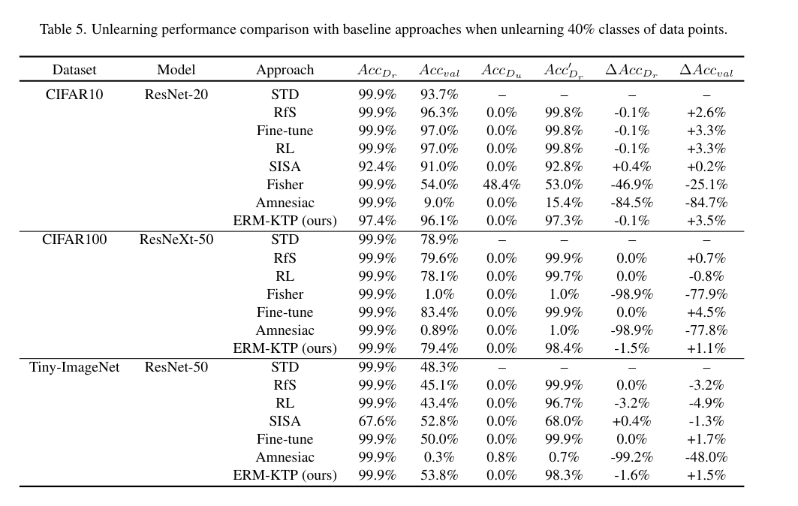
Experiment

Slide 31
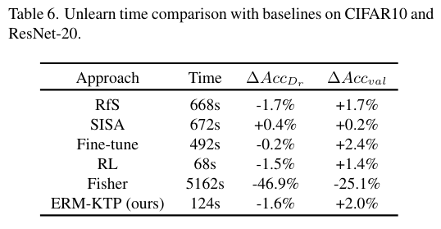
Experiment

Slide 32
고찰
기존 방식들을 섞어보기
Exat unlearning 보다 성능이 좋은 이유 Classification
데이터 증강 등 여러 cheat

Slide 33
부록
Separate the Wheat from the Chaff: Model Deficiency Unlearning via Parameter-Efficient Module Operation = LLM
Towards Effective and General Graph Unlearning via Mutual Evolution = GNN
ERASER: Machine Unlearning in MLaaS via an Inference Serving-Aware Approach = MLaaS
Brainwash: A Poisoning Attack to Forget in Continual Learning = poisoning CL
Tangent Transformers for Composition,Privacy and Removal = transfoermer선형화
Learn To Unlearn for Deep Neural Networks: Minimizing Unlearning Interference With Gradient Projection = SVD
UnlearnCanvas: A Stylized Image Dataset to Benchmark Machine Unlearning for Diffusion Models = unlearn dataset in diffusion
A Unified and General Framework for Continual Learning = fisher map in CL
Label-Agnostic Forgetting: A Supervision-Free Unlearning in Deep Models = unsupervised condition

