Slide 1
SALUN
ICLR, 2024

Slide 2
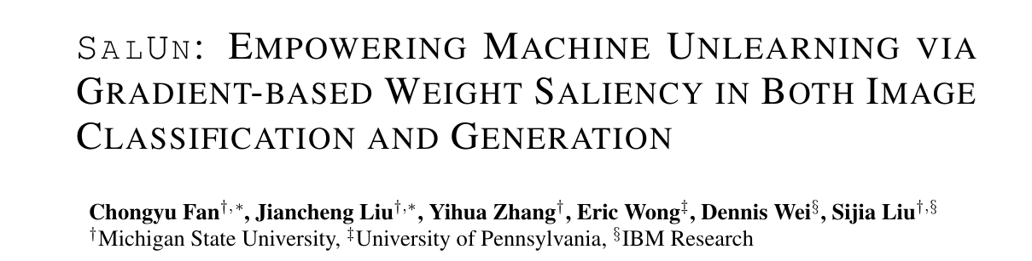
Background
Purpose : 효율적이고 효과적이고 일반적인 Machine Unlearning

Slide 3
Background
기존 Machine Unlearning(MU)의 한계
exact MU – retraining, high cost, challenging for large scale ML
approximate MU – low performance, performance variance
image classification 특화, insufficient for generation

Slide 4
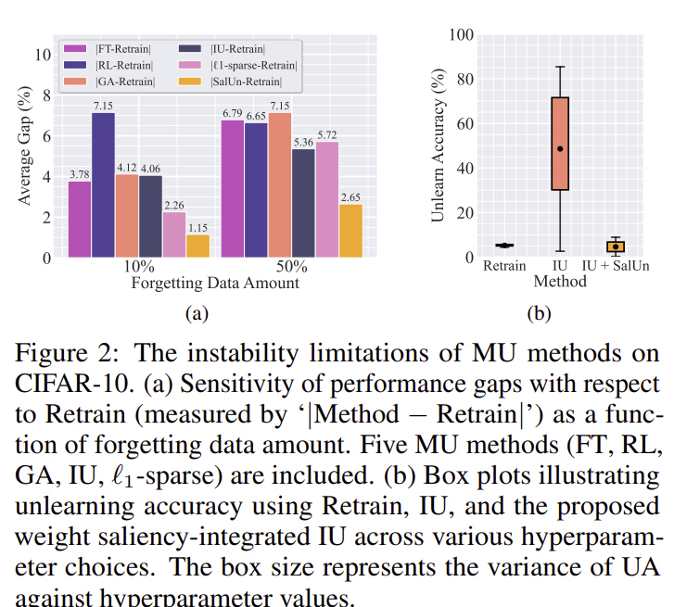
Background
(a) 낮은 효율
(b) 높은 변동성

Slide 5
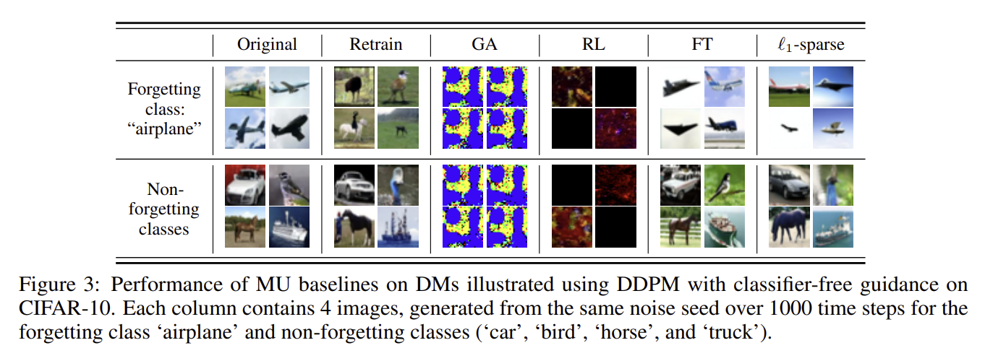
Background

Slide 6
Summary
Exact unlearning과 비슷한 성능의 saliency unlearning
weight saliency 도입
classification-generation adaptive

Slide 7
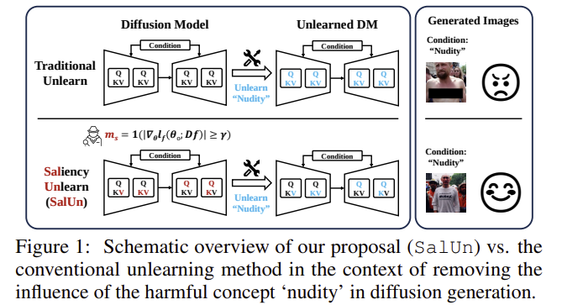
Method – Weight Saliency
‘weight saliency’ unlearning

Slide 8


Method
dataset, forgetting dataset, remaining dataset
noise generator, MSE loss in generation

Slide 9


Method
weight saliency map
unlearning model parameter
(ms가 0일 땐 original 그대로, 1일 땐 다른 weigt로)

Slide 10
Method
Optimization for classification
Optimization for generation

Slide 11
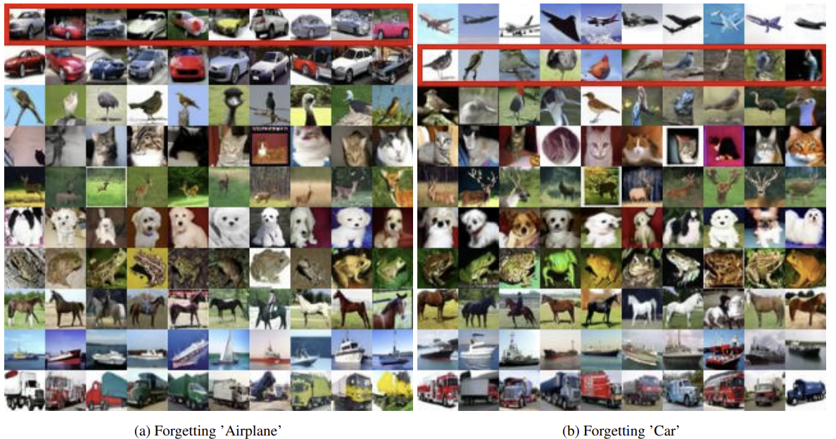
Method

Slide 12
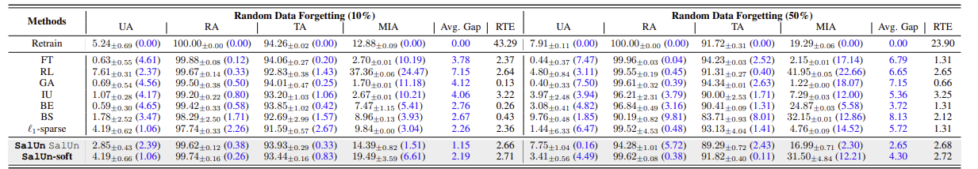
Experiment - classification

Slide 13
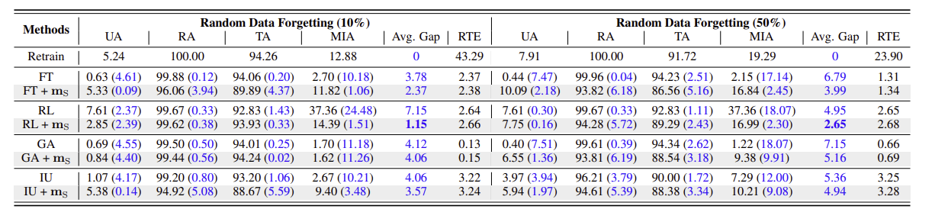
Experiment - classification

Slide 14
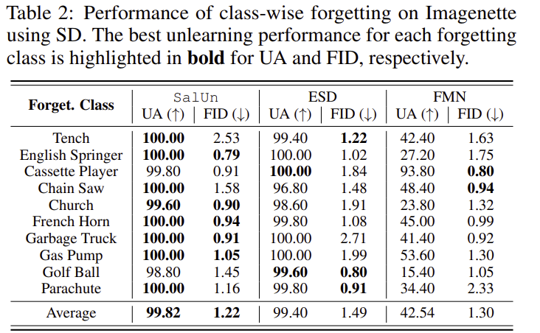
Experiment - generation

Slide 15
고찰
LLM에서의 unlearning
Diffusion language model

