Slide 1
LLaVA
NeurIPS, 2023

Slide 2
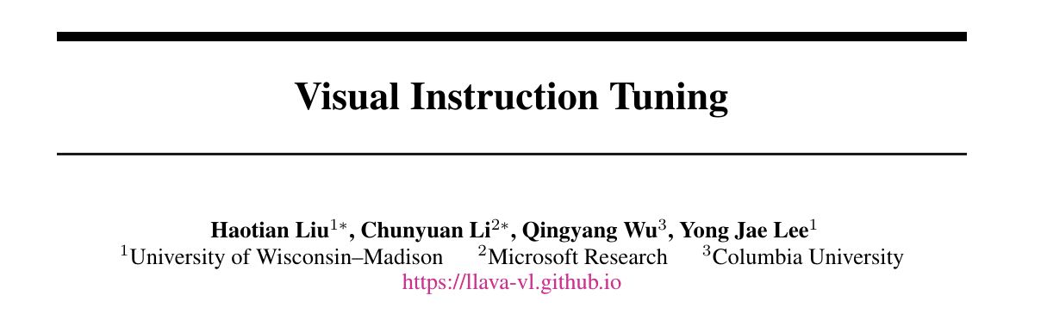
Background
Purpose : instruction에 대한 적절한 response를 생성하게 해주는 LLM의 Instruction tuning기법을 image-text multimodal에도 적용해보자

Slide 3
Summary
Instruction tuning을 적용한 image-text multimodal
Input : vision, question, output : answer text
data 수집, model architecture(LLaVA)
GPT-4 generated data reformation, pre-trained LLM, pre-trained visual model, projection

Slide 4
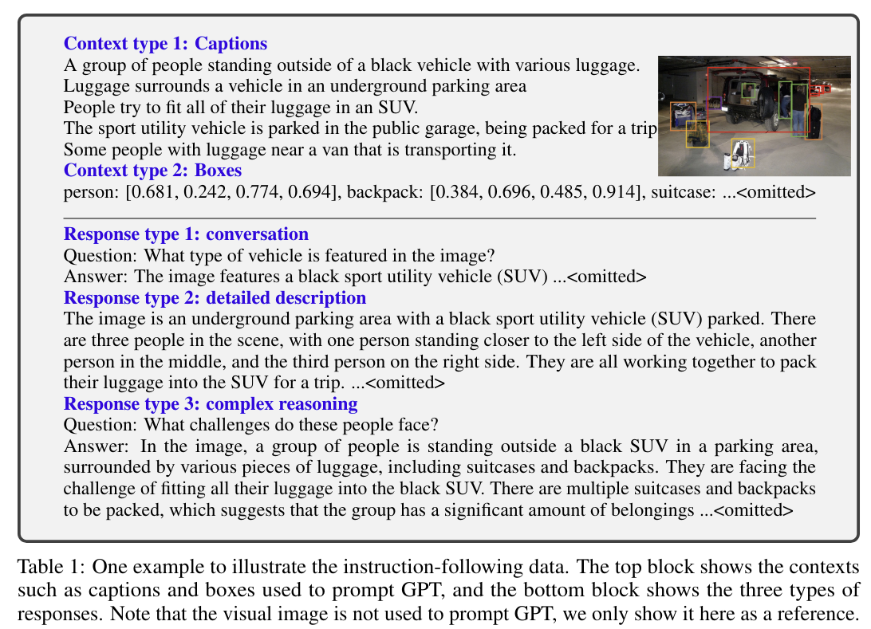
Method - Visual Instruction Data Generation
Image Xv, caption Xc (+box Xb) : COCO
Question Xq, answer Xa
3가지 type
Simple :

Slide 5
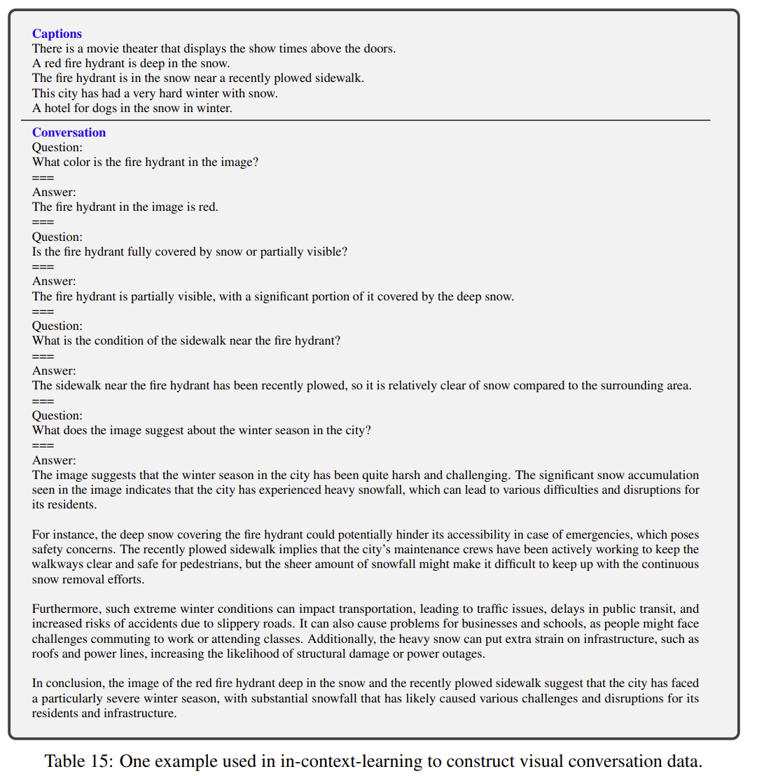
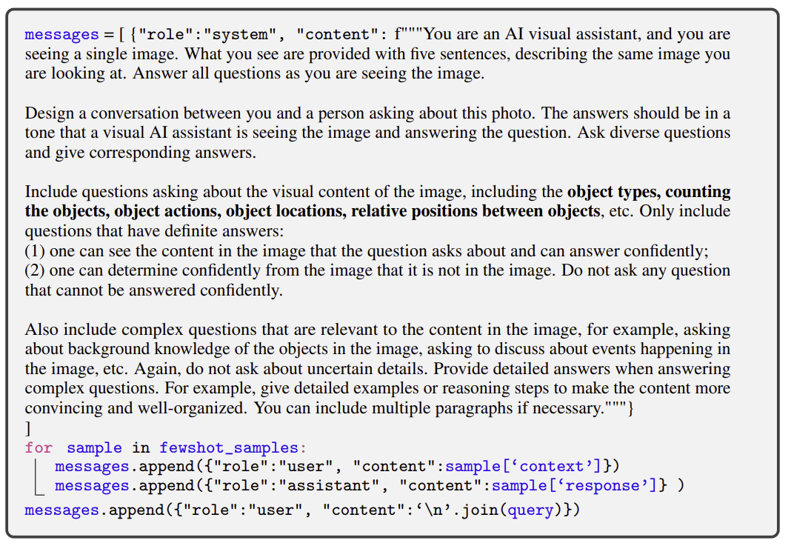
Method - Visual Instruction Data Generation
Xc + {Xqi, Xai} few shot -> {Xqj, Xaj} by GPT
158K = 58K(conversation) + 23K(detailed description) + 77K(complex reasoning)

Slide 6

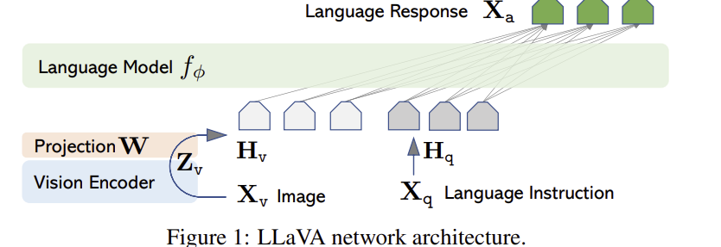

Method - Arichitecture
LLM : LLaMA, Vision encoder : ViT-L/14
Projection : simple linear layer
Flamingo or BLIP-2

Slide 7

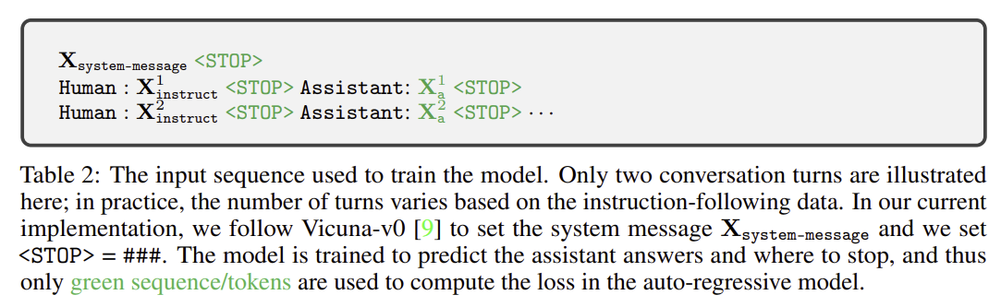
Method - Training

Slide 8
Method - Training
Pre-training projection W
Projection 제외 frozen

Slide 9
Method - Training
Fine-tuning end to end
Frozen only Vision Encoder

Slide 10
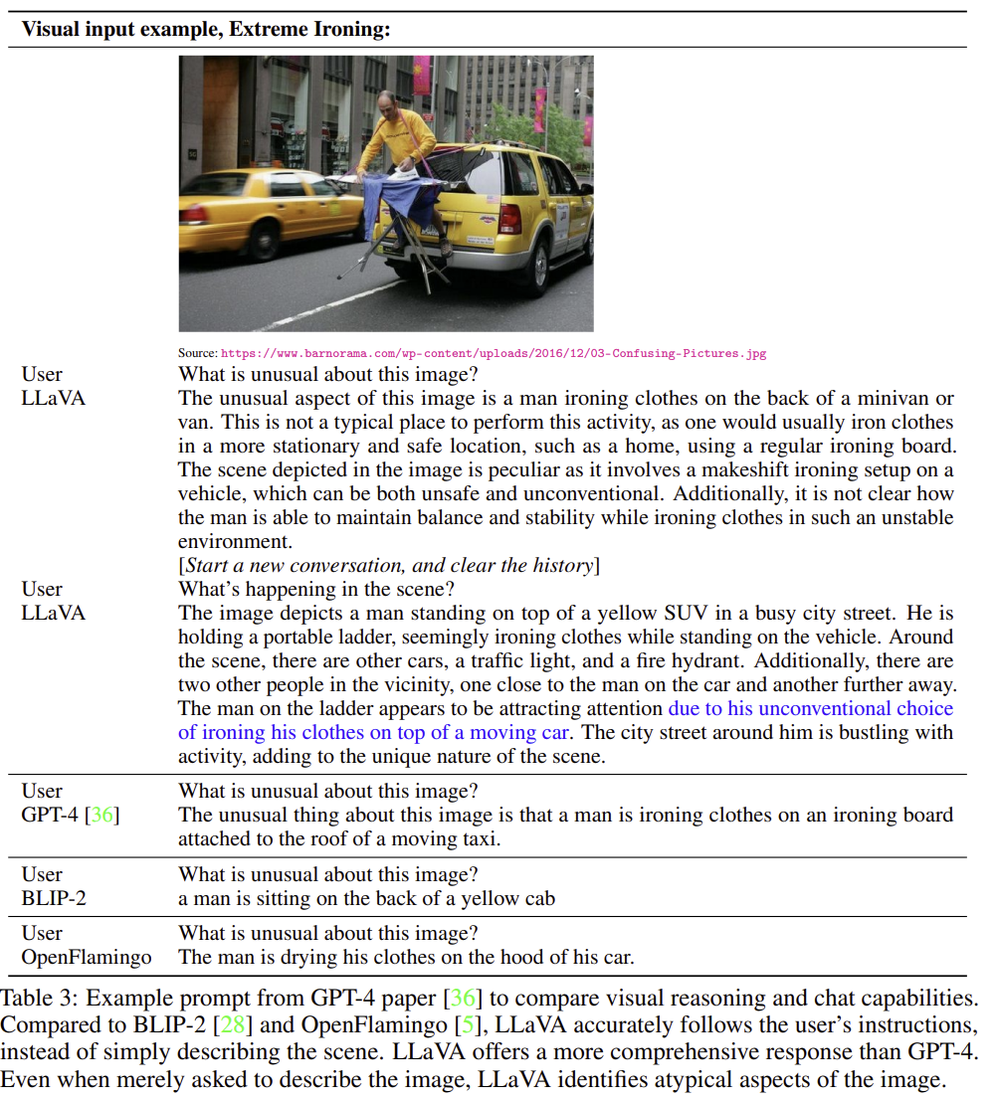
Experiment

Slide 11
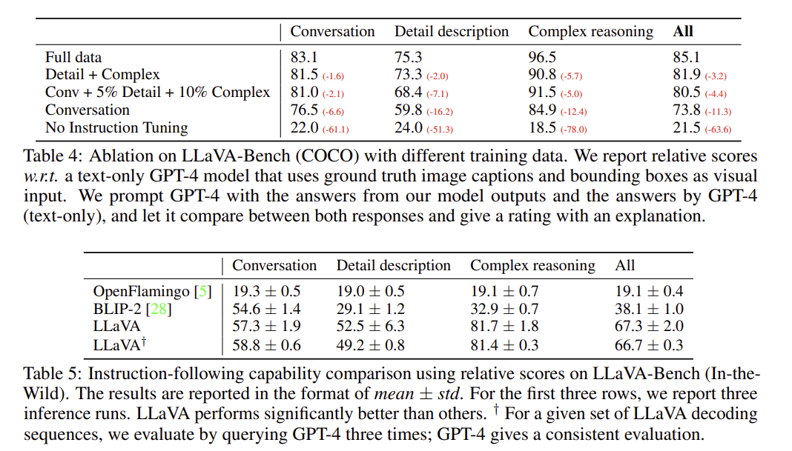
Experiment

Slide 12
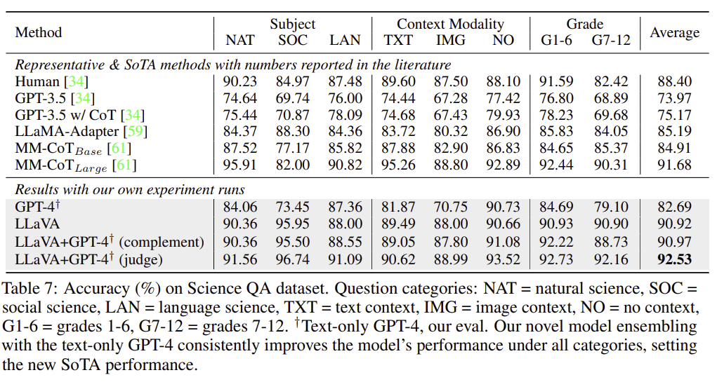
Experiment

Slide 13
고찰
Linear layer projection

