Slide 1
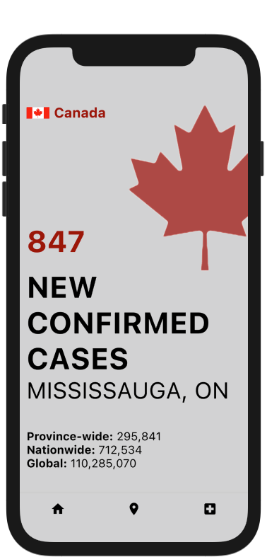
COVID Watch
Using technology to stop the spread

Slide 2


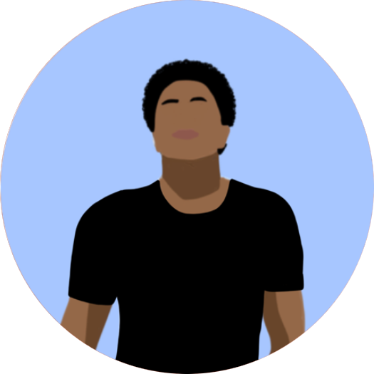
Meet the Team
Tomiwa Oladele
Varnika Singh
Shaquille David

Slide 3
Agenda
Solution
Analysis
Risks and Mitigation
Implementation Timeline
Demo
Q&A

Slide 4
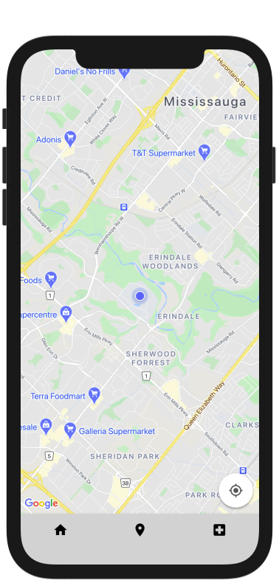
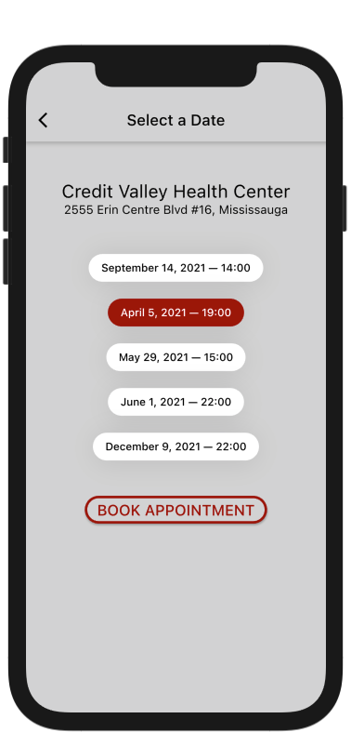
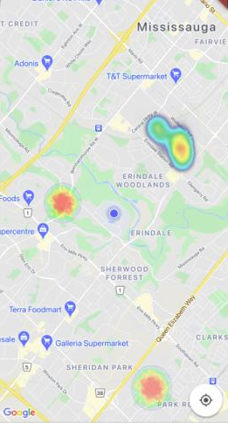
Solution
A "hub" where you can view the latest COVID-19 updates and book your vaccination appointment.
Real-Time Updates
COVID Hotspots
Vaccination Booking

Slide 5
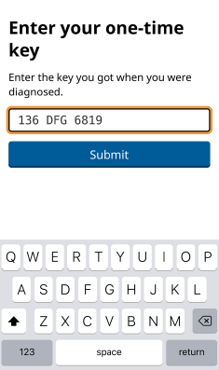
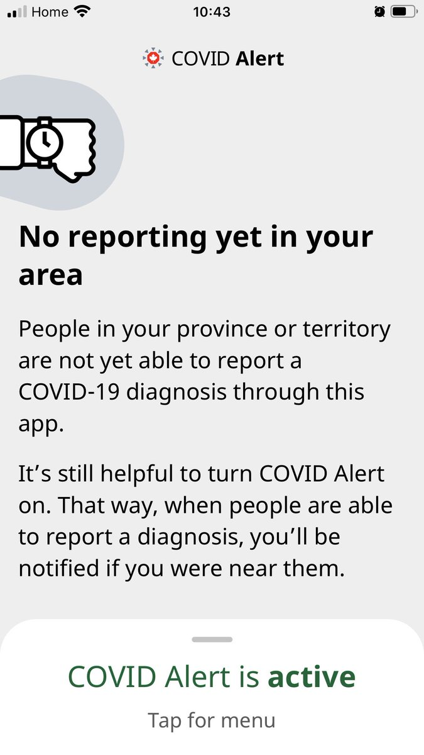
Analysis
A few reasons why the current COVID Alert app is ineffective
Requires a unified effort. This will only work in an ideal world.
Codes, Bluetooth, Battery Usage, Privacy concerns

Slide 6
COVID Alert App Statistics
The app has been downloaded 2.94 million times, however, only 514 users have notified the app about their positive test results.
CTV, September 2020.
Of Canada's 25,000+ confirmed COVID-19 cases since July 31, 2020, only 1,354 cases were reported through the app.
CBC, October 2020

Slide 7


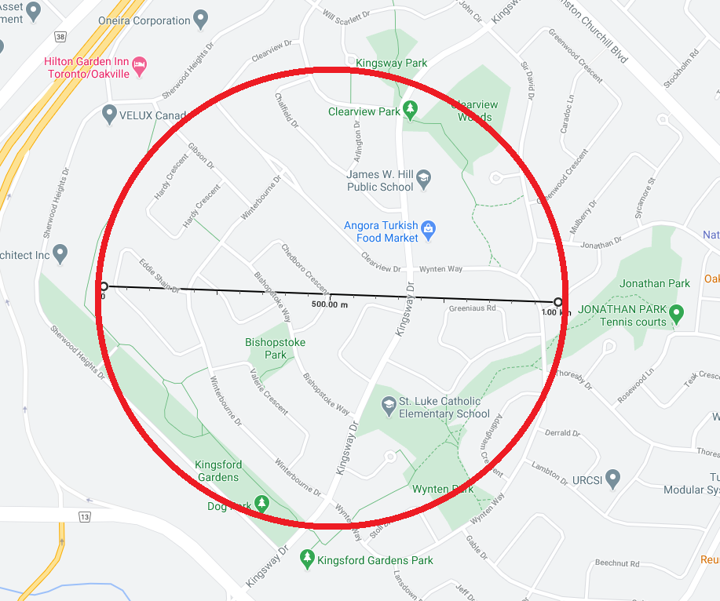
Privacy
An insight on how privacy isn't breached with our app
Gather the longitude and latitude of POSITIVE Covid-19 tests
Place a general hotspot (1.0 km diameter) in the area of positive tests. The more tests in the area, the darker the hotspot.

Slide 8
Risks & Mitigation
Risks
Mitigation
Currently, we are receiving the COVID-19 data from a third-party API from Flutter.
Not everyone has a capable smart phone to run the app.
With the assistance of the Government, we can relay true, exact data.
Implementing a web application with the same features. 92% of Canadians have internet access.

Slide 9




IMPLEMENTATION Timeline
Partnership
Publish
Nationwide Usage
Back to NORMAL
We would like to form a partnership with the Government of Canada as soon as possible.
Provided the necessary data and info, we can distribute our app by end of March.
Have 75% of the population using our app by August 2021.
With the help of our vaccination reservation system, we plan to have 90% of Canadians vaccinated by the end of 2021.

