Slide 1
Predicting Player Efficiency Rating Using In-Game Stats Metrics
Presenters: Lyndon Kelley, Tola Ouk, Martha Valdes

Slide 2

Introduction to Basketball
Created by James Naismith in December of 1891
2 teams made up of 5 players on the court try to get ball into the other’s teams elevated basket and prevent the opposing team from doing so
Major North American organization and largest basketball league in the world is the National Basketball Association, abbreviated as the NBA

Slide 3

PER
Player efficiency rating, better known as PER, is an advanced statistic created by John Hollinger that measures a players total productivity.
PER basically adds all the positive contributions a player makes and subtracts all the negative contributions from this value.
As a nice rule of thumb, better players have higher PERs.
Formula: uPER = (1 / MP) *[ 3P + (2/3) * AST + (2 - factor * (team_AST / team_FG)) * FG + (FT *0.5 * (1 + (1 - (team_AST / team_FG)) + (2/3) * (team_AST / team_FG))) - VOP * TOV- VOP * DRB% * (FGA - FG) - VOP * 0.44 * (0.44 + (0.56 * DRB%)) * (FTA - FT) + VOP * (1 - DRB%) * (TRB - ORB) + VOP * DRB% * ORB + VOP * ST + VOP * DRB% * BLK- PF * ((lg_FT / lg_PF) - 0.44 * (lg_FTA / lg_PF) * VOP) ]

Slide 4
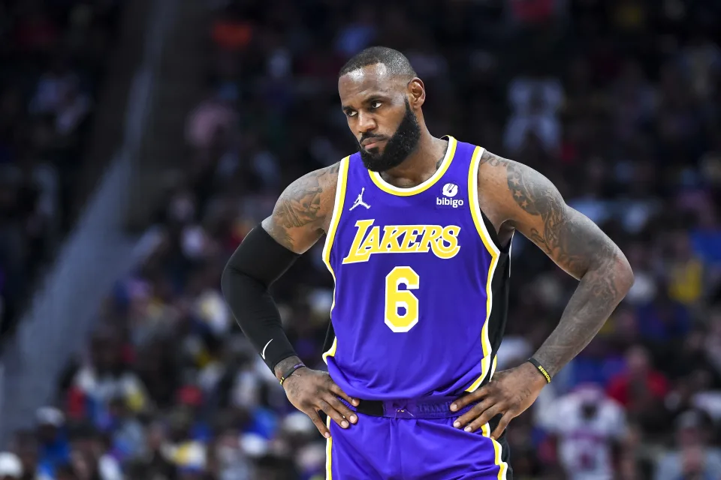
Question and Practical Application
Question: Which game statistics are the best predictors of Player Efficiency Rating (PER) of NBA players?
Players with higher PER are usually better. They contribute a lot more to winning. The best players, like Lebron, usually have high PERs. To win games, you need these players
NBA Front Offices must know which players will have higher PERs is important for contract negotiations. The better players get paid more, and can get awards like an MVP or make an All-NBA team. Players are incentivized to get these awards because they will make significantly more money in their contract. SO front offices need to have an idea of PER to see who will get these awards

Slide 5

Data source
Source: basketball-reference.com
From: Dec. 22, 2020 to Feb. 18, 2021 of the 2021 NBA season
334 observations (players) _ 7 variables

Slide 6
Response and Explanatory Variables
Response variable:
PER: Player Efficiency Rating measures the productivity of each player per minute. Range: 2.4 - 31.4
Predictor variables:
Win Shares (WS) - Range: -0.8 - 6.3
Usage Percentage Measures (UPM) - Range: 8 - 36.2%
True Shooting (TS) - Range: 30 - 76%
Age - Range: 19 - 37 years
Free-throw percentage (FTr) - Range: 0 - 96%
Shots a player takes from three (X3) - Range: 0 - 89%

Slide 7
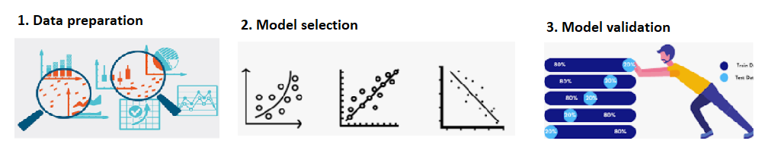
Project procedure

Slide 8
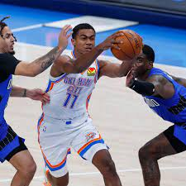

Data Preparation
The dataset initially had 481 player entries as part of it.
Filters set on the data:
Deleted duplicate player entries for teams. There were times that players would have multiple entries because they switched teams in the middle of the season. Only the the entry that combined the total stats was used.
Players had to have played at least 200 minutes. Better than games played, as help measure time and accounts for garbage time
For ease, the correlation values for each of the variable was

Slide 9
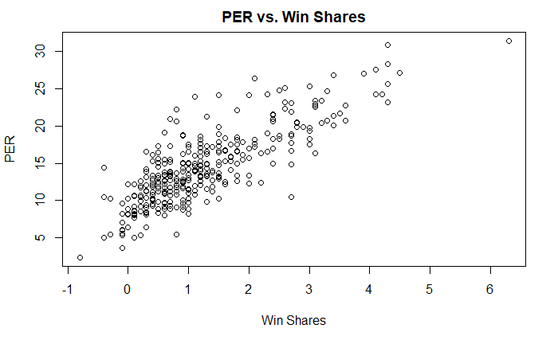
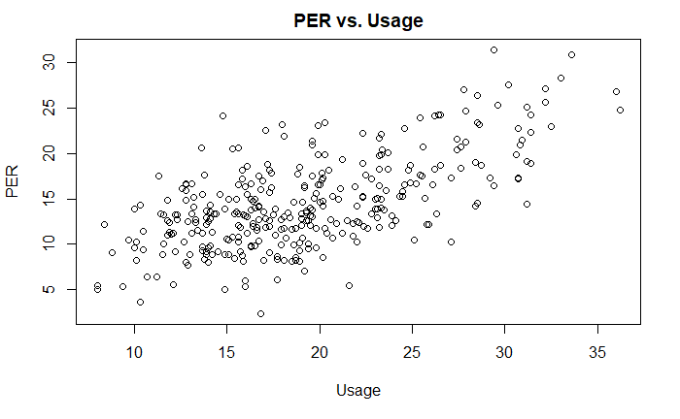
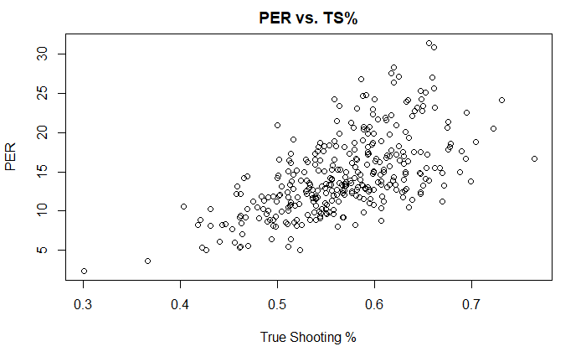
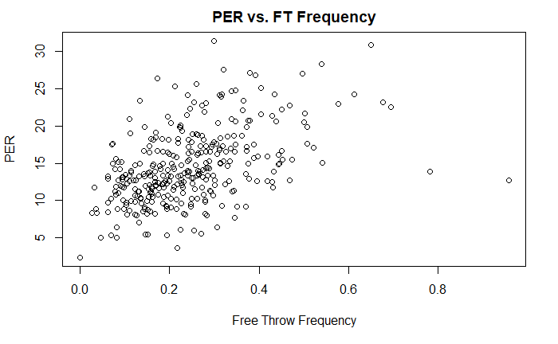
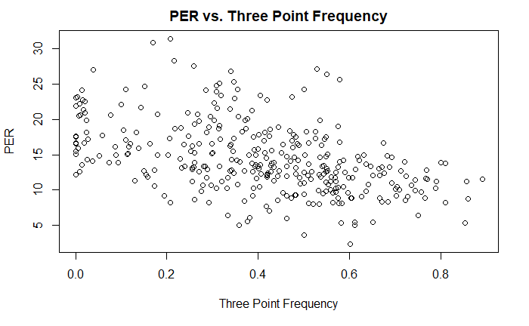
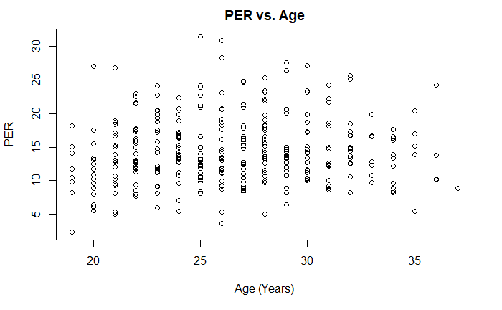
Model Preparation

Slide 10
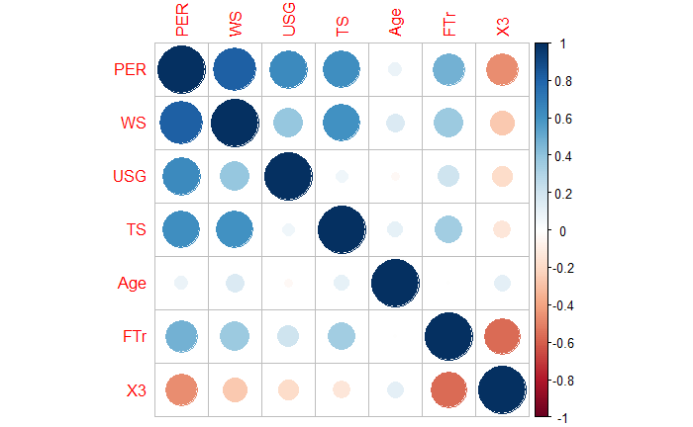
Model Preparation
Correlation analysis

Slide 11
Model Preparation
High correlation:
Player Efficiency Rating and Win Shares
Low correlation:
Player Efficiency Rating and Age

Slide 12
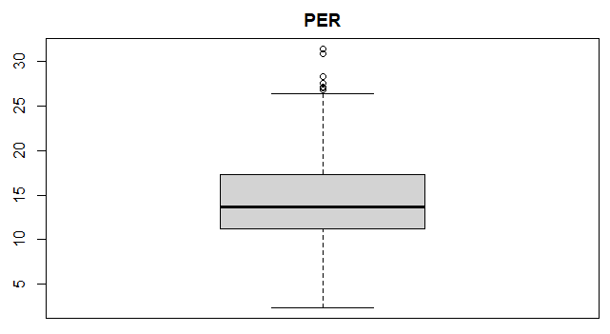
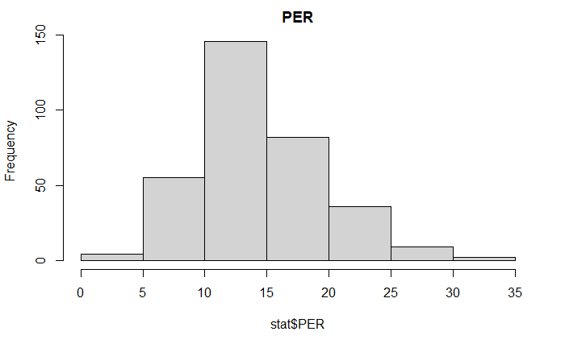
Model Preparation

Slide 13
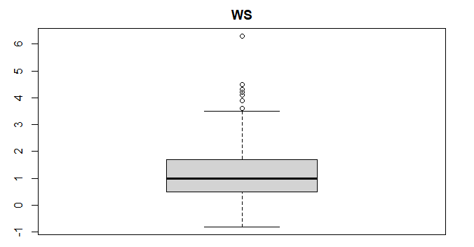
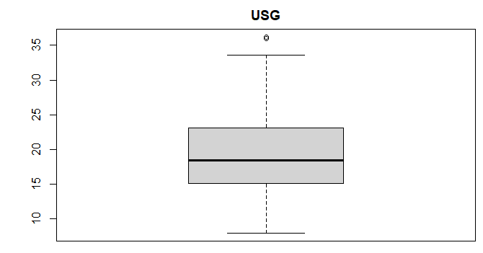
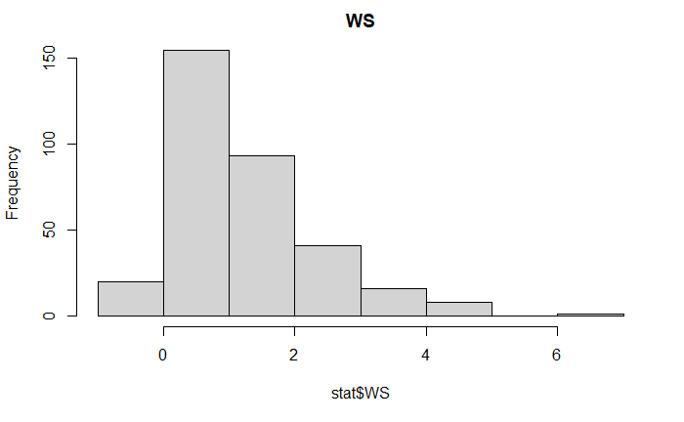
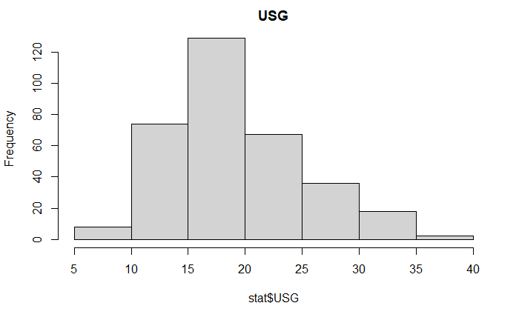
Model Preparation

Slide 14
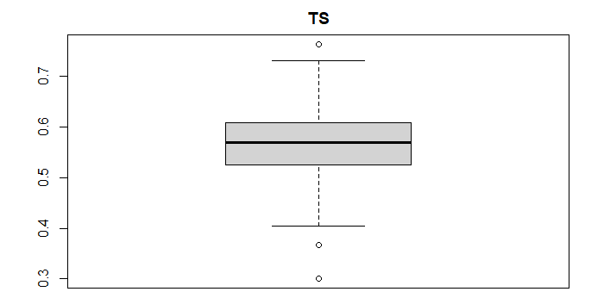
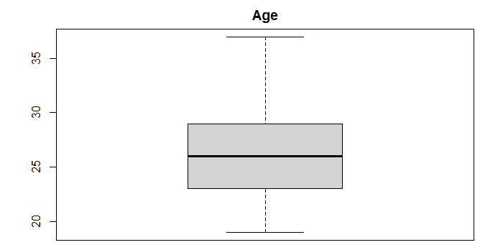
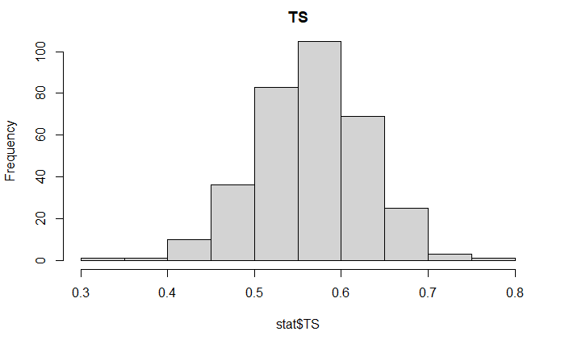
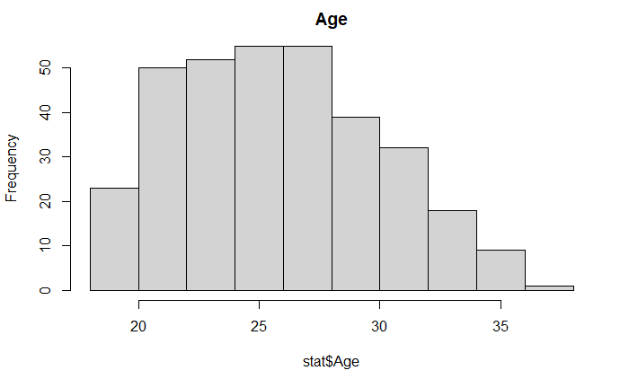
Model Preparation

Slide 15
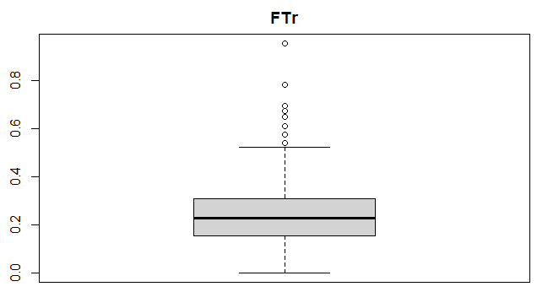
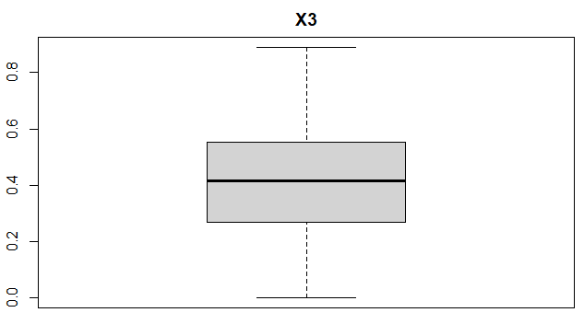
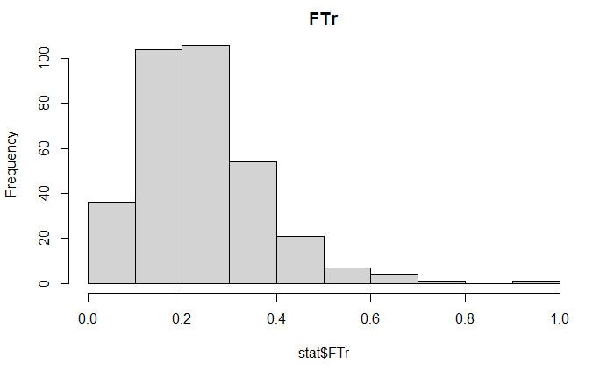
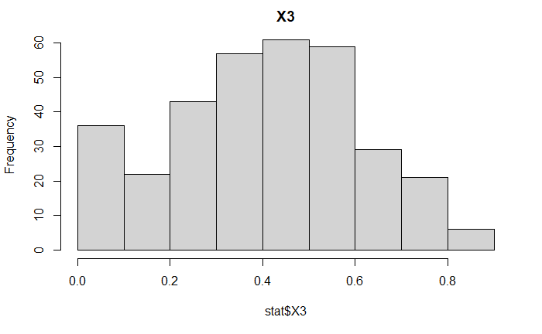
Model Preparation

Slide 16
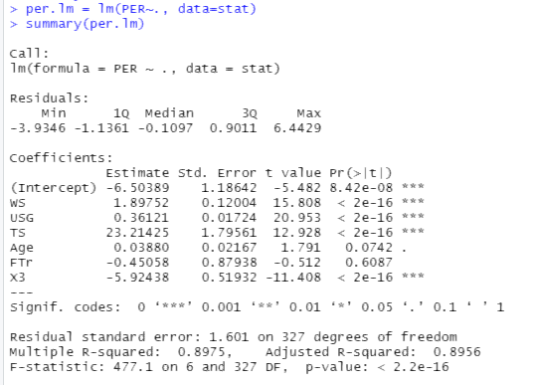
Full Model
Strong relations between PER and WS, USG, TS and X3.
P-values for Age and FTr are high.
There is not sufficient evidence that there are linear relations between PER and Age PER and FTr.
Model: PER = -6.50389 + 1.8752 WS + 0.36121 USG + 23.21425 TS + 0.0388Age - 0.4506FTr - 5.92438 X3
Adjusted R-squared = 0.8956

Slide 17
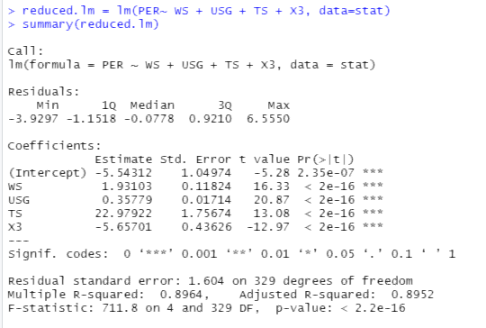
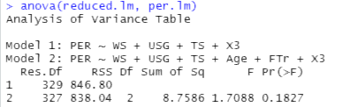
Reduced Model
New model without predictors “Age” and “FTr”.
P-value: all are very small.
There is sufficient evidence that there are linear relations between PER and the predictors.
Reduce Model:
PER = -5.5431 + 1.9310 WS + 0.3578 USG + 22.9792 TS - 5.6570 X3
Adjusted R-squared = 0.8952

Slide 18
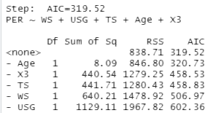
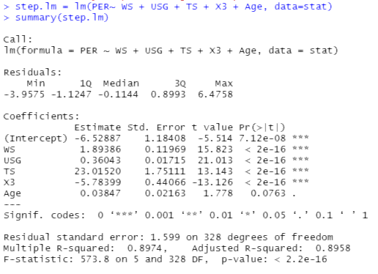

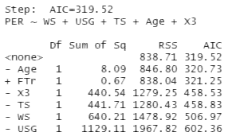
Step function
Backward
All 3 step functions result in the same model:
Forward
Both

Slide 19
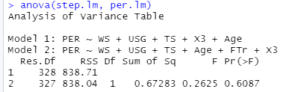
Reduced models Versus Full Model
Model | MSPE (Test-set)
PER ~ WS + USG + TS + Age + FTr + X3 | 2.431009
PER ~ WS + USG + TS + Age + X3 | 2.403303
PER ~ WS + USG + TS + X3 | 2.431094

Slide 20
Conclusion
The full model and reduced models have similar performances.
The four strongest variables to predict PER are Win Share(WS), Usage Percentage (USG), True Shooting Percentage (TS) and Percentage Shots from Three (X3).
Age and Free Throw rate (FTr) have almost no impact on the model’s predictive ability.
Further Study:
The box plots shows some outliers, so these will be further examined in the final analysis.
Later, a cross-validation will be performed with variables that passed the t test and the F test.
Complete regression analysis will be performed for the final paper to further analyze the best model by taking the following into account: scatter plots, multicollinearity diagnosis, residual analysis, and influence diagnostics.

Slide 21
References
Basketball Reference. (n.d.). 2020-21 NBA Player Stats: Per Game. Retrieved November 4, 2021, from https://www.basketball-reference.com/leagues/NBA_2021_per_game.html
Davis, S. (September 18, 2020). Nikola Jokic [Photograph]. Business Insider. https://www.businessinsider.com/why-nikola-jokic-dominant-beloved-player-nba-2019-5
Donnelly, G. (January 13, 2021). [Picture of James Harden][Photograph]. Clutchpoints. https://clutchpoints.com/rockets-ready-to-trade-james-harden-quickly-to-nets-or-sixers/
Hunter, T. (February 25, 2021). [Picture of Theo Maledon][Photograph]. Welcome to Loud city. https://www.welcometoloudcity.com/2021/2/25/22297197/19-year-old-theo-maledon-excelling-in-thunder-starting-lineup
National Basketball Association (NBA) Logo. (n.d.). Symbols.com. Retrieved November 28, 2021, from https://www.symbols.com/symbol/national-basketball-association-%28nba%29-logo.
Nba 2020-2021 Season Player Stats. (2021, February 18). Kaggle. Retrieved November 4, 2021, from https://www.kaggle.com/umutalpaydn/nba-20202021-season-player-stats
Owens, J. (November 25, 2021). [Picture of Lebron James][Photograph]. Yahoo Sports. https://sports.yahoo.com/le-bron-james-calls-suspension-for-bloodying-isaiah-stewart-bulls-230413937.html
Jay Song also helped in gathering and writing the initial analysis

