Slide 1
Seafloor Habitat Mapping Using Multibeam Bathymetric and Backscatter Intensity Multi-features SVM Classification Framework
Presented by
Tola Ouk

Slide 2
Introduction
Application of Seafloor Habitat Mapping:
Marine Environmental Assessment and Management
Habitats Protection
Hazards assessment and Human activities control
Multibeam echo-sounding system (MBES):
Mainstream detection device
Can acquire backscatter intensity data that characterize the sediment properties
Can acquire bathymetry data
Advantage: detect seafloor habitats with high-precision and full-coverage
Goal: Achieve accurate mapping of seafloor habitat types using data from MBES and SVM classification framework.

Slide 3
Experiment Area
Shallow water of southern Wellington, New Zealand
6 - 26 meters deep
3 – 6 degrees of average slope of the seafloor
Overall topography slowly declines from North to South
Active area:
Large fine-grained sediment
Moving sand
Reefs
Marine reserve

Slide 4
Data
Source: Shallow Survey Conference 2012
Multibeam raw data:
collected by Reson company
Used Seabat-7125 multi-beam sounding system on April 28, 2011
Data collection:
400 kHz frequency of multi-beam system
5-6 kts vessel speed
120-degree swath angle
17 survey lines of full coverage data acquired along the northwest-southeast direction

Slide 5
Data Processing
The bathymetry and backscatter intensity data in the original data were parsed and preprocessed by Fledermaus and FMGT software.
Inverse distance weighing method is used to grid the discrete point clouds according to their density statistics, and a digital depth model (DDM) with a resolution of 0.5 m is obtained. (figure 1a - next slide)
Backscatter intensity values are processed to obtain the intrinsic acoustic intensity information of the sediment. The image mosaic and gray enhancement methods are used to generate a sonar image with the same resolution as the DDM. (figure 1b – next slide)

Slide 6
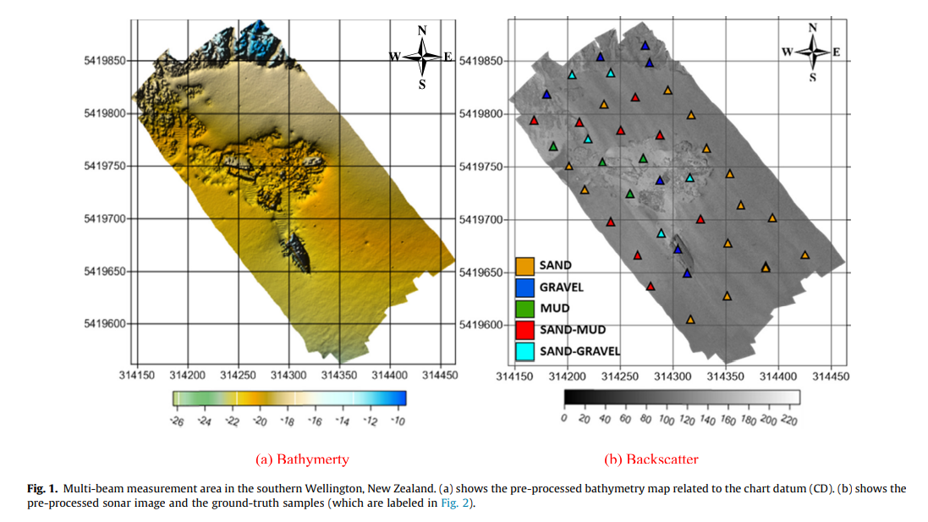

Slide 7
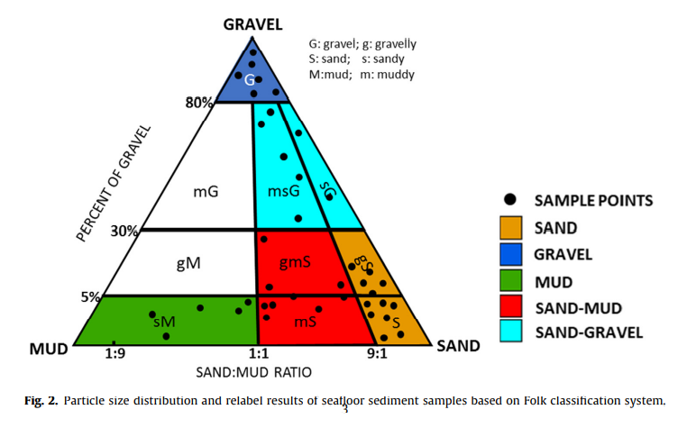
Ground-truth
Sediment types in this area:
Sand
Gravel
Mud
Sand-Mud
Sand-Gravel
Black circles represent particle size distribution position of the sediment samples in Folks classification table.

Slide 8
Method
Feature extraction
Training samples selection and evaluation
Askey-Wilson (AW) kernel function construction

Slide 9
Feature Extraction
17-dimensional features are extracted based on the backscatter and bathymetry data. (Table 1 – next slide)
Three main types of features:
Basic sonar image statistics
Gray level co-occurrence matrix (GLCM)
Seafloor topography factors

Slide 10
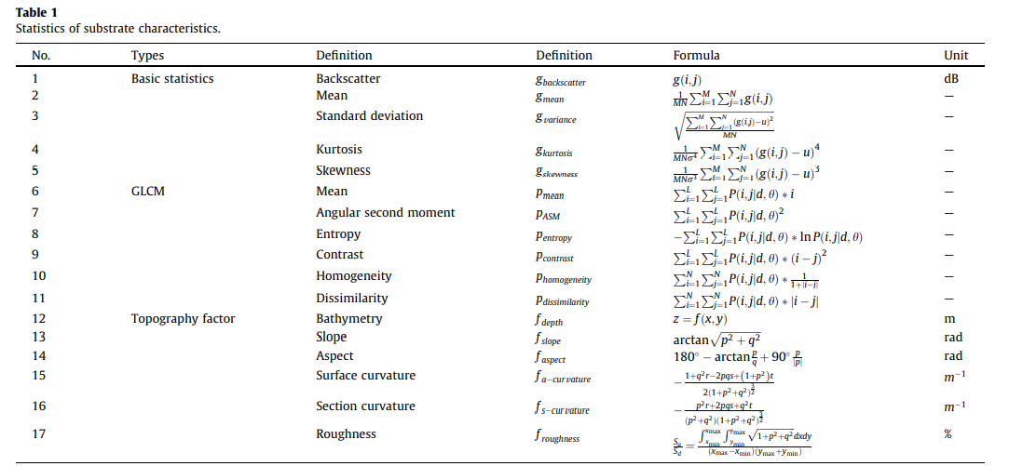

Slide 11
Training Samples Selection and Evaluation
39 Actual seafloor sediment sampling points in the experiment area
5 groups of candidate training sample are randomly selected in the 32 x 32 pixels rectangular neighborhood centered on the sampling point coordinates (Figure 3 - next slide)
Each group contains 5 sub-regions, representing 5 different sediments: Sand, Mud, Gravel, Sand-mud Mixed, and Sand-gravel Mixed
Total number of samples : 32 x 32 x 5 = 5120
Half for training
Half for testing

Slide 12
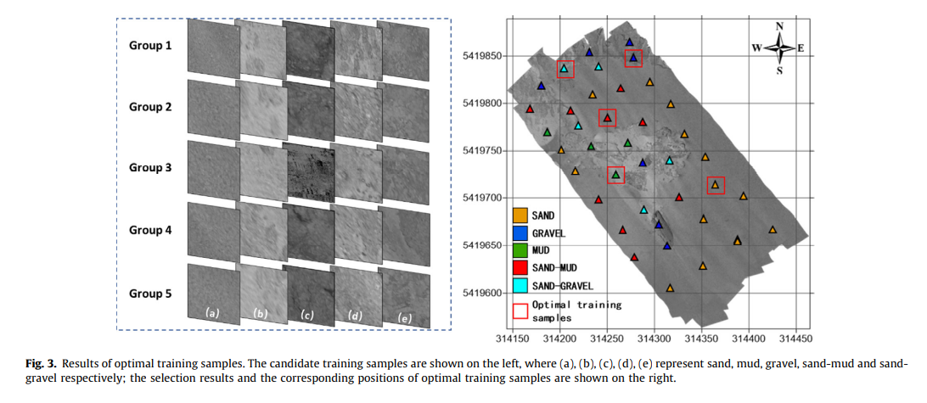

Slide 13
Training Samples Selection and Evaluation
PCA is used on the 17 feature parameters for all candidate training samples
First four principal components (>90.44% accumulated contribution) were selected.
Jeffries-Matusita (J-M) index:
Pairwise distance technique
provides a reliable standard to measure the separating degree between any two types of sediment samples.
Improving the quality of samples input into classifier.

Slide 14



AW Kernel Function Construction
Askey-Wilson (AW) polynomial
d: dimension of x; n: order
X = cosθ, |q| < 1
satisfies orthogonal relationship when {a,b,c,d} are real numbers
Simplified by a = q and a = b = c = 0:
AW kernel function is a combination of Gaussian kernel and linear kernel:
Takes into account advantages of local and global kernel functions
Strong learning ability (small training error)
Inherit strong generalization ability (small test error)
AW kernel function expression:

Slide 15
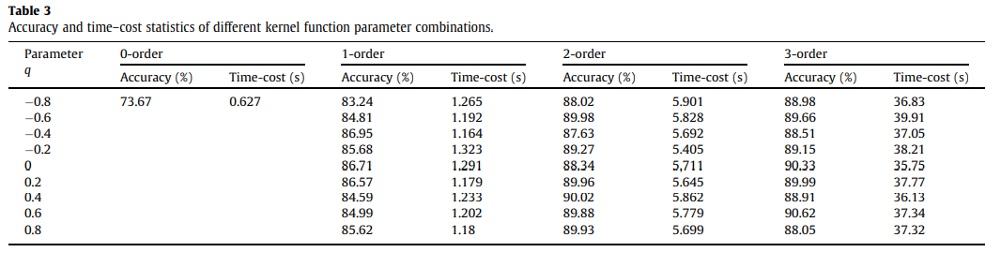
Results
AW SVM implemented with
varying q from -0.8 to 0.8
Order n = 0,1,2,3; (0th order AW Kernel has no parameter q)
Best result: q = 0.2, order n is 2 (High accuracy and low time-cost)

Slide 16
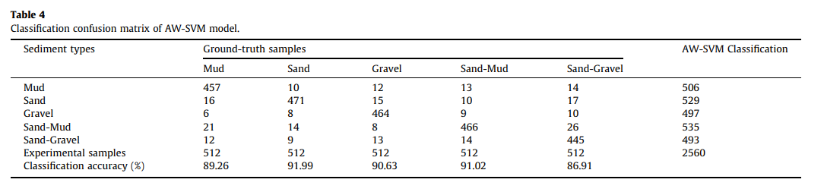
Results
Confusion matrix of AW-SVM model with n = 2, q = 0.2:

Slide 17
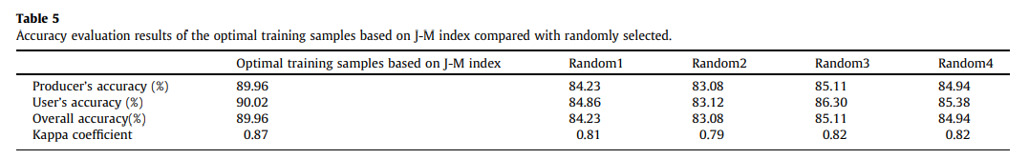
Results
Optimized training samples by the J-M index perform better than randomly selected training sample sets:

Slide 18
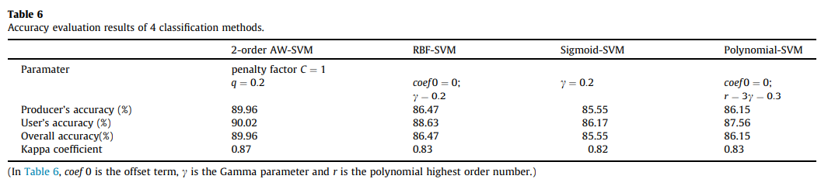
Results
2nd order AW-SVM Compared to other classification methods:
Higher prediction accuracy rates than other three classic kernel functions.

Slide 19
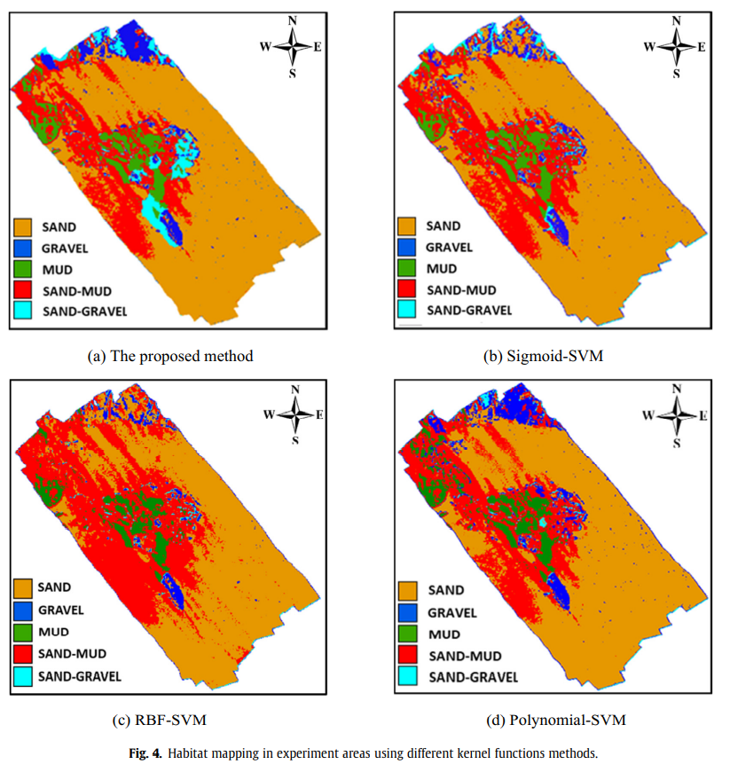
Habitat Mapping Results of the four SVM methods

Slide 20
Conclusion
Combining MBES bathymetry and backscatter intensity data allows for a new seafloor habitat mapping framework.
J-M Index improves the quality of training samples.
AW-SVM sediment classification improves overall classification accuracy(90.02%) and Kappa coefficient (0.87).
Proposed method improves the accuracy and stability over traditional methods.
Potential of multi-beam high-precision detection technology in predicting seafloor habitat types.

Slide 21
Reference
Xiaodong Cui, Hongxia Liu, Miao Fan, Bo Ai, Dan Ma, Fanlin Yang,
Seafloor habitat mapping using multibeam bathymetric and backscatter intensity multi-features SVM classification framework,
Applied Acoustics,
Volume 174,
2021,
107728,
ISSN 0003-682X,
https://doi.org/10.1016/j.apacoust.2020.107728.
(https://www.sciencedirect.com/science/article/pii/S0003682X2030832X)
Abstract: Seafloor habitat mapping plays an important role in marine environmental protection and marine database management. Multibeam echo-sounding system (MBES) has unique advantages in detecting seafloor habitats with its high-precision and full-coverage capability. To further explore the mapping technology of seafloor habitat, this paper builds multi-features support vector machine (SVM) classification framework using multibeam bathymetry and backscatter intensity. First, a training sample robustness evaluation method is proposed based on the Jeffries-Matusita (J-M) index, improving the quality of priori samples input classifier. Second, an SVM classification method based on an Askey-Wilson polynomial kernel function is proposed to optimize the mapping function of kernel function structure and related parameters to the high-dimensional acoustic feature space. Combining multi-beam bathymetry and backscattering intensity together with their derived features, the proposed framework is implemented for automatically classification of five sediment types in the shallow water of southern Wellington, New Zealand. The analysis results show that, compared with the 3 commonly used kernel functions of SVM, the proposed method is more suitable for multibeam seafloor habitat mapping, and that the overall classification accuracy and Kappa coefficient have reached 90.02% and 0.87, respectively. This also highlights the greater potential of multi-beam high-precision detection technology in the prediction of seafloor habitat types.
Keywords: Habitat mapping; Multibeam; SVM; Kernel function; Seafloor sediment classification.

