Slide 1
Binary Classification with Pima Indians Onset of Diabetes Data Set
a)
Data set 768 sample.
Each atribute 9 attribute
preg - pregnant time
plan - glucose quantity
pres - diastolic blood pressure
skin - triceps skin fold thickness
insu - insulin
mass - body mass index
pedi - diabetes pedigree function
age - in years
Class variable – 0 or 1

Slide 2
b)
I used to for 50 percent of train and 50 percent of test because firstly I tried with fifty fifty percent for test and train.

Slide 3
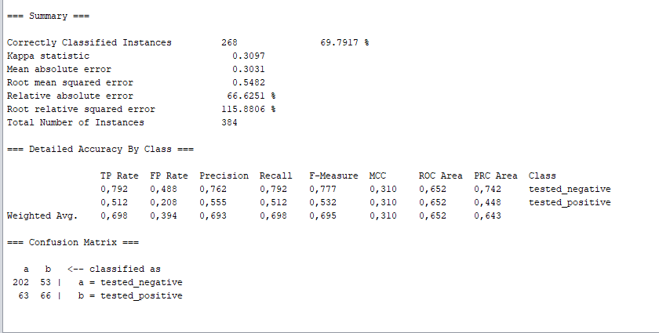
c) K-Nearest Neighbor

Slide 4
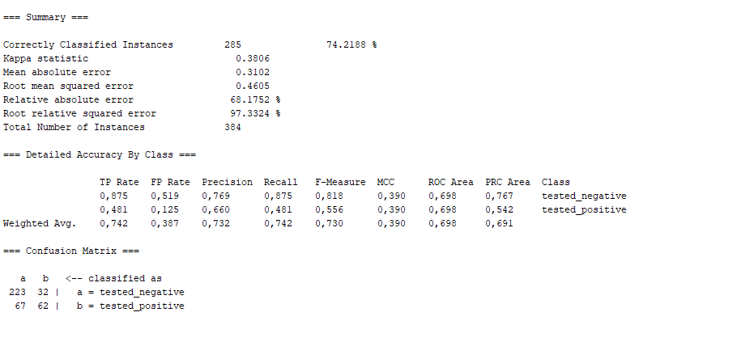
Decision Tree Learning

Slide 5
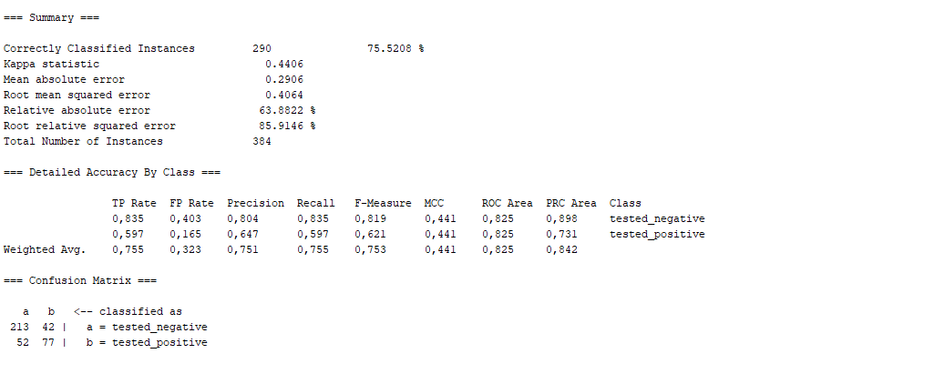
Naive Bayes Classifier Learning

Slide 6
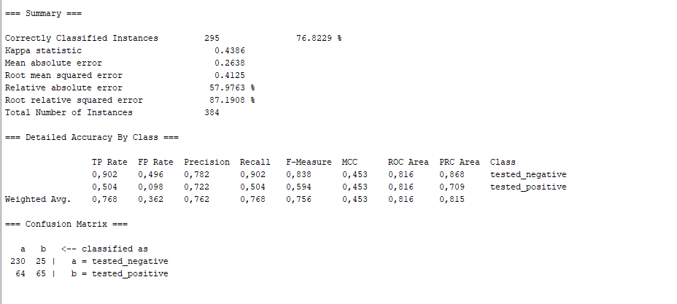
Neural Networks

Slide 7
Prediction Accuracy
Algorithm | Accuracy
Naive Bayes Classifier Learning | % 75.52
Decision Tree Learning | % 74.21
Neural Networks | % 76.82
K-Nearest Neighbor | % 69.79

Slide 8
Speeds
Rank | Algorithm | Build model | Test split | Total
1. | Naive Bayes Classifier | 0 | 0 | 0
2. | Decision Tree Learning | 0 | 0 | 0
3. | K-Nearest Neighbor | 0 | 0.01 | 0.01
4. | Neural Networks | 0.44 | 0 | 0.44

Slide 9
d)Improve accuracy
If we split into %66.6 percent of train, we can took much better conclusion.This used generally if we have enough data to do this.
Naive Bayes Classifier ➔ 77.0428 %
Decision Tree Learning ➔ 75.8755 %
Neural Networks ➔ 77.0428 %
K-Nearest Neighbor(k=3) ➔ 74.3191 %

Slide 10
For Multi-Class Classification with Glass Identification Data Set
In this data set every attributes represent the element and we have 214 data and 10 attributes.

Slide 11
b)
I used to for 50 percent of train and 50 percent of test because I have enough data, it makes sense to use the general method.

Slide 12
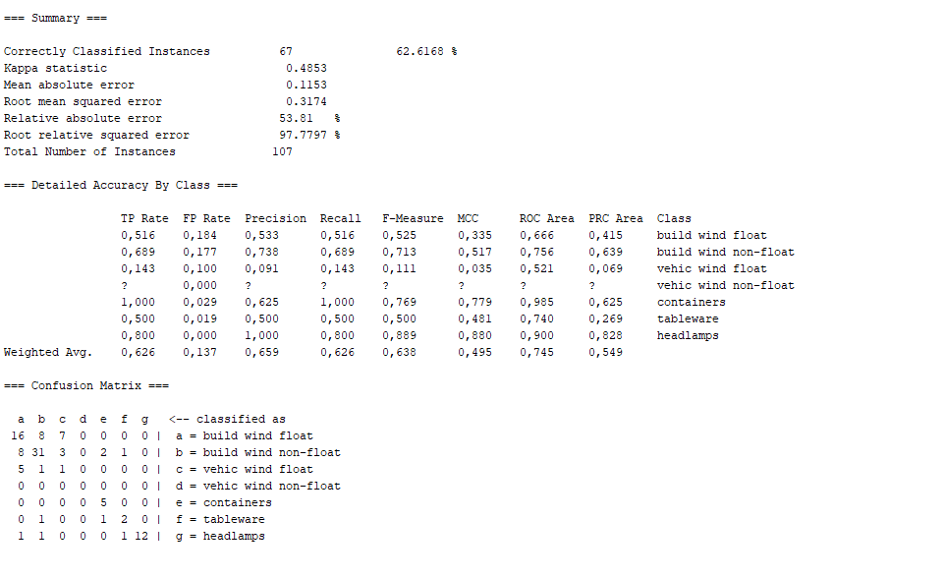
c)Experimental result K-Nearest Neighbor

Slide 13
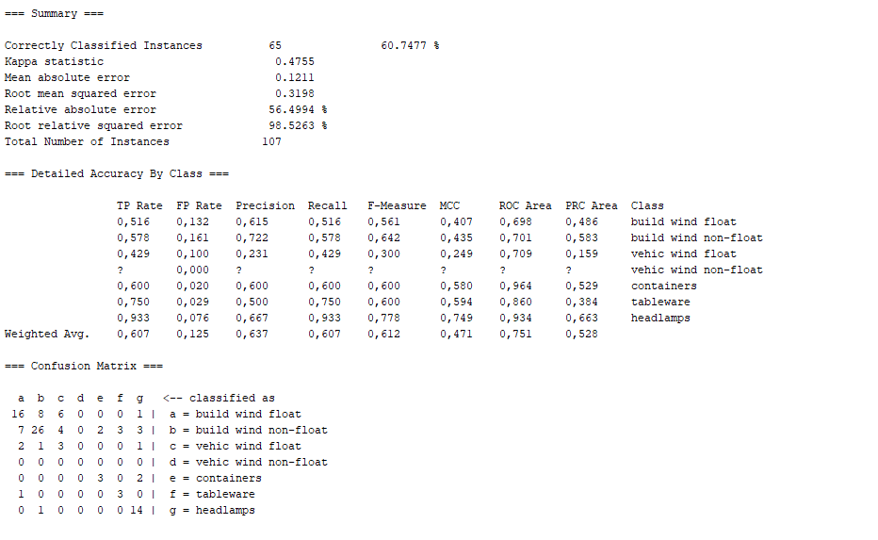
Decision Tree Learning

Slide 14
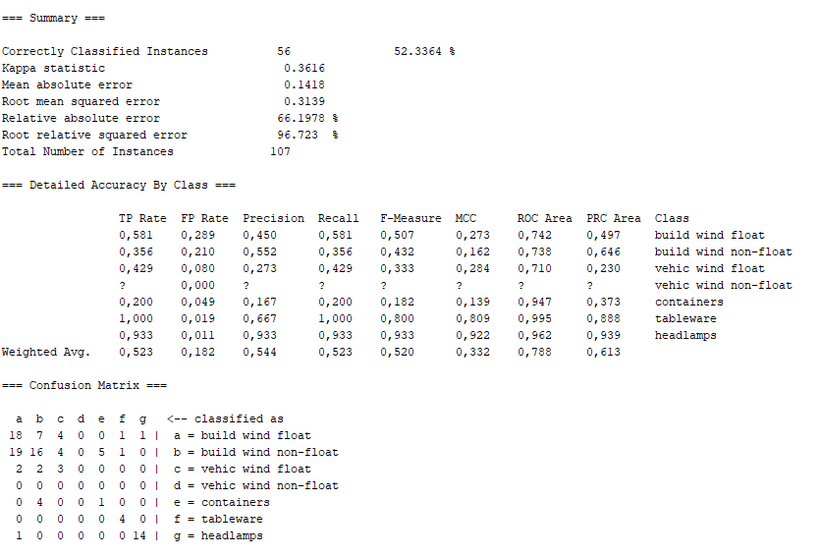
Naive Bayes Classifier Learning

Slide 15
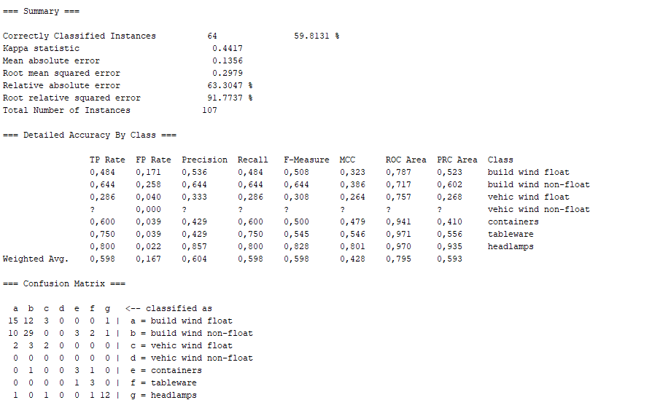
Neural Networks

Slide 16
Prediction Accuracy
Algorithm | Accuracy
Naive Bayes Classifier Learning | % 52.33
Decision Tree Learning | % 60.74
Neural Networks | % 59.81
K-Nearest Neighbor | % 62.61

Slide 17
Speed
Rank | Algorithm | Build model | Test split | Total
1. | K-Nearest Neighbor | 0 | 0 | 0
2. | Naive Bayes Classifier | 0 | 0 | 0
3. | Decision Tree Learning | 0 | 0 | 0
4. | Neural Networks | 0.3 | 0 | 0.3

Slide 18
d)Improve accuracy
If we use %66.6 algorithm accuracy increased for
Naive Bayes Classifier Learning
% 52.33
Decision Tree Learning
% 60.74
Neural Networks
% 59.81
K-Nearest Neighbor
% 66.19

