Slide 1
Colony group-meeting
Measuring radius and height in detail for colonies from different plates
04/21/2021

Slide 2
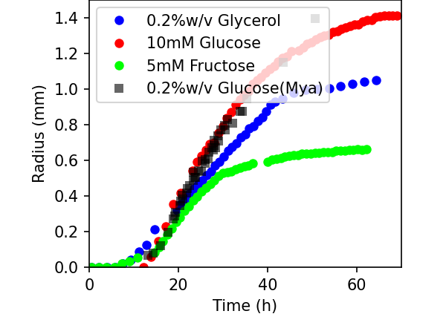
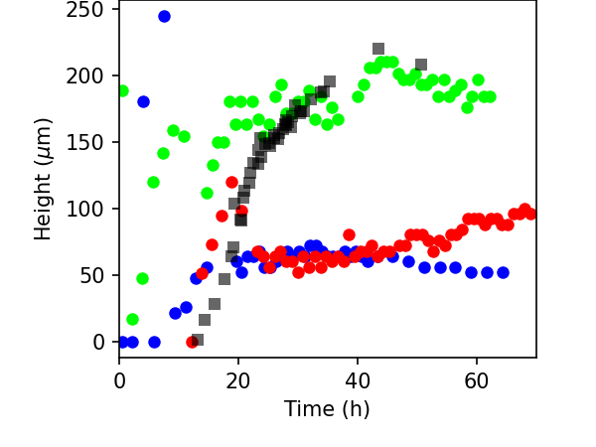
GFP signal travels agar => unreliable height measurements

Slide 3
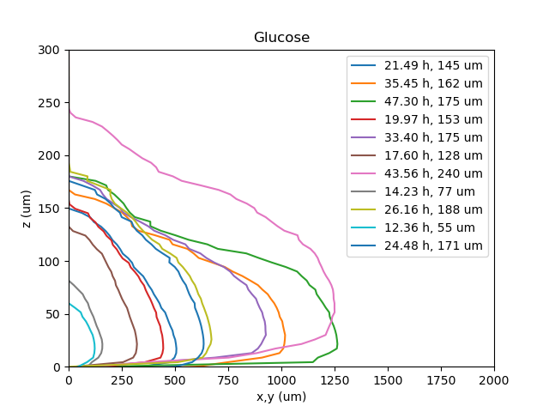
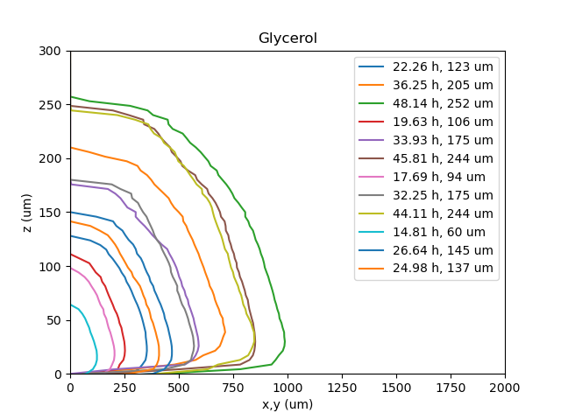
GFP signal travels air ➔ Colony cross-sections
Surface position defined wrong

Slide 4
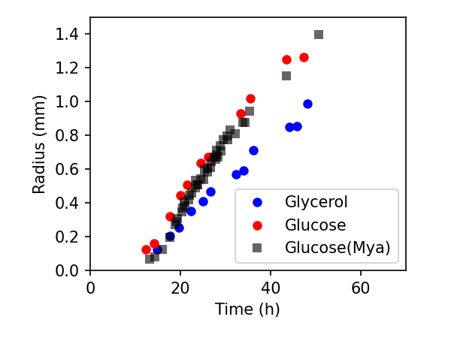
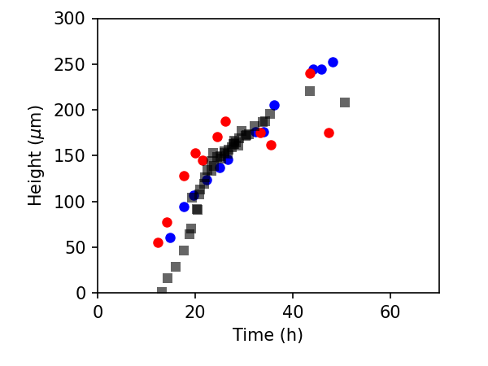
Measured radius and height
Surface position defined wrong

