Slide 1
PDE 3802 Artificial Intelligence in Robotics Install Ubuntu on WSL
Department of Design Engineering and Mathematics

Slide 2
Which version of linux and ROS-2
Pick 24.04 + Jazzy (default)
Official Jazzy debs on Ubuntu 24.04; LTS releases (even years) get 5-year support. docs.ros.org+1
TurtleBot 4 provides Jazzy install scripts & docs; user manual lists 24.04+Jazzy as supported. docs.ros.org+1
Good GPU story on lab PCs: CUDA lists Ubuntu 24.04 as supported. NVIDIA Docs
Stay on 22.04 + Humble (if you need maximum “it just works” for older stacks)
Humble is a mature LTS on Ubuntu 22.04 (supported to May 2027); many legacy tutorials and packages target it. Open Robotics Discourse
TurtleBot 3 note
Jazzy support landed later; verify your TB3 packages/sims if you go 24.04, or stick to 22.04+Humble for zero surprises. Recent docs show TB3 guides tested on 24.04+Jazzy, but earlier threads flagged gaps—so double-check your exact packages. ROBOTIS e-Manual+2GitHub+2
Practical recommendation
TB4-centric lab: go 24.04 + Jazzy.
Heavily TB3/legacy materials: use 22.04 + Humble, or run Humble in Docker on 24.04 workstations to keep laptops modern while robots stay stable

Slide 3
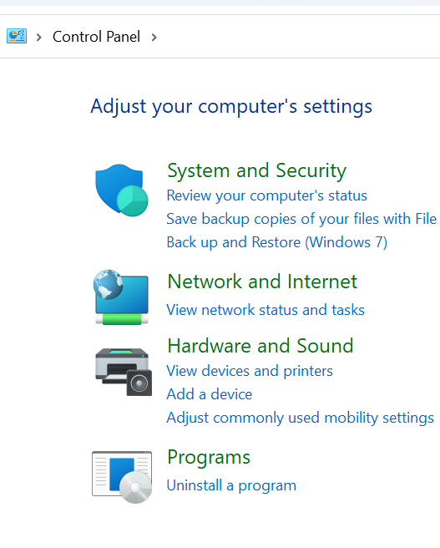
Install Ubuntu on WSL
How to install Ubuntu on WSL, the Windows Linux Subsystem.
This is the best option if you seek a way to install Ubuntu on your Windows machine without dual-boot.
Enable WSL
Before installing WSL, first make sure that it is correctly enabled in your Windows machine.
To do so, open the "Control Panel" and click on "Programs"

Slide 4
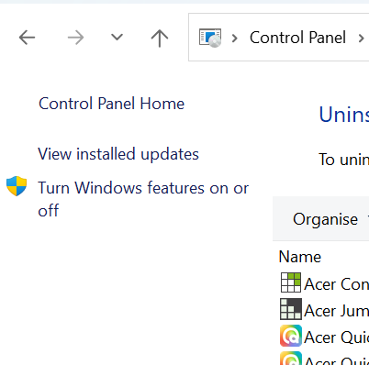
Install Ubuntu on WSL
Then click on "Turn Windows features on or off"
And make sure that the "Windows Subsystem for Linux" is ticked
To apply the changes, you may need to restart your System.

Slide 5
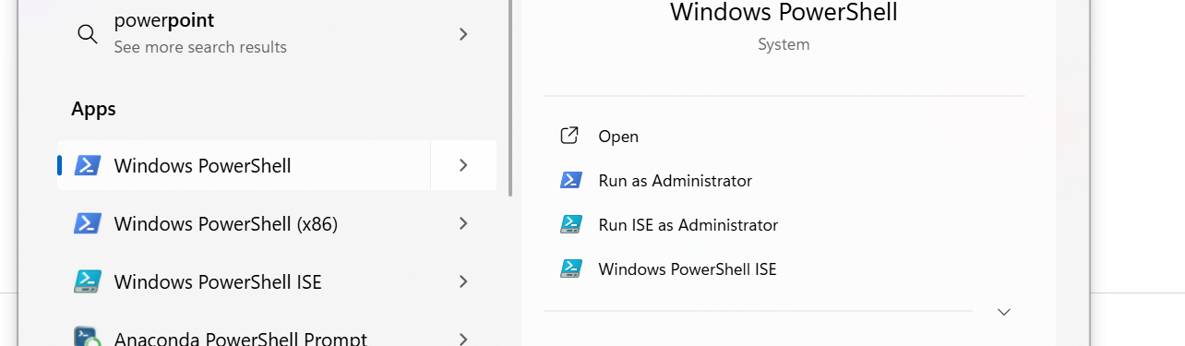
Install WSL
To install WSL on your Windows machine is pretty straightforward, and you just need to open a Windows PowerShell in administrator mode
Once Windows PowerShell is running in administrator mode, you can type the command
wsl --install
To start the installation procedure
Once the installation is completed, you may need to restart your System.

Slide 6
Install Ubuntu in WSL
Once WSL is installed on your system, you can install the Ubuntu distro you prefer among the available ones.
To check the list of distributions available, you can open a Windows PowerShell in administrator mode
And type the command
wsl --list --online
You can use either "Ubuntu-22.04" or "Ubuntu-24.04".
For example, to install the "Ubuntu-24.04" distribution in your WSL, you can type the command
wsl --install -d Ubuntu-24.04
Once the installation is completed, you may need to restart your System.

Slide 7
Use Ubuntu in WSL
Once you have WSL installed with an Ubuntu distro, you can start using it by opening WSL
This will open a new Windows Command Prompt inside the installed Ubuntu distribution
Open Terminal: Press Ctrl + Alt + T to open a new terminal window.
Run a Command: Type one of the following commands and press Enter:
lsb_release -a: This command shows detailed information, with the version listed on the "Description" line.
cat /etc/os-release: This command prints the contents of the os-release file, which includes the version and release code name.
hostnamectl: This command provides system information, including the "Operating System" section where the version is listed.

Slide 8
Install Ubuntu on Dual Boot
This will allow you to decide at the moment of the boot of your PC which operating system to start (Windows or Ubuntu)
Download Ubuntu
Download the Ubuntu ISO using one of the following links:
Ubuntu 24.04
Ubuntu 22.04
Once the download is finished you can proceed to the creation of a USB for the installation of Ubuntu on your PC.

Slide 9
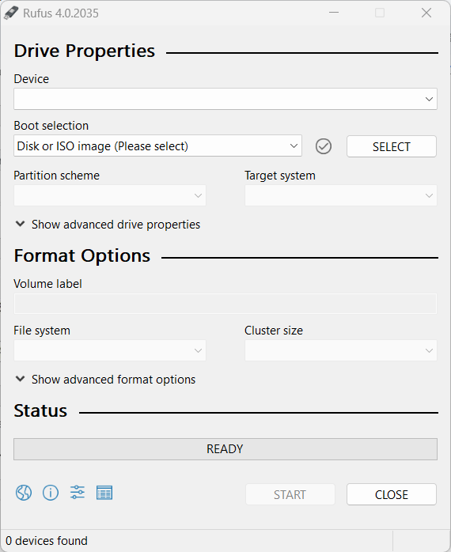
Install Ubuntu on Dual Boot
Create a Boot USB
Once you have downloaded the Ubuntu ISO, you need to create a USB for the Boot of Ubuntu at the startup of your PC. To do so, you will need another tool called Rufus that you can download from here, and once downloaded you can run the executable.
Plug the USB on your PC and in the section "Boot Selection" insert the directory of your PC where you downloaded the Ubuntu ISO in the previous step.
Once done with the configuration of Rufus, click on "Start" and wait until the program finishes the writing process of the ISO on the USB.

Slide 10
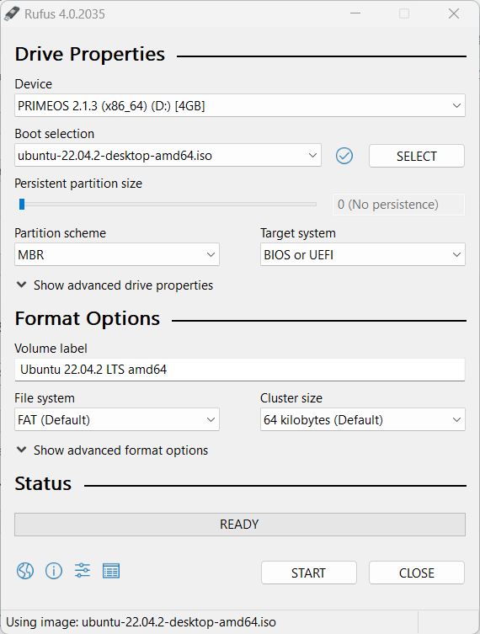
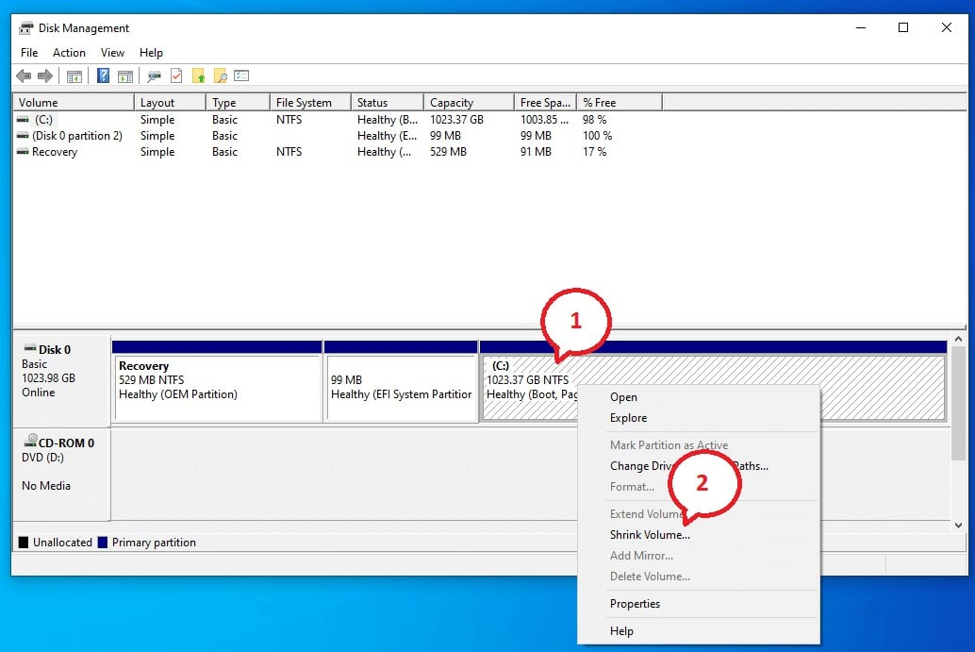
Install Ubuntu on Dual Boot
Preparing Windows for the Dual Boot
Before installing Ubuntu, you need to reserve some space on your Hard Disk to be used by Ubuntu.
Reserve at least 30GB in order to install Ubuntu, ROS, and all the additional components needed.
To create a partition in Windows click on Win + R and then diskmgmt.msc and click on "OK".
This will show you the storage space available on your PC and you will be able to create partitions of the disk and reserve space for other operating systems on the same computer.

Slide 11
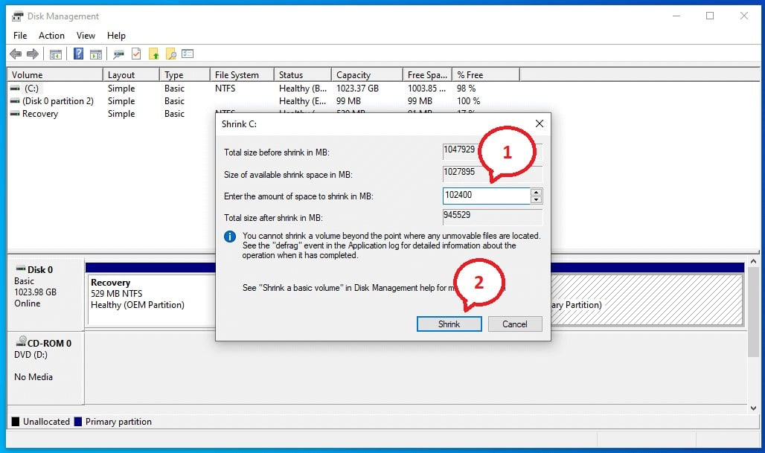
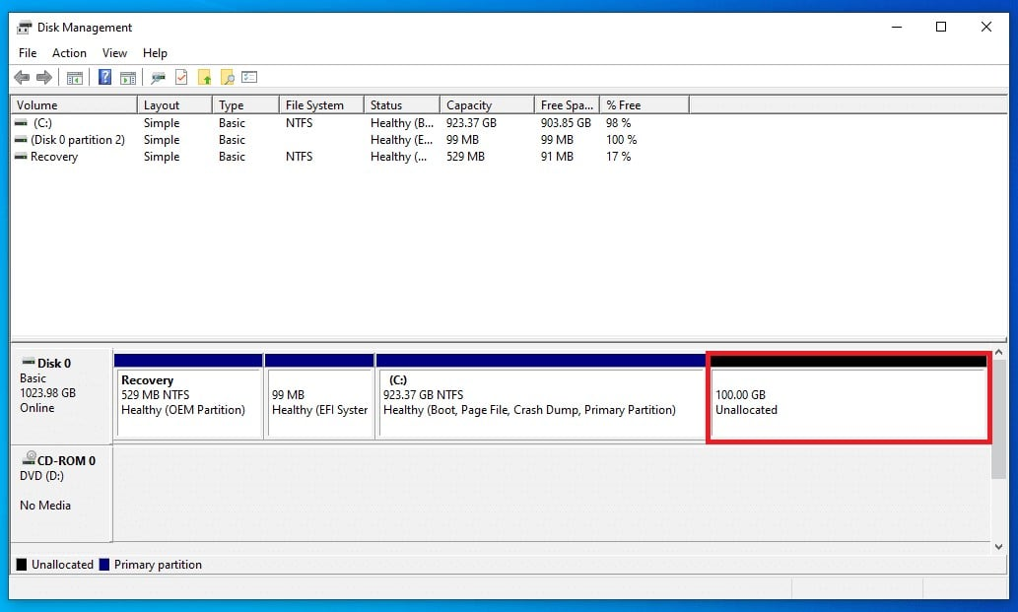
Install Ubuntu on Dual Boot
Then specify the size to be reserved for Ubuntu and once done click on "Shrink«
This will create a partition of your hard disk of the specified size
At this point, you are ready to install Ubuntu and all the components in this reserved area of the hard disk.

Slide 12
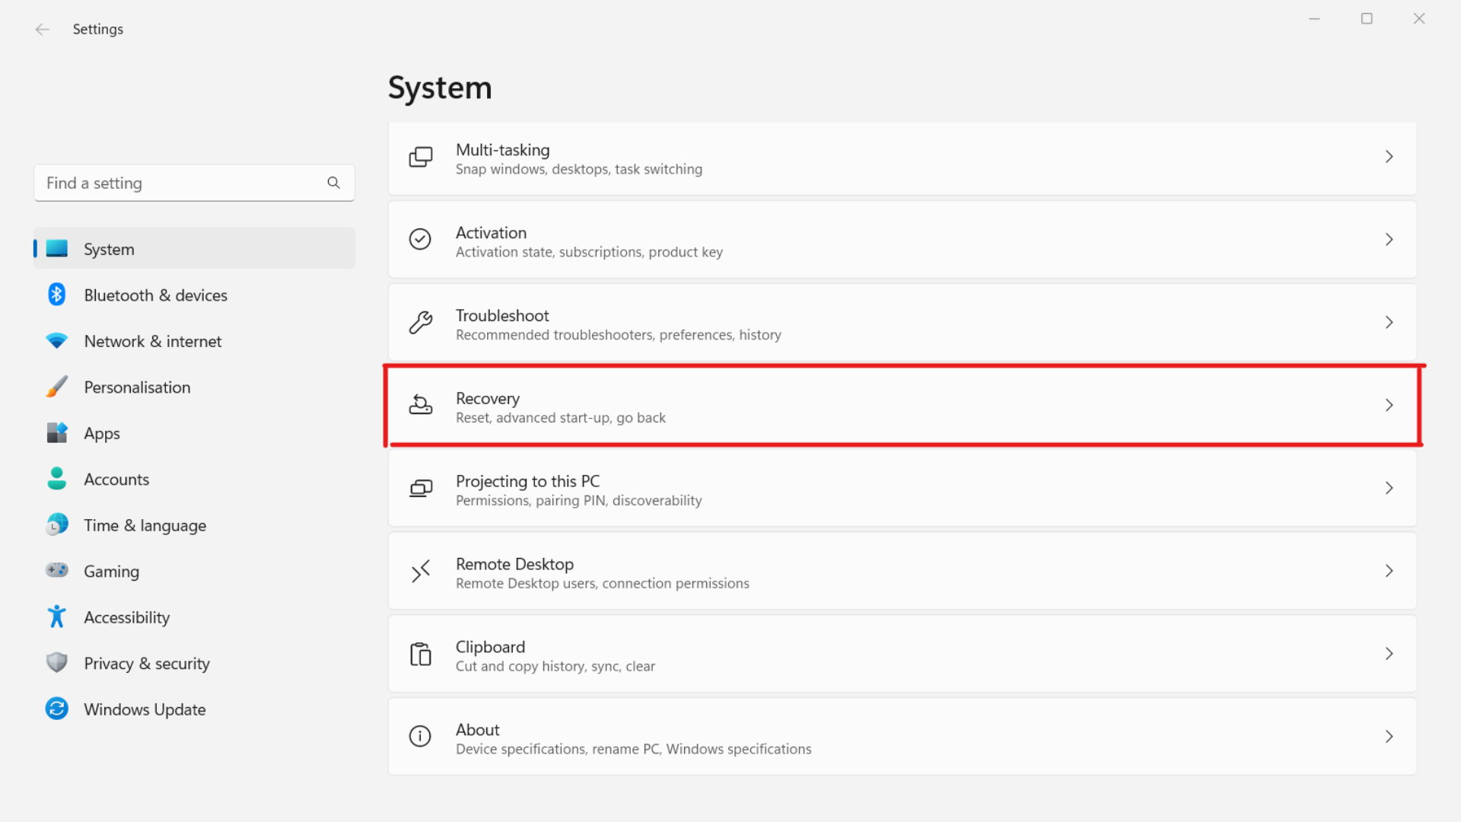
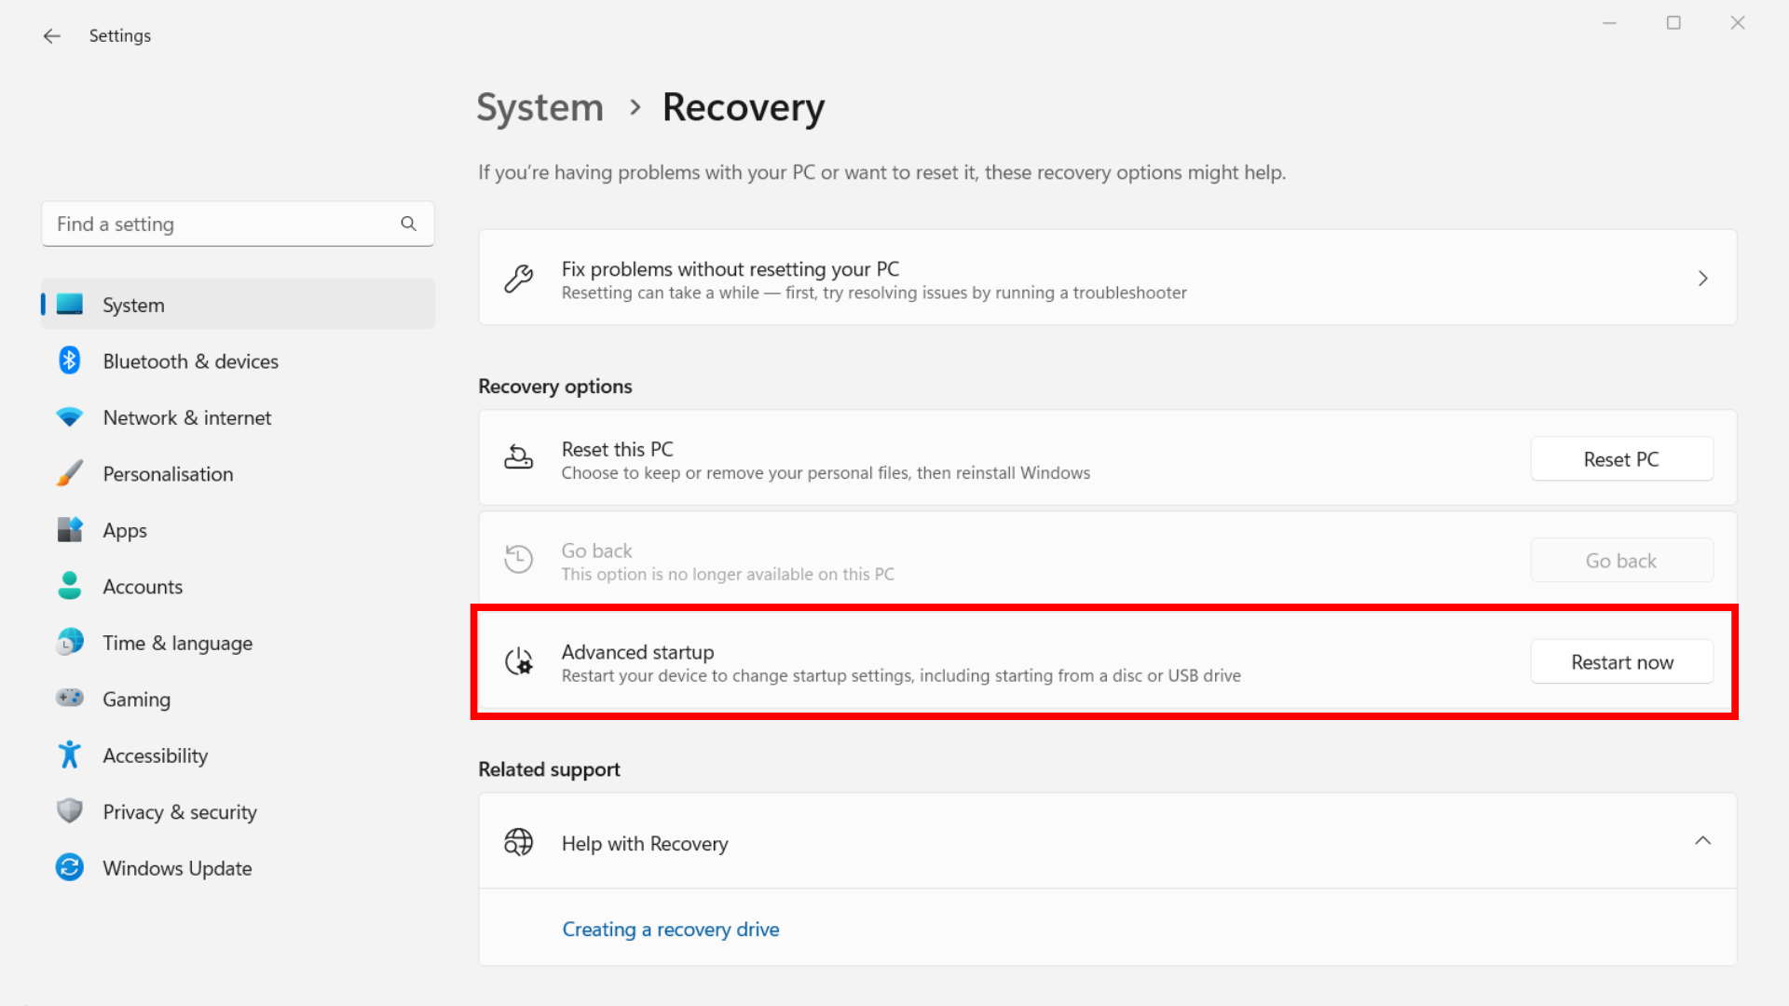
Install Ubuntu on Dual Boot
Installing Ubuntu
Plug the USB in your PC on which you installed Ubuntu and reboot your PC in advanced mode by clicking on "Advanced Startup". To do so, go into Windows settings and then "Update & Security"
Then go to the "Recovery" tab and click on "Advanced Startup" and then on "Restart Now"

Slide 13
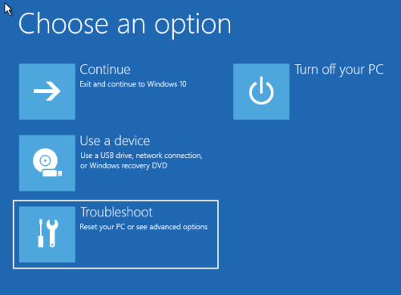
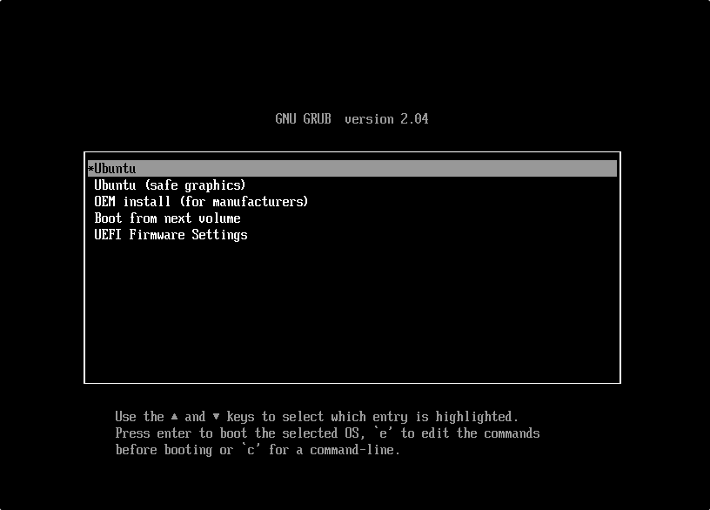
Install Ubuntu on Dual Boot
Windows will reboot in advanced mode and will ask you which action to take. Here click on "Use a device" to reboot your PC with the Ubuntu Boot installed in the USB.
On the next startup of the PC, it will booted with the operating system on the USB and you can start installing Ubuntu

Slide 14
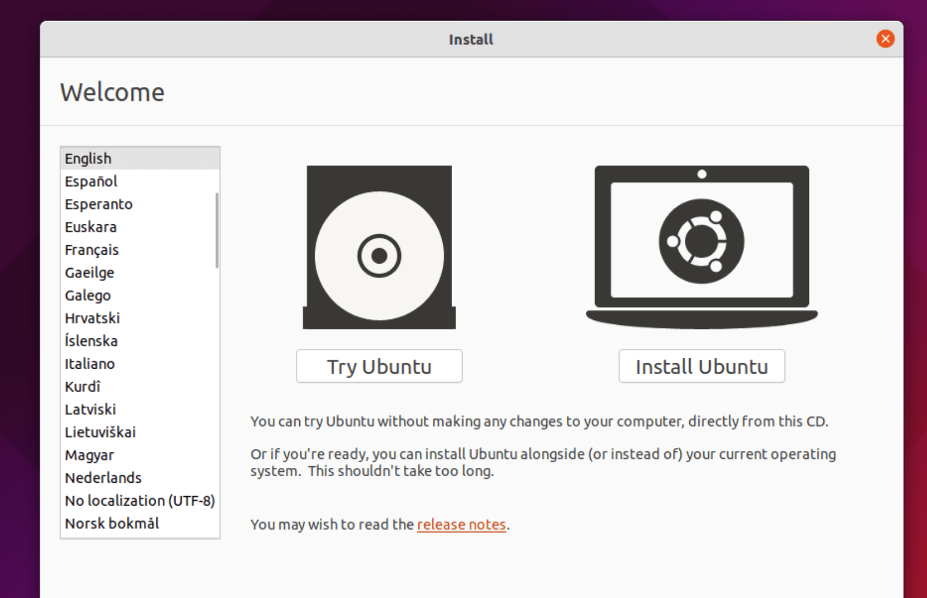
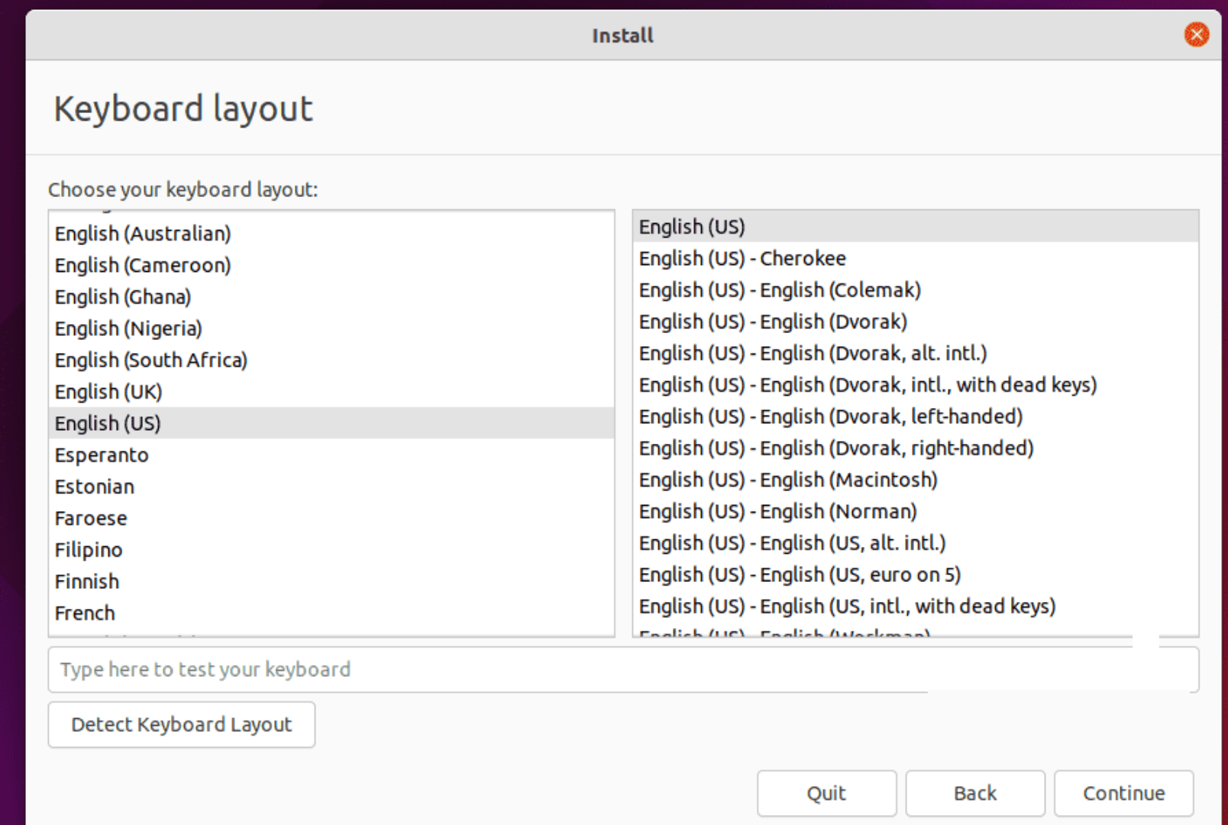
Install Ubuntu on Dual Boot
In the Ubuntu welcome window select "Install Ubuntu"
Then choose the configuration of your keyboard and click on "Continue"

Slide 15
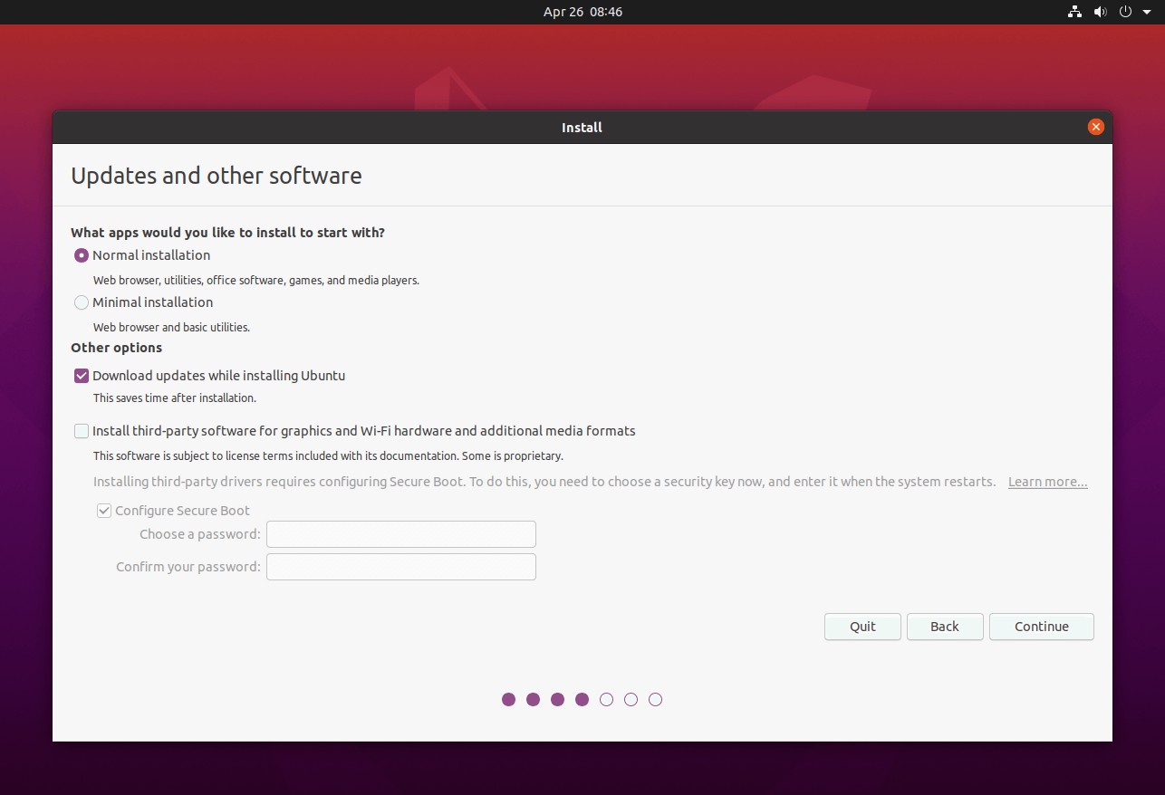
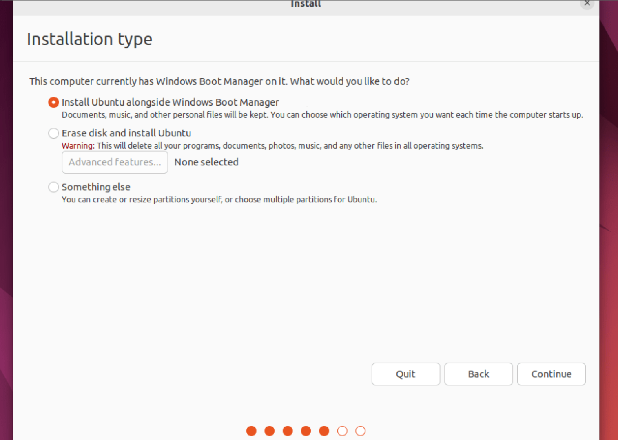
Install Ubuntu on Dual Boot
In the following window, you will be asked which kind of installation you want to execute.
In order to have the full version of Ubuntu with all the components click on "Normal Installation" and during this phase, you will also be asked to automatically download the Ubuntu updates during the installation of the operating system.
Also, you can choose to download and install third-party software like for example the drivers of your graphics card.
I would suggest you at least to select the voice "Download updates while installing Ubuntu" and then click on "Continue"
Finally, before proceeding with the installation of Ubuntu, you will be asked in which storage space you would like to install all the components.
The system will automatically detect that you already have a version of Windows installed on your PC, so you'll see the option to "Install Ubuntu alongside Windows Boot Manager" and click "Continue”

Slide 16
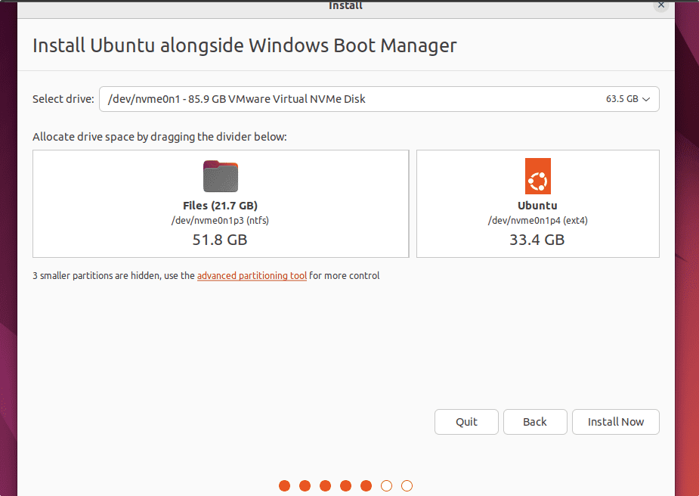
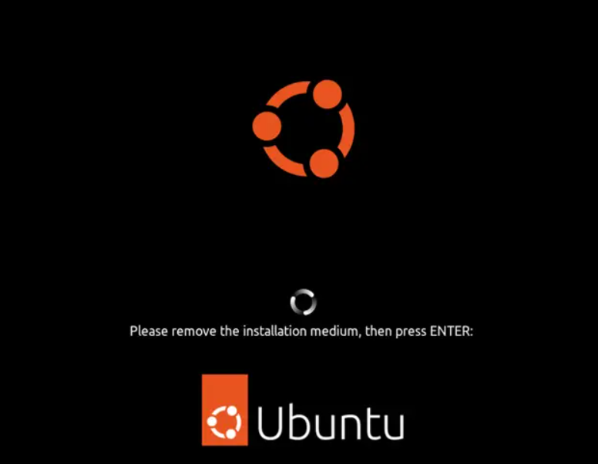
Install Ubuntu on Dual Boot
You can now choose the disk partition in which to install Ubuntu and then select the disk partition we freed in the previous steps and click "Install Now".
The installation configuration is now complete and the system will begin installing Ubuntu on the indicated hard disk partition.
During the installation procedure, you can start by configuring your PC with Ubuntu with the time zone of your area, username, and password for logging in to Ubuntu.
Then restart your PC by clicking on "Restart Now«
Now remove the USB with Ubuntu Boot that you inserted at the beginning of the installation and click "Enter" on your keyboard

Slide 17
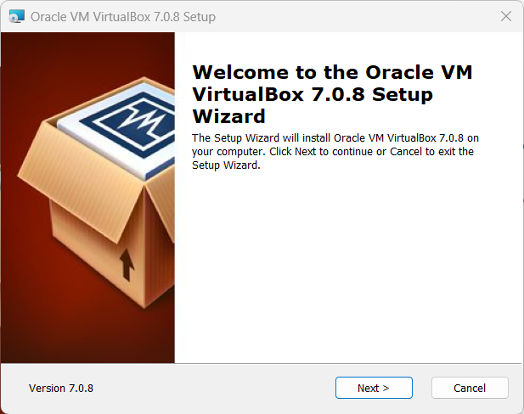
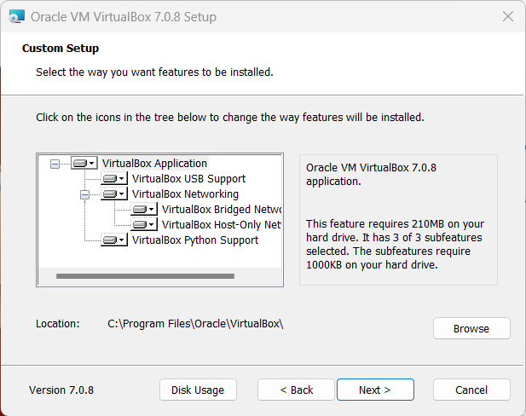
Install Ubuntu on VirtualBox
https://www.virtualbox.org/wiki/Downloads
Choose your operating system
Follow the installation procedure
Install as an administrator
Download the Ubuntu ISO using one of the following links:
Ubuntu 24.04
Ubuntu 22.04
Once the download is finished, you can proceed with the configuration and installation of the Virtual Machine.
In Oracle VM VirtualBox creates a new virtual machine by clicking on "New".

Slide 18
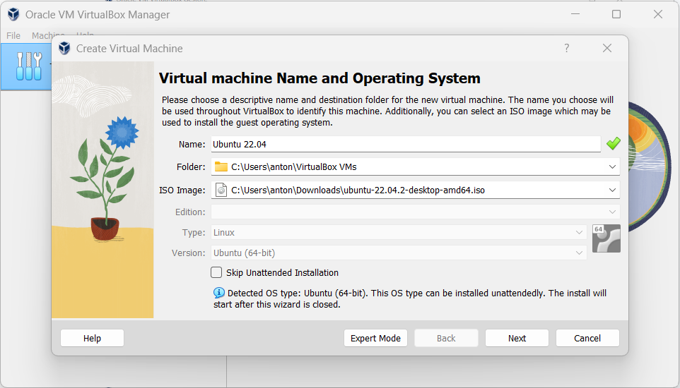
Install Ubuntu on VirtualBox
In Oracle VM VirtualBox creates a new virtual machine by clicking on "New".
Select a name for the virtual machine in the "Name" section, then indicate the path to the Ubuntu 22.04 ISO and click "Next".

Slide 19
ROS-2 Humble Installation
https://docs.ros.org/en/humble/Installation/Ubuntu-Install-Debs.html
In wsl write sudo wsl –l Ubuntu

Slide 20
Visual Studio Code
sudo add-apt-repository ppa:mozillateam/ppa
https://code.visualstudio.com/download
WSL
Download and install VsCode in windows
Launch VS Code (Windows) → Extensions → install “WSL” (Remote – WSL).
From your WSL terminal, run: code .
Linux: From ubuntu software find «code» and install
Install extensions
C++ (autocompletion for the C++ language)
Python (autocompletion for the Python language)
Cmake
Cmake tools
XML
XMLtools
ROS2
Restart VSCode
You can install other recommended extensions

Slide 21
Install Terminator (a more advanced terminal)
Open powershell
Wsl –update
Wsl --shutdown
Reopen Ubuntu terminal
sudo apt update
sudo apt install terminator
terminator &
A GUI window should pop up.
In regular Linux
Sudo apt-get update
Sudo apt-get upgrade
Sudo apt-get install terminator
Try CTRL+SHIFT+O and E
Press CTRL+SHIFT+4 to zoom

Slide 22
Install ros-2 packages for control and simulation
sudo apt-get install ros-humble-ros2-control
sudo apt-get install ros-humble-ros2-controllers
sudo apt-get install ros-humble-xacro
sudo apt-get install ros-humble-ros-gz-*
sudo apt-get install ros-humble-*-ros2-control
sudo apt-get install ros-humble-joint-state-publisher-gui
sudo apt-get install ros-humble-turtlesim
sudo apt-get install ros-humble-robot-localization
sudo apt-get install ros-humble-joy
sudo apt-get install ros-humble-joy-teleop
sudo apt-get install ros-humble-tf-transformations
https://wiki.ros.org/
https://github.com/AntoBrandi/Self-Driving-and-ROS-2-Learn-by-Doing-Odometry-Control
https://robotics.stackexchange.com/

Slide 23
Install the workspace
git clone https://github.com/AntoBrandi/Self-Driving-and-ROS-2-Learn-by-Doing-Odometry-Control.git

Slide 24
Download bumperbot_ws.zip
Move to the home folder
mv -i ~/Downloads/bumperbot_ws.zip ~
sudo apt update && sudo apt install unzip
sudo apt update && sudo apt install zip
Unzip bumperbot_ws.zip
A workspace is formed that includes some examples

Slide 25
Install the workspace
Sudo rosdep init
rosdep update
rosdep install --from-paths src --rosdistro humble -y --ignore-src
Install some Python packages
sudo apt-get install python3-pip
Pip install transforms3d

Slide 26
Getting started with the simulated robot
Sudo rosdep init
Rosdep update
Colcon build
. İnstall/setup.bash
ros2 launch bumperbot_bringup simulated_robot.launch.py

Slide 27
ROS2
Why a robotic operating system

