Slide 1

Exploratory Data Analysis
G2M Case Study (Tolga Yaz)
10-Oct-2021

Slide 2
Background – G2M (Cab Industry) Case Study
XYZ is a private firm in the United States. Due to remarkable growth in the Cab Industry in last few years and multiple key players in the market, it is planning for an investment in Cab industry and as per their Go-to-Market (G2M) strategy they want to understand the market before taking final decision.
Objective: Provide actionable insights to help XYZ identify the right company to make its investment.
The analysis has been divided into parts:
Basics of the Examined Data and Exploration Approach
Total and Mean Profits Per Company Per Year with Charts
Total and Mean Profits Per Company Per Year with Charts without Outliers
Seasonal Changes in Total Profit
Recommendation

Slide 3
Basics of the Examined Data and Exploration Approach
4 data files in .csv format were obtained:
Cab_Data.csv : Includes details of transaction for 2 cab companies.
Customer_ID.csv : Includes a unique identifier which links the customer’s demographic details (mapping table).
Transaction_ID.csv : Includes transaction to customer mapping and payment mode.
City.csv : Includes list of US cities, their population and number of cab users.
Exploration Approach:
The data was transformed into Python Pandas Dataframes to be processed.
The dataframes were observed carefully to identify and deal with the nulls and duplicates.
The four .csv files meantioned above were turned into one main file (dfMain.csv).
Analysis were done upon the dfMain.csv file via usage of Python Libraries and Jupyter Notebooks.
Characteristics of dfMain.csv file:
359 392 Observations,
15 Features.

Slide 4
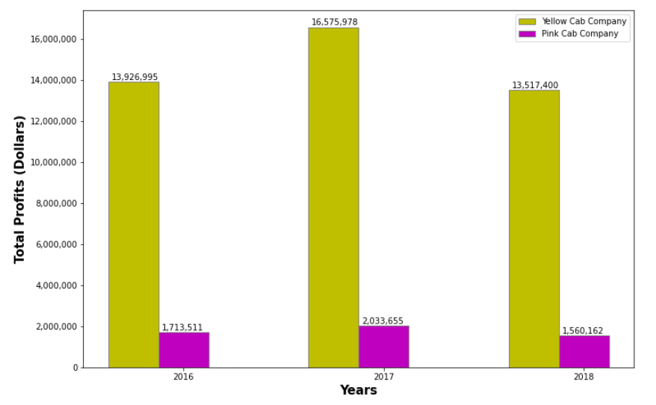
Profit Analysis
Comparison of Total Profits of the Companies Per Year
Yellow Cab Company is much better than Pink Cab Company in terms of total profits in all of the years.
Both companies' total profits decreased from 2017 to 2018 seriously.

Slide 5
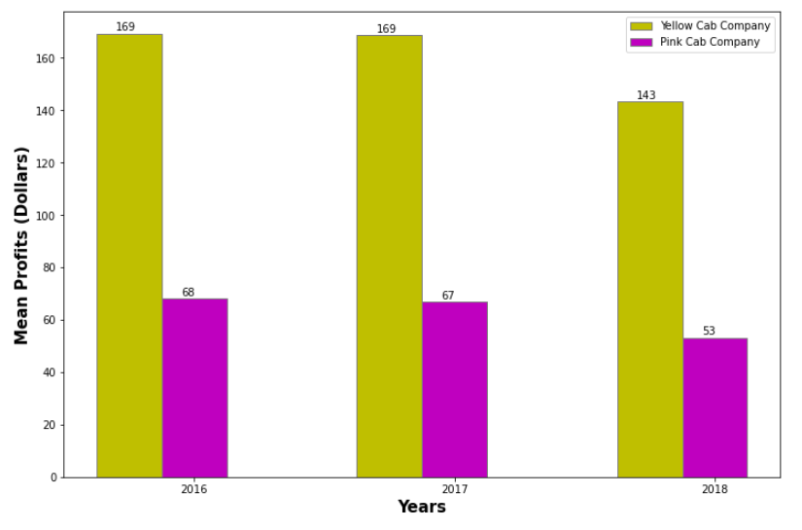
Profit Analysis
Comparison of Mean Profits of the Companies Per Year
Yellow Cab Company is much better than Pink Cab Company in terms of mean profits in all of the years as expected.
Both companies' mean profits decreased from 2017 to 2018 seriously.

Slide 6
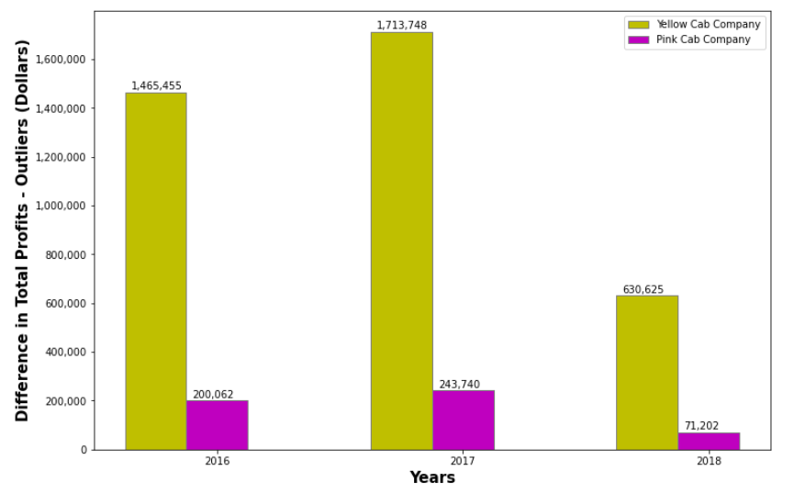
Profit Analysis
Difference in Total Profits of the Companies Without Outliers Per Year
Yellow Cab Company loses much more from total profit than Pink Cab Company when outliers are removed but since its total profit is also much more than the Pink Cab Company, we should examine the total profit chart again without the outliers.

Slide 7
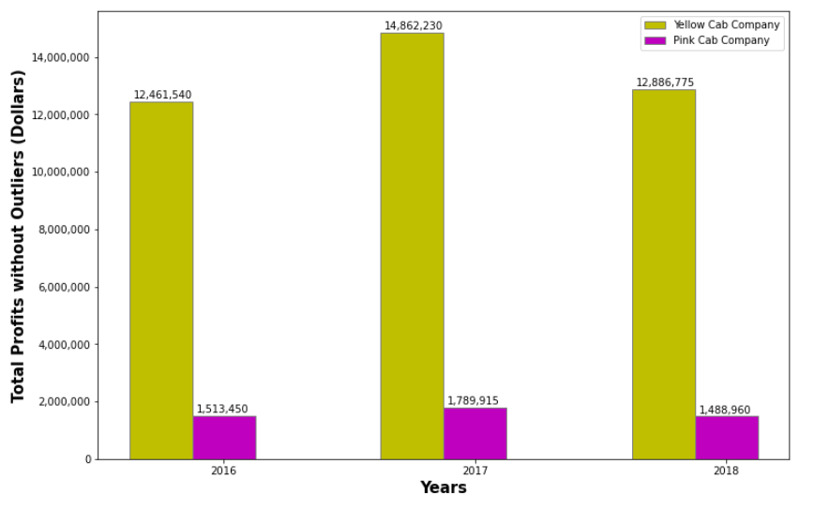
Profit Analysis
Total Profits of the Companies Without Outliers Per Year
Although, removal of outliers affected Yellow Cab Company more, Yellow Cab Company is still much better than Pink Cab Company in terms of total profits in all of the years.

Slide 8
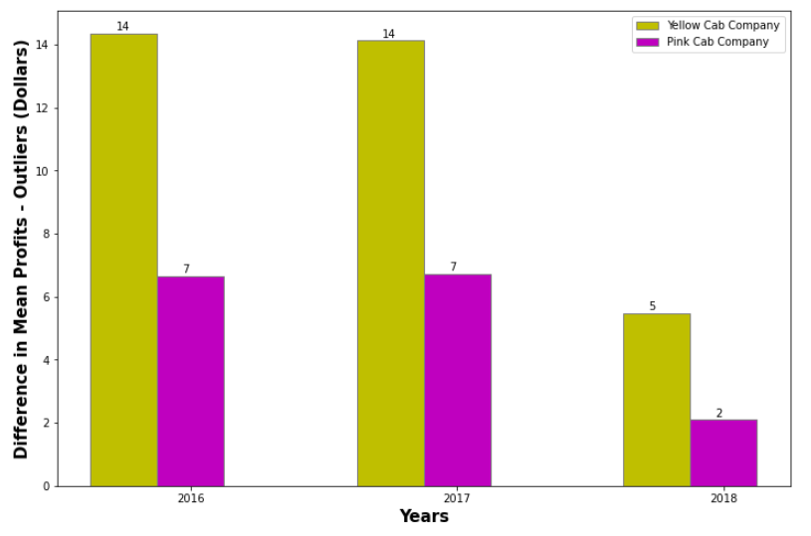
Profit Analysis
Difference in Mean Profits of the Companies Without Outliers Per Year
Yellow Cab Company loses more from mean profit than Pink Cab Company when outliers are removed but since its mean profit is also more than the Pink Cab Company, we should examine the mean profit chart again without the outliers.

Slide 9
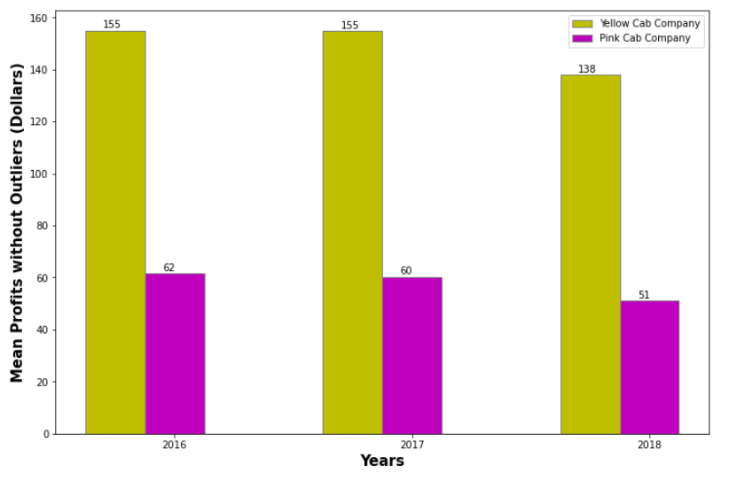
Profit Analysis
Mean Profits of the Companies Without Outliers Per Year
Although, removal of outliers affected Yellow Cab Company more, Yellow Cab Company is still much better than Pink Cab Company in terms of mean profits in all of the years.

Slide 10
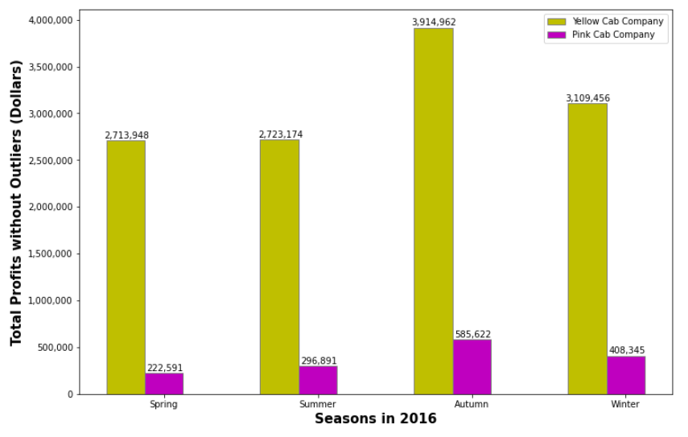
Profit Analysis
Seasonal Changes in Total Profits of the Companies Without Outliers in 2016
Yellow Cab Company is much better than Pink Cab Company in all seasons of the year 2016.

Slide 11
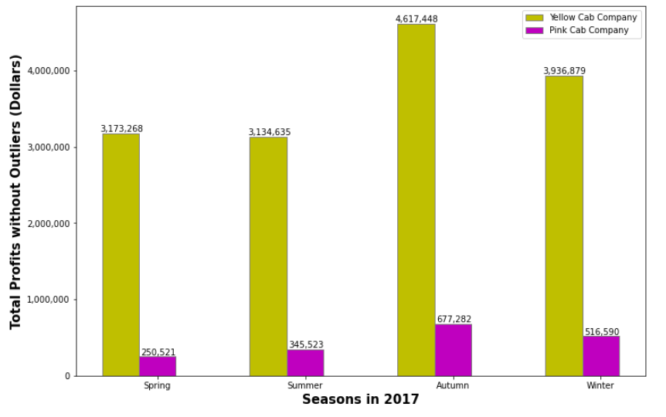
Profit Analysis
Seasonal Changes in Total Profits of the Companies Without Outliers in 2017
Yellow Cab Company is much better than Pink Cab Company in all seasons of the year 2017.

Slide 12
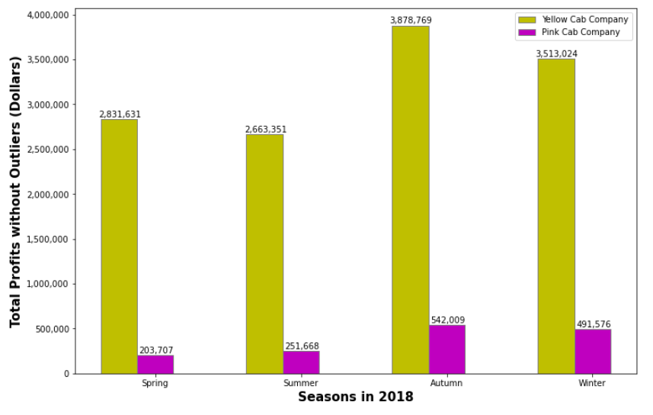
Profit Analysis
Seasonal Changes in Total Profits of the Companies Without Outliers in 2018
Yellow Cab Company is much better than Pink Cab Company in all seasons of the year 2018.

Slide 13
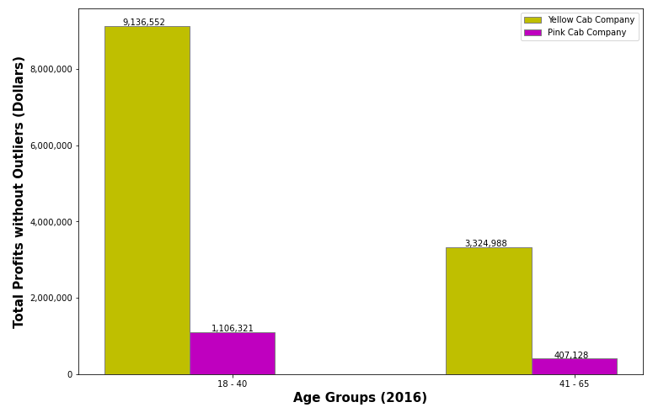
Profit Analysis
Total Profits of the Companies by Age Group Without Outliers in 2016
Yellow Cab Company is much better than Pink Cab Company for both age groups (18 - 40, 41-65) in the year 2016.
The difference is more obvious in the age group of 18 - 40.

Slide 14

Profit Analysis
Total Profits of the Companies by Age Group Without Outliers in 2017
Yellow Cab Company is much better than Pink Cab Company for both age groups (18 - 40, 41-65) in the year 2017.
The difference is more obvious in the age group of 18 - 40.

Slide 15

Profit Analysis
Total Profits of the Companies by Age Group Without Outliers in 2018
Yellow Cab Company is much better than Pink Cab Company for both age groups (18 - 40, 41-65) in the year 2018.
The difference is more obvious in the age group of 18 - 40.

Slide 16
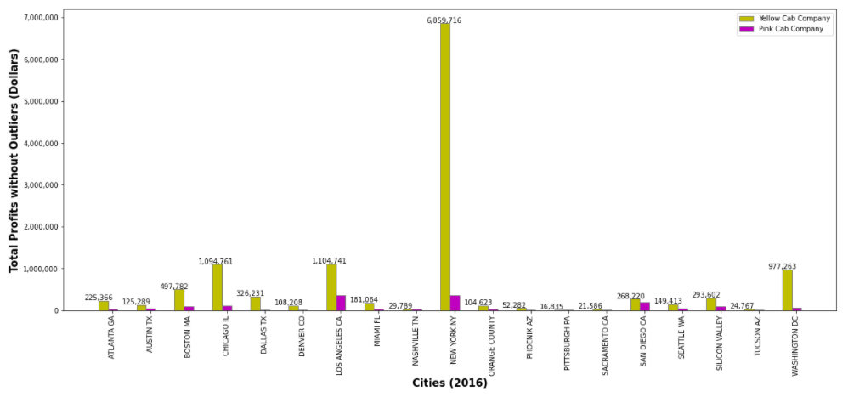
Profit Analysis
Total Profits of the Companies by City Without Outliers in 2016
Yellow Cab Company is also much better than Pink Cab Company, when the profits are examined city by city.

Slide 17
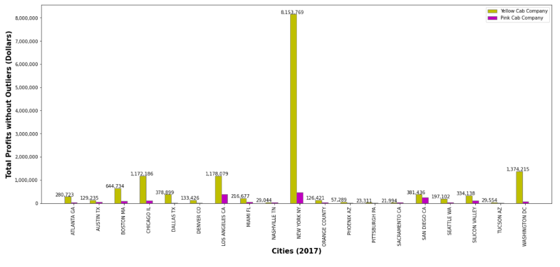
Profit Analysis
Total Profits of the Companies by City Without Outliers in 2017
Yellow Cab Company is also much better than Pink Cab Company, when the profits are examined city by city.

Slide 18
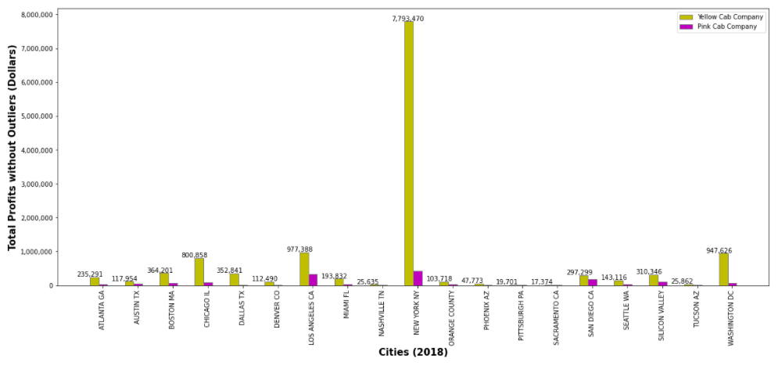
Profit Analysis
Total Profits of the Companies by City Without Outliers in 2018
Yellow Cab Company is also much better than Pink Cab Company, when the profits are examined city by city.

Slide 19
Results
The total profit of Yellow Cab Company in all of the years and in all of the seasons of the years is much more than Pink Cab Company.
When the data is examined by age group (18-40, 41-65) and by city, Yellow Cab Company is still the absolute choice.
These two companies are in very different levels in terms of profit. Yellow Cab Company is much better.

Slide 20
Thanks

