Slide 1
K. DRUKIER
May 2012
Understanding of immune system is crucial for Medicine: both oncology and CVD
UCLA TALK

Slide 2
Five Stories
1) Ultrasensitive Proteomics enables better Diagnostic Oncology;
Towards Predictive Medicine;
Applications of Magnetic nanotechnology in Medicine
3.1 Triple Coincidence Immunoassays
3.2 LEMF-MRI
3.3 More specific Drug Delivery;
3.4 Nano-surgery
4) Towards better CVD diagnostics
4.1 The blood-based diagnostics;
4.2 Imaging unstable plaque
5) Towards better CVD therapies
5.1 Direct delivery of drugs to unstable plaque
5.2 Individualized drug-eluting stents
4.3 Non-invasive angipoplasty

Slide 3
Ultrasensitive proteomics enables stratification of immune system. This permits:
I ) Elucidation of new risk factors
II) Heterogeneity of response to therapies, e.g. immune therapies.
III) Understanding of “peri-menopausal effect”.
This presentation is focused on (I).
Topics II and III are discussed in companion presentations. This includes:
Age dependence of BC and OC prevalence;
Increase of BC/OC prevalence for post-menopausal women under hormone replacement therapy;

Slide 4
The current status
  Weakly Coupled Semi-Linear (WCSL) model:
  1) Targets discovery;
  2) Drugs discovery;
  3) Methods for moiety production;
    Toxicology;
  5) Clinical Validation.
  In Past : (1) and (2) most difficult/expensive
  Today : (4) and (5) longest, most costly.
  => Target specific drug delivery is crucial.

Slide 5
Post-genomic reality
Human Genome smaller than expected
Junk proteins
=> there are present at very low abundance,
=> they are fully functional;
=> they are not “crucial”.
The high throughput pharma methods produces/evaluate > 500,000 “drug candidates “ in last decade
The “good target” proteins are no more than 50,000
Statistically, already now for each “target molecules” we have about 5-10 “putative drugs”.
“Laws of diminished return”.

Slide 6
Contents
The ultra-sensitive measurement of cytokines and angiogenesis factors permits reliable detection of cancers
There are four types of immune system strength; Type I (weak) may be high risk factor for cancers
The complexity of immune system is much lower than expected because it is super strongly coupled non-linear system (SCNL – system)
The immune system is different (more SCNL) in BC vs. HW cohorts
The immune system is simplified and weaker in peri-menopause; this may explain the prevalence of cancers
We elucidated new risk factors for BC

Slide 7
Que Vadis Medicine
Increased importance of:
cohorts stratification (genetic and immune)
predictive and personalized medicine;
“precision drug delivery”;
different than chemotherapy treatments.
Strong Coupled Non-Liner Systems (SCNLs)
Ultrasensitive Proteomics
Molecular Imaging
Magnetic NanoTechnology
Triple coincidence tricks

Slide 8
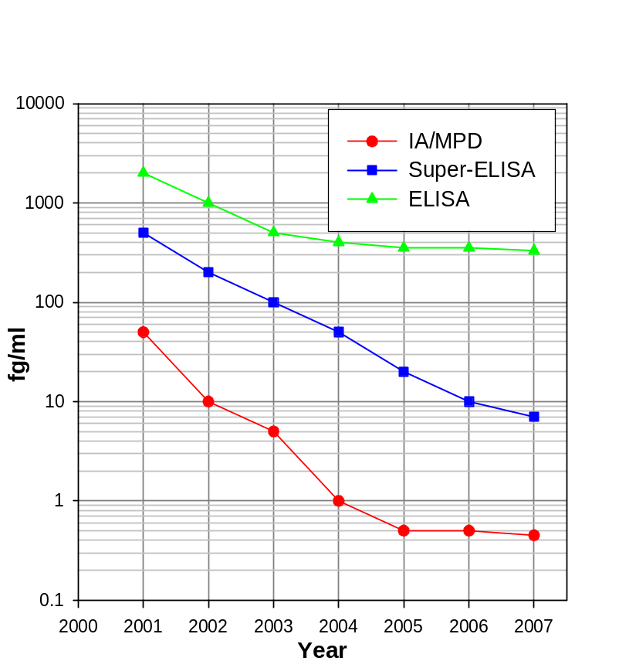
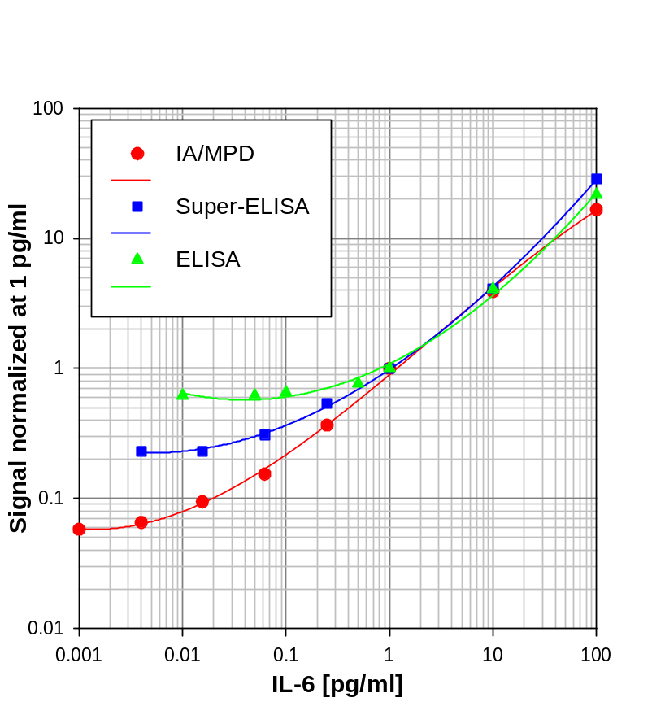
The enabling factor are more sensitive methods of protein detection (IA/MPD and Super-ELISA).
Historical progress of ELISA, Super-ELISA
and IA/MPD.
The comparison of sensitivity of ELISA, Super-ELISA
and IA/MPD for IL-6.

Slide 9
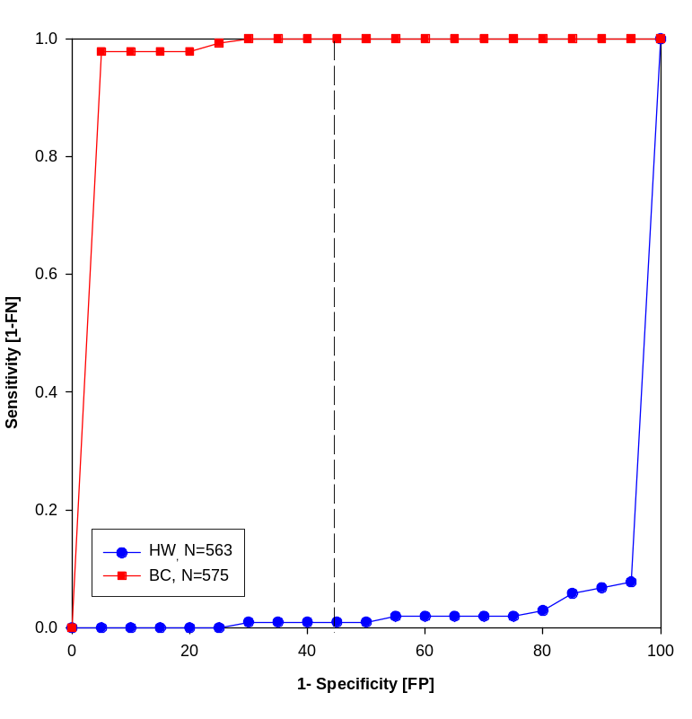
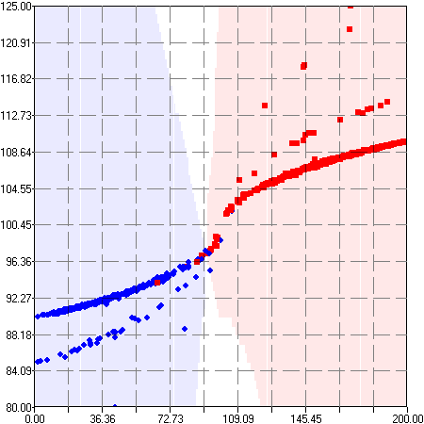
Our methods of Linkage proteomics permit reliable differentiation of HW (N=563) and BC (N=575).
Sensitivity ≥ 95%; Specificity ≥ 95%.
CS_{Q}
CS_{L}
The HW_{All} (N=563) are well separated from BC_{All} (N=575) using CS_{L} vs. CS_{Q} plane. (Algorithm 2).
The ROC-curve for BC (N=575) vs. HW (N=563) (Algorithm 3).

Slide 10
Table 3: Detecting Cancers
 | Cohort | Well identified | Uncertain | F. identified | BM
Breast Cancer | 575 | 555/575 (96.6%) | 10/575 (1.7%) | 10/575 (1.7%) | 5
Healthy Women | 562 | 548/562 (97.5%) | 2/562 (0.4%) | 12/562 (2.1%)
* Ovarian Cancer | 51 | 48/51 ( 94.1%) | 2/51 (3.9%) | 1/51 (2.0%) | 11
* Healthy Women | 56 | 54/56 ( 96.4%) | 2/56 (3.6%) | 0/56 (0.0%)
Prostate Cancer | 32 | 32/32 (100.0%) | 0/32 (0.0%) | 0/32 (0.0%) | 6
BPH/Prostatis | 79 | 77/79 (97.5%) | 0/79 (0.0%) | 2/79 (2.5%)
◦ Lung Cancer | 103 | 102/103 (99.0%) | 1/103 (1.0%) | 0/103 (0.0) | 6
◦ Healthy Women | 50 | 49/50 (98.0%) | 1/50 (2.0%) | 0/50 (0.0)
* Pancreatic Cancer | 72 | 71/72 ( 98.6%) | 0/72 (0.0%) | 1/72 (1.4%) | 8
* Healthy Men/women | 53 | 53/53 (100.0%) | 0/53 (0.0%) | 0/53 (0.0%)
* Melanoma | 172 | 164/172 (95.3%) | 7/172 (4.1%) | 1/172 (0.6%) | 7
* Healthy Men/Women | 100 | 96/100 (96.0%) | 1/100 (1.0%) | 3/100 (3.0%)
NB = No Biomarkers, CI = Correct Identification, ??? = Uncertain, FI = False Identification
*In collaboration with group of Dr. A. Lokshin
◦In collaboration with group of Dr. Y. Kaminska

Slide 11
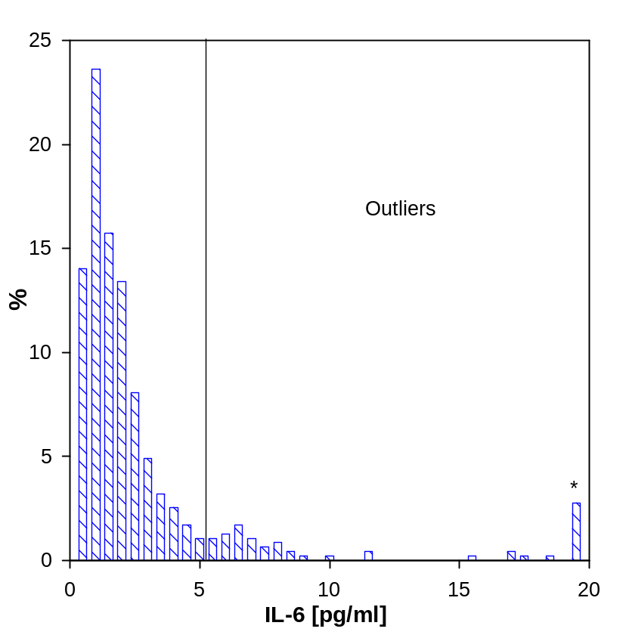
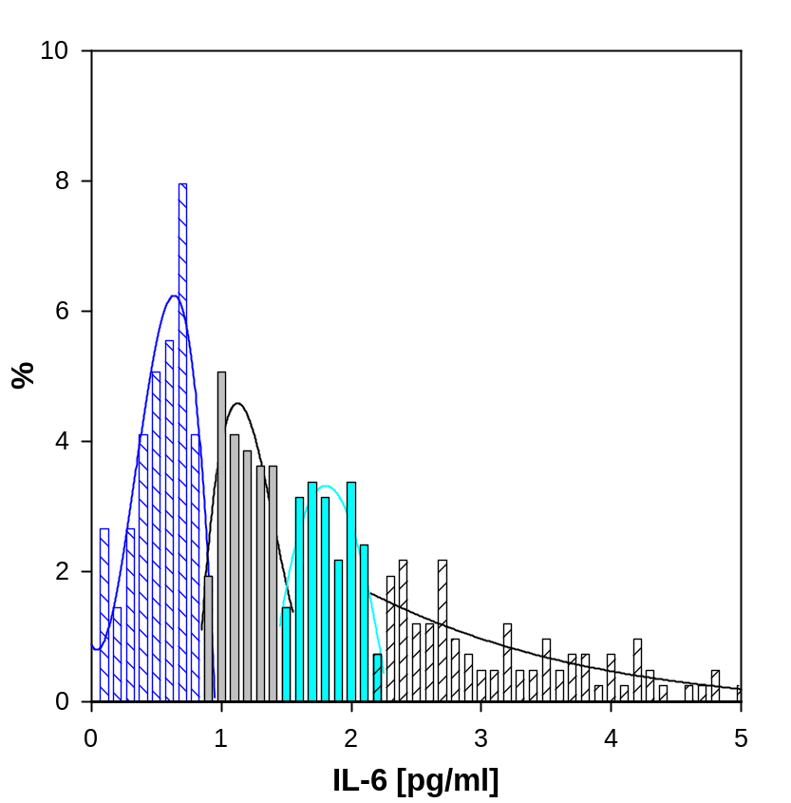
The distribution of IL-6 for HW (N=562)

Slide 12
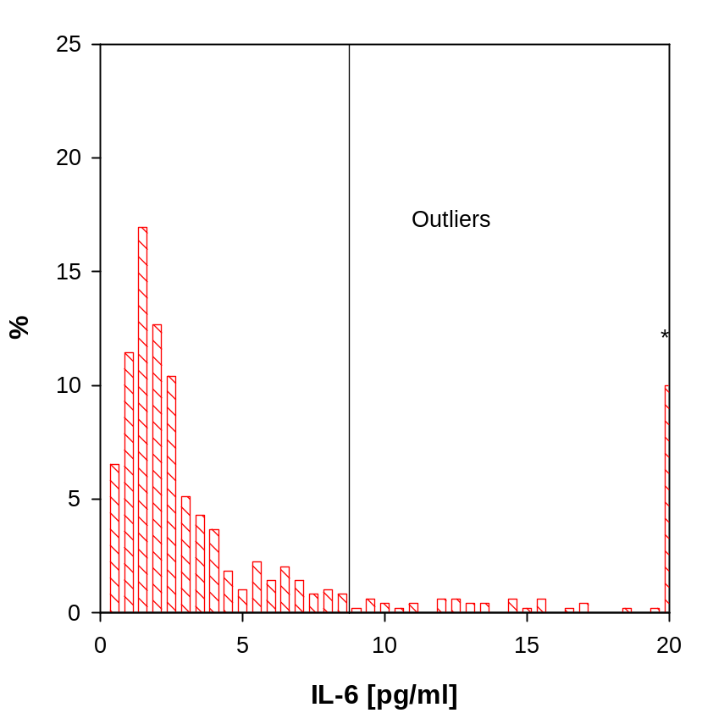
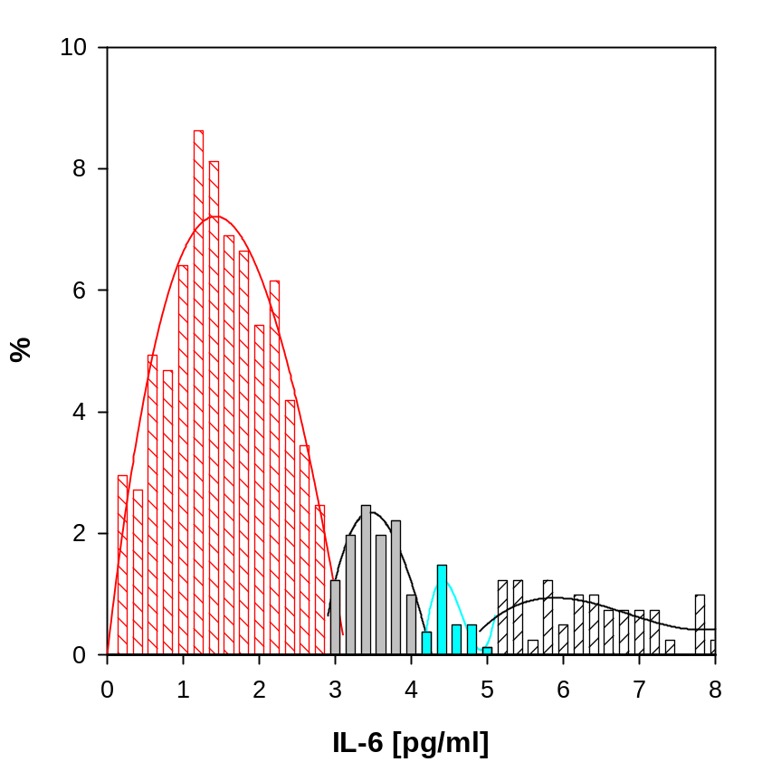
The distribution of IL-6 for BC (N=575)

Slide 13
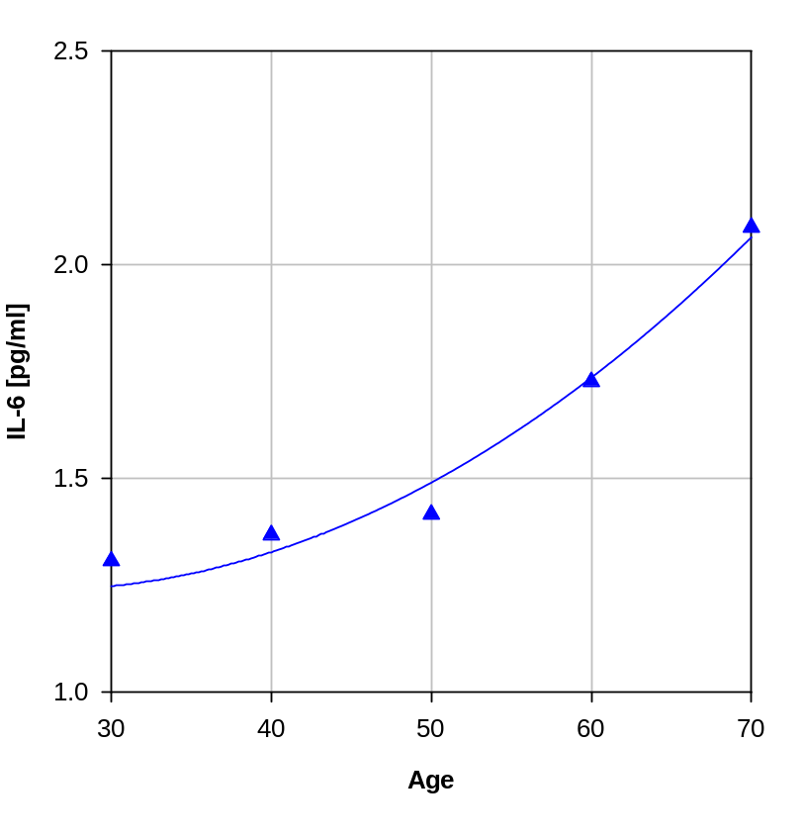
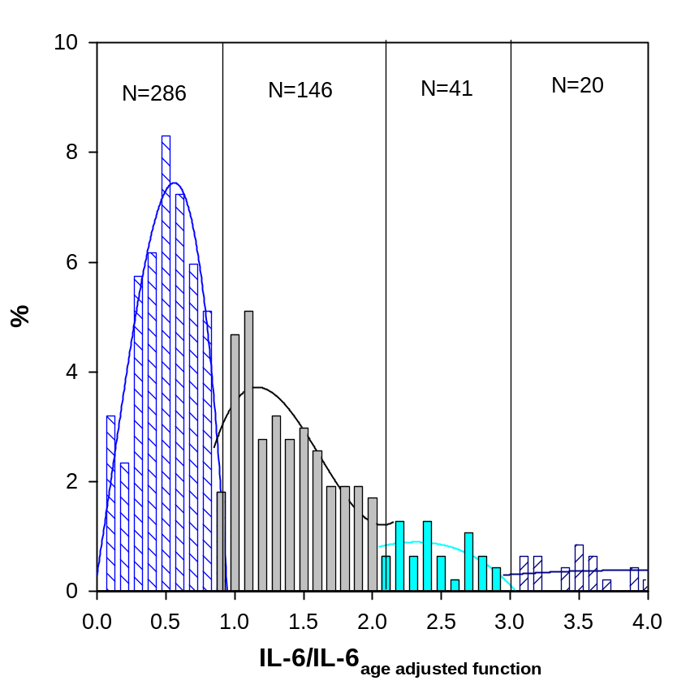
The age dependence of IL-6
for HW (N=562)
The distribution of IL-6 in reduced
variables for HW (N=562)

Slide 14
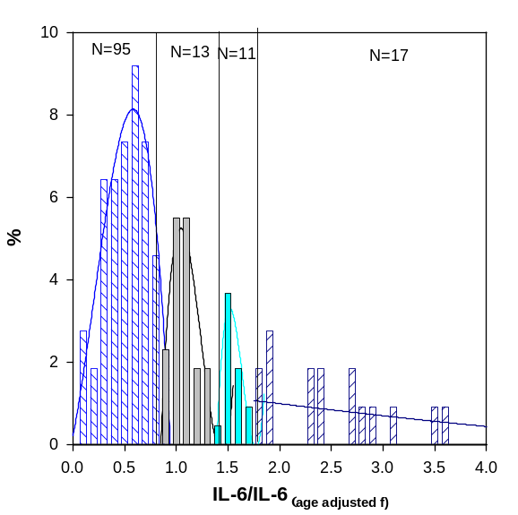
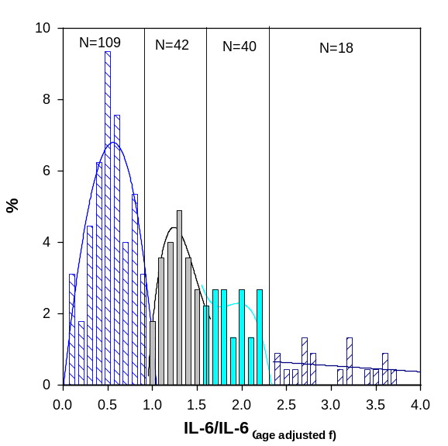
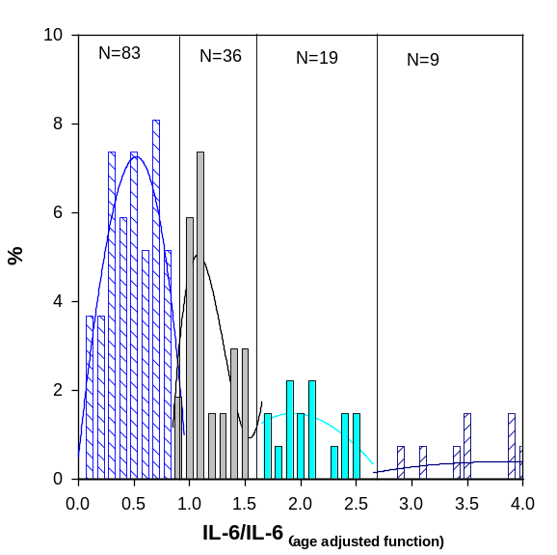
The Distribution of IL-6 in HW_{pre} (N=229), HW_{peri} (N=168)
and HW_{post} (N=165) Cohorts

Slide 15

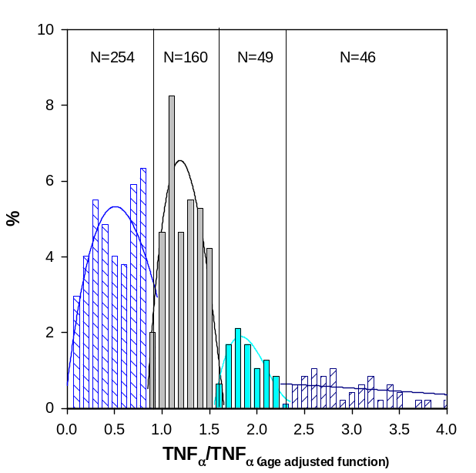
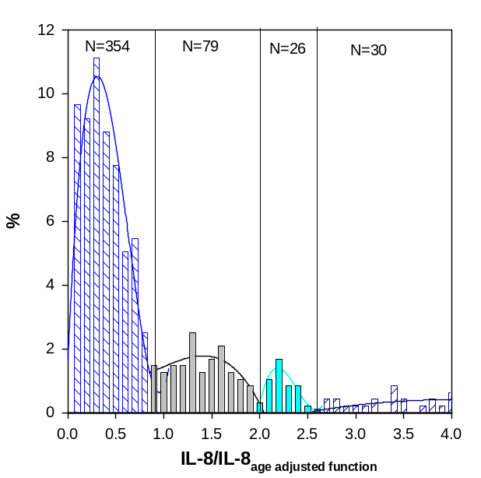
The distribution of TNF_{α}, IL-6, IL-8
in reduced variables for HW (N=562)

Slide 16
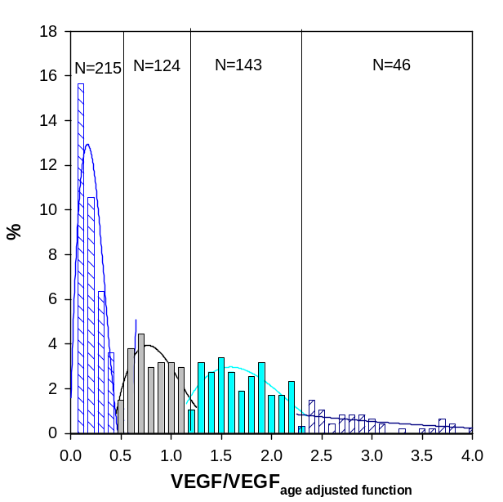
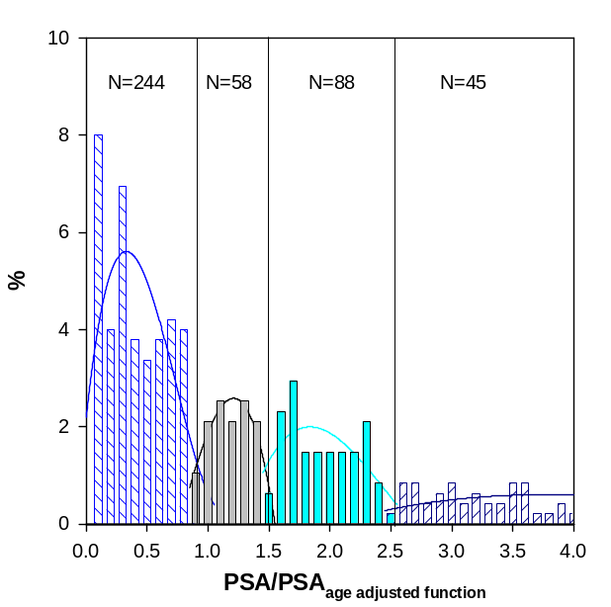
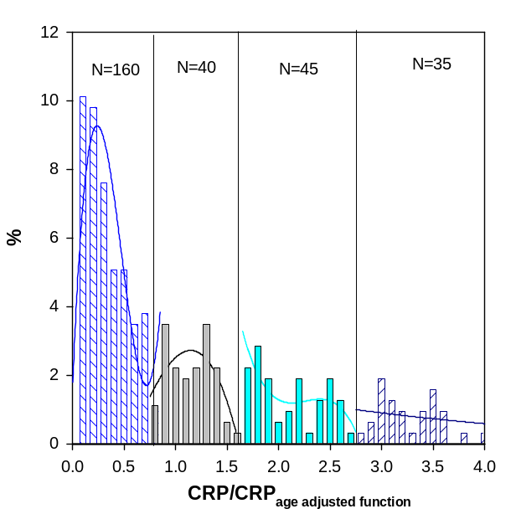
The distribution of PSA, VEGF and CRP in reduced variables for HW

Slide 17
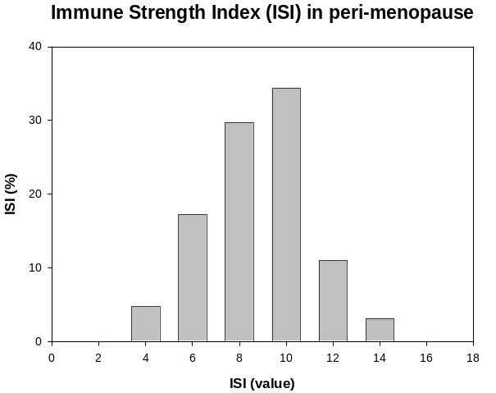
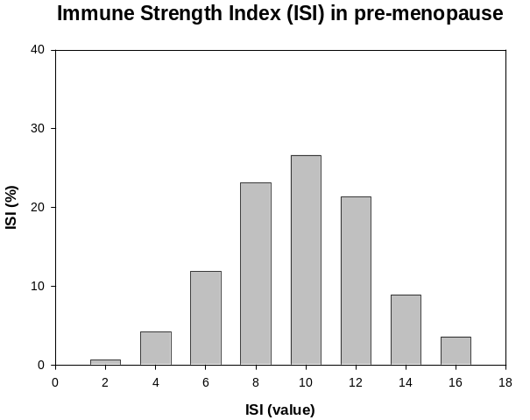
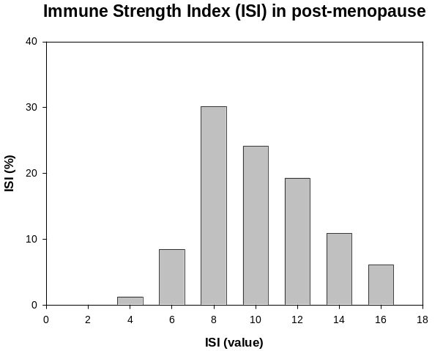
Immune Strength Index (ІSІ)
If Type І → SI=1
If Type ІІ → SI=2
If Type IІІ → SI=3
If Type ІV (outliers)→ SI=4
n
ІSI = Σ SI_{i} i.e. from 4 to 16
i=1

Slide 18
Complexity of SCNL - Systems
A priori the complexity of immune system is too large to handle
N _{different states} = [max (x) – min (x)]/dx
wherein dx = measurement precision.
For example for IL-6 and healthy women
N _{different states} = (5x10² pg/ml – 1x10⁻² pg/ml)/(5x10⁻² pg/ml) ≈ 10⁴
N _{different states} = (5x10³ – 10⁻²)/(5x10⁻²) ≈ 10⁵
What if immune system is described by three immune variable, say TNF_{α}, IL-6, IL-8
N_{ds} (IS) = N_{ds} (TNF_{α})xN_{ds} (IL-6)xN_{ds} (IL-8) ≈ 5x10³x10⁴x10³ = 5x10¹⁰
! No clinical tests possible !

Slide 19
For each immune variable we have only four (4) Types:
Type I = weak, Type II = normal, Type III = strong, Type IV = very strong
Thus for three immune variables, immune system can be stratified into
N_{types} (TNF_{α})xN_{types} (IL-6)xN_{types} (IL-8) = 4x4x4 = 64
For example: (TNFα = weak, IL-6 = weak, IL-8 = weak) → (1,1,1)
(TNFα = v.strong, IL-6 = v.strong, IL-8 = v.strong)→ (4,4,4)
Each sub-type of immune system (immune box) is defined as x_{ij}
i=1,2,3; j=1,2,3,4
The number of individuals in immune box is F(x_{ij}) [occupancy probability]
If system is weakly-coupled, semi-linear / one expects equipartition
F (x_{ij}) → 1/64 = 1.56%

Slide 20
Some trends:
BC HW
High occupancy boxes 1 13.4% 5.55%
(HOBs) 2 12.9% 5.55%
3 7.07% 5.35%
4 6.34% 4.16%
39.7% 25.6%
Low occupancy boxes
(LOBs) BC No = 39 Σ = 13.9%
HW No =40 Σ = 11.0%
The weak immune system (at least one Type I)
BC No = 355 355/410 = 86.6%
HW No = 329 329/504 = 65.1%
The strong immune system (at least one Type IV)
BC No = 219 219/410 = 53.4%
HW No = 210 210/504 = 41.6%
BC cohort is far-out of equipartition, it’s more SCNL than HW!

Slide 21
The HOBs are different in HW and BC
HW = healthy women, BW = (mammography positive, biopsy negative)
MW = (mammography positive, biopsy negative)
Comparison of HOB’s (high in BC)
Box
Malignant (%)
Benign (%)
Healthy (%)
(4,4,1)
13.8
13.0
2.18
(1,2,1)
8.94
8.26
1.38
(1,1,1)
7.34
10.1
4.16
(2,2,1)
7.34
2.71
3.57
(1,3,1)
6.5
7.34
1.59
(1,4,1)
5.69
6.42
1.19
(2,4,1)
4.88
2.75
2.18
(4,2,1)
4.88
2.75
1.98
(4,3,1)
4.88
9.17
0.79
Comparison of HOB’s (high in HW)
Box
Healthy (%)
Benign (%)
Malignant (%)
(1,4,4)
5.55
0.92
0
(3,1,1)
5.55
1.83
0
(2,1,1)
5.35
1.83
2.61
(1,1,1)
4.16
10.1
7.34
(4,1,1)
3.57
0
2.43
(2,2,1)
3.37
2.75
7.34
(2,3,1)
3.37
0
2.61
(2,4,4)
2.78
1.83
0.81

Slide 22
8 highest occupancy I-boxes in MW
8 highest occupancy I-boxes in HW
I-Box | BC | HW | PP1
(4,4,1) | 13.8% | 2.25 | 6.3
(1,2,1) | 8.9% | 1.4% | 6.4
(1,1,1) | 7.3% | 4.2% | 1.7
(2,2,1) | 7.3% | 3.6% | 2.0
(1,3,1) | 6.5% | 1.6% | 4.0
(1,4,1) | 5.8% | 1.2% | 4.8
(2,4,1) | 4.9% | 2.2% | 2.2
(4,3,1) | 4.9% | 0.8% | 6.1
I-Box | HW | BC | PP2
(1,4,4) | 5.6% | 0.0% | >100
(3,1,1) | 5.6% | 0.0% | >100
(2,1,1) | 5.4% | 2.6% | 2.1
(1,1,1) | 4.1% | 7.3% | 0.6
(4,1,1) | 3.6% | 0.0% | >100
(2,2,1) | 3.4% | 7.3% | 2.7
(2,3,1) | 3.3% | 0.0% | >100
(2,4,4) | 2.8% | 0.8% | 3.5
PP1 = HOB(MW)/HOB(HW)
PP2 = HOB(HW)/HOB(MW)

Slide 23
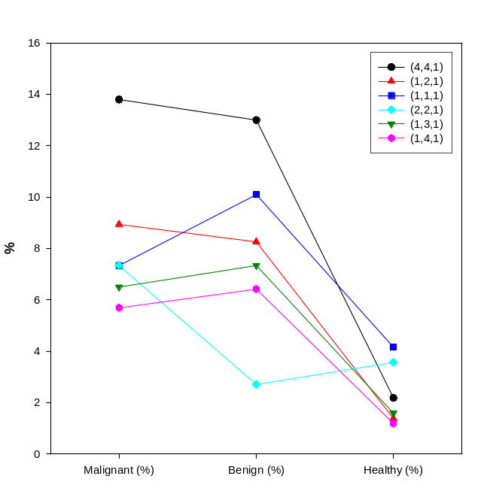
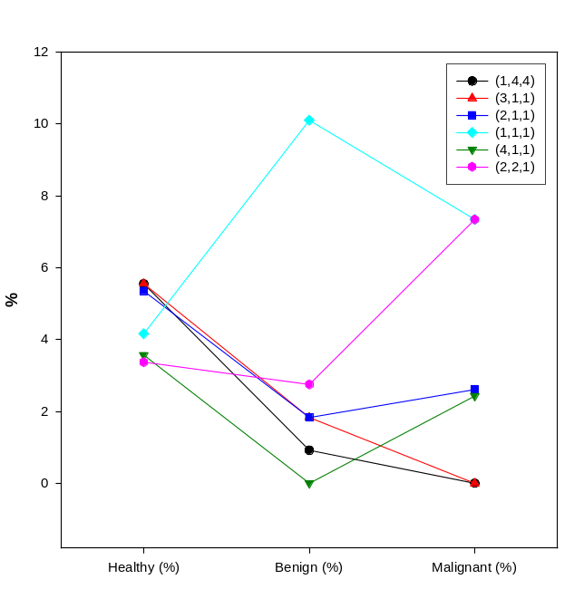
The HOBs in BC cohorts are often LOBs in HW cohort.
The HOBs in HW cohort have often much lower occupancy numbers in BC cohort.
Conclusion 1:
Immune systems of HW and BC are very heterogeneous
Immune system in HW and BC are very different
Immune systems data alone can not differentiate benign and malignant
There exist immune system sub-cohorts for which immune therapy may work better than for other sub-cohorts (“frustrated IS”)

Slide 24
Towards Predictive Medicine
Immune System (IS) Influences Prevalence:
Too Weak IS → Infectious Diseases Cancers
Too Strong IS `→ Diabetes→ CVD Auto-immune Diseases Asthma, Allergies
“Frustrated” IS → ???
“Frustrated” IS = Both Type I (weak) and Type IV (super-strong)
Possible Divisions
Strong vs. weak
Active vs. non-active
Equilibrated vs. non-equilibrated
Allowed vs. prohibited

Slide 25
Towards Predictive Medicine
To detect easier than too predict! The risk-factors not biomarkers are drivers of modern medicine.
Table : The Risk Factors for Cardio-Vascular Diseases
Source PF RI FM Comments
High Cholesterol 10-20% 2-3 0.2-0.5 Cumulative with other RFs
Systemic Inflammation 10% 2-3 0.2-0.3
High Blood Pressure 15-20% 3-5 0.3-0.5
Diabetes 10% 1.5-2 0.15-0.2
Stress 10% 1.5-2 0.15-0.2
Smoking 15-20% 1.5-2 0.2-0.4
Combination (2 above) 2-3% 5 0.1-0.1.5
Combination (3 above) 1-2% 10 0.1-0.2
PF = Population Fraction, RI = Risk increase , FM = Figure of Merit.
Figure of Merit = (Population Fraction) x (Risk Increase)
! Modern Cardiology works because we under stand “Risk Factors !

Slide 26
Risk Factors in Oncology
Table 2: The Risk Factors for Breast Cancer
Sub-cohort PF RI* FM Comments
Familial BC 10% 2-3 0.2-0.3
Askenazi Jews (AJ) 2-3% 5 0.1-0.15 BC in younger women
African American 5% 2 0.1 BC in younger women
Bad prognosis
BRCA1/2 (AJ) 1.5% < 10 < 0.15 BC in women < 40 yrs old
RRCA1/2 (General) 0.5% < 10 < 0.05 BC in women < 40 yrs old
Figure of Merit (FM) = Risk Factor (RF) x Population Fraction (PF)
The understanding of RISK FACTOR is poor in oncology

Slide 27
One set of data – Four ways to analyze
Raw Data (R-Data)
Normalized Data (N-Data)
Ratio-Data
Contrast-Data
Strong vs. weak IS
Equilibrated vs. non-equilibrated
Ratio (HW(%)/BC(%)) ≡ PP1 and Ratio (BC(%)/HW(%) ≡ PP2
Interpretation:
If a particular HW-box has high occupancy for BC-cohort and low for HW-cohort it is a HIGH RISK IS subtype (HR-sub-type)
If particular HW-box has high occupancy for HW(%) but low BC(%) it is LOW RISK IS subtype (LR-sub-type)
Challenge:
Many boxes are prohibited → statistical uncertain type

Slide 28
Table 16: Predictive power - Normalized data (POST) (BC in HW-boxes)
High Risk
Type BC(N) BC(%) HW(N) HW(%) PP1 FM1 Quality
(1,1,4) 13 9.5 0{1?} 0{0.8?} 11.9 1.13 SS !!!!!!
(2,1,2) 6 4.4 1 0.8 6.4 0.28 VS
(2,1,4) 12 8.7 0{1?} 0{0.8?} 10.9 0.95 SS !!!!!!
(2,4,4) 6 4.4 2 1.5 2.9 0.13 S
(4,1,2) 9 6.6 2 1.5 4.4 0.29 VS
(4,4,2) 5 3.6 0{1?} 0{0.8?} 4.5 0.16 VS
All HR 37.2% 6.2% 6.0 2.94
Low Risk
Type BC(N) BC(%) HW(N) HW(%) PP2 FM2 Quality
(1,2,1) 0{1?} 0{0.7?} 8 6.1% 8.7 0.53 SS
(2,1,1) 6 4.4 22 17.6% 4. 0.70 VS
(2,2,1) 1 0.7 6 4.6 6.6 0.30 VS
(3,1,1) 0{1?} 0{0.7?} 8 6.1 8.7 0.53 SS
(4,1,1) 0{1?} 0{0.7?} 11 7.7 11. 0.85 SS !!!!!!
(4,2,1) 0{1?} 0{0.7?} 5 3.1 5.4. 0.21 S
(4,4,4) 2 1.4 5 3.1 2.7 0.09 S
All-LR 7.9% 48.3% 6.1 3.21

Slide 29
Predictive Power – N-Data (Summary)
Table 16: Normalized data (BC in HW-boxes)
High Risk
Cohort Type BC(%) HW(%) PP1 FM1
PRE All-HR 38.3% 6.9% 5.6 2.55
PERI All-HR 46.2% 13.0% 3.6 2.14
POST All-HR 37.2% 6.2% 6.0 2.94
Low Risk
Cohort Type BC(%) HW(%) PP2 FM2
PRE All-LR 5.4% 29.5% 5.5 2.91
PERI All-LR 7.2% 47.0% 6.5 3.59
POST All-LR 7.9% 48.3% 6.1 3.21
Note: FM (N-Data) > 20 x FM (BCRI)
In R-Data, HR sub-types have higher predictive power than LR
In N-Data, HR sub-types have lower predictive power than LR

Slide 30
The AND and OR MODELS
The problem of prediction is asymmetric;
For HR we need to test more often (OR-MODEL)
For LR we are afraid to test more rarely (AND-MODEL)
Statistical problem
Many EMPTY Immune–Boxes restrict MODELS
Are the boxes EMPTY or just one event in?

Slide 31
Two Models
Model I: A particular sub-type of immune system influence the ability to eliminate the mutated sells.
Simplifying: Weak IS → high risk of BC → PPI>2
Normal IS → average risk of BC → 0.5<PPI<2
Strong IS → low risk of BC → PPI<0.5
PP1≡ RATIO (Frequency BC/Frequency HW)
Model 2: Oncogenesis leads to drastic change of IS:
Is effect large enough to move IS to other immune-box; Adjacent boxes: donors (for PPI>2) or acceptors (for PPI<0.5)
CALCULATIONS SUGGEST THAT MODEL 2
DOES NOT WORK

Slide 32
Summary
A particular 4-types IS strength permits stratification into 4x4x4=64 immune sub-types;
The complexity of IS may be low, because it is a particular Rene Thom type of SCNL- system;
Stratification of IS have a good predictive value, e.g. differentiate HW vs. BC cohorts;
The stratification of IS may permit “personalized” medicine.

Slide 33
Towards more specific drug delivery
For majority of receptor distribution in normal and metastatic cells are “similar”, contrast is < factor 2;
For certain number of receptors, contrast may be O(5-10);
One can select > 3 receptors for which contrast > 10;
One need to implement the logical AND operator to prove that mor than 2 receptors are up-regulated on a given cell;
This can be accomplished with magnetic nano-beads linked to a particular Abs;
One can induce “magnetic avalanche” so that magnetic field is high (> 1 T) only if all three receptors are occupied ;
This enables coincidant , high specificity delivery of drugs
Rdrug = P1xP2 x …x.Pn

