Slide 1
Algorithms of Google News
An Analysis of “Google News Personalization Scalable Online Collaborative Filtering”¹

Slide 2
Overview
Data and background
Map-Reduce
Min-Hash Clustering
Probabilistic Latent Semantic Analysis
Co-visitation Counts

Slide 3
Background
Google news is a large multi-user streaming news application
The data set has very high churn due to the abundance of new news stories
There are too many stories to rely on the user’s discretion to filter interesting and uninteresting news
There are thousands of users with known usage histories in the form of “click data”
Because this is an online system with streaming data (users don’t want old news) an offline method will not work.

Slide 4
Make Decisions for Users
The method is called content filtering
The goal is to use any data at your disposal about a user and about incoming articles to predict the user’s interest.
More specifically you would need a function that would take a user and an article and generate a prediction for interest (0,1).
Then order the list such that articles with a high interest prediction are presented to the user.

Slide 5
Available Data
We have a limited variety of data, however we have an abundance of a certain type of data from which we can compute metadata about users and news stories.
Click Histories
  Record the stories that a user has clicked on in the past
  Store this along with all other users click histories in a large table
  The table consists simply of news articles for columns and users for rows.

Slide 6
Map Reduce
A large cluster data processing framework
Handles all network I/O and fault situations, and is transparent to the application programmer
Utilizes Google Filesystem (GFS) a high performance distributed file system.
Utilization of map reduce is straightforward, scalable (1000+ machines), and fault tolerant.
Mostly just a system programming framework, the parallelization of an algorithm is still up to the application programmer

Slide 7
Map Reduce In a Nutshell
Treat Imperative (like java, c, asm…) functions as pure functions (like lisp, apl, mathematica,Haskel...)‏
  Never modify data, simply create new copy of the modified data
  Functions can take functions, return functions as parameters and output (not really important here)‏
Utilize functional programming basic functions Map and Fold (or Reduce)‏
  Mapping is one to one
  Fold reduces the mapping, by colliding similar objects

Slide 8
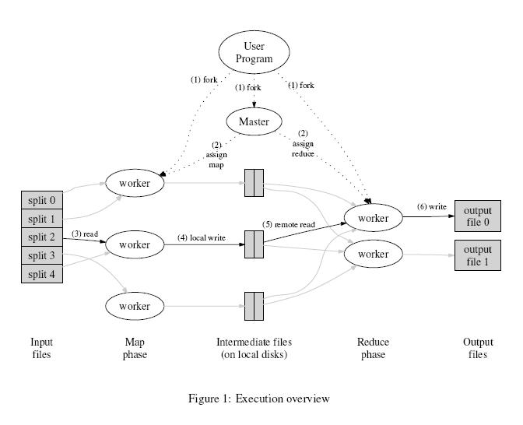

Slide 9
Verbal Explaination of Framework
User Program executes the framework.
The framework assigns a master computer
And partitions the data set over the available workers
The workers map the data
Once all mapping is complete the workers are reassigned reducing tasks.
The result of the reducing tasks are returned to the User Program
*All mapping Completes prior to any reducing

Slide 10
Map Reduce Ex. (word counts)‏
Map - scan words from documents
Map(String key, String value)‏
//key: document name
//value: document contents
for each word w in value
EmitIntermediate(w,”1”)‏
Reduce – add all word’s counts together
Reduce(String key, Iterator value)‏
//key: a word
//value: a list of counts
int result = 0
for each v in value:
result+= ParseInt(v)‏
Emit(AsString(result))‏

Slide 11
Other Features
Some Other Features
  Locality tuning – try to reduce the data that a node has locally as intermediate data from the map function
  Fault tolerance – for failed nodes or failed processes
  Combiner Functions – mini reducer-like function for associative functions.
    previous example one would likely sum the lists of words found in a document and emitIntermediate() the summed lists instead of every word to save bandwidth.‏

Slide 12
Memory-based Method
Makes predictions based on a user’s past selections
For each story generate a vector of users that clicked on the story.
Then use a similarity measurement (dot product) in the user-vector space to compute a users’s similarity with all other users.
Unfortunately this is not scalable
  O(n^2) to compare all stories with all other stories
  So we will borrow a previously mentioned comparison technique – Min-wise Hashing

Slide 13
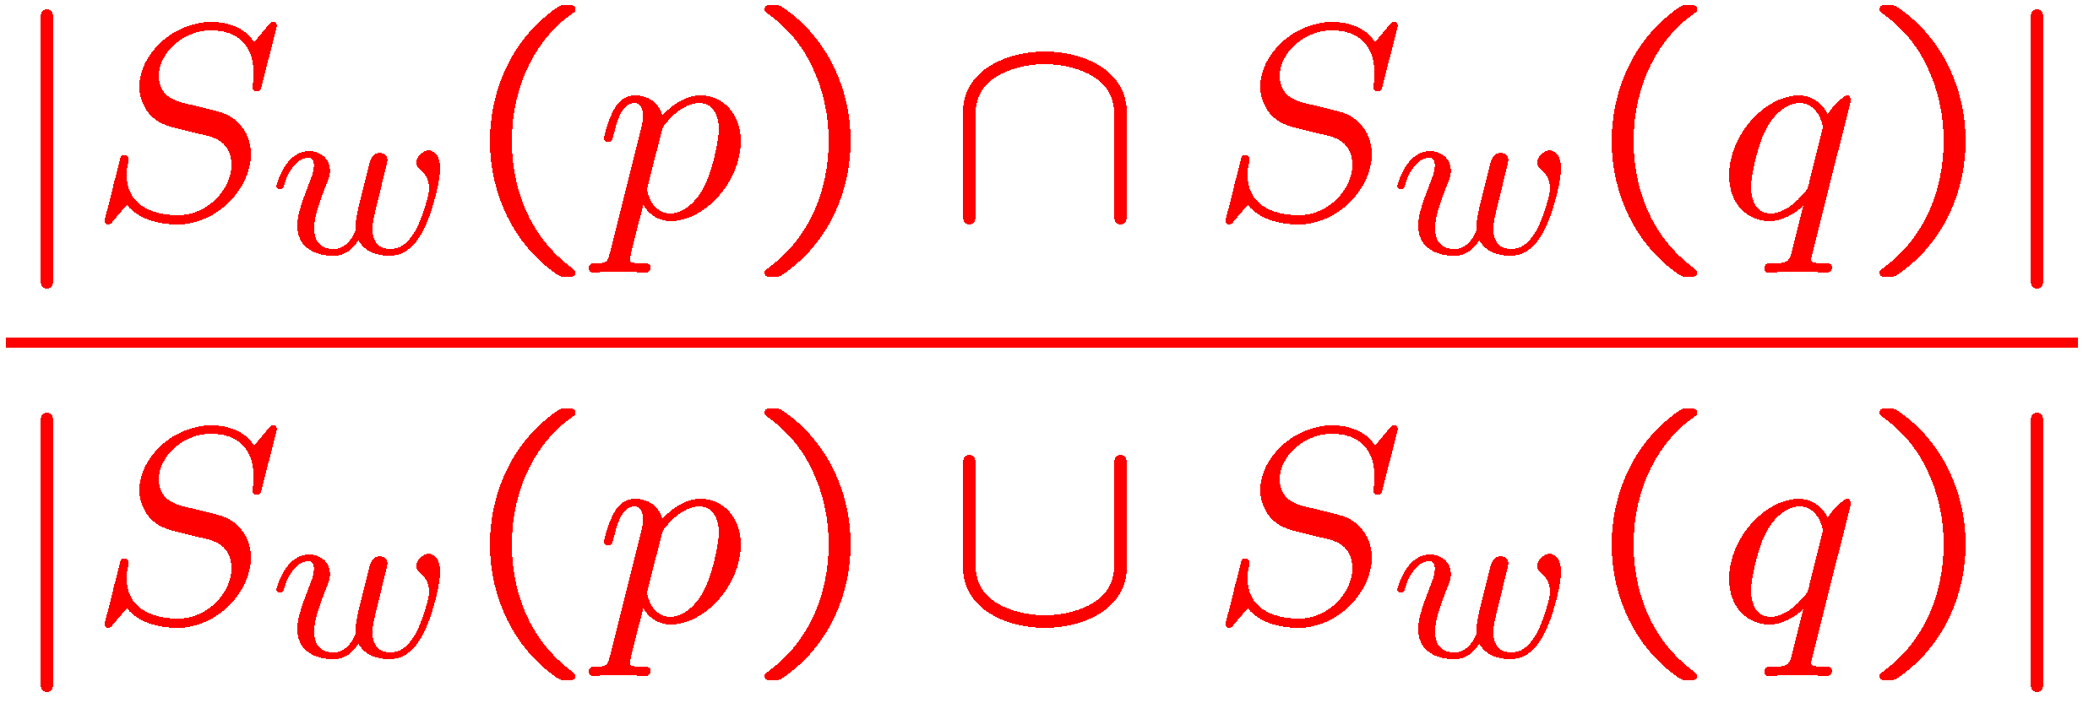
Min-Hash Clustering
Clustering algorithm that uses hash intersections to probabilistically cluster similar user data.
As we are familiar from previous lecture with min-hashing I will not repeat all aspects of the algorithm
As with “web page duplicate detection” we will utilized the jaccard coefficent as our similarity measurement.
S(p,q) =
Locality Sensitive Hashing – map data points using several hash functions. The probability of collision is much higher for the min-hashes of similar objects.

Slide 14
Some tweaks to Min-Hashing
Concatenate p hash-keys (generated from p functions) for each user so the probability that any 2 users will agree on a concatenated hash key is S(u_{i},u_{j})^{p.}
  Concatenation makes the underlying clusters more refined
  Also increases the average similarity if users in a cluster
Repeat the p hashing of users to q clusters in parallel to increase recall
  Hash each user to q clusters where each cluster is defined by the concatenation of p Min-Hash keys
  This amounts to a matrix of min-hashes and hash functions
Instead of generating all random hash permutations over millions of items, Googe generates a set of independent random seed variables for each min-hash function p.
  Use the product of p and q(the min-hash value that maps to a specific cluster) to generate an ID for the article.
  The hash value then severs as a proxy for indexing the random hash permutation.
  The computed seed and hash values have properties similar to the ideal min-hash values.

Slide 15
Map-Reduced Min-Hash Clustering
Due to the complexity and size of the user history matrices the problem of finding approximate min-hash values is not feasible on a single system
As we discussed before the parallel MapReduce framework can be utilized
Because Hashing can be performed independently, min-hash is a simple candidate for parallelizing during the map phase
Additionally the clustering phase is directly related to the reduction method.

Slide 16
Map
Read click histories for users in parallel on multiple machines
Map inputs to a set of key value pairs computing p x q Min-Hash values for each user
  Hash each user-id and the random seed corresponding to the hash function
Combine the Min-Hash values in q groups of p Min-Hashes (this is the combiner step from map reduce)‏
For each q groups concatenate the MinHash values to obtain the cluster-id
The key value pair corresponds to the cluster-id and user-id respectively

Slide 17
Partition And Shuffle
The key-value pairs are split into partitions(shards) at the end of the map phase
Partitions are based on the hash values of the keys
Shards are sorted on the keys so that all key value pairs for the same key(cluster-id) appear together

Slide 18
Reduce
For each cluster-id we obtain the list of user-ids that belong to the cluster
Then remove clusters with low membership(more of a housekeeping step)‏
In a separate MapReduce process the cluster-user list is transposed to yield a list of clusters for each user to which they belong
This is stored as a database and accessed when the user accesses or makes updates to the system
The task of re-clustering is done when a new user arrives, or when the model loses accuracy

Slide 19
PLSI-Probabilistic Latent Semantic Indexing
A method for collaborative filtering based on probability models generated from user data
Models users iϵI and items jϵJ as random variable
The relationships are learned from the joint probability distributions of users and items as a mixture distribution
Hidden variables tϵT are introduced to capture the relationship
The Corresponding t’s can be intuited as groups or clusters of users with similar interests

Slide 20

Latent Classes
*Apologies for the changed
variables from the paper
Here we see the two way latent class model, p_{t} defines the latent class t, and in PLSI is a probability distribution. p_{jt} and p_{it} are the probability components of the element matrix i,j and are S and U from the paper respectively.
  The element matrix consists of frequency in click history-story space, where stories are the columns and the rows are the users
  Formally the model can be written as
  p(j|i; θ) = ∑ p(t | i) p(j | t)‏
  The parameter θ represents the conditional probability distribution for p(t | i) and p(j | t)‏
  The latent variable t makes the users i and items j conditionally dependent.

Slide 21
What are we looking for
  Learning the co-occurrence model that defines the conditional probabilities associated with θ (namely the p_{it} and p_{ij}) is the primary computation for PLSI
  An estimate of these values is obtained by minimizing the empirical logarithmic loss function, (how not bad we can do)‏
  L(θ)= ⁻¹/_{T}∑ log(p(j| t; θ))‏
  This function tries to minimize the difference between a story conditioned on the latent class variable t and the user’s selection of a particular story, for all users and stories.
    this can of course be inverted to group users too
  Ex. User 1 chooses story 2 but not 1
      log(p(j₂ | i₁; θ))≈0 therefore p(j₂ | t₁) ≈ 1
      log(p(j₁ | i₁; θ))<<0 therefore p(j₁ | t₁) ≈ 0

Slide 22
How do you get some Z’s
The method of minimizing the loss function can be obtained with an iterative expectation maximization algorithm
EM consists of two steps
    E step estimates the posterior latent class variables by computing Q latent class variables (generally initialized as a random matrix)‏
    Maximization step computes the relevant probability distributions p(j|t) and p(t|i)‏
In this description we can see a relation to gradient or least squares search algorithms
    The E step is similar to the gradient and estimates the step size
    While the M step iterates the search

Slide 23
Math of EM for Log-Likelihood
E-step
    q*(t;i,j; θ’):= p(t|i,j; θ’)=p’(j|t)p’(t|i)‏
    ^{∑ p’(j|t) p’(t|i)‏}
M-Step
    p(j|t) = _{∑q*(t;i,j; θ’)) (for all i)‏}
    ∑_{j}∑_{i} ^{q*(t;i,j;θ’)‏}
    p(j|t) = _{∑q*(t;i,j; θ’) (for all j)‏}
    ∑_{t}∑_{j} ^{q*(t;i,j;θ’)‏}

Slide 24
Map Reducing EM
Because this model is clearly too large I=J=10 million, and L=1000 (the number of latent variables) the memory requirement for the probability distributions alone is (I+J)*L*4 = 80 gigs!
Unfortunately the method for map reducing EM algorithm is not as straightforward as it was for min-hash. This is mainly because it is iterative and dependent on the previous iteration
However if we rearrange the e-step and rewrite the m steps we get the equations on the following page

Slide 25
Map Reduced EM Equations
Define some new equations
    N(t,j) = ∑q*(t;i,j; θ’) (for all I) -total number of clicks for a story
    ^{N(t)=} ∑_{j}∑_{i} q*(t;i,j;θ’)‏ - total number of clicks for all stories
E-step
    q*(t;i,j; θ’):= p(t|i,j; θ’)= N(t,j)/N(t) p'(t|i)__
    ∑_{tϵT} ^{p’(j|t) p’(t|i)‏}

Slide 26
Map Reduced M Equation
  M-Step
      p(t|i) = _{∑q*(t;i,j; θ’) (for all j)‏}
      ∑_{t}∑_{j} ^{(t;i,j;θ’)‏}
  q*(t:i,j;θ') can now be computed independently for every (i,j) pair observed in the click logs

Slide 27
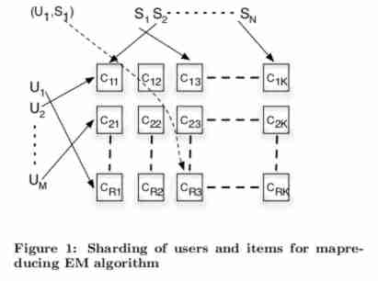

Slide 28
Map Step for Map Reduced EM
  Using a grid of size R x K mappers users and items can be sharded into r=R,k=K groups as a function of their ids (or randomly)‏
  The appropriate click data are sent to the corresponding (r,k) machine where r is the shard that i belongs to and k is the shard for j
  After computing q*(t;i,j;θ') the mappers output 3 key value pairs
    (i,q*) - user shard estimate
    (j,q*) - item shard estimate
    (t,q*) -latent class variable estimate

Slide 29
Map Reduced EM Equations
Reducer Step
  The reducer shard that receives the key-value pairs for the items j computes N(t,j) (for all t)‏
  The reducer shard that receives the key-value pair for I computes p(t|i)‏
  And the reducer shard that receives the key-value pair for t computes N(t)‏
  The computation in each is the summation of its shards
  The Map and Reduce steps repeat for each iteration of the EM model until some convergence occurs

Slide 30
Co-visitation
  a simple method of clustering based on the order in which a user clicks on stories
  Servers track items clicked on by a user within a certain time period
  The time period decays the value given for a co-visitation count
  A graph of nodes representing stories and edges representing the time decayed co-visitation instances
  A newly clicked story and the previous story receives a count when a user views both

Slide 31
Putting It Together
  Sorry for the teaser.
  The paper that this presentation is on contains detailed information about how this system is implemented, however it is not much of an algorithm (and therefore exceeds the scope of this presentation). also its complicated not in a fun way... like taxes complicated.

