Slide 1
Introduction to Information Retrieval Systems
Zhiwei Shao

Slide 2
General Outline
Introduction
Modeling
Text Operations
New Developments in IR
Conclusion

Slide 3
Introduction
Motivation
Basic Concepts
The Retrieval Process

Slide 4
Motivation
Information representation, storage, organization,
access
Search Engines (Google,Yahoo,etc.)
User information need
The hyperspace is vast and almost unknown
Absence of a well defined underlying data model

Slide 5
Basic Concepts
The User Task
  Can formulate what they need: Retrieval
  Can’t (or does not know): Browsing
Retrieval
Database
Browsing

Slide 6
Logical View of the Documents
text+ text
structure
structure fulltext
Index terms
Accents,
Spacing,
etc
Noun
groups
document
stopwords
stemming
Structure
recognition
Automatic
or manual
indexing

Slide 7
The Retrieval Process
Text
user need Text
logical view logical view
user feedback
query inverted file
retrieved docs
ranked docs
User
Interface
Text Operations
Query
Operations
Indexing
DB Manager
Module
Searching
Index
Text
Dababase
Ranking

Slide 8
Modeling
A Taxonomy of Inforamtion Retrieval Models
Retrieval: Ad hoc and Filtering
Characterization of an IR model
Boolean Model
Models for browsing

Slide 9
A Taxonomy of Inforamtion Retrieval Models
Set Theoretic
Fuzzy
Extended Boolean
Classic Models
boolean
vector
probabilistic
U
s
e
r
T
a
s
k
Algebraic
Generalized Vector
Lat. Semantic Index
Neural Networks
Retrieval:
Adhoc
Filtering
Structured Models
Non-Overlapping Lists
Proximal
Probabilistic
Inference Network
Belief Network
Browsing
Browsing
Flat
Structure Guided
Hypertext

Slide 10
Retrieval: Ad hoc and Filtering
Ad hoc
  static documents
  Interactive
  ordered
Filtering
  changing document collection
  not interactive

Slide 11
Characterization of an IR model
D , collection of formal representations of docs
Q , formal representations of user information need (queries)
F, framework for modeling document representations, queries, and their relationship
R(q_{i},d_{j}), ranking function (defines ordering)

Slide 12
Boolean Model
Weights ∈ {0, 1}
Query: Boolean expression
  q = ka ∧ (kb ∨﹁kc)
sim(dj,q)=1,dj is relevant to q
sim(dj,q)=0,dj is not relevant to q
Advantages
  clean formalism
  simplicity
Disadvantages:
  retrieve too many or too few
No index term weighting

Slide 13
Models for browsing
Flat browsing
  Dots in a plan or elements in a list
  No context cue
Structure guided
  like a directory
  Hierarchy
Hypertext (Internet!)
  sequential writing
  a directed graph

Slide 14
Text Operations
Elimation of Stopwords
Stemming
Text Compression

Slide 15
Elimation of Stopwords
Occur in 80% documents
Functional words
  Articles,prepositions and conjunctions etc
Useless for retrieval
Reduce indexing size and processing time

Slide 16
Examples for Stopwords:
Articles: a, an, and the
Prepositions: at, by, in, to, from, and with
Conjunctions: and, but, as, and because
Others: become, everywhere, and likely

Slide 17
Stemming
Common stem, similar meanings
  Connect: connected,connecting,connection and connection
Improve retrieval performance
Reduce distinct index terms
Suffixe removal
  The Porter algorithm
    details on http://www.tartarus.org/~martin/PorterStemmer/def.txt

Slide 18
Examples of Poter Algorithm:
Plurals:
  cats cat s ø
  stresses stress sses ss and ss ss
Participles:
  examined examine ed ø
  doing do ing ø

Slide 19
Text Compression
Motivation
Statistical Methods
Dictionary Methods
Comparing Text Compression Techniques

Slide 20
Motivation
Storage, transmission,search
Time to code and decode(Loss)
Random access(IR)

Slide 21
Statistical Methods
Huffman coding
  Fixed-length each symbol
  More appearance fewer bits
  Decode from any symbol
  Character Huffman and Word Huffman(close to entropy)
Arithmetic coding
  Higher compression rates
  Code compute incrementally
  Decode from the beginning
  Inadequate for IR

Slide 22
An example in Huffman coding tree:
0 1
0 1
0 1
0 1 0 1
Original text: for each rose, a rose is a rose
Compressed text: 0010 0100 1 0101 00 1 0111 00 1
rose
a
each
,
for
is

Slide 23
Dictionary Methods
Ziv-Lempel(fewer than four bits per character)
  Points to earlier occurrence
  Higher compression and decompression speed
  Not for IR

Slide 24
Comparing Text Compression Techniques
Character Word
Arithmetic Huffman Huffman Ziv-Lempel
Compression ratio very good poor very good good
Compression speed slow fast fast very fast
Decompression speed slow fast very fast very fast
Memory space low low high moderate
Compressed pat. Matching no yes yes yes
Random access no yes yes no

Slide 25
New Developments in IR
Peer-to-Peer(P2P)
Multimedia IR
Question-Answering System

Slide 26
Peer-to-Peer
P2P systems:
  Decentralized,self-organized and highly dynamic
  Loosely coupled, autonomous computers
Applications:
  File sharing (Napster, eMule, KaZaA, BitTorrent,etc.)
  IP telephony (Skype, etc.)
  Publish-Subscirbe Information Sharing (Auctions,Blogs,etc.)
  Collaborative Work (Games, etc.)

Slide 27
Multimedia IR
Applications
  Offices
  CAD/CAM
  Medical
  Internet
Differ from traditional IR
  More complex and heterogeneous data
    Text,images,graphs,sound,videos, etc
  Support mixstructured and unstructured data
  Requires handling metadata
  Peculiar characteristics of multimedia data
  Operations performed on such data

Slide 28
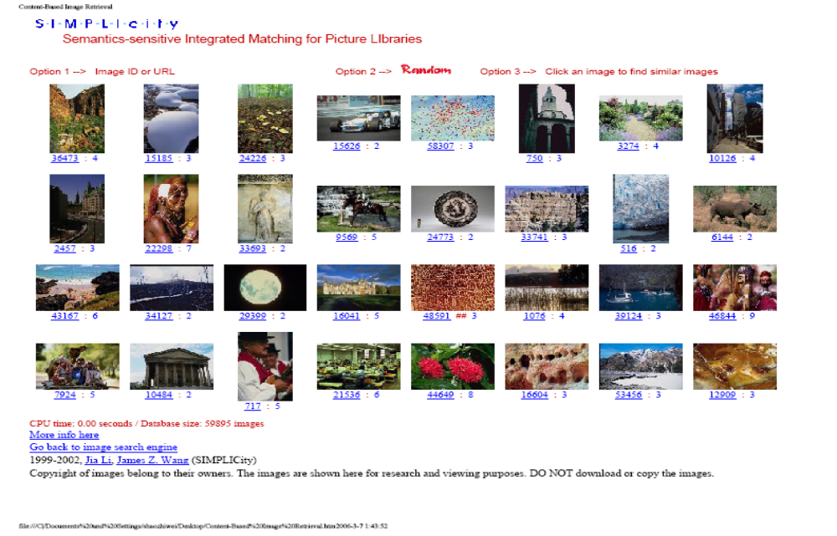
Example: Content-based Image Retrieval:
  http://wang.ist.psu.edu/IMAGE

Slide 29
Question-Answering System
Express query in natural language(e.g. English)
  In which city Eiffel Tower is located?
  Who is the first person on the Moon?
Short NL passages as query results, not entire docs
  Paris
  Neil Armstrong
Use techniques like NLP

Slide 30
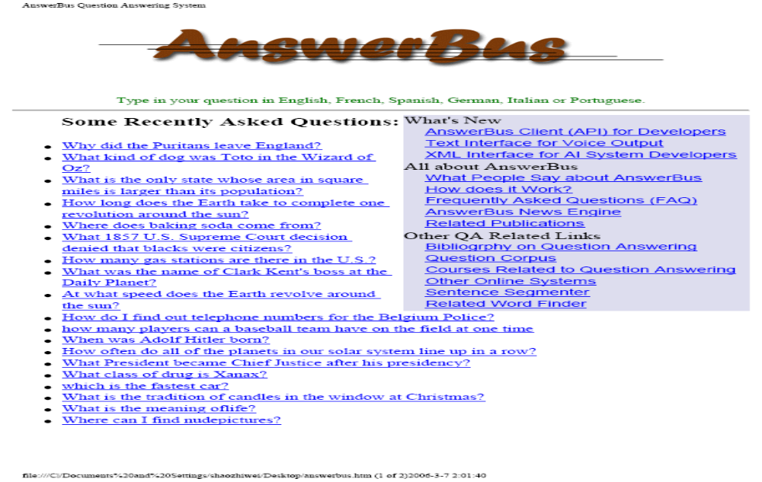
Example: Answer Bus
  http://answerbus.coli.uni-sb.de/index.shtml

Slide 31
Conclusion
Significant quality improvements
Still a tedious and difficult task
Need more research
Requires close cooperation

