Slide 1





Boosting Documents in Solr by Recency, Popularity, and User Preferences
Timothy Potter
thelabdude@gmail.com, May 25, 2011
Notes:
Attendees with come away from this presentation with a good understanding and access to source code for boosting and/or filtering documents by recency, popularity, and personal preferences. My solution improves upon the common "recip" based solution for boosting by document age. The framework also supports boosting documents by a popularity score, which is calculated and managed outside the index. I will present a few different ways to calculate popularity in a scalable manner. Lastly, my solution supports the concept of a personal document collection, where each user is only interested in a subset of the total number of documents in the index. My presentation will provide a good example of how to filter and/or boost results based on user preferences, which is a very common requirement of many Web applications.

Slide 2

What I Will Cover
Recency Boost
Popularity Boost
Filtering based on user preferences
Notes:
The one thing I’d like you to come away with today is confidence that Solr has powerful boosting capabilities built-in, but they require some fine-tuning and experimentation.
Some simple recipes for complementing core Solr functionality to do:
I. Boost documents by age (recency / freshness boost)
II. Boost documents by popularity
III. Filter results based on User Preferences (Personalized collection)

Slide 3
My Background
Timothy Potter
Large scale distributed systems engineer specializing in Web and enterprise search, machine learning, and big data analytics.
5 years Lucene
  Search solution for learning management sys
2+ years Solr
  Mobile app for magazine content
    Solr + Mahout + Hadoop
  FAST to Solr Migration for a Real Estate Portal
  VinWiki: Wine search and recommendation engine
Notes:
Currently working at the National Renewable Energy Laboratory on building an infrastructure for storing and analyzing large volumes of smart grid related energy data using Hadoop technologies.
Been doing search work for the past 5 years including a Lucene based search solution of eLearning content, Solr based solution for online magazine content and a FAST to Solr migration for a real estate portal. My other area of interest is in Mahout; I've contributed a few bug fixes and several pages on the wiki including working with Grant Ingersoll on benchmarking Mahout's distributed clustering algorithms in the Amazon cloud.
Technical Blog: http://thelabdude.blogspot.com/ Currently working on JSF2 components for Solr.

Slide 4

Boost documents by age
Just do a descending sort by age = done?
Boost more recent documents and penalize older documents just for being old
Useful for news, business docs, and local search
Notes:
All other things being equal, more recent documents are better
What’s not covered is how to determine if you should apply the boost. That’s a more in-depth topic that is the focus of academic research, especially in relation to Web search.
News and most magazine articles
Business documents – perhaps a less aggressive boost function
identification of recency sensitive queries before ranking.
see: http://technicallypossible.wordpress.com/2011/03/13/identifying-queries-which-demand-recency-sensitive-results-in-web-search/

Slide 5
Solr: Indexing
  In schema.xml:
  <fieldType name="tdate"
  class="solr.TrieDateField"
  omitNorms="true"
  precisionStep="6"
  positionIncrementGap="0"/>
  <field name="pubdate"
  type="tdate"
  indexed="true"
  stored="true"
  required="true" />
Date published = DateUtils.round(item.getPublishedOnDate(),Calendar.HOUR);
Notes:
Careful! TrieFields make it more efficient to do range searches on numeric fields indexed at full precision, but it doesn't actually do anything to round the fields for people who genuinely want their stored and index values to only have second/minute/hour/day precision regardless of what the initial raw data looks like. Currently, Solr doesn't have anything built-in to round a date down to a different precision, such as minute / hour. Thus, you may need to do this yourself prior to indexing a document. see SOLR-741
// from commons DateUtils
Date published = DateUtils.round(item.getPublishedOnDate(), Calendar.HOUR);

Slide 6
FunctionQuery Basics
FunctionQuery: Computes a value for each document
  Ranking
  Sorting
constant
literal
fieldvalue
ord
rord
sum
sub
product
pow
abs
log
sqrt
map
scale
query
linear
recip
max
min
ms
sqedist - Squared Euclidean Dist
hsin, ghhsin - Haversine Formula
geohash - Convert to geohash
strdist

Slide 7
Solr: Query Time Boost
Use the recip function with the ms function:
q={!boost b=$recency v=$qq}&
recency=recip(ms(NOW/HOUR,pubdate),3.16e-11,0.08,0.05)&
qq=wine
Use edismax vs. dismax if possible:
q=wine&
boost=recip(ms(NOW/HOUR,pubdate),3.16e-11,0.08,0.05)
Recip is a highly tunable function
  recip(x,m,a,b) implementing a / (m*x + b)
  m = 3.16E-11 a= 0.08 b=0.05 x = Document Age
Notes:
Solr 1.4+ the recommended approach is to use the recip function with the ms function:
There are approximately 3.16e10 milliseconds in a year, so one can scale dates to fractions of a year with the inverse, or 3.16e-11
recip(ms(NOW/HOUR,pubdate),3.16e-11,1,1)
For standard query parser, you could do:
q={!boost b=recip(ms(NOW/HOUR,pubdate),3.16e-11,1,1)}wine
This uses the built-in boost function query. This uses a Lucene FieldCache under the covers on the pubdate field (stored in the index as long).
The ms(NOW/HOUR) uses less precise measure of document age (rounding clause), which helps reduce memory consumption.
Lessons:
1 - {!boost b=} syntax breaks spell-checking so you need to use spellcheck.q to be explicit
2 - Use edismax because it multiplies the boost whereas dismax adds "bf"
3 - Use a tdate field when indexing
4 - Use ms(NOW/HOUR) and less precision when indexing
5 - Use max(boost,0.20) - to bottom out the age penalty

Slide 8
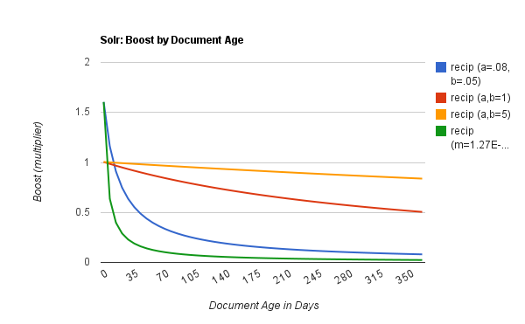
Tune Solr recip function
Notes:
A reciprocal function with recip(x,m,a,b) implementing a/(m*x+b). m,a,b are constants, x is any numeric field or arbitrarily complex function. When a and b are equal, and x>=0, this function has a maximum value of 1 that drops as x increases. Increasing the value of a and b together results in a movement of the entire function to a flatter part of the curve. These properties can make this an ideal function for boosting more recent documents – see http://wiki.apache.org/solr/FunctionQuery

Slide 9
Tips and Tricks
Boost should be a multiplier on the relevancy score
{!boost b=} syntax confuses the spell checker so you need to use spellcheck.q to be explicit
  q={!boost b=$recency v=$qq}&spellcheck.q=wine
Bottom out the old age penalty using min:
  min(recip(…), 0.20)
Not a one-size fits all solution – academic research focused on when to apply it
Notes:
identification of recency sensitive queries before ranking.
see: http://technicallypossible.wordpress.com/2011/03/13/identifying-queries-which-demand-recency-sensitive-results-in-web-search/

Slide 10

Boost by Popularity
Score based on number of unique views
Not known at indexing time
View count should be broken into time slots
Notes:
Score made of number of unique views in a time slot + avg rating / # of comments, etc.
Must be computed outside of the index; refreshed periodically
Probably don’t want to mix this with age boost as an older document might be really popular for some weird reason; think of old videos that become popular on YouTube
Age – probably not as an old doc might get popular
identification of recency sensitive queries before ranking.
see: http://technicallypossible.wordpress.com/2011/03/13/identifying-queries-which-demand-recency-sensitive-results-in-web-search/

Slide 11
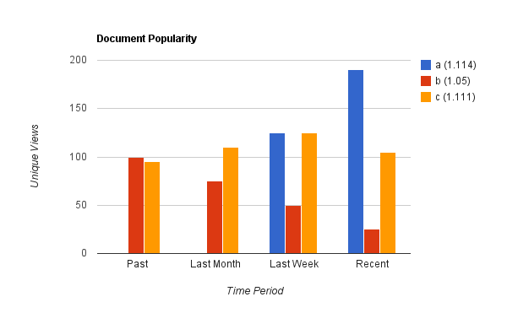
Popularity Illustrated
Notes:
Bar chart illustrates time slots
Popularity score favors more recent content
Document A is most popular; B was popular but is now on the decline and C has enjoyed consistent interest for a longer period but scores a little lower than A because of the recent interest in A

Slide 12
Solr: ExternalFileField
  In schema.xml:
  <fieldType name="externalPopularityScore"
  keyField="id"
  defVal="1"
  stored="false" indexed="false"
  class=”solr.ExternalFileField"
  valType="pfloat"/>
  <field name="popularity"
  type="externalPopularityScore" />

Slide 13
Popularity Boost: Nuts & Bolts
User activity
logged
solr-home/data/
external_popularity
Solr Server
a=1.114
b=1.05
c=1.111
…
Logs
View Counting Job
commit

Slide 14
Popularity Tips & Tricks
For big, high traffic sites, use log analysis
  Perfect problem for MapReduce
  Take a look at Hive for analyzing large volumes of log data
Minimum popularity score is 1 (not zero) … up to 2 or more
  1 + (0.4*recent + 0.3*lastWeek + 0.2*lastMonth …)
Watch out for spell checker “buildOnCommit”
Notes:
Most likely use case would be to use log-file analysis
> Ideal problem for MapReduce
Question the audience – who has heard of MapReduce?

Slide 15
Filtering By User Preferences
Easy approach is to build basic preference fields in to the index:
  Content types of interest – content_type
  High-level categories of interest - category
  Source of interest – source
We had too many categories and sources that a user could enable / disable to use basic filtering
  Custom SearchComponent with a connection to a JDBC DataSource

Slide 16
Preferences Component
Connects to a database
Caches DocIdSet in a Solr FastLRUCache
Cached values marked as dirty using a simple timestamp passed in the request
Declared in solrconfig.xml:
<searchComponent
class=“demo.solr.PreferencesComponent"
name=”pref">
<str name="jdbcJndi">jdbc/solr</str>
</searchComponent>

Slide 17
Preferences Filter
Parameters passed in the query string:
  pref.id = primary key in db
  pref.mod = preferences modified on timestamp
    So the Solr side knows the database has been updated
Use simple SQL queries to compute a list of disabled categories, feeds, and types
  Lucene FieldCaches for category, source, type
Custom SearchComponent included in the list of components for edismax search handler
    <arr name="last-components">
    <str>pref</str>
    </arr>

Slide 18

Preferences Filter in Action
Update
Preferences
Query with
pref.id=123 and
pref.mod = TS
Solr Server
User Preferences Db
Preferences Component
pref.id & pref.mod
SQL to compute
excluded categories
sources and types
LRU
Cache
If cached mod == pref.mod
read from cache

Slide 19
Wrap Up
Use recip & ms functions to boost recent documents
Use ExternalFileField to load popularity scores calculated outside the index
Use a custom SearchComponent with a Solr FastLRUCache to filter documents using complex user preferences

Slide 20
Contact
Timothy Potter
  thelabdude@gmail.com
  http://thelabdude.blogspot.com
  http://www.linkedin.com/in/thelabdude

