Slide 1
AsyncAwait
C#

Slide 2
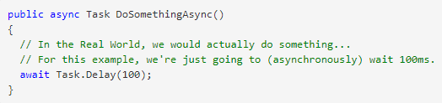
Async keyword
Notes:
The “async” keyword enables the “await” keyword in that method and changes how method results are handled. That’s all the async keyword does! It does not run this method on a thread pool thread, or do any other kind of magic. The async keyword only enables the await keyword (and manages the method results).

Slide 3
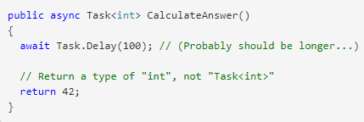
Return value

Slide 4
Context
UI context.
ASP.NET request context.
thread pool context.
Notes:
Simple answer:
If you’re on a UI thread, then it’s a UI context.
If you’re responding to an ASP.NET request, then it’s an ASP.NET request context.
Otherwise, it’s usually a thread pool context.
Complex answer:
If SynchronizationContext.Current is not null, then it’s the current SynchronizationContext. (UI and ASP.NET request contexts are SynchronizationContext contexts).
Otherwise, it’s the current TaskScheduler (TaskScheduler.Default is the thread pool context).

Slide 5
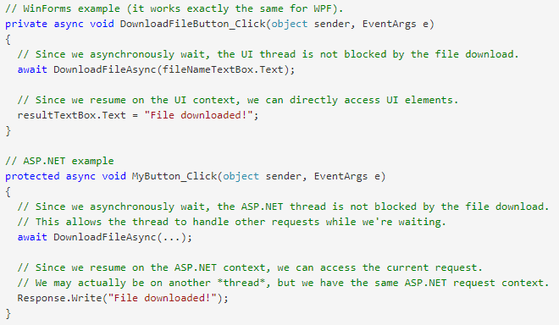
Context
Notes:
Simple answer:
If you’re on a UI thread, then it’s a UI context.
If you’re responding to an ASP.NET request, then it’s an ASP.NET request context.
Otherwise, it’s usually a thread pool context.
Complex answer:
If SynchronizationContext.Current is not null, then it’s the current SynchronizationContext. (UI and ASP.NET request contexts are SynchronizationContext contexts).
Otherwise, it’s the current TaskScheduler (TaskScheduler.Default is the thread pool context).

Slide 6
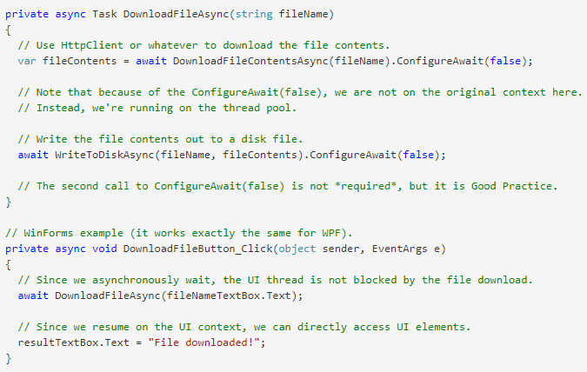
ConfigureAwait

Slide 7
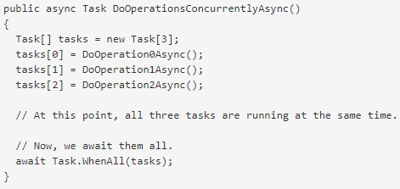
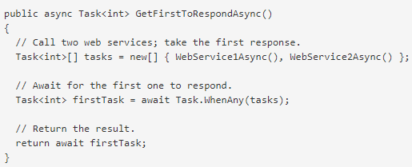
ConfigureAwait

Slide 8
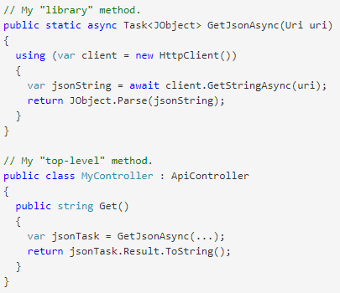
Dummy Deadlock
Notes:
The top-level method calls GetJsonAsync (within the UI/ASP.NET context).
GetJsonAsync starts the REST request by calling HttpClient.GetStringAsync (still within the context).
GetStringAsync returns an uncompleted Task, indicating the REST request is not complete.
GetJsonAsync awaits the Task returned by GetStringAsync. The context is captured and will be used to continue running the GetJsonAsync method later. GetJsonAsync returns an uncompleted Task, indicating that the GetJsonAsync method is not complete.
The top-level method synchronously blocks on the Task returned by GetJsonAsync. This blocks the context thread.
… Eventually, the REST request will complete. This completes the Task that was returned by GetStringAsync.
The continuation for GetJsonAsync is now ready to run, and it waits for the context to be available so it can execute in the context.
Deadlock. The top-level method is blocking the context thread, waiting for GetJsonAsync to complete, and GetJsonAsync is waiting for the context to be free so it can complete.

Slide 9
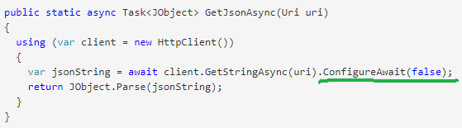
Dummy Deadlock
Notes:
The top-level method calls GetJsonAsync (within the UI/ASP.NET context).
GetJsonAsync starts the REST request by calling HttpClient.GetStringAsync (still within the context).
GetStringAsync returns an uncompleted Task, indicating the REST request is not complete.
GetJsonAsync awaits the Task returned by GetStringAsync. The context is captured and will be used to continue running the GetJsonAsync method later. GetJsonAsync returns an uncompleted Task, indicating that the GetJsonAsync method is not complete.
The top-level method synchronously blocks on the Task returned by GetJsonAsync. This blocks the context thread.
… Eventually, the REST request will complete. This completes the Task that was returned by GetStringAsync.
The continuation for GetJsonAsync is now ready to run, and it waits for the context to be available so it can execute in the context.
Deadlock. The top-level method is blocking the context thread, waiting for GetJsonAsync to complete, and GetJsonAsync is waiting for the context to be free so it can complete.

Slide 10
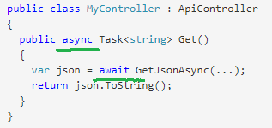
Dummy Deadlock
Notes:
The top-level method calls GetJsonAsync (within the UI/ASP.NET context).
GetJsonAsync starts the REST request by calling HttpClient.GetStringAsync (still within the context).
GetStringAsync returns an uncompleted Task, indicating the REST request is not complete.
GetJsonAsync awaits the Task returned by GetStringAsync. The context is captured and will be used to continue running the GetJsonAsync method later. GetJsonAsync returns an uncompleted Task, indicating that the GetJsonAsync method is not complete.
The top-level method synchronously blocks on the Task returned by GetJsonAsync. This blocks the context thread.
… Eventually, the REST request will complete. This completes the Task that was returned by GetStringAsync.
The continuation for GetJsonAsync is now ready to run, and it waits for the context to be available so it can execute in the context.
Deadlock. The top-level method is blocking the context thread, waiting for GetJsonAsync to complete, and GetJsonAsync is waiting for the context to be free so it can complete.

Slide 11
Dummy Deadlock
Notes:
The top-level method calls GetJsonAsync (within the UI/ASP.NET context).
GetJsonAsync starts the REST request by calling HttpClient.GetStringAsync (still within the context).
GetStringAsync returns an uncompleted Task, indicating the REST request is not complete.
GetJsonAsync awaits the Task returned by GetStringAsync. The context is captured and will be used to continue running the GetJsonAsync method later. GetJsonAsync returns an uncompleted Task, indicating that the GetJsonAsync method is not complete.
The top-level method synchronously blocks on the Task returned by GetJsonAsync. This blocks the context thread.
… Eventually, the REST request will complete. This completes the Task that was returned by GetStringAsync.
The continuation for GetJsonAsync is now ready to run, and it waits for the context to be available so it can execute in the context.
Deadlock. The top-level method is blocking the context thread, waiting for GetJsonAsync to complete, and GetJsonAsync is waiting for the context to be free so it can complete.

