Slide 1
Life Cycle
One Task Story

Slide 2
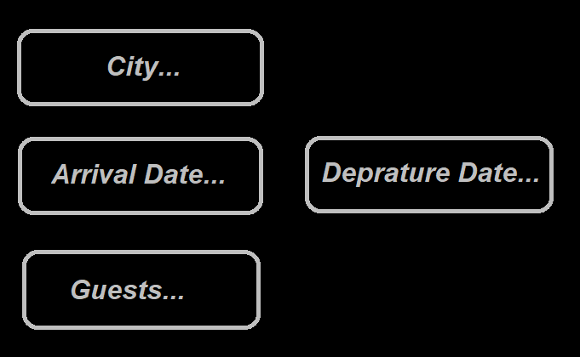
BookLook

Slide 3


New Query – Reference Point

Slide 4
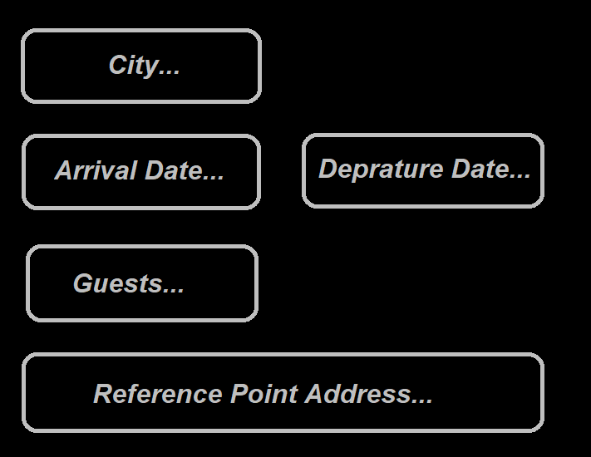

New Query – Reference Point .v1

Slide 5
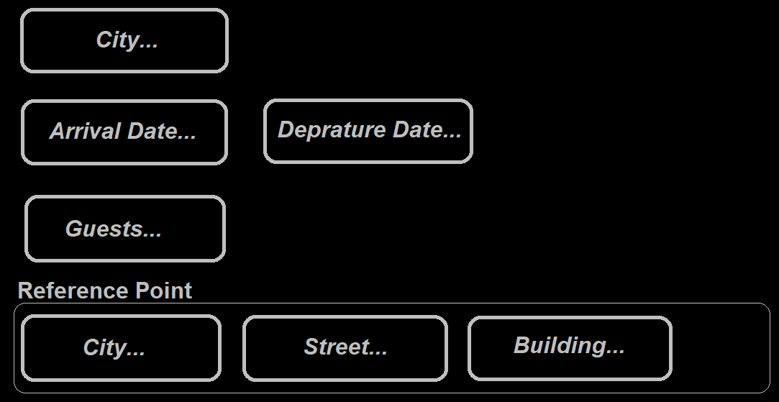

New Query – Reference Point .v2

Slide 6

New Query – Reference Point .v2

Slide 7



New Query – Reference Point .v2

Slide 8
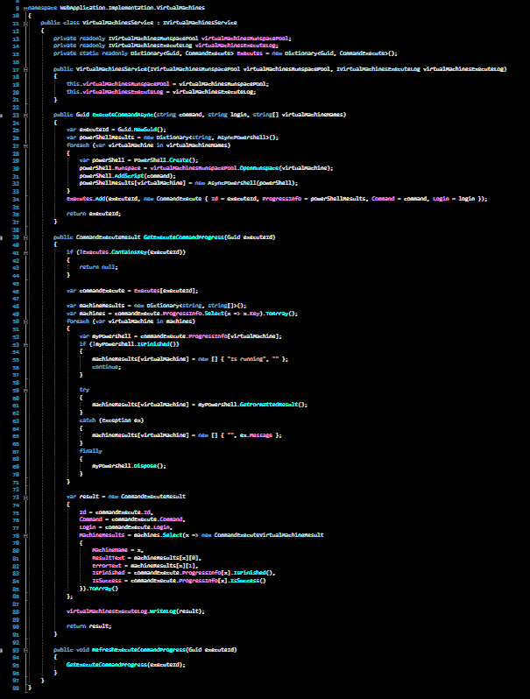


New Query – Reference Point .v2

Slide 9

New Query – Reference Point .v3

Slide 10
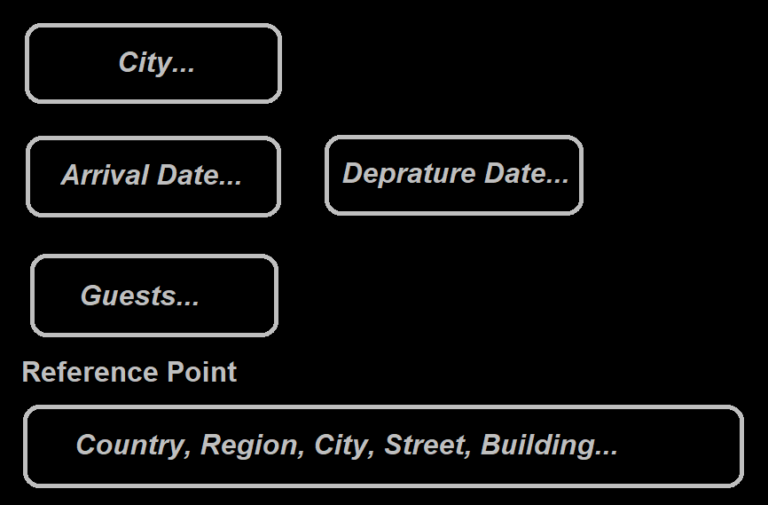
New Query – Reference Point .v3

Slide 11
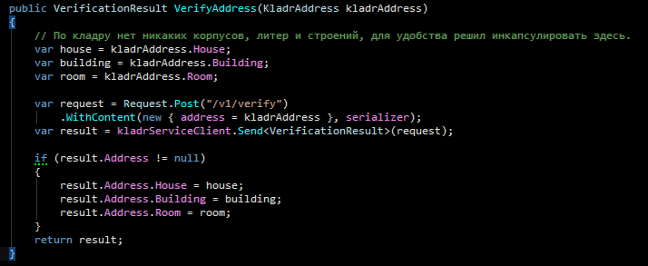

New Query – Reference Point .v3

Slide 12
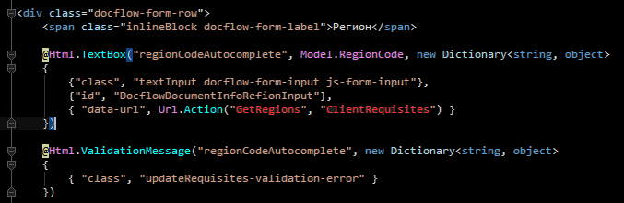
New Query – Reference Point .v3

Slide 13


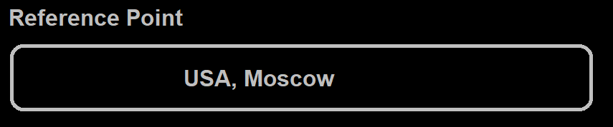

New Query – Reference Point .v3

Slide 14
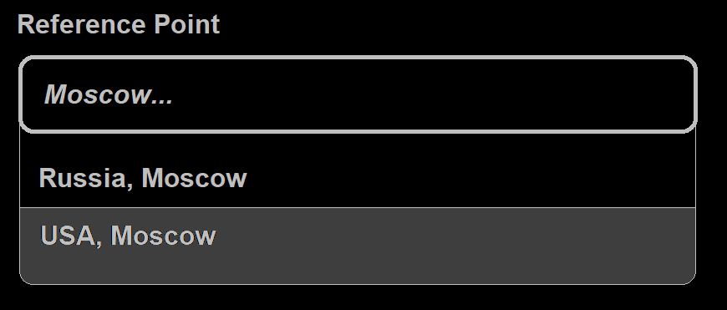
New Query – Reference Point .v4

Slide 15
New Query – Reference Point .v4

Slide 16
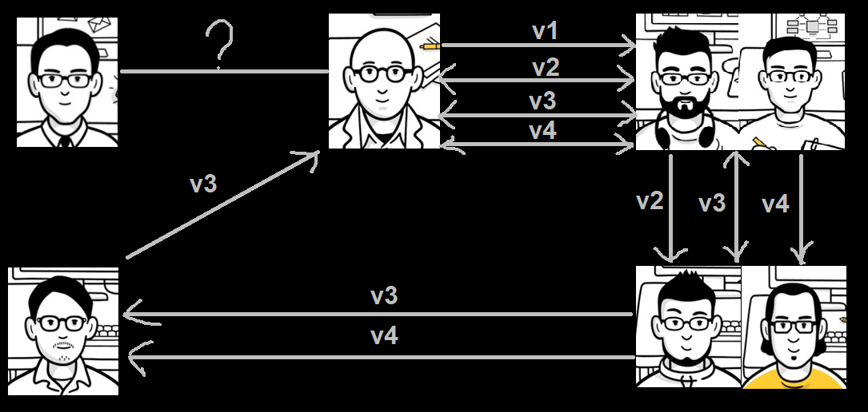
New Query – Retrospective

