Slide 1
MultiThreading
acync

Slide 2
SyncModel.SingleThread

Slide 3
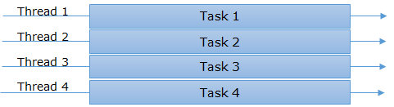
SyncModel.MultiThread

Slide 4
A-SyncModel.SingleThread

Slide 5
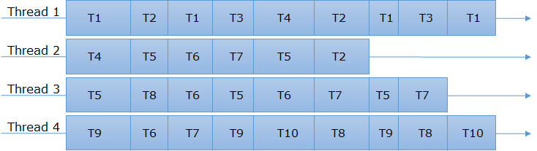
A-SyncModel.MultiThread

Slide 6
Threading Uses
Maintaining a responsive user interface
Making efficient use of an otherwise blocked CPU
Parallel programming
Speculative execution
Allowing requests to be processed simultaneously
Notes:
Maintaining a responsive user interface
By running time-consuming tasks on a parallel “worker” thread, the main UI thread is free to continue processing keyboard and mouse events.
Making efficient use of an otherwise blocked CPU
Multithreading is useful when a thread is awaiting a response from another computer or piece of hardware. While one thread is blocked while performing the task, other threads can take advantage of the otherwise unburdened computer.
Parallel programming
Code that performs intensive calculations can execute faster on multicore or multiprocessor computers if the workload is shared among multiple threads in a “divide-and-conquer” strategy (see Part 5).
Speculative execution
On multicore machines, you can sometimes improve performance by predicting something that might need to be done, and then doing it ahead of time. LINQPad uses this technique to speed up the creation of new queries. A variation is to run a number of different algorithms in parallel that all solve the same task. Whichever one finishes first “wins” — this is effective when you can’t know ahead of time which algorithm will execute fastest.
Allowing requests to be processed simultaneously
On a server, client requests can arrive concurrently and so need to be handled in parallel (the .NET Framework creates threads for this automatically if you use ASP.NET, WCF, Web Services, or Remoting). This can also be useful on a client (e.g., handling peer-to-peer networking — or even multiple requests from the user).

Slide 7
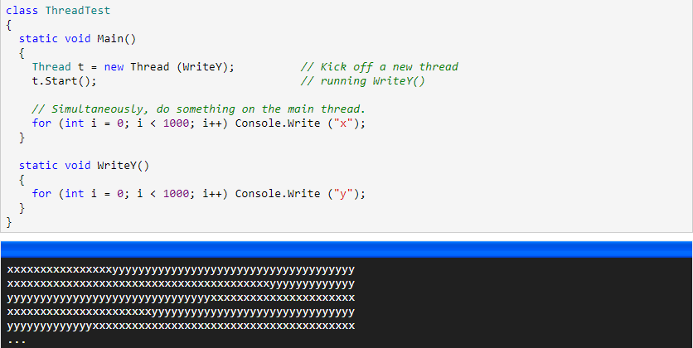
Threads

Slide 8
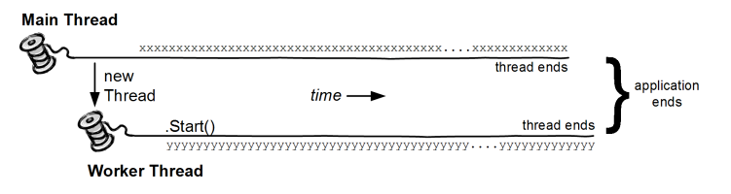
Threads

Slide 9
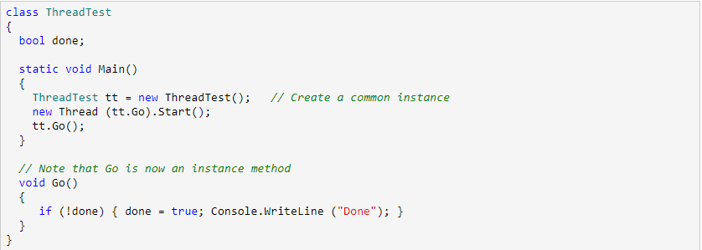
Two Threads

Slide 10
Two Threads
Notes:
It is author’s mistake

Slide 11
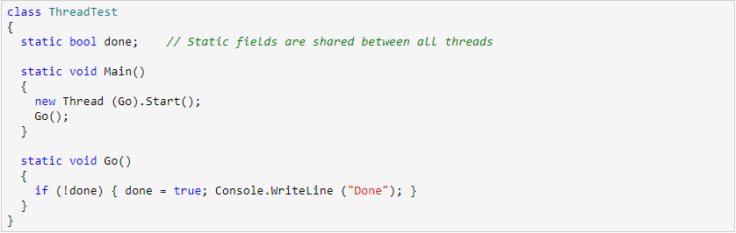
Two Threads static

Slide 12
Two Threads static

Slide 13
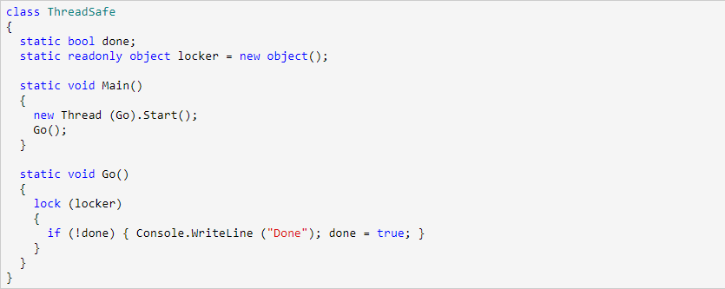
Two Threads static with Lock

Slide 14
Practice

Slide 15
Practice

Slide 16

Practice

Slide 17
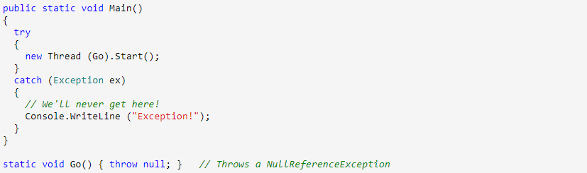
Exceptions

Slide 18
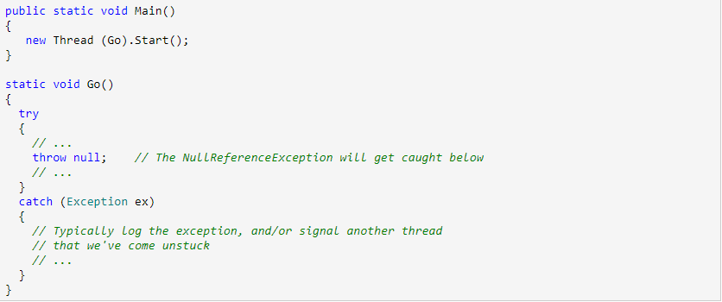
Exceptions

Slide 19
Thread Pooling - Why?
Whenever you start a thread, a few hundred microseconds are spent
keeps a lid on the total number of worker threads
Notes:
Whenever you start a thread, a few hundred microseconds are spent organizing such things as a fresh private local variable stack. Each thread also consumes (by default) around 1 MB of memory. The thread pool cuts these overheads by sharing and recycling threads, allowing multithreading to be applied at a very granular level without a performance penalty. This is useful when leveraging multicore processors to execute computationally intensive code in parallel in “divide-and-conquer” style.
The thread pool also keeps a lid on the total number of worker threads it will run simultaneously. Too many active threads throttle the operating system with administrative burden and render CPU caches ineffective. Once a limit is reached, jobs queue up and start only when another finishes. This makes arbitrarily concurrent applications possible, such as a web server. (The asynchronous method pattern is an advanced technique that takes this further by making highly efficient use of the pooled threads; we describe this in Chapter 23 of C# 4.0 in a Nutshell).

Slide 20
Thread Pooling - Ways
Via the Task Parallel Library (from Framework 4.0)
By calling ThreadPool.QueueUserWorkItem
Via asynchronous delegates

Slide 21
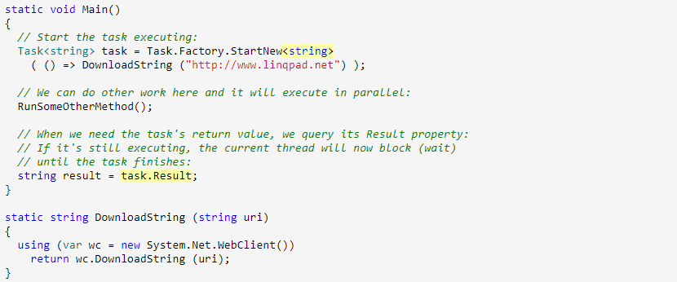
Thread Pooling - TPL
Notes:
HandlingExceptions
Any unhandled exceptions are conveniently rethrown onto the host thread when you call a task's Wait method. (If you don’t call Wait and instead abandon the task, an unhandled exception will shut down the process as with an ordinary thread.)

Slide 22
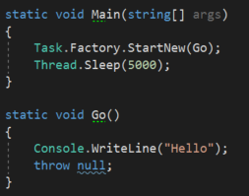

Thread Pooling - Exceptions
Notes:
HandlingExceptions
Any unhandled exceptions are conveniently rethrown onto the host thread when you call a task's Wait method. (If you don’t call Wait and instead abandon the task, an unhandled exception will shut down the process as with an ordinary thread.)

Slide 23
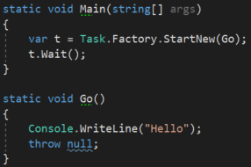

Thread Pooling - Exceptions
Notes:
HandlingExceptions
Any unhandled exceptions are conveniently rethrown onto the host thread when you call a task's Wait method. (If you don’t call Wait and instead abandon the task, an unhandled exception will shut down the process as with an ordinary thread.)

Slide 24
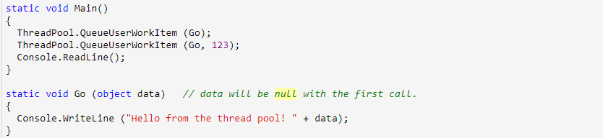
Thread Pooling - QueueUserWorkItem
Notes:
HandlingExceptions

Slide 25
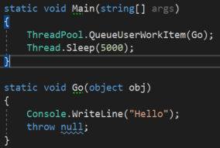

Thread Pooling - QueueUserWorkItem
Notes:
HandlingExceptions
Any unhandled exceptions are conveniently rethrown onto the host thread when you call a task's Wait method. (If you don’t call Wait and instead abandon the task, an unhandled exception will shut down the process as with an ordinary thread.)

Slide 26
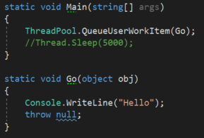

Thread Pooling - QueueUserWorkItem
Notes:
HandlingExceptions
Any unhandled exceptions are conveniently rethrown onto the host thread when you call a task's Wait method. (If you don’t call Wait and instead abandon the task, an unhandled exception will shut down the process as with an ordinary thread.)

Slide 27
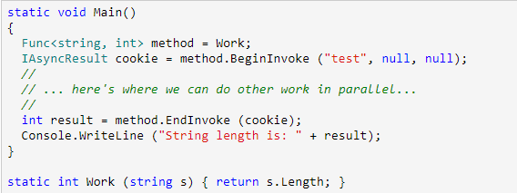
Thread Pooling – Asynchronous delegate

Slide 28
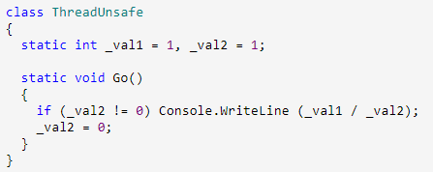
Locking

Slide 29
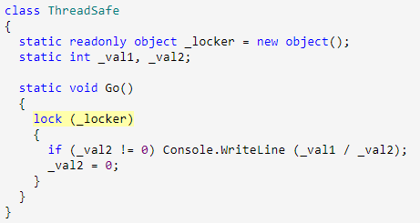
Locking

Slide 30
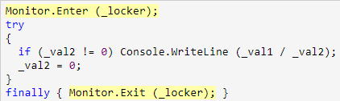
Locking
Notes:
The lockTaken overloads
The code that we just demonstrated is exactly what the C# 1.0, 2.0, and 3.0 compilers produce in translating a lock statement.
There’s a subtle vulnerability in this code, however. Consider the (unlikely) event of an exception being thrown within the implementation of Monitor.Enter, or between the call to Monitor.Enter and the try block (due, perhaps, to Abort being called on that thread — or an OutOfMemoryException being thrown). In such a scenario, the lock may or may not be taken. If the lock is taken, it won’t be released — because we’ll never enter the try/finally block. This will result in a leaked lock.

Slide 31
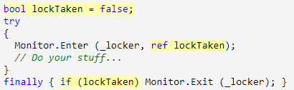
Locking
Notes:
The lockTaken overloads
The code that we just demonstrated is exactly what the C# 1.0, 2.0, and 3.0 compilers produce in translating a lock statement.
There’s a subtle vulnerability in this code, however. Consider the (unlikely) event of an exception being thrown within the implementation of Monitor.Enter, or between the call to Monitor.Enter and the try block (due, perhaps, to Abort being called on that thread — or an OutOfMemoryException being thrown). In such a scenario, the lock may or may not be taken. If the lock is taken, it won’t be released — because we’ll never enter the try/finally block. This will result in a leaked lock.

Slide 32
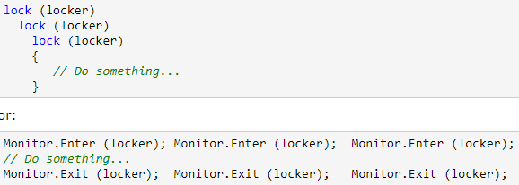
Locking

Slide 33
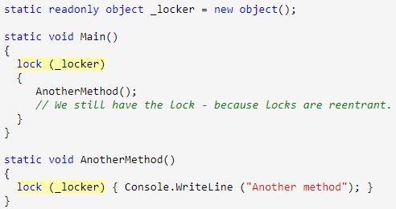
Locking

Slide 34
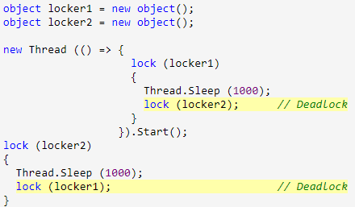
Deadlock

Slide 35
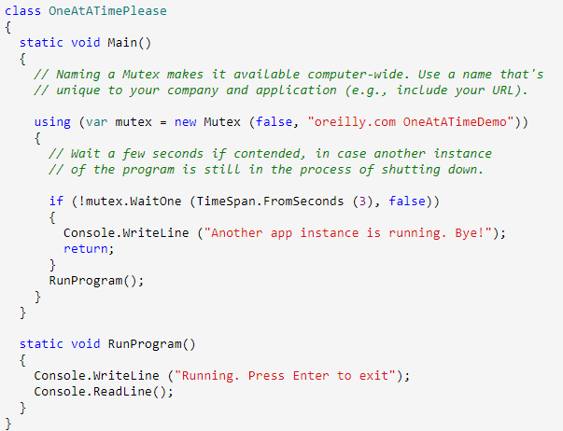
Mutex

Slide 36
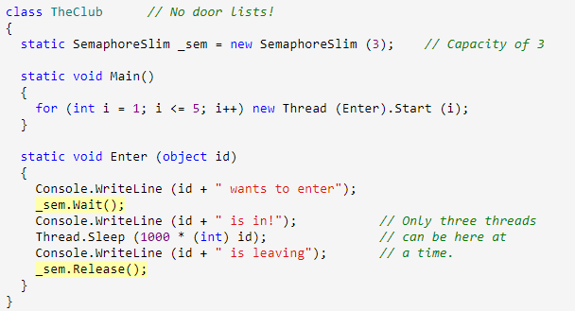
Semaphore

Slide 37
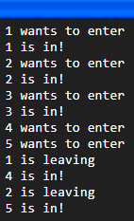
Semaphore

Slide 38
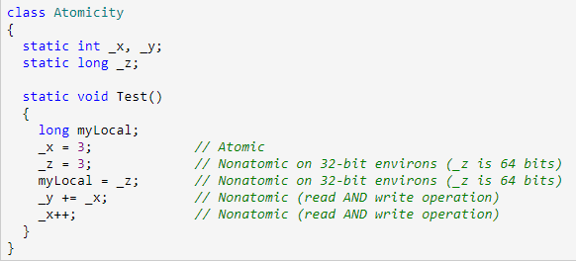
Interlocked

Slide 39

Interlocked
Notes:
_x can be not a zero

Slide 40
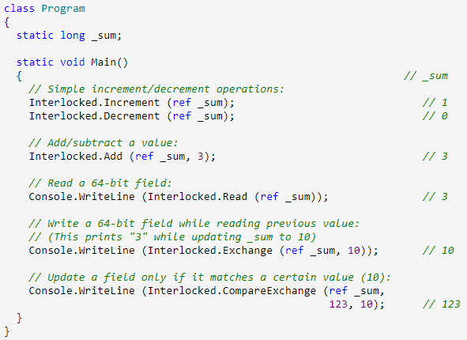
Interlocked
Notes:
_x can be not a zero

Slide 41
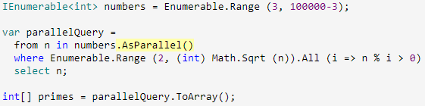
PLINQ
Notes:
_x can be not a zero

Slide 42
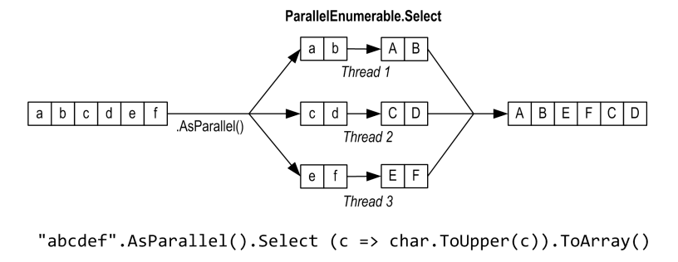
PLINQ
Notes:
_x can be not a zero

Slide 43
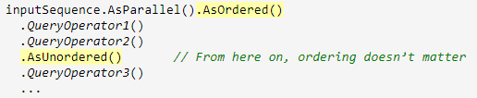
PLINQ
Notes:
_x can be not a zero

