Slide 1
Predictive Models for Fetal Health
Classifying CTG recordings as Normal, Suspect or Pathological
DataLab Analytics Final Project | Sheriff Olalekan Ayoola | Supervisor: Oyeleke Olayemi

Slide 2
The problem and our objective
Preventable fetal and maternal deaths remain high in low-resource settings, often because distress is detected late.
CTG devices are cheap, but reading them correctly needs trained staff who are scarce.
Objective: build a model that classifies a CTG recording as Normal (1), Suspect (2) or Pathological (3) and deploy it as a simple web app returning probabilities.
Success metrics
Recall (Pathological)
Never miss a distressed fetus
Macro F1-score
Fair across all 3 classes
Macro precision
Limit false alarms
ROC-AUC (one-vs-rest)
Class separation quality
1

Slide 3
Data preparation: a clean, leak-free pipeline
2,126
0
13
80/20
recordings, 21 CTG features + target
missing values, all numeric
duplicates removed
stratified split before any fitting
Negative values appear only in histogram_tendency (-1/0/1 codes), so they are valid and kept.
No categorical predictors, so no encoding needed; the target is already numeric.
Outliers detected with the IQR rule; continuous features winsorised at the 0.5/99.5 percentile using training data only. Sparse event counts left untouched.
Scaler, SMOTE and feature selection are all fitted on the training set only, so no information leaks from the test set.
2

Slide 4
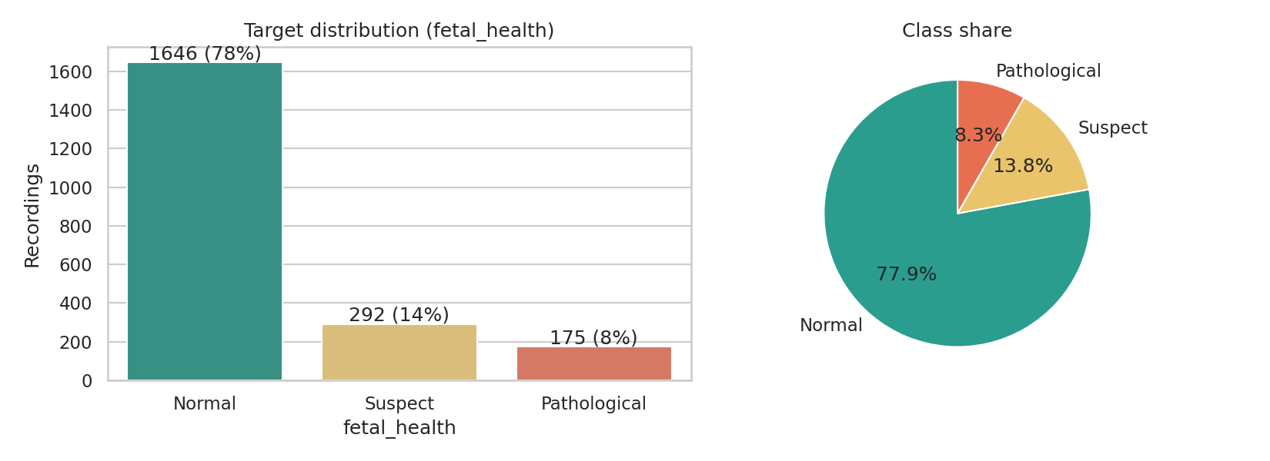
The target is imbalanced
About 78% Normal, 14% Suspect, 8% Pathological. A model that always says "Normal" would score ~78% accuracy yet miss every at-risk fetus. We therefore judge models on recall, macro-F1 and AUC, and balance the training set with SMOTE.
3

Slide 5
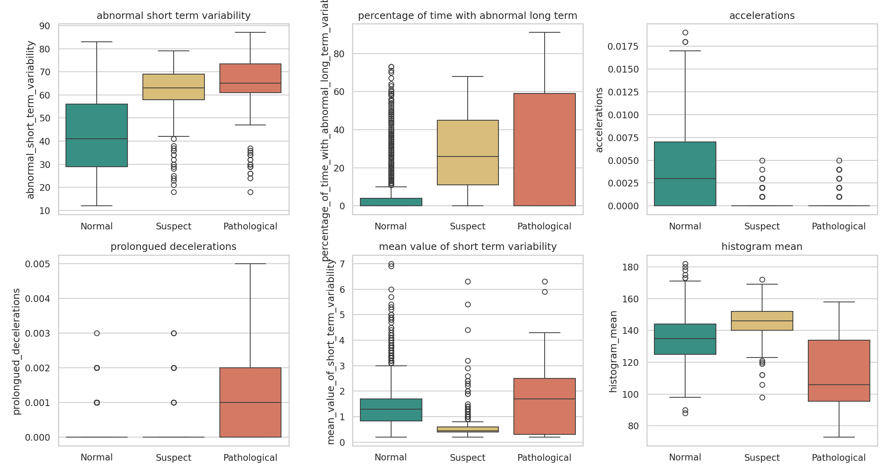
Abnormal patterns separate the classes
Abnormal short-term variability: ~43% in Normal vs ~62-65% in Suspect/Pathological.
Accelerations present in ~70% of Normal recordings but only ~16-17% of the others.
Prolonged decelerations occur in ~54% of Pathological cases vs ~4-5% of the rest.
4

Slide 6
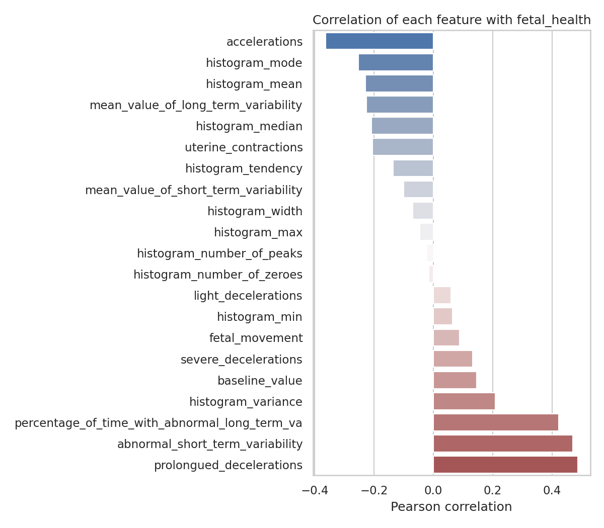
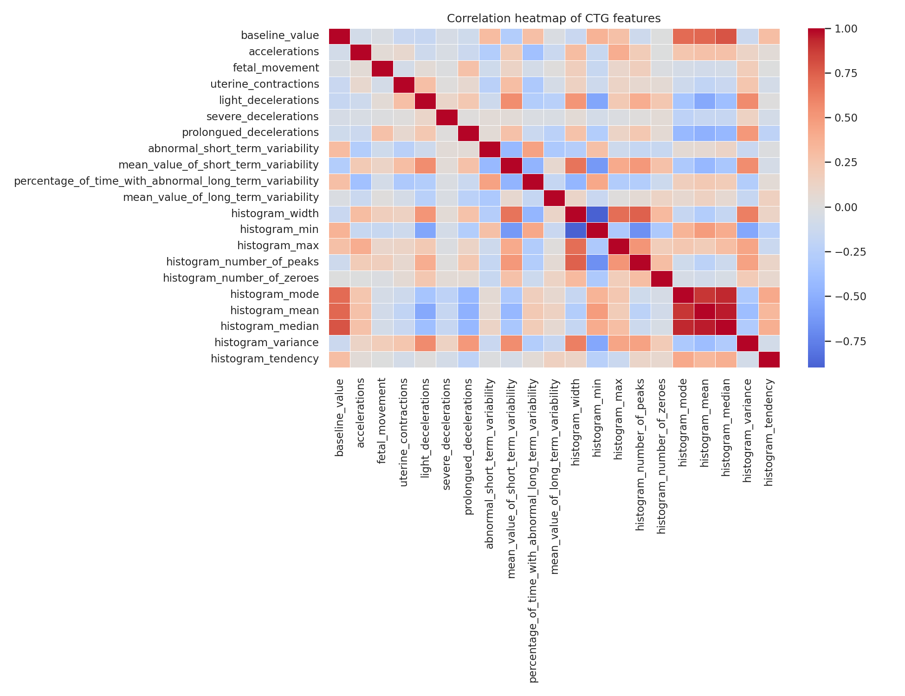
Which signals relate to fetal health?
Strongest links with worse outcomes: prolonged decelerations (0.49), abnormal short-term variability (0.47) and abnormal long-term variability (0.42). Histogram mean/median/mode are highly redundant (r up to 0.95).
5

Slide 7
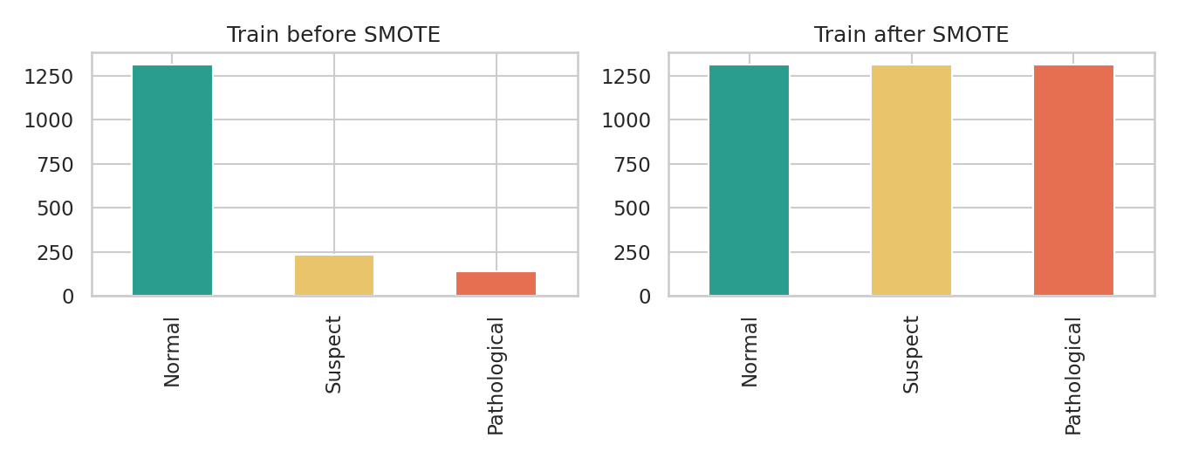
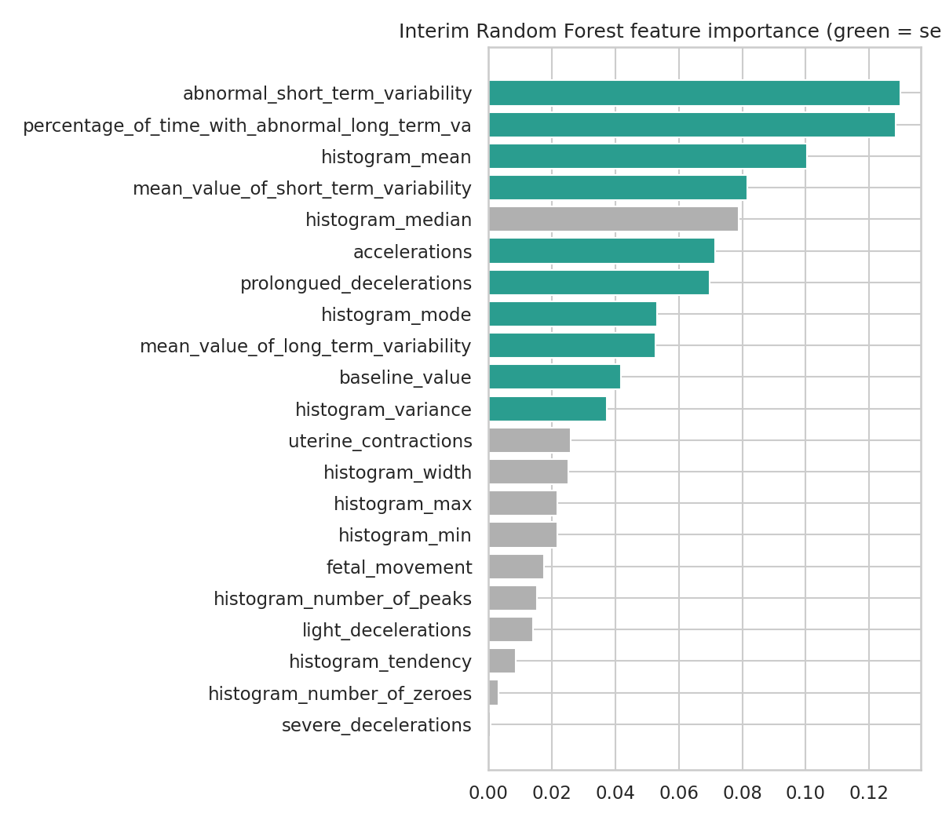
Scaling, SMOTE and feature selection
StandardScaler fitted on train only, then applied to test.
SMOTE on scaled train only: 1316 / 234 / 140 became 1316 / 1316 / 1316. Test set left untouched.
Random Forest importance plus domain knowledge kept 10 of 21 features and dropped the redundant histogram_median.
6

Slide 8
Four models compared on unseen test data
Tree ensembles clearly beat the simpler models; Logistic Regression is weakest (non-linear patterns).
Random Forest: best 5-fold CV macro-F1 (0.888) and top AUC, so it was tuned and deployed.
Final tuned Random Forest: accuracy 94.1%, macro-F1 0.90, AUC 0.985.
7

Slide 9
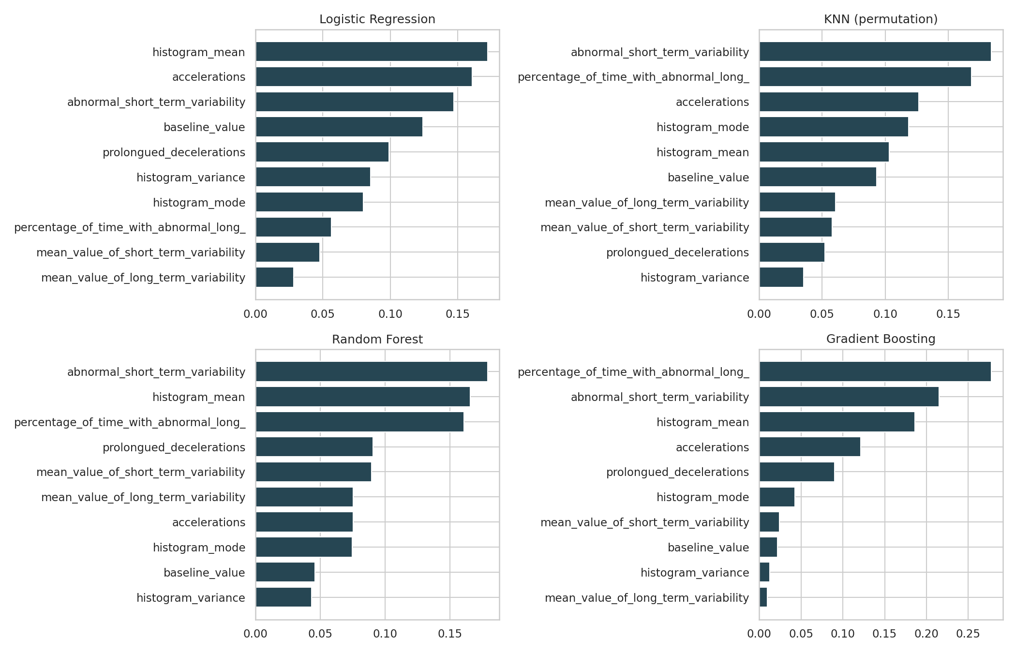
What drives the predictions
All four models rely on the signals clinicians watch: abnormal short- and long-term variability, histogram mean, accelerations and prolonged decelerations. This makes the predictions clinically sensible.
8

Slide 10
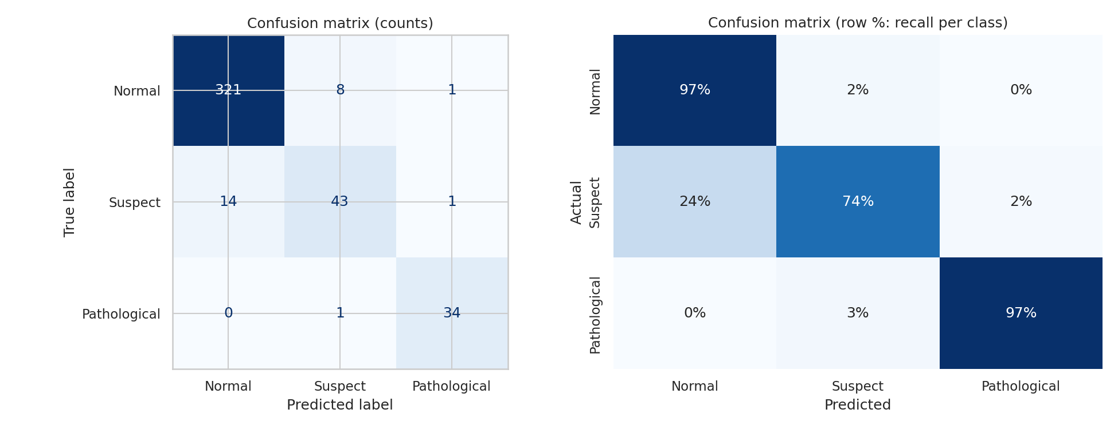
Confusion matrix: 97% of Pathological cases caught
34 of 35 Pathological cases detected; none predicted as Normal.
Normal: 321 of 330 correct.
Weak spot: Suspect (74% recall). 14 of 58 were labelled Normal, as this class is the borderline zone.
Precision / recall / F1: Normal 0.96 / 0.97 / 0.97 Suspect 0.83 / 0.74 / 0.78 Pathological 0.94 / 0.97 / 0.96
9

Slide 11
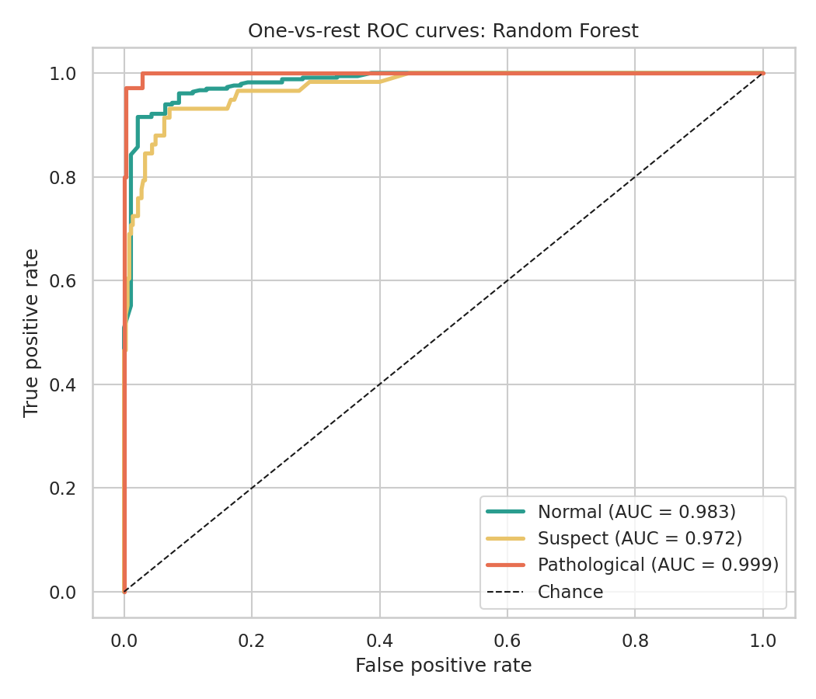
ROC curves: excellent class separation
0.999
Pathological AUC
0.983
Normal AUC
0.972
Suspect AUC
0.5 = random guessing. All three classes exceed 0.97.
10

Slide 12
Deployment: Streamlit web app prototype
1
2
3
Enter 10 CTG measurements
Click Predict
Read probabilities
Number inputs pre-filled with typical values
Same clipping and scaling as training, then Random Forest
e.g. "The model predicts a 98.5% probability the status is Pathological"
Outputs probabilities for Normal, Suspect and Pathological, colour-coded green/amber/red.
Suspect or Pathological results prompt urgent clinician review.
Run locally with: streamlit run app.py
11

Slide 13
Recommendations
Use as decision support
Flag recordings for urgent review; never replace a clinician.
Escalate Suspect cases
The least reliable class: any Suspect or Pathological probability should trigger human follow-up.
Train staff on key signals
Variability, prolonged decelerations and missing accelerations drive risk.
Validate locally first
Test on local clinic data and keep monitoring performance over time.
Improve the model
Gather more Suspect/Pathological cases; try XGBoost, calibration and threshold tuning.
12

Slide 14
Conclusion
94%
0.90
97%
0.985
test accuracy
macro F1
Pathological recall
macro ROC-AUC
A tuned Random Forest on 10 clinically meaningful CTG features reliably flags Pathological recordings, with no Pathological case predicted as Normal in testing. Suspect cases remain the hardest to separate. The model is a prototype for decision support and needs local clinical validation before real use.

