Slide 1







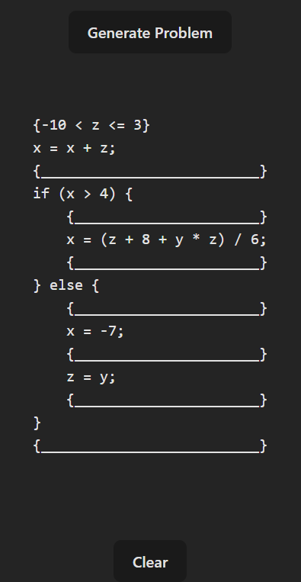
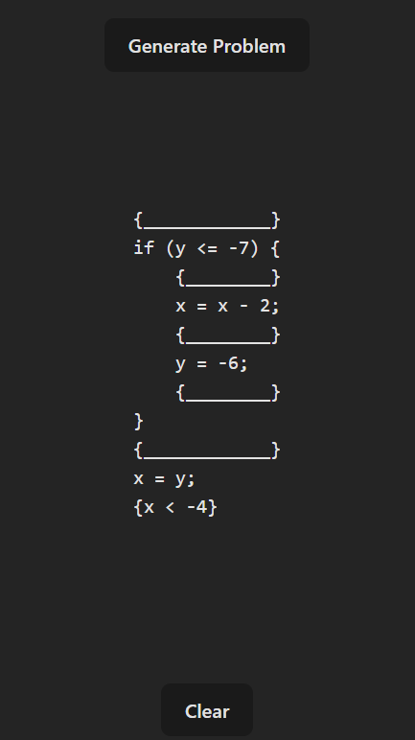

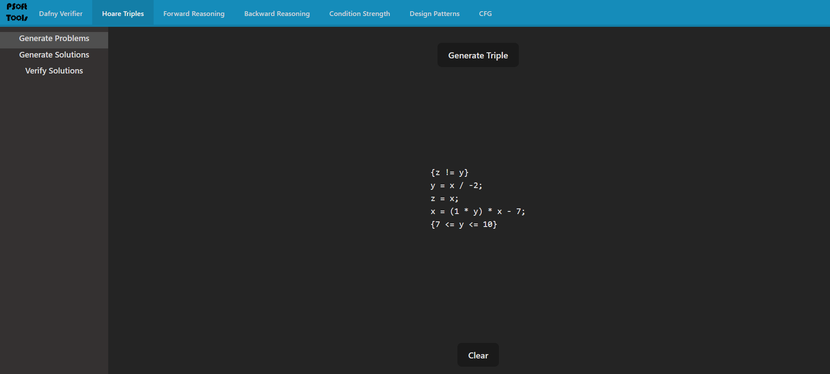
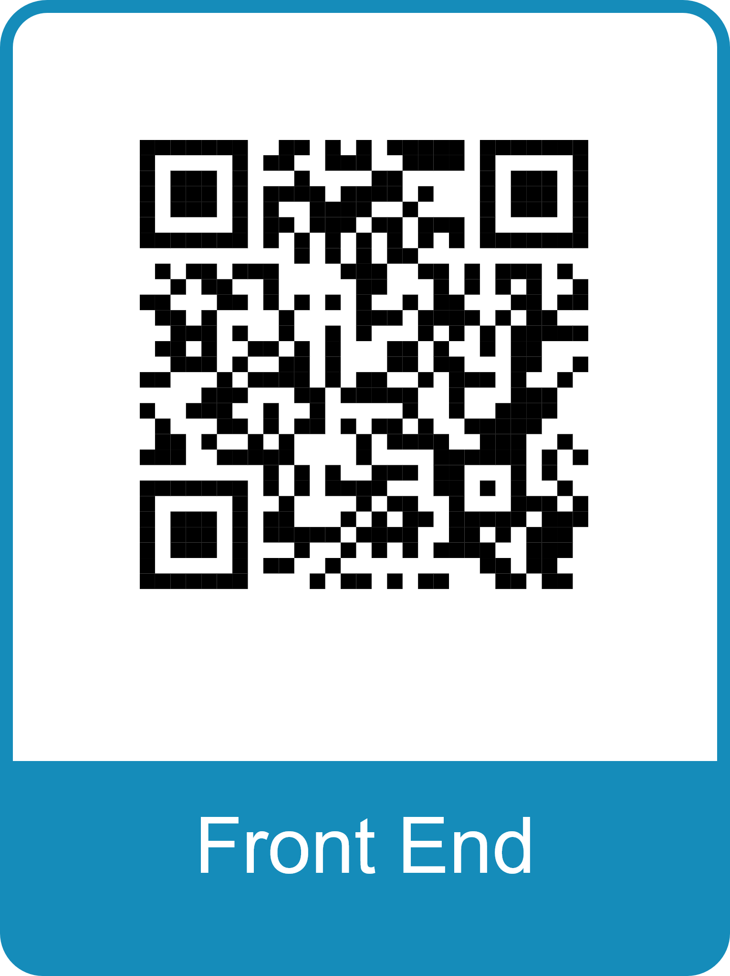
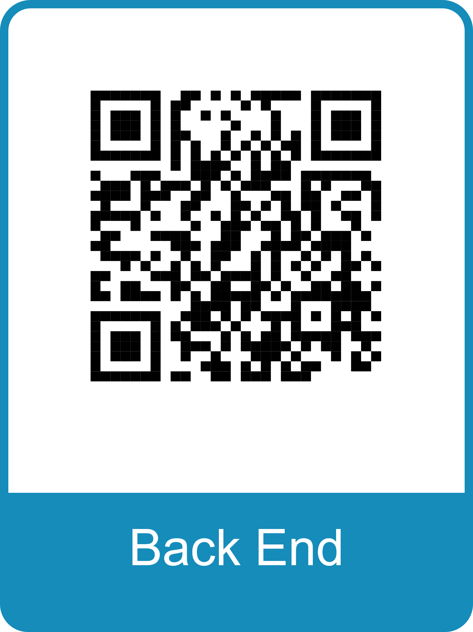
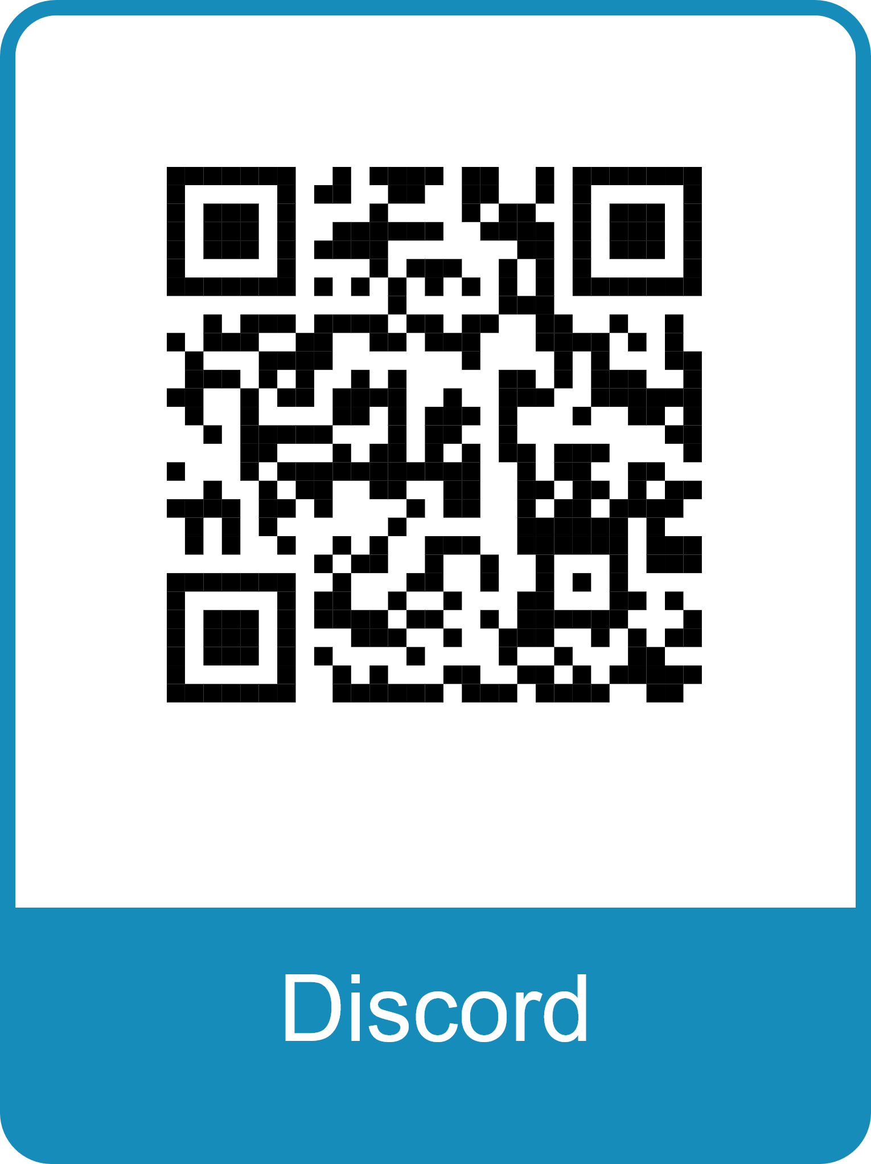
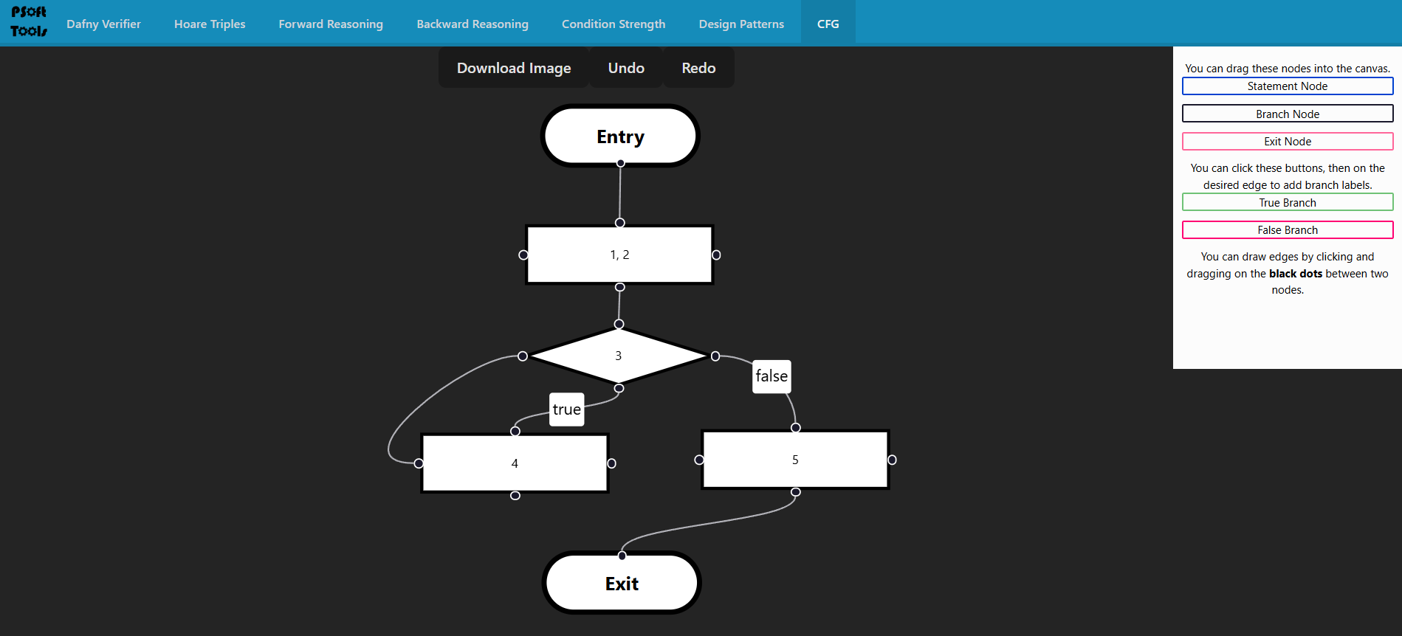
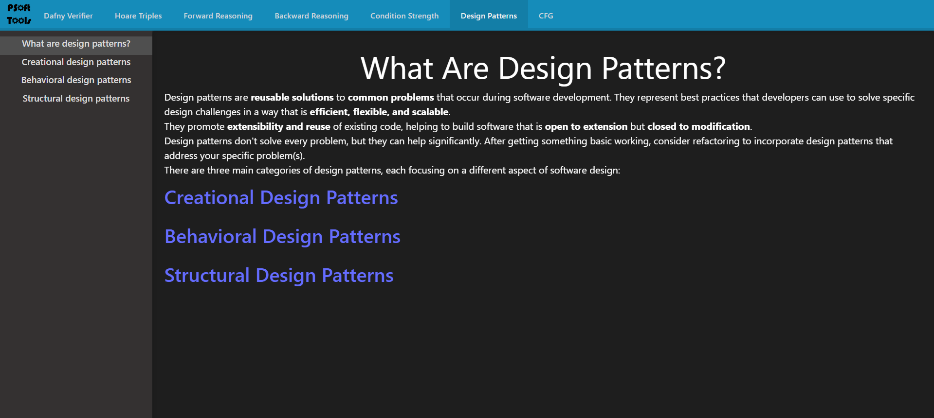
*Special thanks to Prof. Kuzmin!
Project Lead: Cal Hiffa
Members: Tyler Hunt, Nathaniel Viana, Kevin Lukash
PSOFT TOOLS Overview
BACK END
FRONT END
FUTURE PLANS
Our goal is to create an interactive web tool to assist students taking Principles of Software.
Tech Stack
Front end: React, Vite, Tailwind
Back end: Express.js, Python
Semester Goals
Implement tools for Hoare triples, forward and backwards reasoning, condition strength and CFGs
Host the website on a server so it can be accessed by students
Improve the appearance of the website
Our accomplishments this semester:
Improved server-side communication
Completed forwards and backwards reasoning practice problem generation
Started forwards and backwards reasoning verification
Improved documentation
Our accomplishments this semester:
Refined styling across pages
Updated Design Patterns pages and fleshed out with more information
Added pages for generation and verification of triples and reasoning
Display output for our reasoning and triple generators
Made the CFG page more user-friendly and visually appealing
Laid the groundwork for implementation of the condition strength tool
Improved documentation
Front end
Continue to improve the overall appearance of website
Finish setting up pages for all course content
Back end
Finish forward and backwards reasoning verification
Implement condition strength comparisons
Host the backend on a server for ease of accessibility by students
CHALLENGES
Lack of in-depth documentation from previous developers
Lack of experience with front end development among some members
Some members learning or relearning PSoft concepts during the project
CONNECT WITH US

