Slide 1
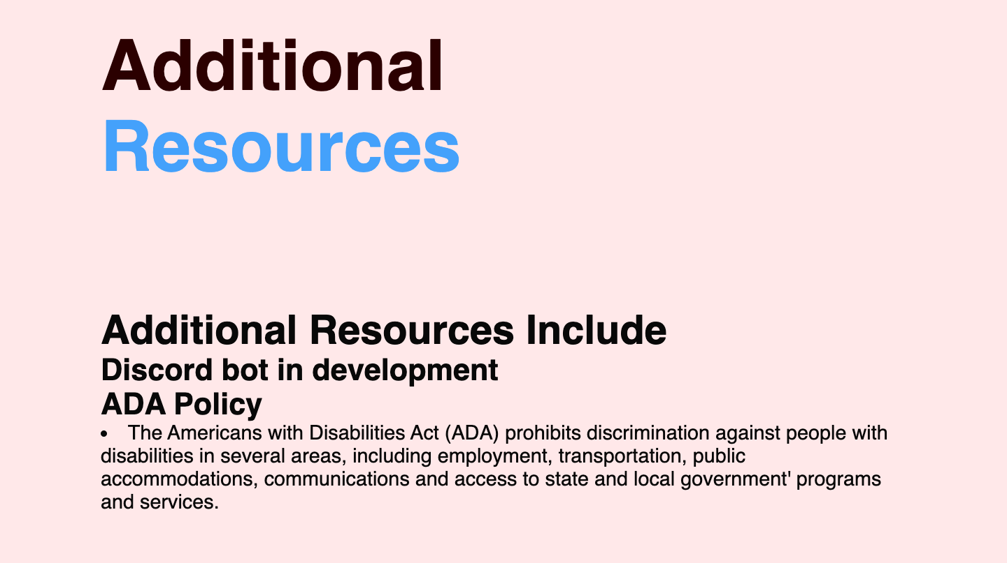
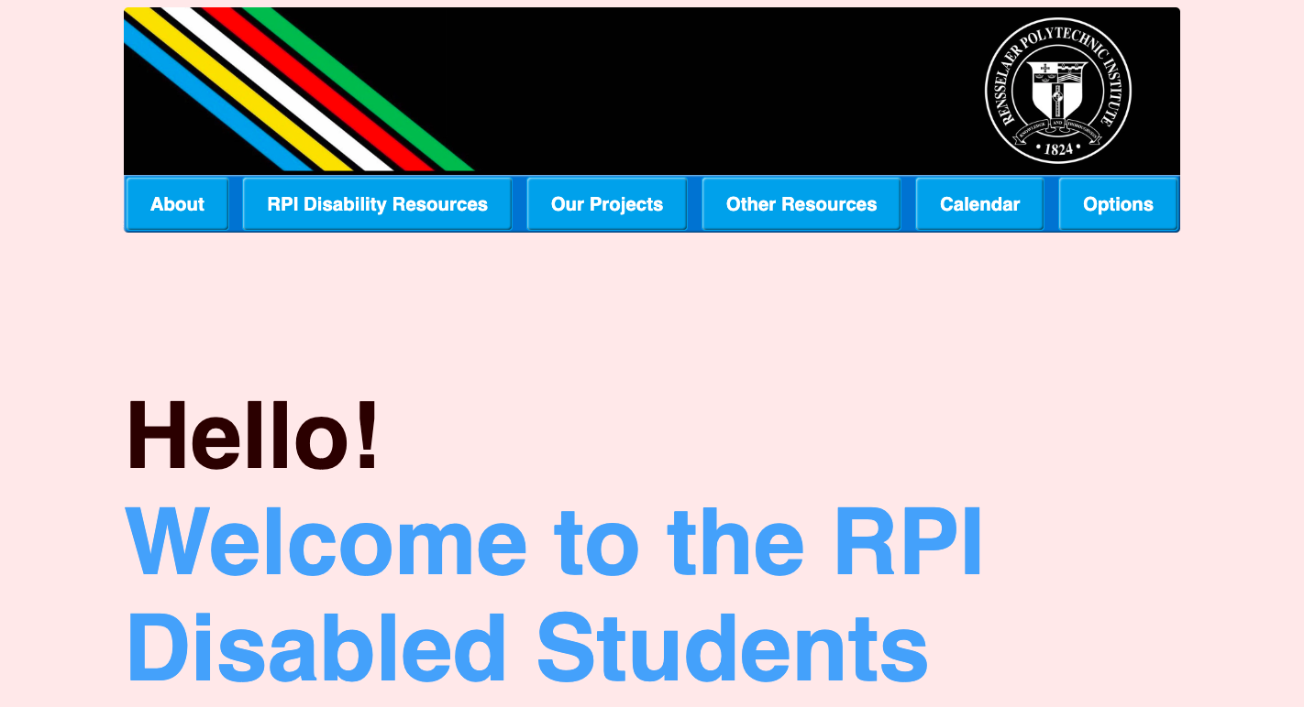
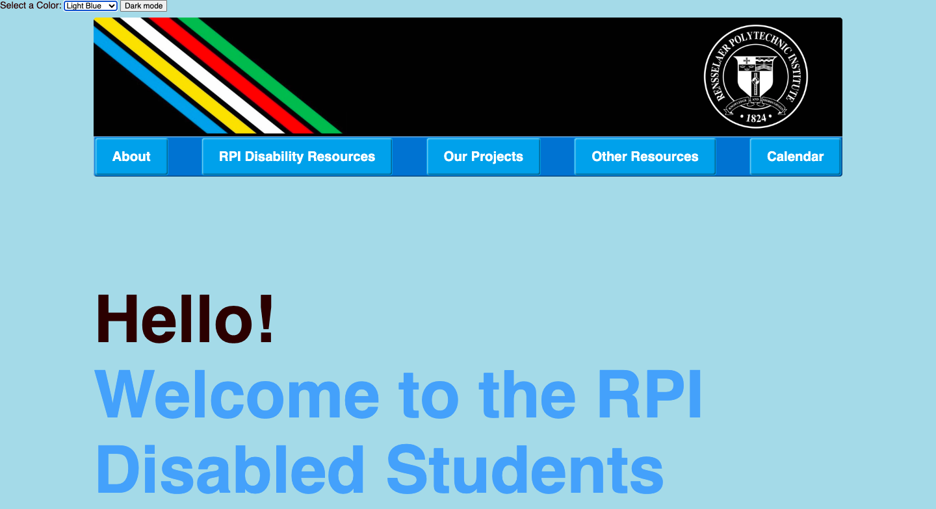
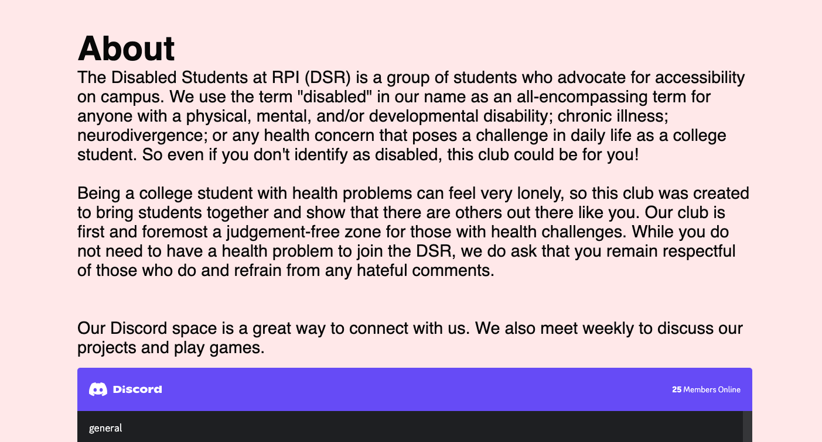
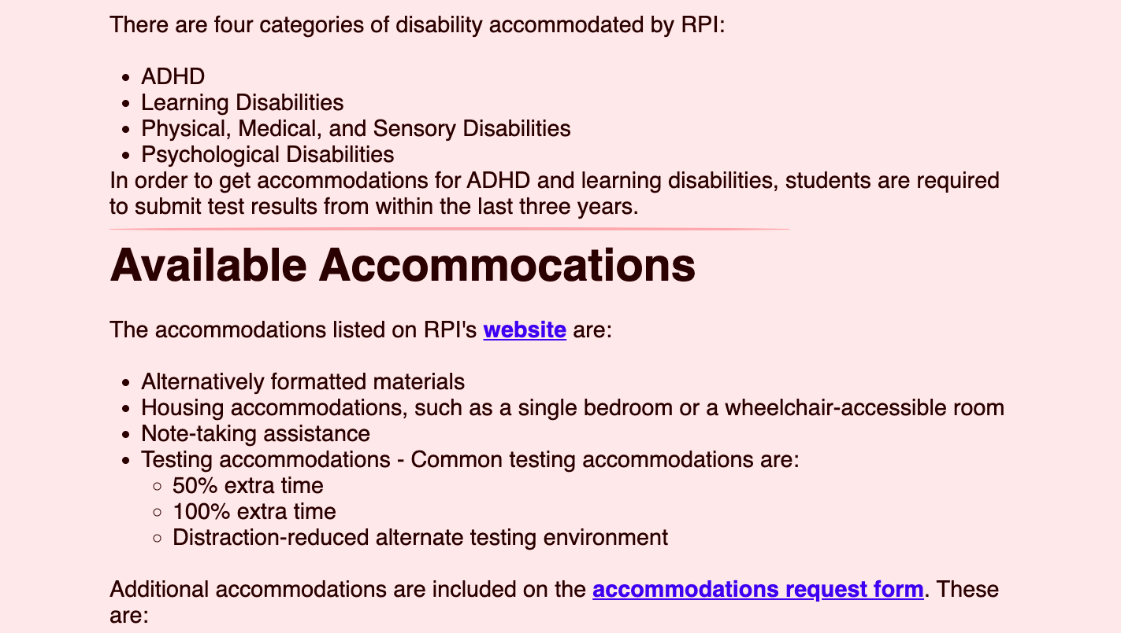
DSR Website
Cal/Mary Hiffa, Arthik Dasari, Hayden Diver
Empowering Inclusivity: An Accessible Website for All.
Introduction
Website Overview
Accessibility Standards Compliance
Future Developments
The DSR Website project team aims to create a fully accessible site to be utilized by the Disabled Students at RPI club. Using our site, students will be able to see club information in one convenient location and will have access to additional resources regarding disability accommodations and accessibility on the RPI campus.
Our website has six main pages:
The Homepage has general information about the DSR Club and offers their discord group for those interested in joining.
The RPI Disability Resources page has all the available accommodations at RPI and how to request them.
The Projects page shows some projects that the DSR club has done.
The Additional Resources page ->
The Events Calendar page shows dates and times of club meetings
The Accessibility Options page will allow people to change various settings and configurations to enhance usability and accommodate different needs.
We are designing our website to align with the Americans with Disabilities act (ADA) to ensure equal access and opportunities for all students.
Our journey towards inclusivity never stops! We are dedicated to ongoing enhancements to make our website even more accessible and user-friendly. Here's a sneak peek into our future developments:
Mobile Integration
We would like our website to be accessible on mobile devices for those on-the-go.
Community Feedback Portal
We would like to implement this in the future to help us to prioritize and implement improvements based on real user needs.
Extended Collaboration with Disability Services
Objectives
Over the course of the semester, we intend to:
Create the base site
Ensure that the website conforms with Accessibility Guidelines such as navigation, multimedia, forms, and other key elements.
Integrate more resources onto our website such as other RCOS projects or a map of the RPI campus with accessibility ratings for all buildings
Conclusion
We would like to express our sincere gratitude to each one of you for taking the time to delve into our RCOS project, we have worked very hard, and we are honored by your interest and support.
Key features
Contact Information
Key features of our accessible website are:
Alternative Text
Resizable Text
Variety of color choices for the site background
Easy to use Navigation Bar and Large Buttons
Contact Us for Support or Feedback:
Email: disabledstudentsofrpi@gmail.com

