Slide 1
Domestic Energy Use – Key Findings (EFUS 2011)
Summary based on EFUS 2011 Report 1: Summary of findings (BRE for DECC, Dec 2013)
Prepared by BRE for DECC
(December 2013)

Slide 2
Key Findings Overview
Heating-season mean internal temperatures (Oct–Apr): Living room 19.3°C; Hallway 18.8°C; Bedroom 18.9°C; whole dwelling ~19.0°C (no weekday/weekend differences)
Model discrepancies: Observed Zone 1–Zone 2 difference ~0.6°C vs ~1.3°C assumed in SAP; SAP Zone 1 temperature ~0.8°C higher than EFUS observed
Heating usage: Centrally heated households with regular heating median 8.4–8.8h (self-reported) or 8.8–9.5h (temperature-derived) daily; those in during weekdays heat longer (9.4h vs 8h)
Heating season: Regular heating reported for 6–7 months, 1–2 months shorter than SAP assumptions
Boost heating: Among timer-controlled regular heating households (12.2m), 61% use boost weekly; 26% do not.

Slide 3
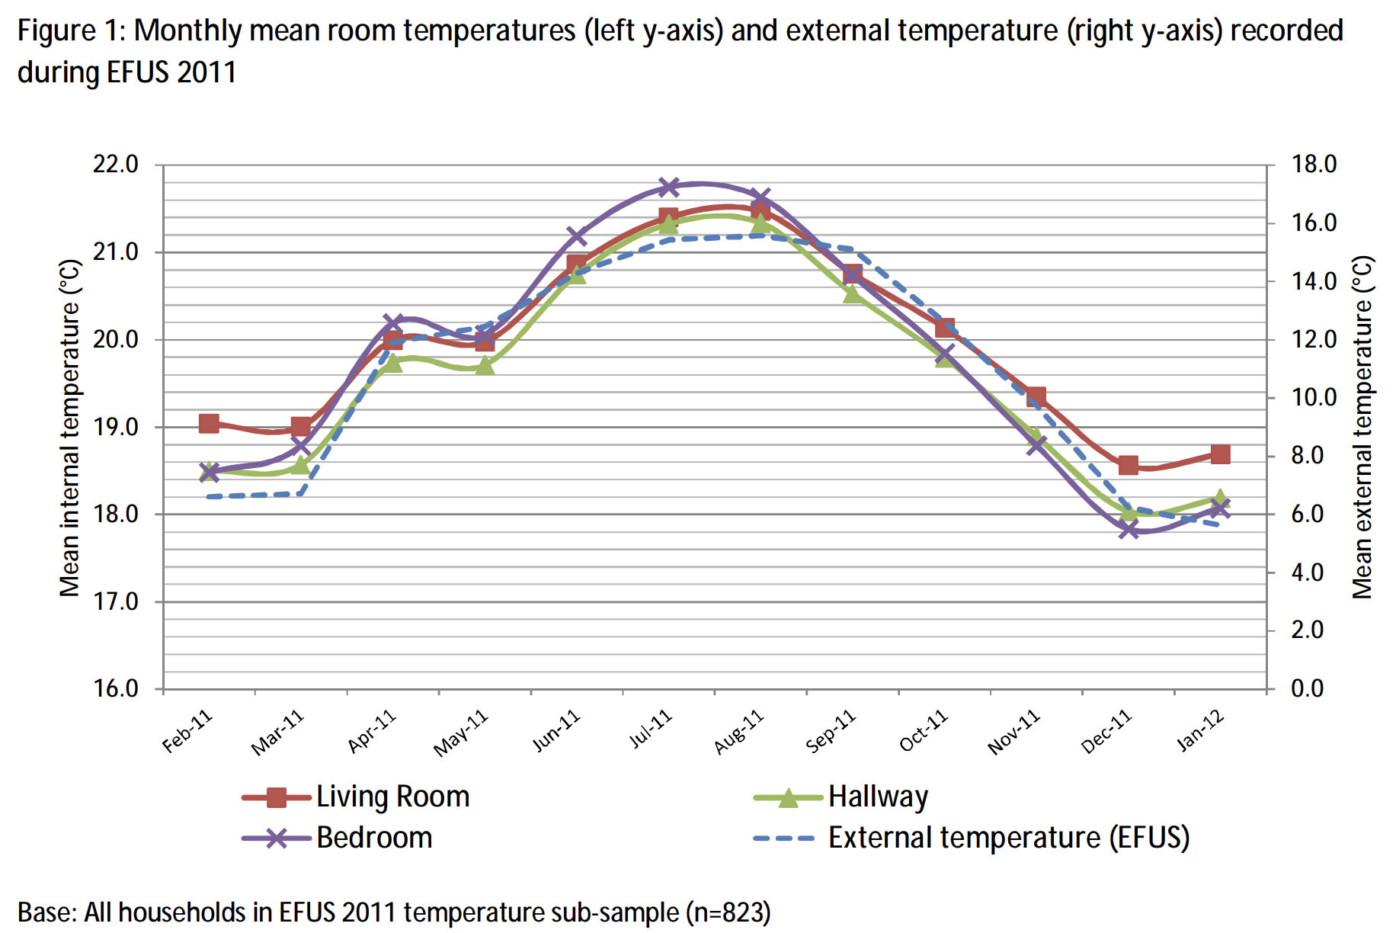
Mean Household Temperatures (Monthly)
Living: 19.3°C
Hallway: 18.8°C
Bedroom: 18.9°C

Slide 4
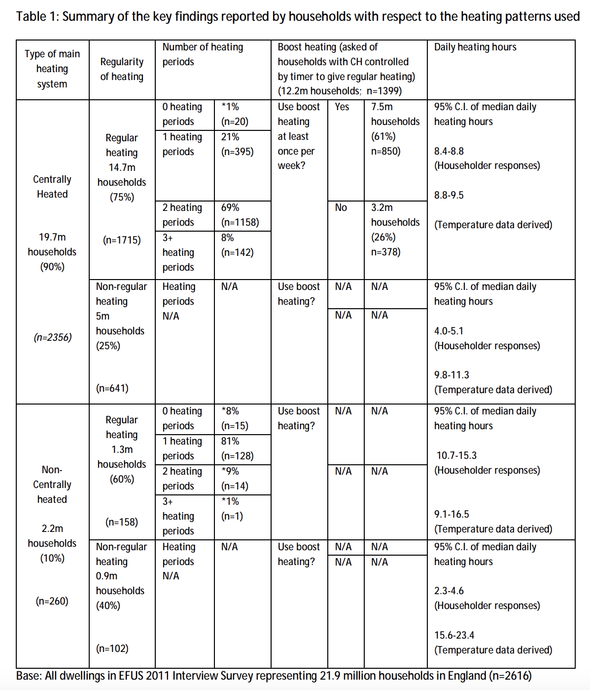
Heating Hours – Main Heating Patterns
Key finding: Median daily heating 8.4–8.8h (self-reported) or 8.8–9.5h (temperature-monitored)

Slide 5
Implications & Takeaways
Model calibration needed: Reduce Zone 1–Zone 2 temperature gradient (~0.6°C observed vs ~1.3°C in SAP); remove weekday/weekend temperature deltas
Update heating season assumptions: Use 6–7 months (vs 8 in SAP) and median daily hours of 8.4–9.5h; consider boost heating usage (61% of timer-controlled households)
Model overestimation risk: Many households don't reach thermostat set-points during heating periods, potentially causing energy consumption overestimates
Temperature factors: Higher achieved temps associated with double glazing, daytime occupancy, smaller floor area (<50m²), older occupants (>75 years)
Policy implications: ~65% of households have rooms not heated by main system; improvements to poorly performing properties may reduce underspend rather than deliver consumption reductions

