Slide 1
Webpage
The best personal webpage

Slide 2
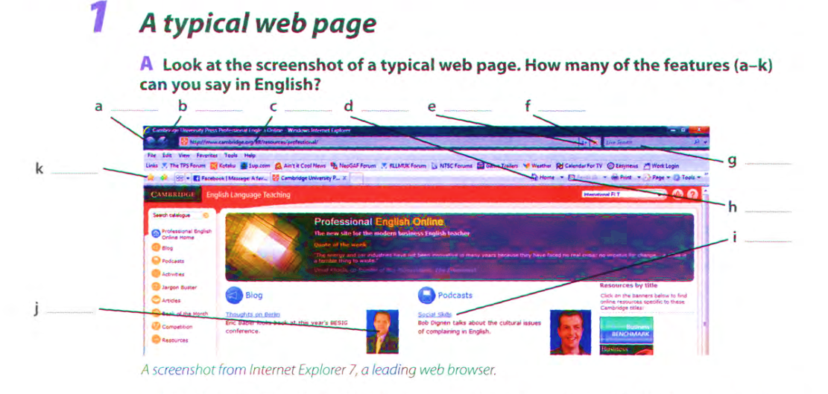

Slide 3
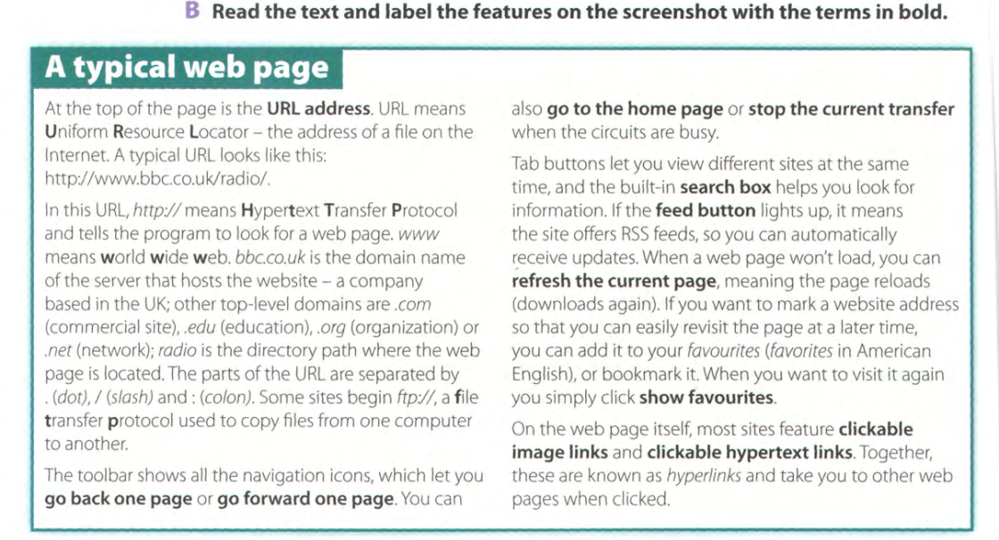

Slide 4



Slide 5
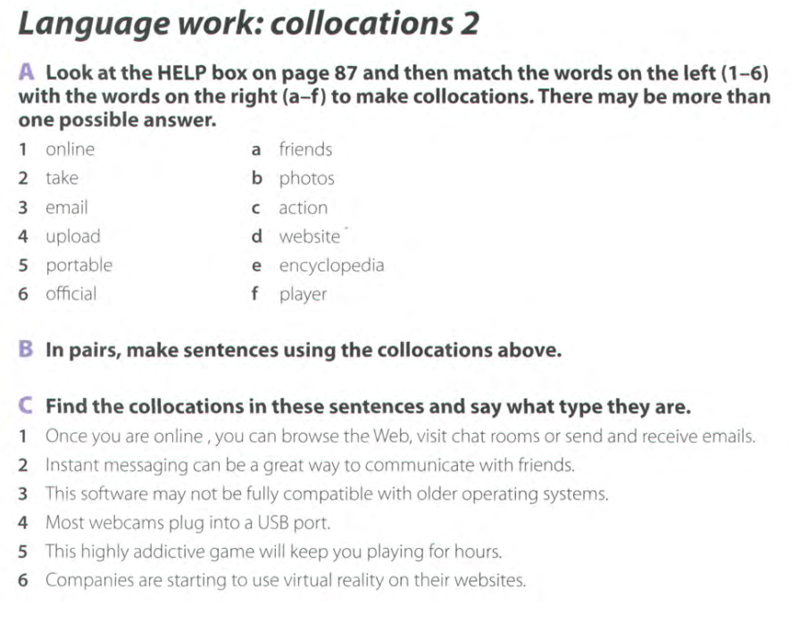

Slide 6
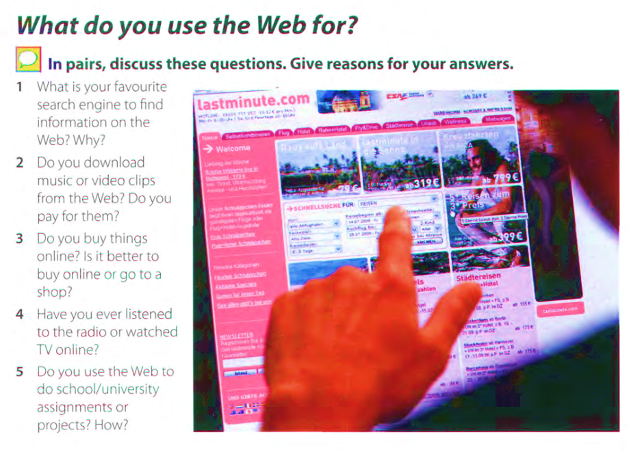

Slide 7
What is a Website - YouTube
Difference Between A Website and A Webpage - YouTube

