Slide 1
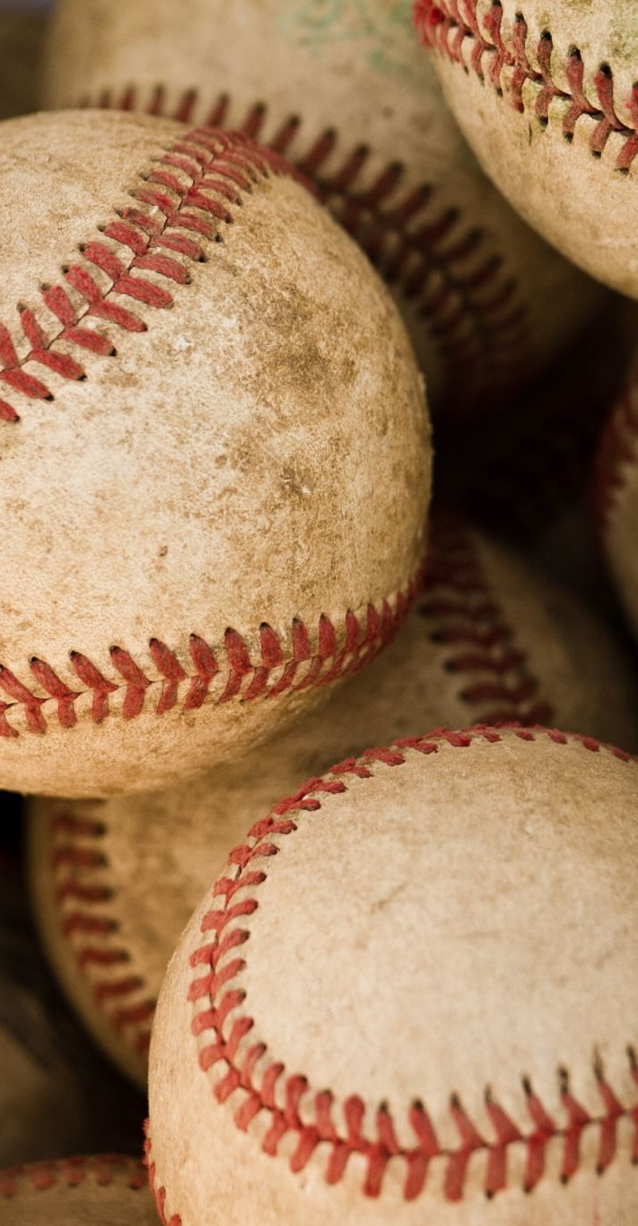
Introduction: Baseball Salary Analysis

Slide 2
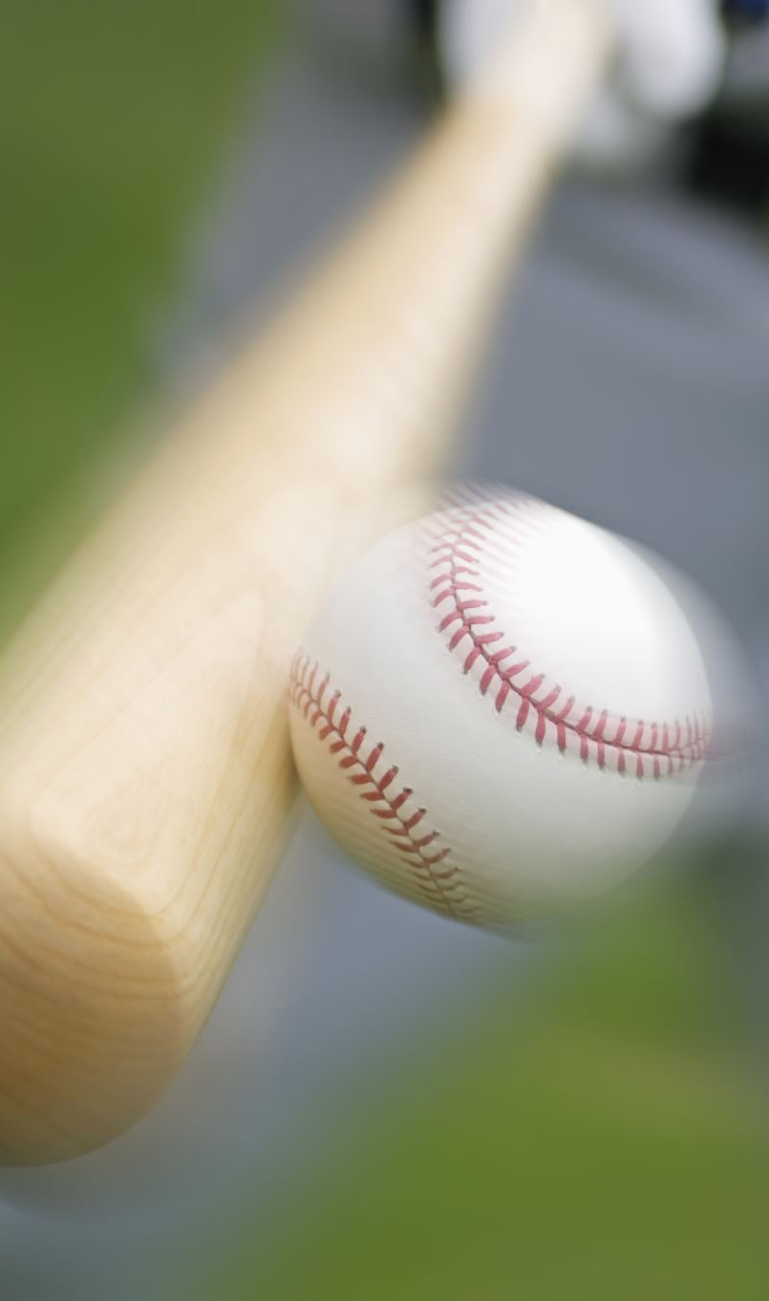
Introduction
The data for this project comes from the Lahman baseball database. The data is a joined hitting and salary dataset that has basic statitistics (hits, walks, homeruns etc.) and the player’s salary in dollars.
Goals:
determine what metrics Major League Baseball teams value the most.
make recommendations of metrics for players to focus on.

Slide 3
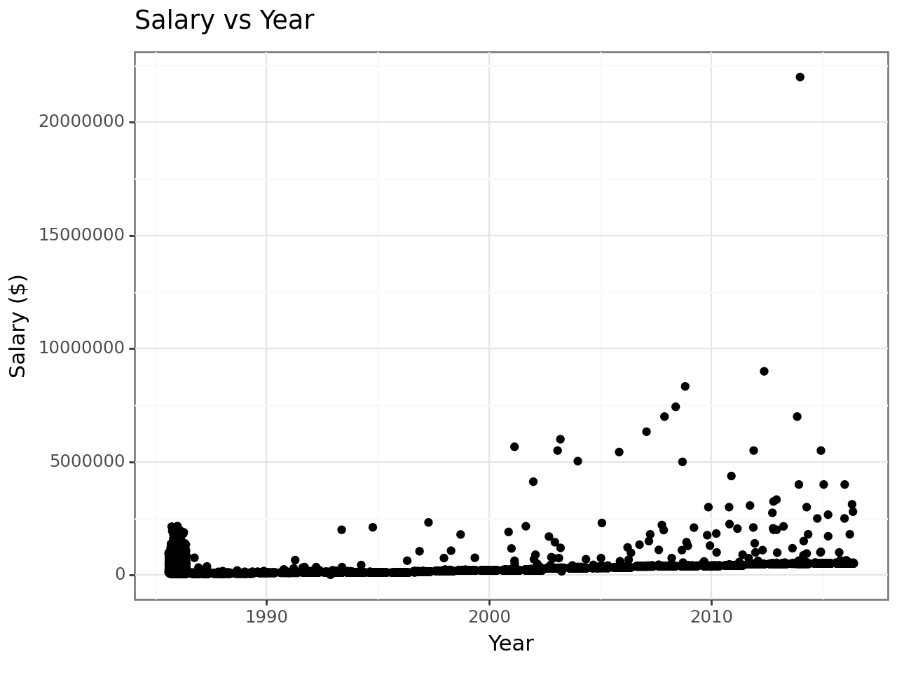
EDA
Salaries have in general gone up over time.
Major outlier that is over 20 million dollars and
Exponential relationship between year and time.
No major obvious difference in league

Slide 4
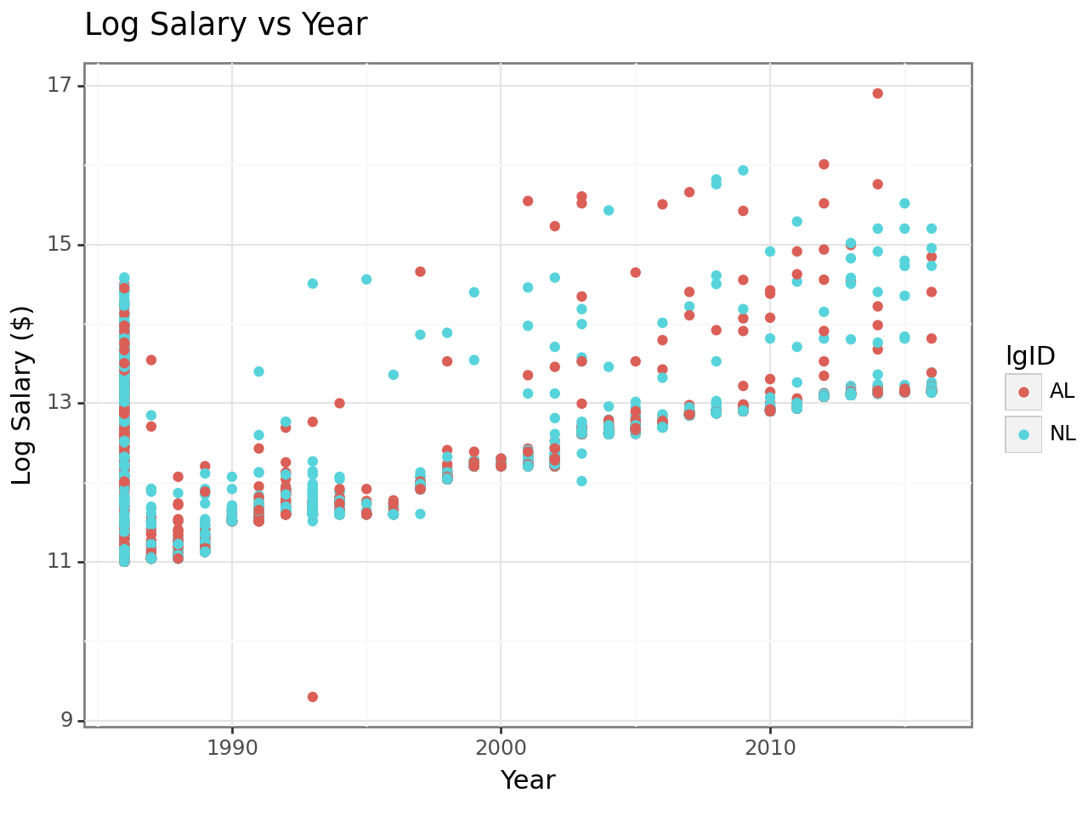
This shows that there is a mix of both AL (American League) an NL (National League) teams all throughout, but the highest paid player played for the AL (the Yankees).
Notes:
The above scatterplot shows the log of the player’s salary by year and divided by the league that the player played in.

Slide 5
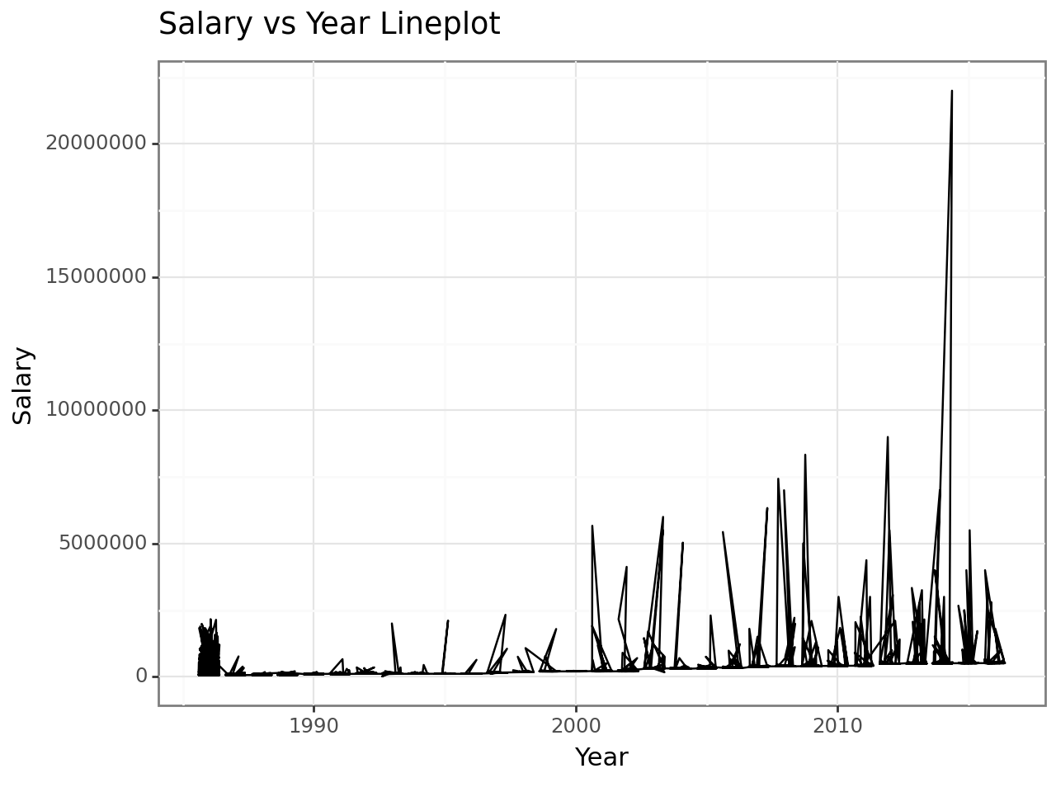
There is no obvious seasonality
Notes:
One possible model that I could have used was a time-series model. This line plot of year and salary shows the same trends as the scatterplot

Slide 6
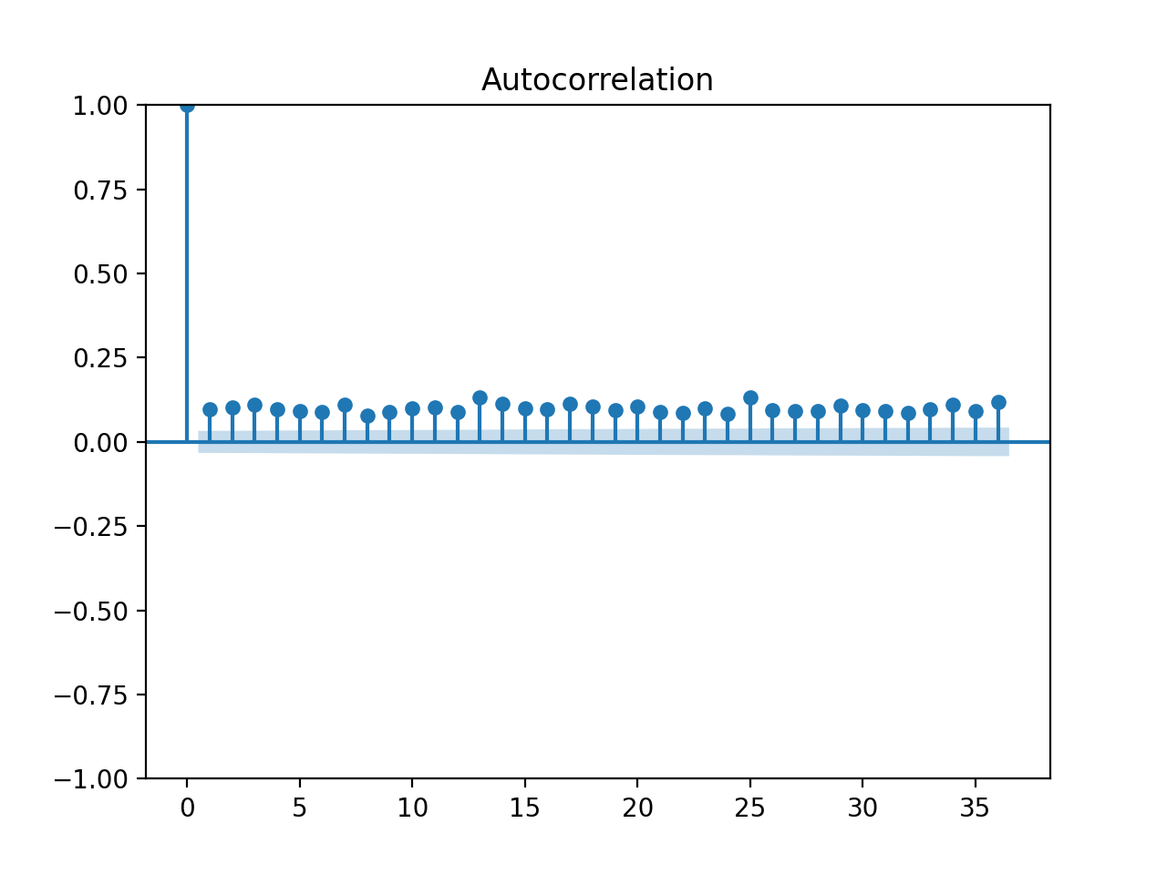
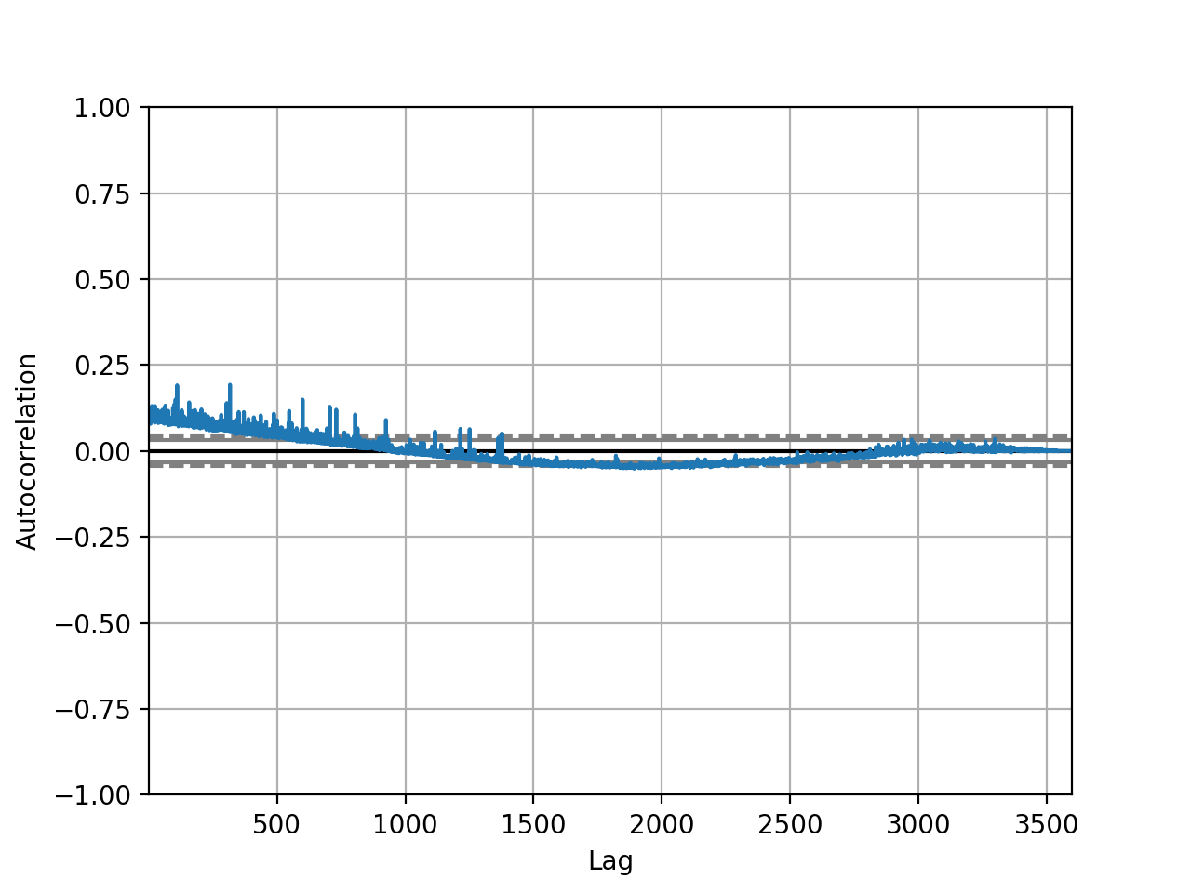
Auto-correlation plots
Notes:
The two above plots show that there isn’t autocorrelation between the salaries of the players. This is important because it means that the salaries can be considered to be independent.

Slide 7
Methods & Feature Engineering
added generated the columns OBP, SLG, OPS and BABIP (on base percentage, slugging percentage, on base + slugging, batting average on balls in play).
one-hot encoded the award names, team, notes (is just the position the award was for) and the league (AL or NL).
Notes:
These features not only helped to lower the mean square error of the predictions, but also proved to have high shap values.

Slide 8
Methods & Feature Engineering
The linear regression model was a standard model with no hyperparameter tuning. It generates coefficients from the data to make predictions about new data.
The K-nearest neighbors model was tuned based on the k hyper-parameter. It uses points that are close-by to determine the value of the test data points. The k values of 1, 3, 5, 7, 9, and 11 were explored.
The random forest model was not tuned and used 100 n_estimators. Random forests create multiple decision trees and employ bagging to generate predictions.
The gradient boosting model was tuned for learning rates of 0.001, 0.01, 0.1, 0.2, 0.3. Boosted models fit the mistakes of the previous model and tries to correct them.
Model | MSE
Linear Regression | .362
K-Nearest Neighbors | .383
Random Forest Regressor | .251
Gradient Boosting | .2570
Feedforward Neural Network | .392

Slide 9

Discussion on Model Selection
The better models were the random forest regressor and the gradient boosted regressor.
The neural network had trouble with consistency as it would vary from a lower MSE of around .30 to a higher MSE of around .60. It would run fast, but with too many nodes it also would over fit.
The other model that potentially had some overfitting issues was the gradient boosted regressor.
Speed and the performance of the random forest model was better than all of the other models.
K-nearest neighbors and the linear regression underfit the data thus leading to worse performance compared to the random forest model.
Notes:
The next level up was vanilla linear regression and k-nearest neighbors, and in last was the neural network.
Once it was tuned it had more consistent performance, but it still could not beat any of the the other models

Slide 10
Best Model & Shap Results
The best model was a random forest regressor. It has a MSE of 0.251 and an R-squared of 0.625. I used an
n_estimators of 100 and then performed a SHAP feature importance analysis.
The most important feature was year (which was apparent from the scatterplot)
Top 3 outside of year were
At-bats,
Walks
Hits.
Batting average was outside the top 10.
On base percentage 5th
Slugging percentage 6th
The only award to make the shap-value plot was rookie of the year. Part of this may be because there was not a lot of salary data for MVP winners.

Slide 11
Conclusion
Players that play the most are going to be paid the most. It also means that hitters that have lots of hits and walks are also paid more.
Hitters should look to improve his on base percentage and slugging percentage not only batting average.
Baseball baseball baseball

Slide 12
Improvements
An improvement that could be made would be to fit a linear regression model first using the year, and then model the residuals using machine learning.
This would account for the effect of year and then the machine learning could be used to find out what is valuable outside of the year the player was playing.
More data could also be added for more player and more up-to date data could be added more the current players.

Slide 13
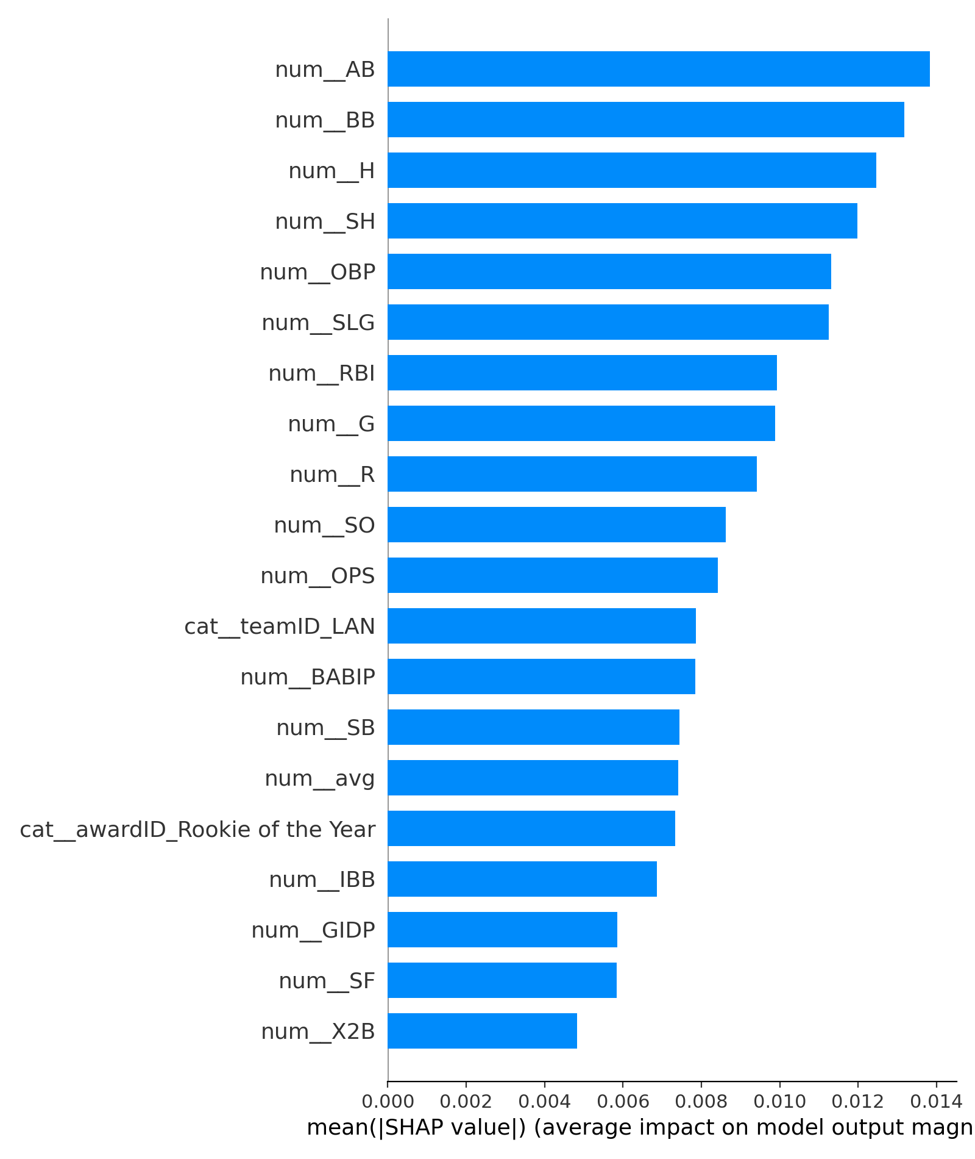
Appendix Code and Graphs
0.3623293043289021
0.4166494718205416
0.39018931281445157
Best value of k: 11
0.42682506379359497
0.3833831010298545
0.25106082478749453 0.6246528033057623
<IPython.core.display.HTML object>

Slide 15
Best learning rate: 0.1
0.25701050990714963 0.6203148154044605
Results summary Results in my_dir\my_project Showing 10 best trials Objective(name="val_loss", direction="min") Trial 1 summary Hyperparameters: units_input: 256 dropout_input: 0.4 num_layers: 1 units_0: 224 dropout_0: 0.4 learning_rate: 0.01 Score: 0.5988154411315918 Trial 0 summary Hyperparameters: units_input: 224 dropout_input: 0.3 num_layers: 1 units_0: 256 dropout_0: 0.4 learning_rate: 0.001 Score: 0.6579942107200623 Trial 3 summary Hyperparameters: units_input: 128 dropout_input: 0.4 num_layers: 3 units_0: 192 dropout_0: 0.4 learning_rate: 0.001 units_1: 32 dropout_1: 0.2 units_2: 32 dropout_2: 0.2 Score: 0.6866323351860046 Trial 4 summary Hyperparameters: units_input: 160 dropout_input: 0.4 num_layers: 3 units_0: 224 dropout_0: 0.2 learning_rate: 0.0001 units_1: 192 dropout_1: 0.3 units_2: 64 dropout_2: 0.4 Score: 119.62092590332031 Trial 2 summary Hyperparameters: units_input: 224 dropout_input: 0.4 num_layers: 1 units_0: 32 dropout_0: 0.2 learning_rate: 0.0001 Score: 131.4298095703125
Best hyperparameters: <keras_tuner.src.engine.hyperparameters.hyperparameters.HyperParameters object at 0x000001F83ECF5FD0>
Results summary Results in my_dir\my_project Showing 10 best trials Objective(name="val_loss", direction="min") Trial 1 summary Hyperparameters: units_input: 256 dropout_input: 0.4 num_layers: 1 units_0: 224 dropout_0: 0.4 learning_rate: 0.01 Score: 0.5988154411315918 Trial 0 summary Hyperparameters: units_input: 224 dropout_input: 0.3 num_layers: 1 units_0: 256 dropout_0: 0.4 learning_rate: 0.001 Score: 0.6579942107200623 Trial 3 summary Hyperparameters: units_input: 128 dropout_input: 0.4 num_layers: 3 units_0: 192 dropout_0: 0.4 learning_rate: 0.001 units_1: 32 dropout_1: 0.2 units_2: 32 dropout_2: 0.2 Score: 0.6866323351860046 Trial 4 summary Hyperparameters: units_input: 160 dropout_input: 0.4 num_layers: 3 units_0: 224 dropout_0: 0.2 learning_rate: 0.0001 units_1: 192 dropout_1: 0.3 units_2: 64 dropout_2: 0.4 Score: 119.62092590332031 Trial 2 summary Hyperparameters: units_input: 224 dropout_input: 0.4 num_layers: 1 units_0: 32 dropout_0: 0.2 learning_rate: 0.0001 Score: 131.4298095703125 Best hyperparameters: <keras_tuner.src.engine.hyperparameters.hyperparameters.HyperParameters object at 0x000001F83ECF5FD0>
29/29 [==============================] - 0s 1ms/step Manually Calculated Test MSE: 0.6747493510820899

