Slide 1


AI INVESTMENT FUND
Synth Grid Systems Stock Pitch
ANALYST
COMPANY / TICKER
DATE
DAISY (quant team)
S36
December 31, 2025
UNIVERSITY OF MICHIGAN · AI BUSINESS GROUP

Slide 2

01
Company Overview
MARKET CAP
SECTOR
REVENUE (TTM)
P/E RATIO (NTM)
$341.77 B
Industrials
not in data
22.5x
WHAT THEY DO
WHY NOW
Synth Grid Systems builds transformers and switchgear for utilities and data-center campuses.
It earns most of its revenue on equipment and the rest on multi-year service contracts.
S36 is in an established uptrend — the close of $427.21 is above its 200-day EMA of $387.79, and the 50-day EMA ($424.14) is above the 200-day. It then pulled back: RSI-14 got as low as 37.9 in the last five sessions…
Next earnings date: not in data
Headline: Synth Grid Systems reports quarterly results in line with guidance
COMPETITIVE MOAT
KEY FINANCIAL METRICS
Not in data: no source for market share, patents or switching costs.
The rule does not need one: this is a trend pullback setup — buy a short pullback inside an established uptrend, as the pullback ends.
+14.0% EPS growth (TTM, year on year)
42.0% gross margin
21.0% operating margin
15.0% net margin
0.90% dividend yield
Beta 1.05
52-week range $295.76 – $445.53
Synth Grid Systems (S36)
AI Investment Fund · Slide 01

Slide 3
02
Investment Thesis
CORE THESIS STATEMENT
Synth Grid Systems: A pullback in an established uptrend just ended. The trend pullback book is built to buy a short pullback inside an established uptrend, as the pullback ends; this is that setup, not a forecast about the company.
BULL CASE
BEAR CASE
12-month bull $602.77 (+41.1%): EPS growing 23.3% a year, discounted at 8.9%
Trade: T2 $434.12 (+1.6%) — reference level
12-month bear $232.26 (-45.6%): EPS growing 4.8% a year, discounted at 10.4%
Trade: stop $414.42 (-3.0%), the rule's exit
Wrong if: The trend breaks: a close below the 50-day EMA ($424.14)
VALUATION / PRICE TARGET
CURRENT EVENTS + RISKS
$414.07 probability-weighted (-3.1%) by 2026-12-31; total return -2.2% with the 0.9% dividend
Method: 25% bear / 50% base / 25% bull earnings DCF; base $410.62
Peer comps $418.67 (-2.0%, 4 peers)
Street mean target $469.93 (+10.0%) — reference only
Views disagree: The rule says BUY, while the 12-month probability-weighted target is -3.1% from here. Conviction is cut for it; treat this as a trade, sized as one.
This is a short hold bought into weakness: the single biggest risk is that the weakness is news, not noise. A pullback that is actually the start of a re-rating keeps…
1 early-warning flag(s) are already on (vix_inversion) — stress score 0.11, crisis starts at 0.5.
Valuation disagrees with the rule: the blended fair value is -2.9% against the current price. The rule is what was tested, so the trade stands, but this is a reason to…
Synth Grid Systems (S36)
AI Investment Fund · Slide 02

Slide 4
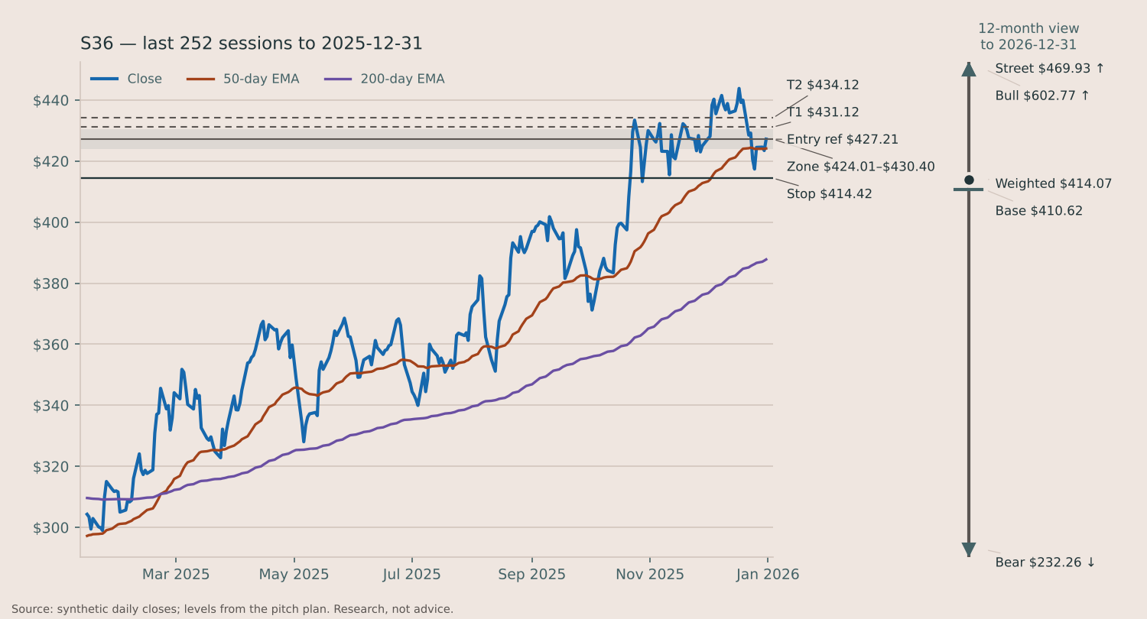
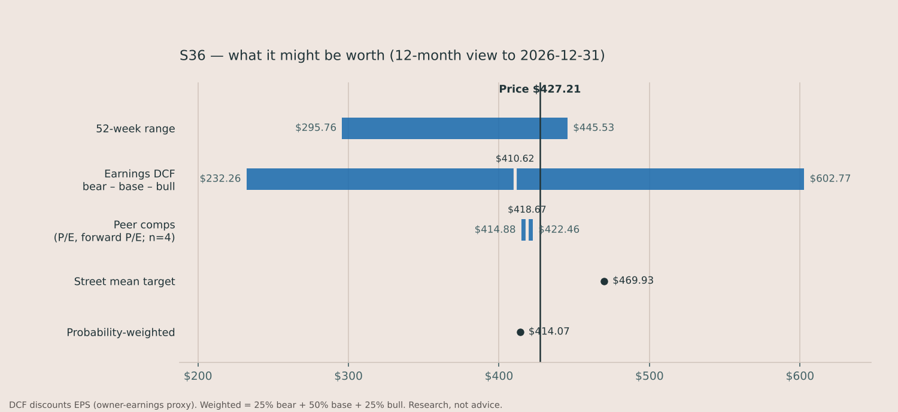
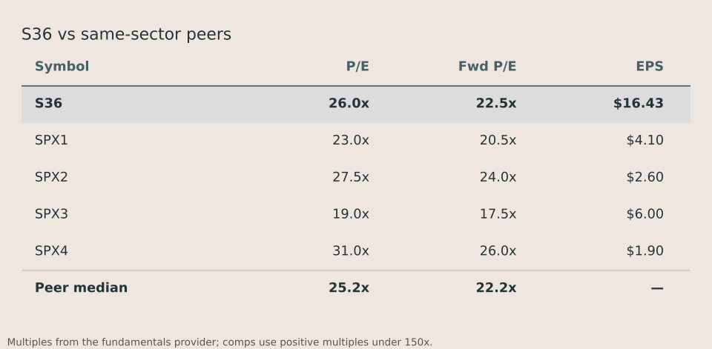
03
Data & Supporting Analysis
How the trend pullback book has done (2021-01-04 to 2025-12-31, 510 trades): win rate 43%, expectancy -0.06R per trade. In-sample replay, not a walk-forward record. Prices: daily closes to 2025-12-31. Research, not advice.
Synth Grid Systems (S36)
AI Investment Fund · Slide 03

Slide 5
04
Recommendation
BUY
Initiate position · Low conviction (42)
POSITION SIZE / ENTRY PRICE
WHY THIS FITS OUR FUND
Entry: at the open on Friday Jan 02, 2026 near $427.21 (zone $424.01–$430.40)
Stop $414.42 (-3.0%) · T1 $431.12 · T2 $434.12 · R:R 0.31
Size: 8.4% of the fund (risk-based); 0.25% of the fund at risk
Untested refinement: if it opens above $433.60 (close + 1 ATR), skip and re-check at the next close
Beta 0.61 (60-day vs SPY, from the bar store); correlation to the benchmark 0.41
QUESTIONS FOR THE TEAM TO DISCUSS:
1
The rule says BUY, but the 12-month probability-weighted target is -3% from here. Do we size this as a trade only, or not at all?
2
The stock is 4% below its 52-week high of $445.53. Is that room to run, or overhead supply?
Synth Grid Systems (S36)
AI Investment Fund · Slide 04

