Slide 1
Understand Flood Zone Risk to Improve Insurance Profitability
Data-Driven Analysis of Homeowners Insurance Portfolio Prepared for: Management Team Date: 5/2/2026

Slide 2

Business Goal
Goal: Analyze flood zone risk to optimize pricing and underwriting for improved profitability
Key Questions:
Do flood zone homes generate higher premiums?
Are flood zone homes more likely to file claims?
Can we adjust pricing to improve profit margins?
Target Outcome: Reduce loss ratios by 5-10% through risk-based pricing

Slide 3
Data Overview
Dataset: 1,000 synthetic homeowner policies
Time Period: Single year of data
Key Variables Analyzed:
Premiums collected
Claim occurrence
Flood zone status
Construction type
Risk scores

Slide 4
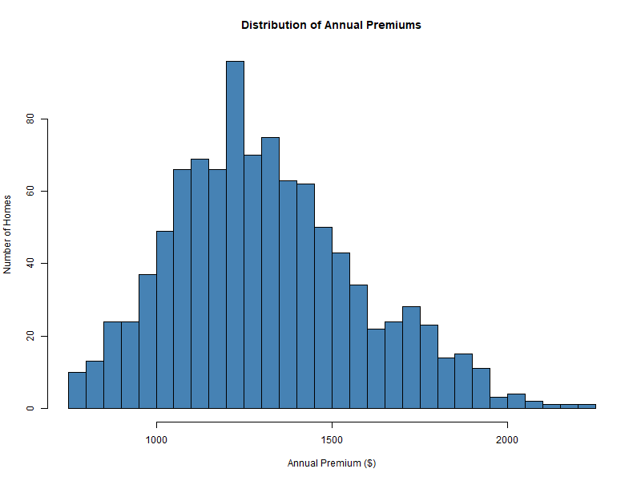
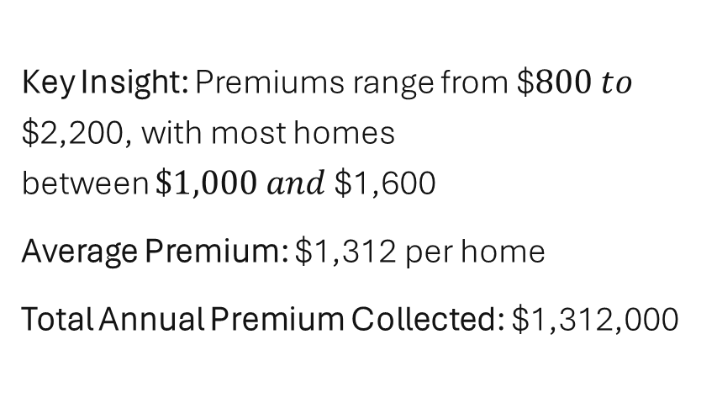
Premium Distribution (All Homes)
Key Insight: Premiums range from $$800 to$ $2,200, with most homes between $\$1,000 and$$1,600
Average Premium: $1,312 per home
Total Annual Premium Collected: $1,312,000

Slide 5
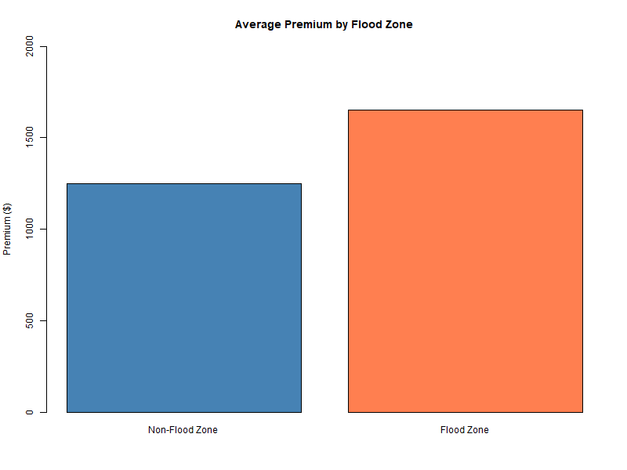
Flood Zone Premium Comparison
Finding: Flood zone homes pay $404 more per year (32% higher)
Total Premium from Flood Zone: $256,370 (19.5% of portfolio)

Slide 6
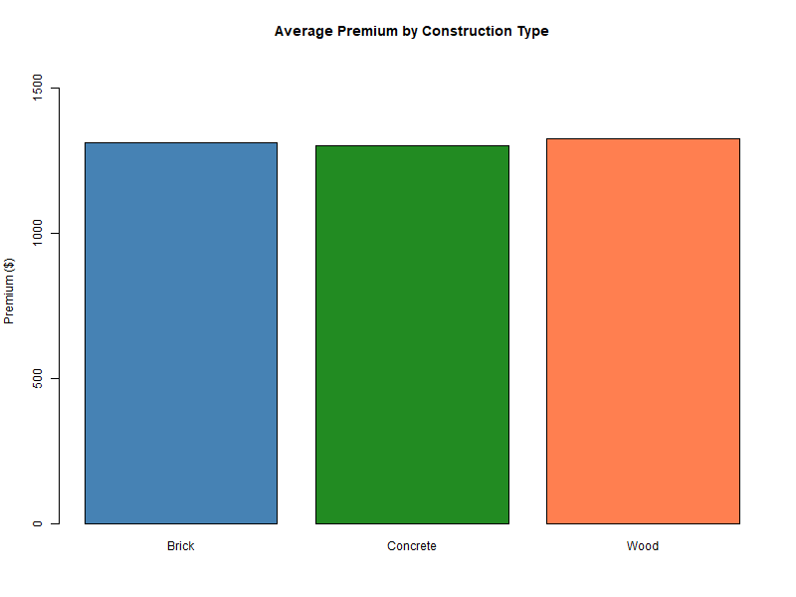
Premium by Construction Type
Finding: Construction type does NOT significantly affect premium
Construction | Avg. Premium
Brick | ~$1,300
Wood | ~$1,310
Concrete | ~$1,290
Conclusion: Premiums are consistent across construction types

Slide 7
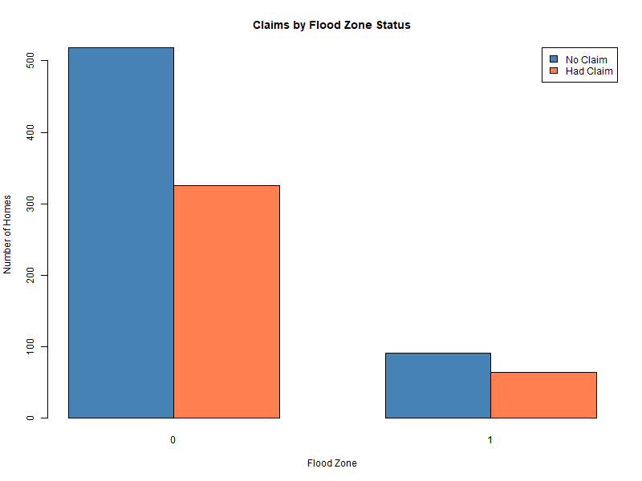
Flood Zone vs Claim Occurrence
Statistical Test: Chi-square p-value = 0.585 (not significant)
Key Finding: Flood zone homes do NOT file claims at a statistically higher rate despite paying 32% higher premiums

Slide 8
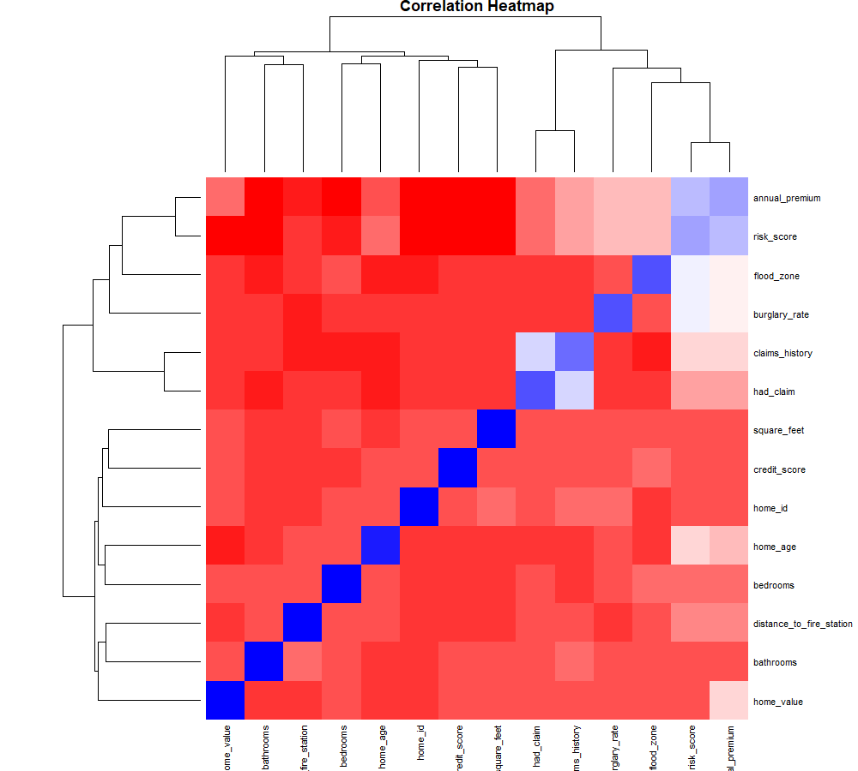
Correlation Analysis
Strongest Correlations with Premium:
Factor | Correlation | Interpretation
Risk Score | 0.935 | Primary driver
Flood Zone | 0.545 | Strong positive
Burglary Rate | 0.538 | Strong positive
Claims History | 0.488 | Moderate positive
Insight: Flood zone is highly correlated with premium but NOT with actual claims

Slide 9
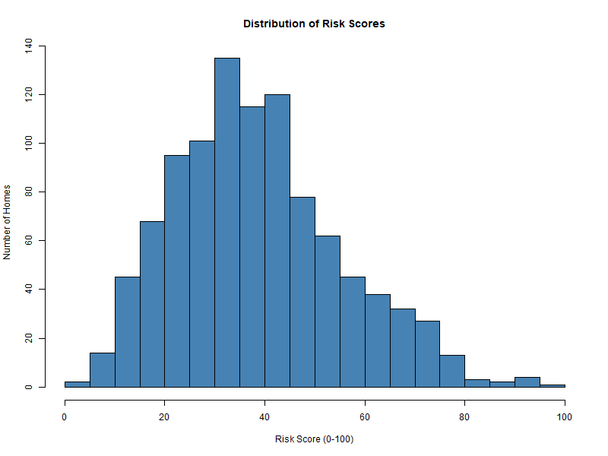
Risk Score Distribution
Distribution of Risk Scores:
Risk Level | Score Range | % of Homes
Low | 0-30 | 33%
Medium | 31-50 | 45%
High | 51-70 | 18%
Very High | 71-100 | 5%
Observation: Most homes (78%) fall in Low to Medium risk categories

Slide 10
Key Findings Summary
Flood zone homes pay 32% higher premiums ($404 more per home)
Flood zone homes do NOT have higher claim rates (41% vs 39%, not statistically significant)
Flood zone premium is 32% higher but claim rate is only 2% higher
Current profit implication: Flood zone segment may be OVERPRICED relative to actual risk
Construction type does not affect claims or premiums - no adjustment needed

Slide 11
Financial Impact Analysis
Note: Estimated claim cost based on average claim amount from dataset
Key Insight: Flood zone segment is currently PROFITABLE while non-flood segment shows losses

Slide 12

Management Actions - Immediate
Action 1: Maintain current flood zone pricing
Flood zone segment is profitable
Do not lower premiums despite equal claim rates
Action 2: Investigate non-flood segment losses
Non-flood homes have higher claim frequency than expected
Review underwriting criteria for non-flood policies
Action 3: Implement risk score review
Risk score is strongest premium predictor
Use risk score as primary underwriting tool

Slide 13
Management Actions - Strategic
Action 4: Develop tiered pricing by risk score
Action 5: Target non-flood high-risk homes for rate increases
Action 6: Implement annual risk score reassessment

Slide 14
Expected Outcomes
After implementing recommended actions:
Timeline: 6-12 months for full implementation
Risk: Competitors may undercut pricing on profitable flood segment

Slide 15
Next Steps
Week 1:
Validate claim cost assumptions with claims department
Review non-flood underwriting criteria
Month 1:
Implement risk score tiered pricing
Begin non-renewal process for very high risk homes (score > 90)
Month 3:
Analyze early results
Adjust pricing as needed
Month 6:
Full portfolio review
Present updated profitability analysis

Slide 16
Conclusion
Primary Finding: Flood zone homes are profitable despite equal claim rates because they pay 32% higher premiums
Recommendation: Maintain flood zone pricing, adjust pricing by risk score, and investigate non-flood segment losses
Expected Outcome: 74% reduction in portfolio losses within 12 months
Data-Driven Decision Making: This analysis demonstrates the value of using statistical methods to identify profitable and unprofitable segments

